Slide 1
“Work, Labor, and Patience”
1 Thessalonians 1
October 4-5, 2014
Calvary Chapel of El Paso

Slide 2
1 Thessalonians 1:1
Paul, and Silvanus, and Timotheus, unto the church of the Thessalonians which is in God the Father and in the Lord Jesus Christ: Grace be unto you, and peace, from God our Father, and the Lord Jesus Christ.

Slide 3
1 John 3:3
And every man that hath this hope in him purifieth himself, even as he is pure.

Slide 4
Acts 17:1
Now when they had passed through Amphipolis and Apollonia, they came to Thessalonica, where was a synagogue of the Jews:

Slide 5
Acts 17:2
And Paul, as his manner was, went in unto them, and three sabbath days reasoned with them out of the scriptures,

Slide 6
Acts 17:3
Opening and alleging, that Christ must needs have suffered, and risen again from the dead; and that this Jesus, whom I preach unto you, is Christ.

Slide 7
Acts 17:4
And some of them believed, and consorted with Paul and Silas; and of the devout Greeks a great multitude, and of the chief women not a few.

Slide 8
Acts 17:5a
But the Jews which believed not, moved with envy, took unto them certain lewd fellows of the baser sort, and gathered a company,

Slide 9
Acts 17:5b
and set all the city on an uproar, and assaulted the house of Jason, and sought to bring them out to the people.

Slide 10
Acts 17:6
And when they found them not, they drew Jason and certain brethren unto the rulers of the city, crying, These that have turned the world upside down are come hither also;

Slide 11
Acts 17:7
Whom Jason hath received: and these all do contrary to the decrees of Caesar, saying that there is another king, one Jesus.

Slide 12
Acts 17:8
And they troubled the people and the rulers of the city, when they heard these things.

Slide 13
Acts 17:9
And when they had taken security of Jason, and of the other, they let them go.

Slide 14
Acts 17:10
And the brethren immediately sent away Paul and Silas by night unto Berea: who coming thither went into the synagogue of the Jews.

Slide 15
Acts 17:11
These were more noble than those in Thessalonica, in that they received the word with all readiness of mind, and searched the scriptures daily, whether those things were so.

Slide 16
Acts 17:12
Therefore many of them believed; also of honourable women which were Greeks, and of men, not a few.

Slide 17
Acts 17:13
But when the Jews of Thessalonica had knowledge that the word of God was preached of Paul at Berea, they came thither also, and stirred up the people.

Slide 18
Acts 17:14
And then immediately the brethren sent away Paul to go as it were to the sea: but Silas and Timotheus abode there still.

Slide 19
Acts 17:15
And they that conducted Paul brought him unto Athens: and receiving a commandment unto Silas and Timotheus for to come to him with all speed, they departed.

Slide 20
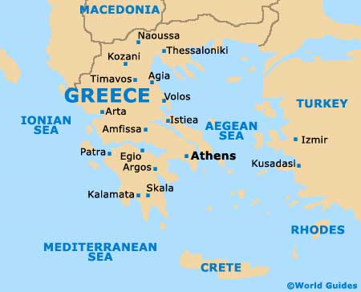

Slide 21
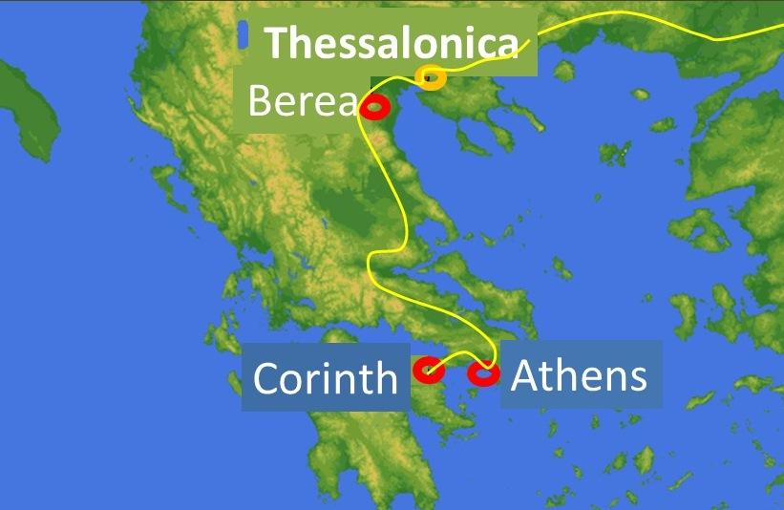

Slide 22
1 Thessalonians 1:1
Paul, and Silvanus, and Timotheus, unto the church of the Thessalonians which is in God the Father and in the Lord Jesus Christ: Grace be unto you, and peace, from God our Father, and the Lord Jesus Christ.

Slide 23
1 Thessalonians 1:2
We give thanks to God always for you all, making mention of you in our prayers;

Slide 24
1 Thessalonians 1:3
Remembering without ceasing your work of faith, and labour of love, and patience of hope in our Lord Jesus Christ, in the sight of God and our Father;

Slide 25
Acts 17:2
And Paul, as his manner was, went in unto them, and three sabbath days reasoned with them out of the scriptures,

Slide 26
Acts 17:3
Opening and alleging, that Christ must needs have suffered, and risen again from the dead; and that this Jesus, whom I preach unto you, is Christ.

Slide 27
Philippians 4:15
Now ye Philippians know also, that in the beginning of the gospel, when I departed from Macedonia, no church communicated with me as concerning giving and receiving, but ye only.

Slide 28
Philippians 4:16
For even in Thessalonica ye sent once and again unto my necessity.

Slide 29
1 Thessalonians 2:9
For ye remember, brethren, our labour and travail: for labouring night and day, because we would not be chargeable unto any of you, we preached unto you the gospel of God.

Slide 30
1 Thessalonians 1:4
Knowing, brethren beloved, your election of God.

Slide 31
1 Thessalonians 1:5
For our gospel came not unto you in word only, but also in power, and in the Holy Ghost, and in much assurance; as ye know what manner of men we were among you for your sake.

Slide 32
2 Thessalonians 2:13
But we are bound to give thanks alway to God for you, brethren beloved of the Lord, because God hath from the beginning chosen you to salvation through sanctification of the Spirit and belief of the truth:

Slide 33
John 16:8
And when he is come, he will reprove the world of sin, and of righteousness, and of judgment:

Slide 34
Acts 1:8
But ye shall receive power, after that the Holy Ghost is come upon you: and ye shall be witnesses unto me both in Jerusalem, and in all Judaea, and in Samaria, and unto the uttermost part of the earth.

Slide 35
1 Thessalonians 1:6
And ye became followers of us, and of the Lord, having received the word in much affliction, with joy of the Holy Ghost:

Slide 36
1 Thessalonians 1:7
So that ye were ensamples to all that believe in Macedonia and Achaia.

Slide 37
Philippians 3:17
Brethren, be followers together of me, and mark them which walk so as ye have us for an ensample.

Slide 38
1 Thessalonians 1:8
For from you sounded out the word of the Lord not only in Macedonia and Achaia, but also in every place your faith to God-ward is spread abroad; so that we need not to speak any thing.

Slide 39
1 Thessalonians 1:9
For they themselves shew of us what manner of entering in we had unto you, and how ye turned to God from idols to serve the living and true God;

Slide 40
1 Thessalonians 1:10
And to wait for his Son from heaven, whom he raised from the dead, even Jesus, which delivered us from the wrath to come.

Slide 41
Your Work of Faith—
You Turned to God from Idols!

Slide 42
Your Labor of Love—
To Serve the Living and True God!

Slide 43
And Patience of Hope—
To Wait for His Son from Heaven!

Slide 44
Isaiah 42:8
I am the LORD: that is my name: and my glory will I not give to another, neither my praise to graven images.

Slide 45
1 Timothy 6:17
Charge them that are rich in this world, that they be not highminded, nor trust in uncertain riches, but in the living God, who giveth us richly all things to enjoy;

Slide 46
Titus 2:11
For the grace of God that bringeth salvation hath appeared to all men,

Slide 47
Titus 2:12
Teaching us that, denying ungodliness and worldly lusts, we should live soberly, righteously, and godly, in this present world;

Slide 48
Titus 2:13
Looking for that blessed hope, and the glorious appearing of the great God and our Saviour Jesus Christ;

Slide 49
Titus 2:14
Who gave himself for us, that he might redeem us from all iniquity, and purify unto himself a peculiar people, zealous of good works.

Slide 50
As this Church was:
Be an Encouragement
Be an Example
Be Enthusiastic
Be Expectant!

Slide 51
