Slide 1
Christmas Quiz
When Mary and Joseph went to Bethlehem, how did they get there?
A. They walked
Joseph walked, Mary rode a donkey.
They took a chariot
We don’t really know

Slide 2
Christmas Quiz
2. How many angels spoke to the shepherds?
A multitude
Two – Gabriel and Michael
One
Not sure

Slide 3
Christmas Quiz
What song did the angels sing?
“Glory to God in the Highest”
“O Little Town of Bethlehem
“Joy to the World”
None of the Above

Slide 4
Christmas Quiz
What animals were present at Jesus’ birth?
Cows, sheep and camels
Horses, sheep and donkeys
Lions and tigers and bears
None of the Above

Slide 5
Christmas Quiz
In what books of the Bible can you find the Christmas story?
Matthew, Mark, Luke and John
Matthew and Luke
Mark and Matthew
Matthew, Mark and Luke

Slide 6
Jesus had no beginning.
John 1:1-5 (NKJV) ¹ In the beginning was the Word, and the Word was with God, and the Word was God. ² He was in the beginning with God. ³ All things were made through Him, and without Him nothing was made that was made. ⁴ In Him was life, and the life was the light of men. ⁵ And the light shines in the darkness, and the darkness did not comprehend it.

Slide 7
The Word Became Flesh and Dwelt Among Us
John 1:14 (NKJV) ¹⁴ And the Word became flesh and dwelt among us, and we beheld His glory, the glory as of the only begotten of the Father, full of grace and truth.

Slide 8
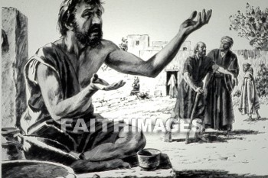
The Word Became Flesh and Dwelt Among Us
Tears are falling, hearts are breaking
How we need to hear from God

Slide 9
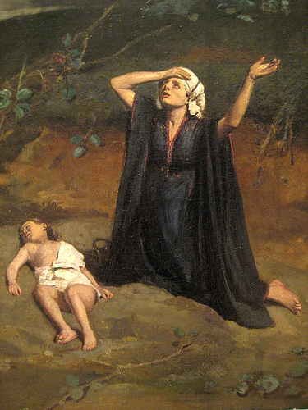
The Word Became Flesh and Dwelt Among Us
You’ve been promised
We’ve been waiting
Welcome Holy Child
Welcome Holy Child

Slide 10
Isaiah prophesied Christ’s Birth.
Isaiah 9:6 (NKJV) ⁶ For unto us a Child is born, Unto us a Son is given; And the government will be upon His shoulder. And His name will be called Wonderful, Counselor, Mighty God, Everlasting Father, Prince of Peace.

Slide 11
Isaiah prophesied Christ would be born of a virgin.
Isaiah 7:14 (NKJV) ¹⁴ Therefore the Lord Himself will give you a sign: Behold, the virgin shall conceive and bear a Son, and shall call His name Immanuel.

Slide 12
Moses prophesied the birth of Christ.
Deuteronomy 18:15 (NKJV)
15 "The Lord your God will raise up for you a Prophet like me from your midst, from your brethren. Him you shall hear,

Slide 13
Micah the prophet prophesied the birth of Christ.
Micah 5:2 (NKJV) ² "But you, Bethlehem Ephrathah, Though you are little among the thousands of Judah, Yet out of you shall come forth to Me The One to be Ruler in Israel, Whose goings forth are from of old, From everlasting."

Slide 14
Cultural Preparations
350 B.C. Alexander the Great conquered the known world.
Ordinary people became very familiar with common Greek.
In 280 B.C. the Hebrew Scriptures were translated to Greek (the Septuagint).

Slide 15
Political Preparations
The Romans built an extensive system of roads that connected Europe, Africa and Asia.
God’s message would spread across the known world.
Caesar Augustus called for a census – the will of God.

Slide 16
Religious Preparations
Israel strayed from God.
God’s judgment was the Babylonian captivity.
538 B.C. Cyrus restored worship in Jerusalem.
In the time of Jesus, their righteousness became and outward righteousness.

Slide 17
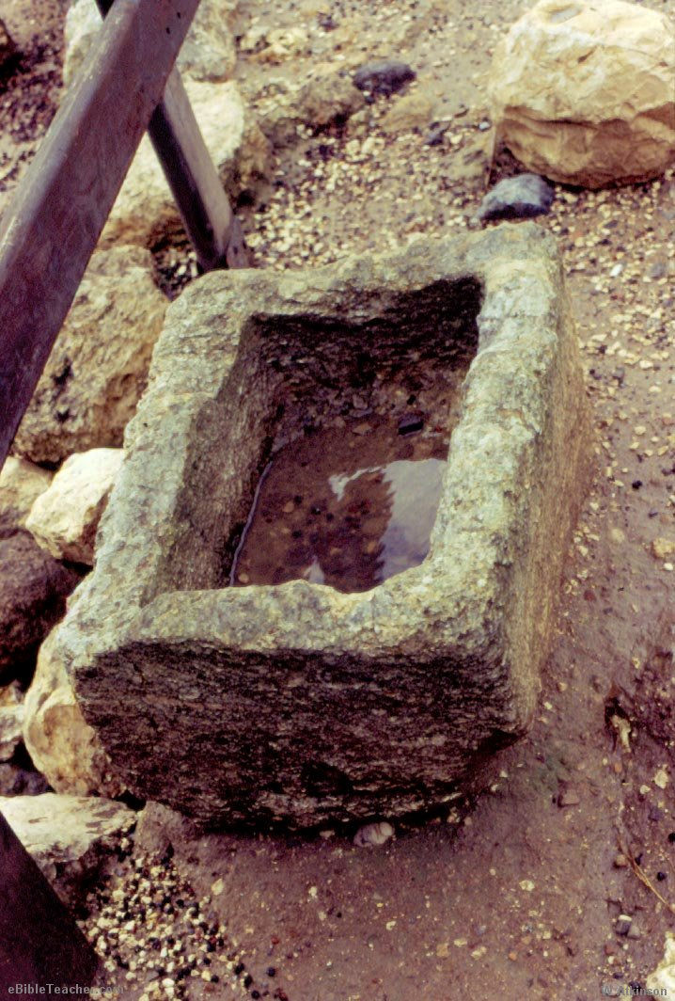
The Manger
Hope that You don’t mind our manger
How I wish we would have known

Slide 18
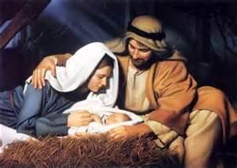
The Word Became Flesh And Dwelt Among Us
But long-awaited Holy Stranger
Make Yourself at Home
Please make Yourself at Home

Slide 19
The Son of God Humbled Himself
Philippians 2:5-8 (NKJV) ⁵ Let this mind be in you which was also in Christ Jesus, ⁶ who, being in the form of God, did not consider it robbery to be equal with God, ⁷ but made Himself of no reputation, taking the form of a bondservant, and coming in the likeness of men. ⁸ And being found in appearance as a man, He humbled Himself and became obedient to the point of death, even the death of the cross.

Slide 20
The Son of God Humbled Himself
2 Corinthians 8:9 (NKJV) ⁹ For you know the grace of our Lord Jesus Christ, that though He was rich, yet for your sakes He became poor, that you through His poverty might become rich.

Slide 21
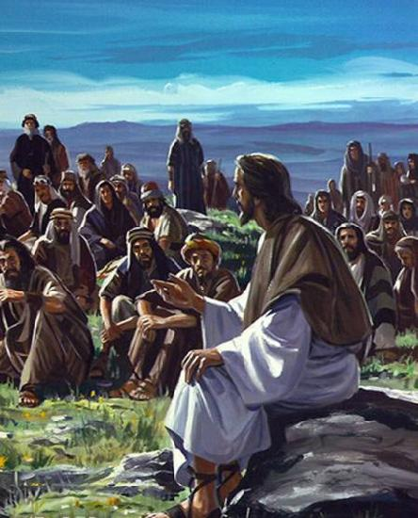
His Ministry
Bring Your peace into our violence
Bid our hungry souls be filled

Slide 22
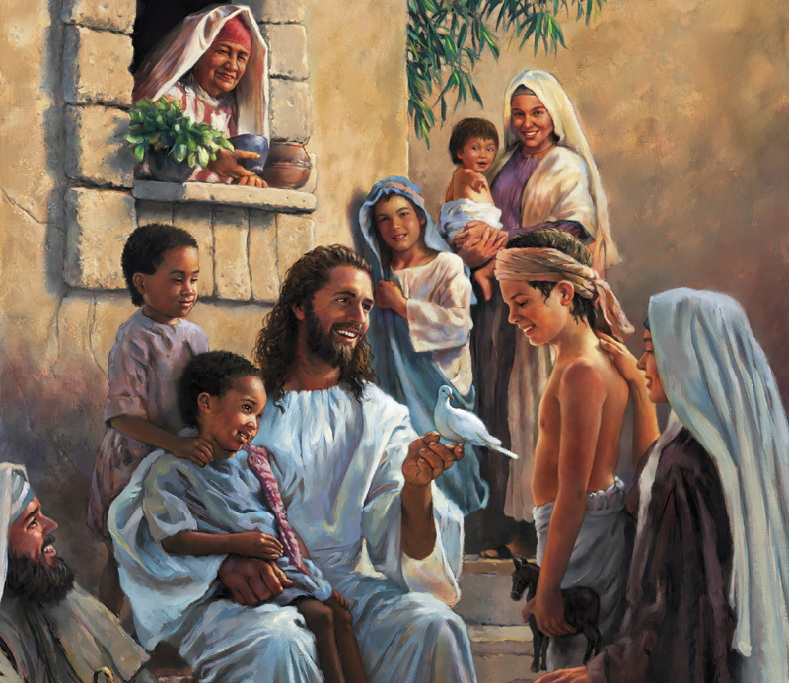
His Ministry
Word now breaking Heaven’s silence
Welcome to our world
Welcome to our world

Slide 23
His Ministry
Matthew 4:17 (NKJV) ¹⁷ From that time Jesus began to preach and to say, "Repent, for the kingdom of heaven is at hand."

Slide 24
His Ministry
Matthew 9:35-36 (NKJV) ³⁵ Then Jesus went about all the cities and villages, teaching in their synagogues, preaching the gospel of the kingdom, and healing every sickness and every disease among the people. ³⁶ But when He saw the multitudes, He was moved with compassion for them, because they were weary and scattered, like sheep having no shepherd.

Slide 25
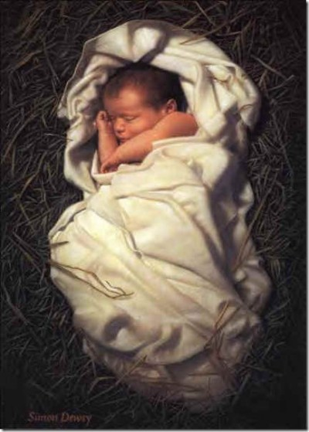
Preparing for the Cross
Fragile fingers sent to heal us
Tender brow prepared for thorn

Slide 26
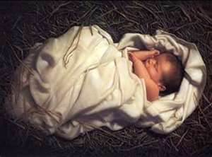
Preparing for the Cross
Tiny heart whose blood will save us
Unto us is born, Unto us is born

Slide 27
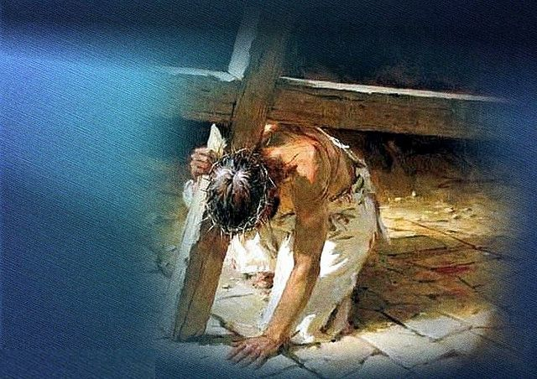
The Cross and Resurrection
So wrap our injured flesh around you
Breathe our air and walk our sod

Slide 28
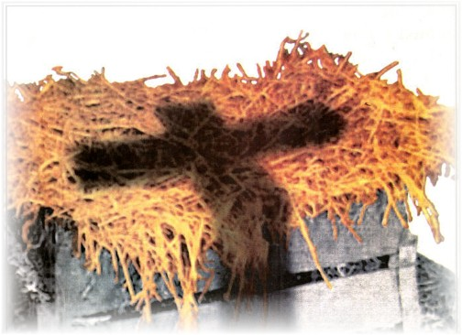
The Cross and Resurrection
Rob our sin and make us holy
Perfect Son of God, Perfect Son of God
Welcome to our world

Slide 29
God loves You
John 3:16 (NKJV) ¹⁶ For God so loved the world that He gave His only begotten Son, that whoever believes in Him should not perish but have everlasting life.

Slide 30
John 3:16
GOD – The Greatest Lover
SO LOVED – The Greatest Degree
THE WORLD – The Greatest Company
THAT HE GAVE – The Greatest Act
HIS ONLY BEGOTTEN SON – The Greatest Gift
THAT WHOSOEVER – The Greatest Opportunity
BELIEVETH – The Greatest Simplicity
IN HIM – The Greatest Attraction
SHOULD NOT PERISH – The Greatest Promise
BUT – The Greatest Difference
HAVE – The Greatest Certainty
EVERLASTING LIFE – The Greatest Possession

