Slide 1
The Seven Feasts of Israel: I. Passover
Leviticus 23:4-14
August 26, 2015
Calvary Chapel of El Paso

Slide 2
Leviticus 23:4
These are the feasts of the LORD, even holy convocations, which ye shall proclaim in their seasons.

Slide 3
Leviticus 23:5
In the fourteenth day of the first month at even is the LORD'S passover.

Slide 4
Leviticus 23:6
And on the fifteenth day of the same month is the feast of unleavened bread unto the LORD: seven days ye must eat unleavened bread.

Slide 5
Leviticus 23:7
In the first day ye shall have an holy convocation: ye shall do no servile work therein.

Slide 6
Leviticus 23:8
But ye shall offer an offering made by fire unto the LORD seven days: in the seventh day is an holy convocation: ye shall do no servile work therein.

Slide 7
Leviticus 23:9
And the LORD spake unto Moses, saying,

Slide 8
Leviticus 23:10a
Speak unto the children of Israel, and say unto them, When ye be come into the land which I give unto you, and shall reap the harvest thereof,

Slide 9
Leviticus 23:10b
then ye shall bring a sheaf of the firstfruits of your harvest unto the priest:

Slide 10
Leviticus 23:11
And he shall wave the sheaf before the LORD, to be accepted for you: on the morrow after the sabbath the priest shall wave it.

Slide 11
Leviticus 23:12
And ye shall offer that day when ye wave the sheaf an he lamb without blemish of the first year for a burnt offering unto the LORD.

Slide 12
Leviticus 23:13
And the meat offering thereof shall be two tenth deals of fine flour mingled with oil, an offering made by fire unto the LORD for a sweet savour: and the drink offering thereof shall be of wine, the fourth part of an hin.

Slide 13
Leviticus 23:14
And ye shall eat neither bread, nor parched corn, nor green ears, until the selfsame day that ye have brought an offering unto your God: it shall be a statute for ever throughout your generations in all your dwellings.

Slide 14
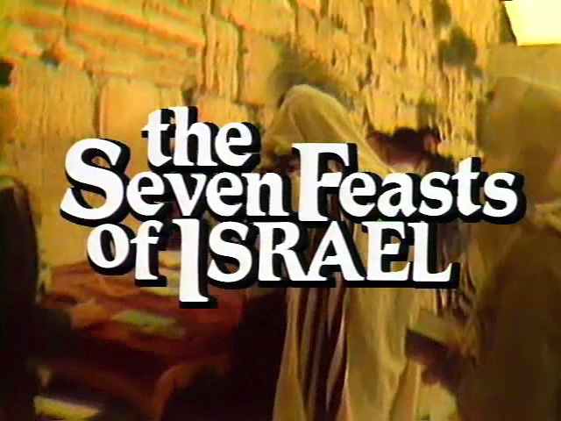

Slide 15
Leviticus 23:2
Speak unto the children of Israel, and say unto them, Concerning the feasts of the LORD, which ye shall proclaim to be holy convocations, even these are my feasts.

Slide 16
Leviticus 23:3
Six days shall work be done: but the seventh day is the sabbath of rest, an holy convocation; ye shall do no work therein: it is the sabbath of the LORD in all your dwellings.

Slide 17
Leviticus 23:4
These are the feasts of the LORD, even holy convocations, which ye shall proclaim in their seasons.

Slide 18
Mo-ed:
an appointment for an assembly at a fixed time and season

Slide 19
Qodesh Miqra:
a called out assembly or gathering of sanctified, dedicated, and consecrated people brought together in and for a public meeting

Slide 20
The Passover—
Pesach

Slide 21
Leviticus 23:5
In the fourteenth day of the first month at even is the LORD'S passover.

Slide 22
Exodus 12:40
Now the sojourning of the children of Israel, who dwelt in Egypt, was four hundred and thirty years.

Slide 23
Exodus 12:1
And the LORD spake unto Moses and Aaron in the land of Egypt, saying,

Slide 24
Exodus 12:2
This month shall be unto you the beginning of months: it shall be the first month of the year to you.

Slide 25
Exodus 12:3
Speak ye unto all the congregation of Israel, saying, In the tenth day of this month they shall take to them every man a lamb, according to the house of their fathers, a lamb for an house:

Slide 26
Exodus 12:4
And if the household be too little for the lamb, let him and his neighbour next unto his house take it according to the number of the souls; every man according to his eating shall make your count for the lamb.

Slide 27
Exodus 12:5
Your lamb shall be without blemish, a male of the first year: ye shall take it out from the sheep, or from the goats:

Slide 28
Exodus 12:6
And ye shall keep it up until the fourteenth day of the same month: and the whole assembly of the congregation of Israel shall kill it in the evening.

Slide 29
Exodus 12:7
And they shall take of the blood, and strike it on the two side posts and on the upper door post of the houses, wherein they shall eat it.

Slide 30
Exodus 12:8
And they shall eat the flesh in that night, roast with fire, and unleavened bread; and with bitter herbs they shall eat it.

Slide 31
Exodus 12:9
Eat not of it raw, nor sodden (boil) at all with water, but roast with fire; his head with his legs, and with the purtenance (inner parts) thereof.

Slide 32
Exodus 12:10
And ye shall let nothing of it remain until the morning; and that which remaineth of it until the morning ye shall burn with fire.

Slide 33
Exodus 12:11
And thus shall ye eat it; with your loins girded, your shoes on your feet, and your staff in your hand; and ye shall eat it in haste: it is the LORD'S passover.

Slide 34
Exodus 12:12
For I will pass through the land of Egypt this night, and will smite all the firstborn in the land of Egypt, both man and beast; and against all the gods of Egypt I will execute judgment: I am the LORD.

Slide 35
Exodus 12:13
And the blood shall be to you for a token upon the houses where ye are: and when I see the blood, I will pass over you, and the plague shall not be upon you to destroy you, when I smite the land of Egypt.

Slide 36
Exodus 12:14
And this day shall be unto you for a memorial; and ye shall keep it a feast to the LORD throughout your generations; ye shall keep it a feast by an ordinance for ever.

Slide 37
Mark 11:7
And they brought the colt to Jesus, and cast their garments on him; and he sat upon him.

Slide 38
Mark 11:8
And many spread their garments in the way: and others cut down branches off the trees, and strawed them in the way.

Slide 39
Mark 11:9
And they that went before, and they that followed, cried, saying, Hosanna; Blessed is he that cometh in the name of the Lord:

Slide 40
Mark 11:10
Blessed be the kingdom of our father David, that cometh in the name of the Lord: Hosanna in the highest.

Slide 41
Mark 11:11
And Jesus entered into Jerusalem, and into the temple: and when he had looked round about upon all things, and now the eventide was come, he went out unto Bethany with the twelve.

Slide 42
John 19:14
And it was the preparation of the passover, and about the sixth hour: and he saith unto the Jews, Behold your King!

Slide 43
John 19:15
But they cried out, Away with him, away with him, crucify him. Pilate saith unto them, Shall I crucify your King? The chief priests answered, We have no king but Caesar.

Slide 44
John 19:16
Then delivered he him therefore unto them to be crucified. And they took Jesus, and led him away.

Slide 45
Isaiah 53:7
He was oppressed, and he was afflicted, yet he opened not his mouth: he is brought as a lamb to the slaughter, and as a sheep before her shearers is dumb, so he openeth not his mouth.

Slide 46
1 Peter 1:18
Forasmuch as ye know that ye were not redeemed with corruptible things, as silver and gold, from your vain conversation received by tradition from your fathers;

Slide 47
1 Peter 1:19
But with the precious blood of Christ, as of a lamb without blemish and without spot:

Slide 48
Exodus 12:46
In one house shall it be eaten; thou shalt not carry forth ought of the flesh abroad out of the house; neither shall ye break a bone thereof.

Slide 49
John 19:31a
The Jews therefore, because it was the preparation, that the bodies should not remain upon the cross on the sabbath day,

Slide 50
John 19:31b
(for that sabbath day was an high day,) besought Pilate that their legs might be broken, and that they might be taken away.

Slide 51
John 19:32
Then came the soldiers, and brake the legs of the first, and of the other which was crucified with him.

Slide 52
John 19:33
But when they came to Jesus, and saw that he was dead already, they brake not his legs:

Slide 53
John 19:34
But one of the soldiers with a spear pierced his side, and forthwith came there out blood and water.

Slide 54
John 1:29
The next day John seeth Jesus coming unto him, and saith, Behold the Lamb of God, which taketh away the sin of the world.

Slide 55
1 Corinthians 5:7
Purge out therefore the old leaven, that ye may be a new lump, as ye are unleavened. For even Christ our passover is sacrificed for us:

Slide 56
John 3:16
For God so loved the world, that he gave his only begotten Son, that whosoever believeth in him should not perish, but have everlasting life.

Slide 57
John 3:17
For God sent not his Son into the world to condemn the world; but that the world through him might be saved.

Slide 58
John 3:18
He that believeth on him is not condemned: but he that believeth not is condemned already, because he hath not believed in the name of the only begotten Son of God.

Slide 59
John 3:19
And this is the condemnation, that light is come into the world, and men loved darkness rather than light, because their deeds were evil.

Slide 60
John 3:20
For every one that doeth evil hateth the light, neither cometh to the light, lest his deeds should be reproved.

Slide 61
John 3:21
But he that doeth truth cometh to the light, that his deeds may be made manifest, that they are wrought in God.

