Slide 1
The Lord’s Supper: Jesus Drawing Near
Luke 24:13-35
July 5-6, 2014
Calvary Chapel of El Paso

Slide 2
Luke 24:13
Now behold, two of them were traveling that same day to a village called Emmaus, which was seven miles from Jerusalem.

Slide 3
Luke 24:14
And they talked together of all these things which had happened.

Slide 4
Luke 24:15
So it was, while they conversed and reasoned, that Jesus Himself drew near and went with them.

Slide 5
Luke 24:16
But their eyes were restrained, so that they did not know Him.

Slide 6
Luke 24:17
And He said to them, "What kind of conversation is this that you have with one another as you walk and are sad?"

Slide 7
Luke 24:18
Then the one whose name was Cleopas answered and said to Him, "Are You the only stranger in Jerusalem, and have You not known the things which happened there in these days?"

Slide 8
Luke 24:19
And He said to them, "What things?" So they said to Him, "The things concerning Jesus of Nazareth, who was a Prophet mighty in deed and word before God and all the people,

Slide 9
Luke 24:20
and how the chief priests and our rulers delivered Him to be condemned to death, and crucified Him.

Slide 10
Luke 24:21
But we were hoping that it was He who was going to redeem Israel. Indeed, besides all this, today is the third day since these things happened.

Slide 11
Luke 24:22
Yes, and certain women of our company, who arrived at the tomb early, astonished us.

Slide 12
Luke 24:23
When they did not find His body, they came saying that they had also seen a vision of angels who said He was alive.

Slide 13
Luke 24:24
And certain of those who were with us went to the tomb and found it just as the women had said; but Him they did not see."

Slide 14
Luke 24:25
Then He said to them, "O foolish ones, and slow of heart to believe in all that the prophets have spoken!

Slide 15
Luke 24:26
Ought not the Christ to have suffered these things and to enter into His glory?"

Slide 16
Luke 24:27
And beginning at Moses and all the Prophets, He expounded to them in all the Scriptures the things concerning Himself.

Slide 17
Luke 24:28
Then they drew near to the village where they were going, and He indicated that He would have gone farther.

Slide 18
Luke 24:29
But they constrained Him, saying, "Abide with us, for it is toward evening, and the day is far spent." And He went in to stay with them.

Slide 19
Luke 24:30
Now it came to pass, as He sat at the table with them, that He took bread, blessed and broke it, and gave it to them.

Slide 20
Luke 24:31
Then their eyes were opened and they knew Him; and He vanished from their sight.

Slide 21
Luke 24:32
And they said to one another, "Did not our heart burn within us while He talked with us on the road, and while He opened the Scriptures to us?"

Slide 22
Luke 24:33
So they rose up that very hour and returned to Jerusalem, and found the eleven and those who were with them gathered together,

Slide 23
Luke 24:34
saying, "The Lord is risen indeed, and has appeared to Simon!"

Slide 24
Luke 24:35
And they told about the things that had happened on the road, and how He was known to them in the breaking of bread.

Slide 25
Have you ever given up on Jesus?

Slide 26
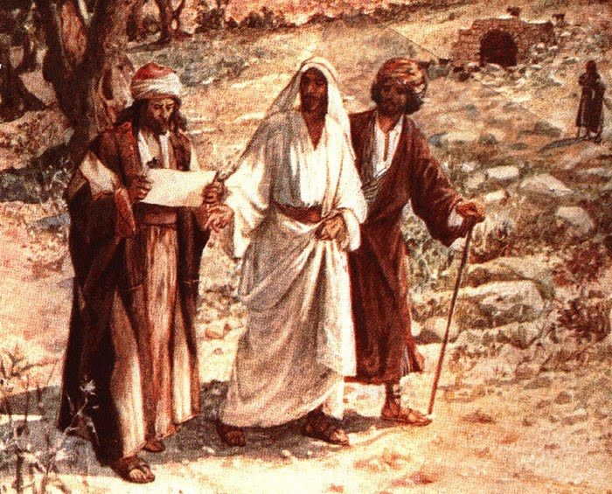

Slide 27
1 Peter 5:6
Therefore humble yourselves under the mighty hand of God, that He may exalt you in due time,

Slide 28
1 Peter 5:7
casting all your care upon Him, for He cares for you.

Slide 29
Romans 5:1
Therefore, having been justified by faith, we have peace with God through our Lord Jesus Christ,

Slide 30
Romans 5:2
through whom also we have access by faith into this grace in which we stand, and rejoice in hope of the glory of God.

Slide 31
Romans 5:3
And not only that, but we also glory in tribulations, knowing that tribulation produces perseverance;

Slide 32
Romans 5:4
and perseverance, character; and character, hope.

Slide 33
Romans 5:5
Now hope does not disappoint, because the love of God has been poured out in our hearts by the Holy Spirit who was given to us.

Slide 34
Romans 5:6
For when we were still without strength, in due time Christ died for the ungodly.

Slide 35
Romans 5:8
But God demonstrates His own love toward us, in that while we were still sinners, Christ died for us.

Slide 36
Romans 12:12
rejoicing in hope, patient in tribulation, continuing steadfastly in prayer;

Slide 37
