Slide 1
The Judgment Seat of Jacob, Part 2
Genesis 49:8-12
September 13-14, 2014
Calvary Chapel of El Paso

Slide 2
Genesis 49:8
"Judah, you are he whom your brothers shall praise; Your hand shall be on the neck of your enemies; Your father's children shall bow down before you.

Slide 3
Genesis 49:9
Judah is a lion's whelp; From the prey, my son, you have gone up. He bows down, he lies down as a lion; And as a lion, who shall rouse him?

Slide 4
Genesis 49:10
The scepter shall not depart from Judah, Nor a lawgiver from between his feet, Until Shiloh comes; And to Him shall be the obedience of the people.

Slide 5
Genesis 49:11
Binding his donkey to the vine, And his donkey's colt to the choice vine, He washed his garments in wine, And his clothes in the blood of grapes.

Slide 6
Genesis 49:12
His eyes are darker than wine, And his teeth whiter than milk.

Slide 7
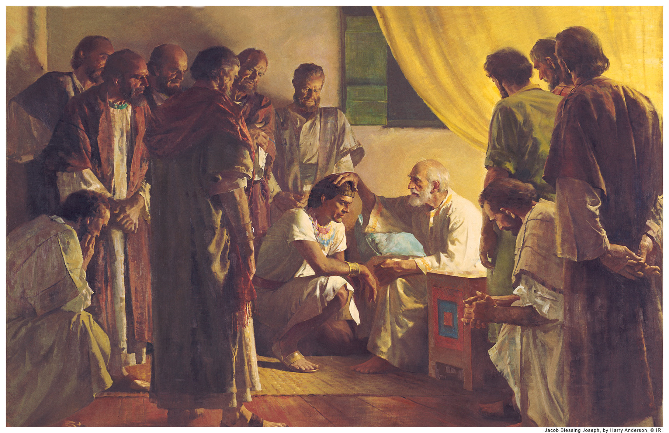

Slide 8
Genesis 49:1
And Jacob called his sons and said, "Gather together, that I may tell you what shall befall you in the last days:

Slide 9
Hebrews 1:1
God, who at various times and in various ways spoke in time past to the fathers by the prophets,

Slide 10
Hebrews 1:2
has in these last days spoken to us by His Son, whom He has appointed heir of all things, through whom also He made the worlds;

Slide 11
John 8:21
Then said Jesus again unto them, I go my way, and ye shall seek me, and shall die in your sins: whither I go, ye cannot come.

Slide 12
John 8:22
Then said the Jews, Will he kill himself? because he saith, Whither I go, ye cannot come.

Slide 13
John 8:23
And he said unto them, Ye are from beneath; I am from above: ye are of this world; I am not of this world.

Slide 14
John 8:24
I said therefore unto you, that ye shall die in your sins: for if ye believe not that I am he, ye shall die in your sins.

Slide 15
OVERVIEW

Slide 16
Genesis 49:8
"Judah, you are he whom your brothers shall praise; Your hand shall be on the neck of your enemies; Your father's children shall bow down before you.

Slide 17
Philippians 2:5
Let this mind be in you, which was also in Christ Jesus:

Slide 18
Philippians 2:6
Who, being in the form of God, thought it not robbery to be equal with God:

Slide 19
Philippians 2:7
But made himself of no reputation, and took upon him the form of a servant, and was made in the likeness of men:

Slide 20
Philippians 2:8
And being found in fashion as a man, he humbled himself, and became obedient unto death, even the death of the cross.

Slide 21
Philippians 2:9
Wherefore God also hath highly exalted him, and given him a name which is above every name:

Slide 22
Philippians 2:10
That at the name of Jesus every knee should bow, of things in heaven, and things in earth, and things under the earth;

Slide 23
Philippians 2:11
And that every tongue should confess that Jesus Christ is Lord, to the glory of God the Father.

Slide 24
Isaiah 45:22
"Look to Me, and be saved, All you ends of the earth! For I am God, and there is no other.

Slide 25
Isaiah 45:23
I have sworn by Myself; The word has gone out of My mouth in righteousness, And shall not return, That to Me every knee shall bow, Every tongue shall take an oath.

Slide 26
Isaiah 45:24
He shall say, 'Surely in the LORD I have righteousness and strength. To Him men shall come, And all shall be ashamed Who are incensed against Him.

Slide 27
Isaiah 45:25
In the LORD all the descendants of Israel Shall be justified, and shall glory.'"

Slide 28
Psalm 110:5
The Lord at thy right hand shall strike through kings in the day of his wrath.

Slide 29
Psalm 110:6
He shall judge among the heathen, he shall fill the places with the dead bodies; he shall wound the heads over many countries.

Slide 30
Romans 11:25
For I would not, brethren, that ye should be ignorant of this mystery, lest ye should be wise in your own conceits; that blindness in part is happened to Israel, until the fulness of the Gentiles be come in.

Slide 31
Romans 11:26
And so all Israel shall be saved: as it is written, There shall come out of Sion the Deliverer, and shall turn away ungodliness from Jacob:

Slide 32
Romans 11:27
For this is my covenant unto them, when I shall take away their sins.

Slide 33
Messiah’s First Coming

Slide 34
Genesis 49:9
Judah is a lion's whelp; From the prey, my son, you have gone up. He bows down, he lies down as a lion; And as a lion, who shall rouse him?

Slide 35
Genesis 49:10
The scepter shall not depart from Judah, Nor a lawgiver from between his feet, Until Shiloh comes; And to Him shall be the obedience of the people.

Slide 36
John 1:14
And the Word was made flesh, and dwelt among us, (and we beheld his glory, the glory as of the only begotten of the Father,) full of grace and truth.

Slide 37
Ephesians 2:14
For He Himself is our peace, who has made both one, and has broken down the middle wall of separation,

Slide 38
Messiah’s Second Coming

Slide 39
Genesis 49:11
Binding his donkey to the vine, And his donkey's colt to the choice vine, He washed his garments in wine, And his clothes in the blood of grapes.

Slide 40
Genesis 49:12
His eyes are darker than wine, And his teeth whiter than milk.

Slide 41
Isaiah 55:1
Ho! Everyone who thirsts, Come to the waters; And you who have no money, Come, buy and eat. Yes, come, buy wine and milk Without money and without price.

Slide 42
Conclusion

Slide 43
John 3:16
For God so loved the world, that he gave his only begotten Son, that whosoever believeth in him should not perish, but have everlasting life.

Slide 44
John 3:17
For God sent not his Son into the world to condemn the world; but that the world through him might be saved.

Slide 45
John 3:18
He that believeth on him is not condemned: but he that believeth not is condemned already, because he hath not believed in the name of the only begotten Son of God.

Slide 46
John 3:19
And this is the condemnation, that light is come into the world, and men loved darkness rather than light, because their deeds were evil.

Slide 47
John 3:20
For every one that doeth evil hateth the light, neither cometh to the light, lest his deeds should be reproved.

Slide 48
John 3:21
But he that doeth truth cometh to the light, that his deeds may be made manifest, that they are wrought in God.

Slide 49
