Slide 1
The Judgment Seat of Jacob, Part 1
Genesis 49:1-7
August 23-24, 2014
Calvary Chapel of El Paso

Slide 2
Genesis 49:1
And Jacob called his sons and said, "Gather together, that I may tell you what shall befall you in the last days:

Slide 3
Genesis 49:2
"Gather together and hear, you sons of Jacob, And listen to Israel your father.

Slide 4
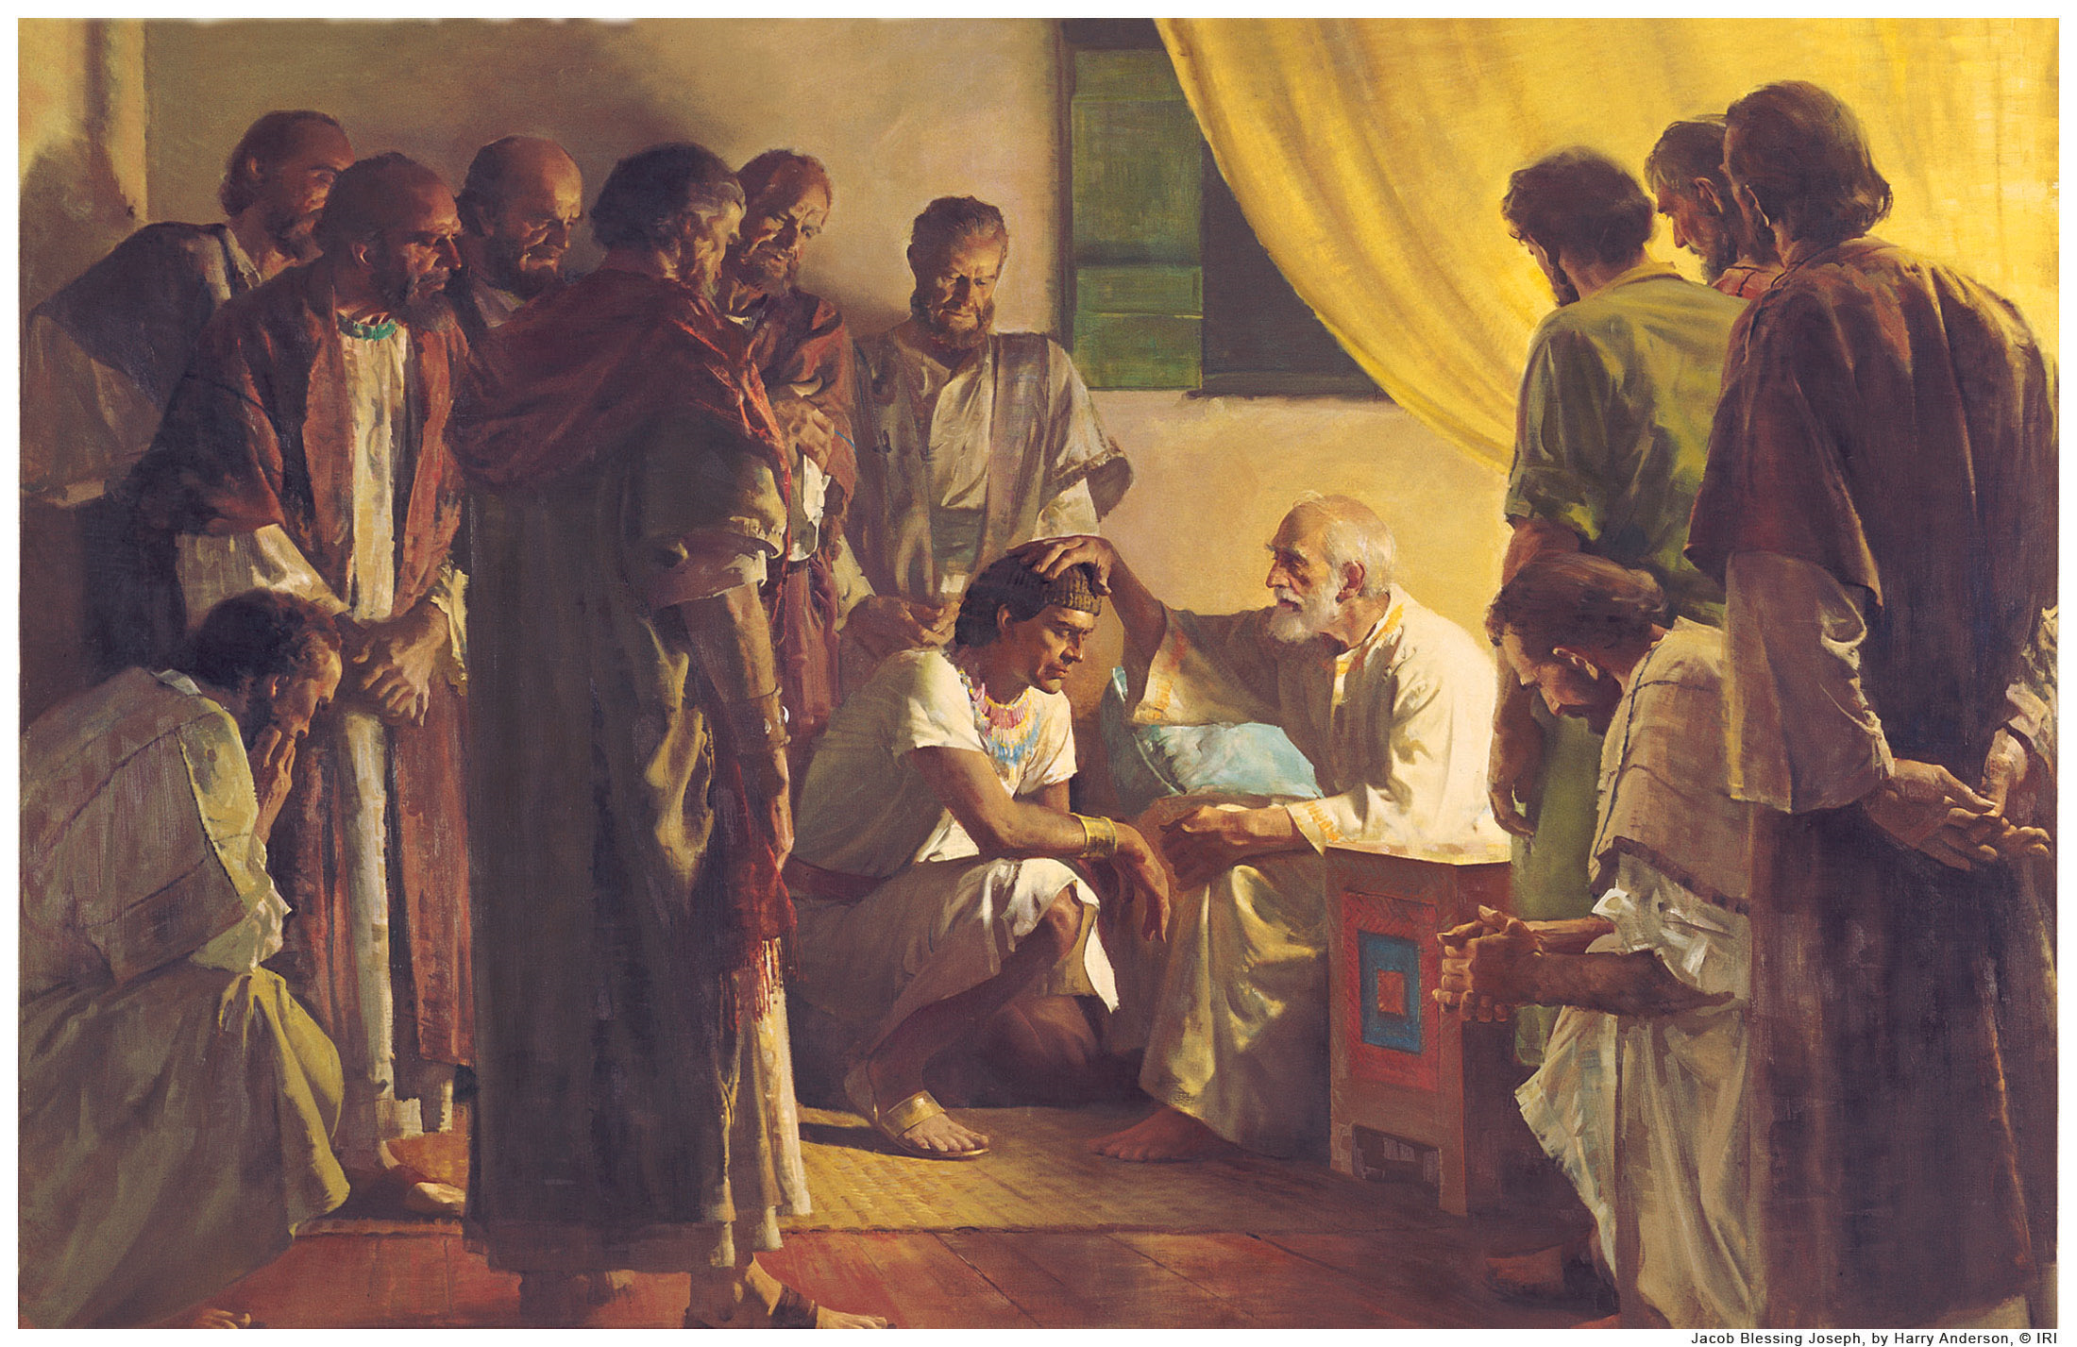

Slide 5
2 Corinthians 5:10
For we must all appear before the judgment seat of Christ, that each one may receive the things done in the body, according to what he has done, whether good or bad.

Slide 6
Romans 14:10
But why do you judge your brother? Or why do you show contempt for your brother? For we shall all stand before the judgment seat of Christ.

Slide 7
Revelation 20:11
Then I saw a great white throne and Him who sat on it, from whose face the earth and the heaven fled away. And there was found no place for them.

Slide 8
Revelation 20:12a
And I saw the dead, small and great, standing before God, and books were opened. And another book was opened, which is the Book of Life…

Slide 9
Revelation 20:12b
…And the dead were judged according to their works, by the things which were written in the books.

Slide 10
Genesis 49:1
And Jacob called his sons and said, "Gather together, that I may tell you what shall befall you in the last days:

Slide 11
Genesis 49:2
"Gather together and hear, you sons of Jacob, And listen to Israel your father.

Slide 12
Genesis 47:31
Then he said, "Swear to me." And he swore to him. So Israel bowed himself on the head of the bed.

Slide 13
Hebrews 11:21
By faith Jacob, when he was dying, blessed each of the sons of Joseph, and worshiped, leaning on the top of his staff.

Slide 14
Reuben—The First Shall be Last

Slide 15
Genesis 49:3
"Reuben, you are my firstborn, My might and the beginning of my strength, The excellency of dignity and the excellency of power.

Slide 16
Genesis 49:4
Unstable as water, you shall not excel, Because you went up to your father's bed; Then you defiled it—He went up to my couch.

Slide 17
Genesis 35:22
And it happened, when Israel dwelt in that land, that Reuben went and lay with Bilhah his father's concubine; and Israel heard about it. Now the sons of Jacob were twelve:

Slide 18
1 Chronicles 5:1a
Now the sons of Reuben the firstborn of Israel—he was indeed the firstborn, but because he defiled his father's bed…

Slide 19
1 Chronicles 5:1b
…his birthright was given to the sons of Joseph, the son of Israel, so that the genealogy is not listed according to the birthright;

Slide 20
Deuteronomy 33:6
"Let Reuben live, and not die, Nor let his men be few."

Slide 21
Psalm 112:5
A good man deals graciously and lends; He will guide his affairs with discretion.

Slide 22
Psalm 112:6
Surely he will never be shaken; The righteous will be in everlasting remembrance.

Slide 23
Psalm 112:7
He will not be afraid of evil tidings; His heart is steadfast, trusting in the LORD.

Slide 24
Matthew 19:30
But many who are first will be last, and the last first.

Slide 25
Simeon and Levi—Scattered in Israel

Slide 26
Genesis 49:5
"Simeon and Levi are brothers; Instruments of cruelty are in their dwelling place.

Slide 27
Genesis 49:6
Let not my soul enter their council; Let not my honor be united to their assembly; For in their anger they slew a man, And in their self-will they hamstrung an ox.

Slide 28
Genesis 49:7
Cursed be their anger, for it is fierce; And their wrath, for it is cruel! I will divide them in Jacob And scatter them in Israel.

Slide 29
Ephesians 4:26
"Be angry, and do not sin": do not let the sun go down on your wrath,

Slide 30
Ephesians 4:31
Let all bitterness, wrath, anger, clamor, and evil speaking be put away from you, with all malice.

Slide 31
Ephesians 4:32
And be kind to one another, tenderhearted, forgiving one another, just as God in Christ forgave you.

Slide 32
Joshua 19:1
The second lot came out for Simeon, for the tribe of the children of Simeon according to their families. And their inheritance was within the inheritance of the children of Judah.

Slide 33
Joshua 19:9a
The inheritance of the children of Simeon was included in the share of the children of Judah, for the share of the children of Judah was too much for them.

Slide 34
Joshua 19:9b
Therefore the children of Simeon had their inheritance within the inheritance of that people.

Slide 35
Joshua 13:33
But to the tribe of Levi Moses had given no inheritance; the LORD God of Israel was their inheritance, as He had said to them.

Slide 36
Ephesians 5:11
And have no fellowship with the unfruitful works of darkness, but rather expose them.

Slide 37
Malachi 4:5
Behold, I will send you Elijah the prophet Before the coming of the great and dreadful day of the LORD.

Slide 38
Malachi 4:6
And he will turn The hearts of the fathers to the children, And the hearts of the children to their fathers, Lest I come and strike the earth with a curse."

Slide 39
Ephesians 2:4
But God, who is rich in mercy, because of His great love with which He loved us,

Slide 40
Ephesians 2:5
even when we were dead in trespasses, made us alive together with Christ (by grace you have been saved),

Slide 41
Ephesians 2:6
and raised us up together, and made us sit together in the heavenly places in Christ Jesus,

Slide 42
Ephesians 2:7
that in the ages to come He might show the exceeding riches of His grace in His kindness toward us in Christ Jesus.

Slide 43
Ephesians 2:8
For by grace you have been saved through faith, and that not of yourselves; it is the gift of God,

Slide 44
Ephesians 2:9
not of works, lest anyone should boast.

Slide 45
Ephesians 2:10
For we are His workmanship, created in Christ Jesus for good works, which God prepared beforehand that we should walk in them.

