Slide 1
The Feast of Trumpets, Part 1
Leviticus 23:23-25
September 30, 2015
Calvary Chapel of El Paso

Slide 2
Leviticus 23:23
And the LORD spake unto Moses, saying,

Slide 3
Leviticus 23:24
Speak unto the children of Israel, saying, In the seventh month, in the first day of the month, shall ye have a sabbath, a memorial of blowing of trumpets, an holy convocation.

Slide 4
Leviticus 23:25
Ye shall do no servile work therein: but ye shall offer an offering made by fire unto the LORD.

Slide 6
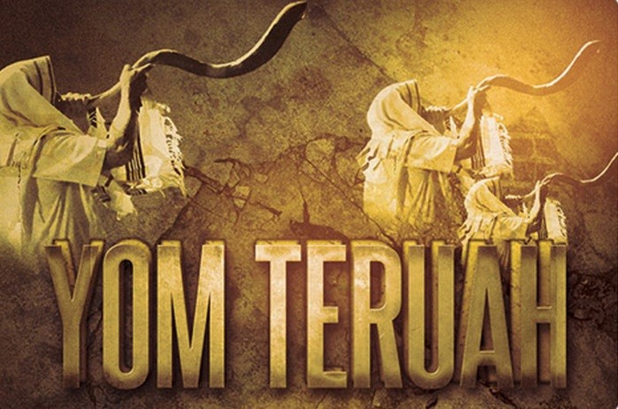

Slide 7
Rosh Hashanah—“The Head of the Year”

Slide 8
Yom Teru’ah—
“The Day of the Awakening Blast”

Slide 9
Yom ha-Zikkaron—
The Day of Remembrance

Slide 10
Yom Hakeseh—“The Day of Hiding” or “The Hidden Day”

Slide 11
Psalm 81:3
Blow up the trumpet in the new moon, in the time appointed, on our solemn feast day.

Slide 12
John 10:10
The thief cometh not, but for to steal, and to kill, and to destroy: I am come that they might have life, and that they might have it more abundantly.

Slide 13
1 Corinthians 14:33
For God is not the author of confusion, but of peace, as in all churches of the saints.

Slide 14
1 Corinthians 2:7
But we speak the wisdom of God in a mystery, even the hidden wisdom, which God ordained before the world unto our glory:

Slide 15
1 Corinthians 2:8
Which none of the princes of this world knew: for had they known it, they would not have crucified the Lord of glory.

Slide 16
Psalm 27:3
Though an host should encamp against me, my heart shall not fear: though war should rise against me, in this will I be confident.

Slide 17
Psalm 27:4
One thing have I desired of the LORD, that will I seek after; that I may dwell in the house of the LORD all the days of my life, to behold the beauty of the LORD, and to enquire in his temple.

Slide 18
Psalm 27:5
For in the time of trouble he shall hide me in his pavilion: in the secret of his tabernacle shall he hide me; he shall set me up upon a rock.

Slide 19
Psalm 27:6
And now shall mine head be lifted up above mine enemies round about me: therefore will I offer in his tabernacle sacrifices of joy; I will sing, yea, I will sing praises unto the LORD.

Slide 20
Psalm 27:1
The LORD is my light and my salvation; whom shall I fear? the LORD is the strength of my life; of whom shall I be afraid?

Slide 21
Why is this Feast a Mystery?

Slide 22
Leviticus 23:24
Speak unto the children of Israel, saying, In the seventh month, in the first day of the month, shall ye have a sabbath, a memorial of blowing of trumpets, an holy convocation.

Slide 23
Leviticus 23:25
Ye shall do no servile work therein: but ye shall offer an offering made by fire unto the LORD.

Slide 24
Numbers 29:1
And in the seventh month, on the first day of the month, ye shall have an holy convocation; ye shall do no servile work: it is a day of blowing the trumpets unto you.

Slide 25
Isaiah 5:20
Woe unto them that call evil good, and good evil; that put darkness for light, and light for darkness; that put bitter for sweet, and sweet for bitter!

Slide 26
Isaiah 5:21
Woe unto them that are wise in their own eyes, and prudent in their own sight!

Slide 27
Matthew 24:36
But of that day and hour knoweth no man, no, not the angels of heaven, but my Father only.

Slide 28
Matthew 24:37
But as the days of Noe were, so shall also the coming of the Son of man be.

Slide 29
Matthew 24:38
For as in the days that were before the flood they were eating and drinking, marrying and giving in marriage, until the day that Noe entered into the ark,

Slide 30
Matthew 24:39
And knew not until the flood came, and took them all away; so shall also the coming of the Son of man be.

Slide 31
Luke 17:28
Likewise also as it was in the days of Lot; they did eat, they drank, they bought, they sold, they planted, they builded;

Slide 32
Luke 17:29
But the same day that Lot went out of Sodom it rained fire and brimstone from heaven, and destroyed them all.

Slide 33
Genesis 1:14
And God said, Let there be lights in the firmament of the heaven to divide the day from the night; and let them be for signs, and for seasons, and for days, and years:

Slide 34
Psalm 104:19
He appointed the moon for seasons: the sun knoweth his going down.

Slide 35
Psalm 136:8
The sun to rule by day: for his mercy endureth for ever:

Slide 36
Psalm 136:9
The moon and stars to rule by night: for his mercy endureth for ever.

Slide 37
Luke 21:25
And there shall be signs in the sun, and in the moon, and in the stars; and upon the earth distress of nations, with perplexity; the sea and the waves roaring;

Slide 38
Colossians 2:16
Let no man therefore judge you in meat, or in drink, or in respect of an holyday, or of the new moon, or of the sabbath days:

Slide 39
Colossians 2:17
Which are a shadow of things to come; but the body is of Christ.

Slide 40
Colossians 1:12
Giving thanks unto the Father, which hath made us meet to be partakers of the inheritance of the saints in light:

Slide 41
Colossians 1:13
Who hath delivered us from the power of darkness, and hath translated us into the kingdom of his dear Son:

Slide 42
Colossians 1:14
In whom we have redemption through his blood, even the forgiveness of sins:

Slide 43
1 Thessalonians 4:16
For the Lord himself shall descend from heaven with a shout, with the voice of the archangel, and with the trump of God: and the dead in Christ shall rise first:

Slide 44
1 Thessalonians 4:17
Then we which are alive and remain shall be caught up together with them in the clouds, to meet the Lord in the air: and so shall we ever be with the Lord.

Slide 45
1 Thessalonians 4:18
Wherefore comfort one another with these words.

Slide 46
1 Corinthians 15:51
Behold, I shew you a mystery; We shall not all sleep, but we shall all be changed,

Slide 47
1 Corinthians 15:52
In a moment, in the twinkling of an eye, at the last trump: for the trumpet shall sound, and the dead shall be raised incorruptible, and we shall be changed.

