Slide 1
The Day of the Lord Revisited
1 Thessalonians 5:1-11
December 13-14, 2014
Calvary Chapel of El Paso

Slide 2
1 Thessalonians 5:1
But of the times and the seasons, brethren, ye have no need that I write unto you.

Slide 3
1 Thessalonians 5:2
For yourselves know perfectly that the day of the Lord so cometh as a thief in the night.

Slide 4
1 Thessalonians 5:3
For when they shall say, Peace and safety; then sudden destruction cometh upon them, as travail upon a woman with child; and they shall not escape.

Slide 5
1 Thessalonians 5:4
But ye, brethren, are not in darkness, that that day should overtake you as a thief.

Slide 6
1 Thessalonians 5:5
Ye are all the children of light, and the children of the day: we are not of the night, nor of darkness.

Slide 7
1 Thessalonians 5:6
Therefore let us not sleep, as do others; but let us watch and be sober.

Slide 8
1 Thessalonians 5:7
For they that sleep sleep in the night; and they that be drunken are drunken in the night.

Slide 9
1 Thessalonians 5:8
But let us, who are of the day, be sober, putting on the breastplate of faith and love; and for an helmet, the hope of salvation.

Slide 10
1 Thessalonians 5:9
For God hath not appointed us to wrath, but to obtain salvation by our Lord Jesus Christ,

Slide 11
1 Thessalonians 5:10
Who died for us, that, whether we wake or sleep, we should live together with him.

Slide 12
1 Thessalonians 5:11
Wherefore comfort yourselves together, and edify one another, even as also ye do.

Slide 13
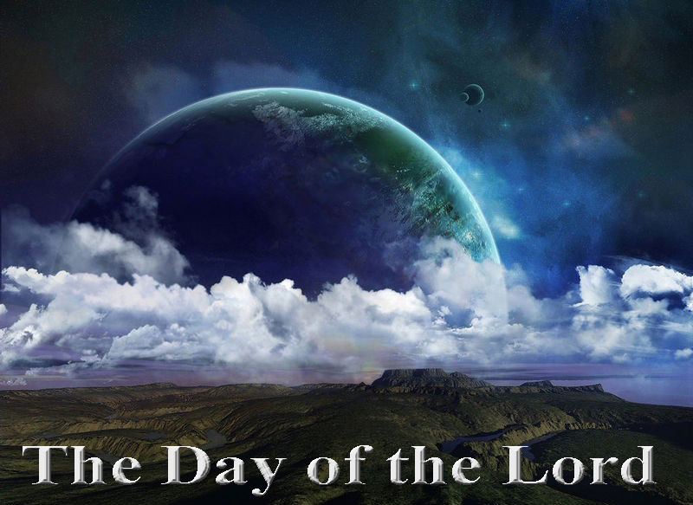

Slide 14
Acts 20:26
Wherefore I take you to record this day, that I am pure from the blood of all men.

Slide 15
Acts 20:27
For I have not shunned to declare unto you all the counsel of God.

Slide 16
The Day of the Lord—Defined

Slide 17
1 Thessalonians 4:18
Wherefore comfort one another with these words.

Slide 18
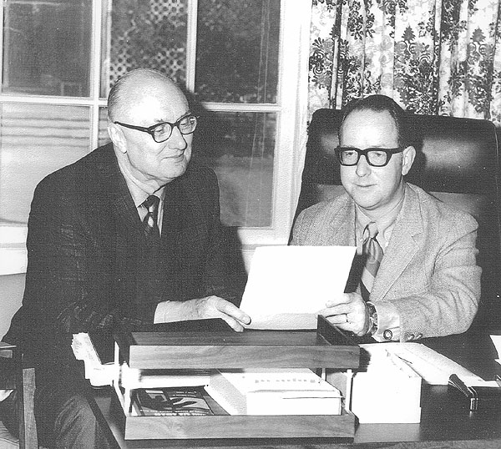

Slide 19
Isaiah 13:9
Behold, the day of the LORD cometh, cruel both with wrath and fierce anger, to lay the land desolate: and he shall destroy the sinners thereof out of it.

Slide 20
Isaiah 13:10
For the stars of heaven and the constellations thereof shall not give their light: the sun shall be darkened in his going forth, and the moon shall not cause her light to shine.

Slide 21
Isaiah 13:11
And I will punish the world for their evil, and the wicked for their iniquity; and I will cause the arrogancy of the proud to cease, and will lay low the haughtiness of the terrible.

Slide 22
Isaiah 13:12
I will make a man more precious than fine gold; even a man than the golden wedge of Ophir.

Slide 23
Isaiah 13:13
Therefore I will shake the heavens, and the earth shall remove out of her place, in the wrath of the LORD of hosts, and in the day of his fierce anger.

Slide 24
The Day of the Lord—A Day of Darkness

Slide 25
Zephaniah 1:14
The great day of the LORD is near, it is near, and hasteth greatly, even the voice of the day of the LORD: the mighty man shall cry there bitterly.

Slide 26
Zephaniah 1:15
That day is a day of wrath, a day of trouble and distress, a day of wasteness and desolation, a day of darkness and gloominess, a day of clouds and thick darkness,

Slide 27
Zephaniah 1:16
A day of the trumpet and alarm against the fenced cities, and against the high towers.

Slide 28
Zephaniah 1:17
And I will bring distress upon men, that they shall walk like blind men, because they have sinned against the LORD: and their blood shall be poured out as dust, and their flesh as the dung.

Slide 29
Zephaniah 1:18a
Neither their silver nor their gold shall be able to deliver them in the day of the LORD'S wrath;

Slide 30
Zephaniah 1:18b
but the whole land shall be devoured by the fire of his jealousy: for he shall make even a speedy riddance of all them that dwell in the land.

Slide 31
Joel 2:1
Blow ye the trumpet in Zion, and sound an alarm in my holy mountain: let all the inhabitants of the land tremble: for the day of the LORD cometh, for it is nigh at hand;

Slide 32
Joel 2:2a
A day of darkness and of gloominess, a day of clouds and of thick darkness, as the morning spread upon the mountains: a great people and a strong;

Slide 33
Joel 2:2b
there hath not been ever the like, neither shall be any more after it, even to the years of many generations.

Slide 34
Amos 5:18
Woe unto you that desire the day of the LORD! to what end is it for you? the day of the LORD is darkness, and not light.

Slide 35
Amos 5:19
As if a man did flee from a lion, and a bear met him; or went into the house, and leaned his hand on the wall, and a serpent bit him.

Slide 36
Amos 5:20
Shall not the day of the LORD be darkness, and not light? even very dark, and no brightness in it?

Slide 37
2 Thessalonians 2:7
For the mystery of iniquity doth already work: only he who now letteth will let, until he be taken out of the way.

Slide 38
2 Thessalonians 2:8
And then shall that Wicked be revealed, whom the Lord shall consume with the spirit of his mouth, and shall destroy with the brightness of his coming:

Slide 39
2 Thessalonians 2:9
Even him, whose coming is after the working of Satan with all power and signs and lying wonders,

Slide 40
2 Thessalonians 2:10
And with all deceivableness of unrighteousness in them that perish; because they received not the love of the truth, that they might be saved.

Slide 41
2 Thessalonians 2:11
And for this cause God shall send them strong delusion, that they should believe a lie:

Slide 42
2 Thessalonians 2:12
That they all might be damned who believed not the truth, but had pleasure in unrighteousness.

Slide 43
The Day of the Lord—A Day of Destruction

Slide 44
1 Thessalonians 5:3
For when they shall say, Peace and safety; then sudden destruction cometh upon them, as travail upon a woman with child; and they shall not escape.

Slide 45
Daniel 9:27a
And he shall confirm the covenant with many for one week: and in the midst of the week he shall cause the sacrifice and the oblation to cease,

Slide 46
Daniel 9:27b
and for the overspreading of abominations he shall make it desolate, even until the consummation, and that determined shall be poured upon the desolate.

Slide 47
The Day of the Lord—A Day of Despair

Slide 48
John 3:36
He that believeth on the Son hath everlasting life: and he that believeth not the Son shall not see life; but the wrath of God abideth on him.

Slide 49
Luke 21:25
And there shall be signs in the sun, and in the moon, and in the stars; and upon the earth distress of nations, with perplexity; the sea and the waves roaring;

Slide 50
Luke 21:26
Men's hearts failing them for fear, and for looking after those things which are coming on the earth: for the powers of heaven shall be shaken.

Slide 51
The Day of the Lord—A Day of Deliverance

Slide 52
1 Thessalonians 5:9
For God hath not appointed us to wrath, but to obtain salvation by our Lord Jesus Christ,

Slide 53
1 Thessalonians 5:10
Who died for us, that, whether we wake or sleep, we should live together with him.

Slide 54
1 Thessalonians 5:11
Wherefore comfort yourselves together, and edify one another, even as also ye do.

Slide 55
