Slide 1
The Believer’s Code of Conduct
2 Kings 18:1-8
Fourth of July Weekend
Calvary Chapel of El Paso

Slide 2
2 Kings 18:1
Now it came to pass in the third year of Hoshea son of Elah king of Israel, that Hezekiah the son of Ahaz king of Judah began to reign.

Slide 3
2 Kings 18:2
Twenty and five years old was he when he began to reign; and he reigned twenty and nine years in Jerusalem. His mother's name also was Abi, the daughter of Zachariah.

Slide 4
2 Kings 18:3
And he did that which was right in the sight of the LORD, according to all that David his father did.

Slide 5
2 Kings 18:4a
He removed the high places, and brake the images, and cut down the groves, and brake in pieces the brasen serpent that Moses had made:

Slide 6
2 Kings 18:4b
for unto those days the children of Israel did burn incense to it: and he called it Nehushtan.

Slide 7
2 Kings 18:5
He trusted in the LORD God of Israel; so that after him was none like him among all the kings of Judah, nor any that were before him.

Slide 8
2 Kings 18:6
For he clave to the LORD, and departed not from following him, but kept his commandments, which the LORD commanded Moses.

Slide 9
2 Kings 18:7
And the LORD was with him; and he prospered whithersoever he went forth: and he rebelled against the king of Assyria, and served him not.

Slide 10
2 Kings 18:8
He smote the Philistines, even unto Gaza, and the borders thereof, from the tower of the watchmen to the fenced city.

Slide 11
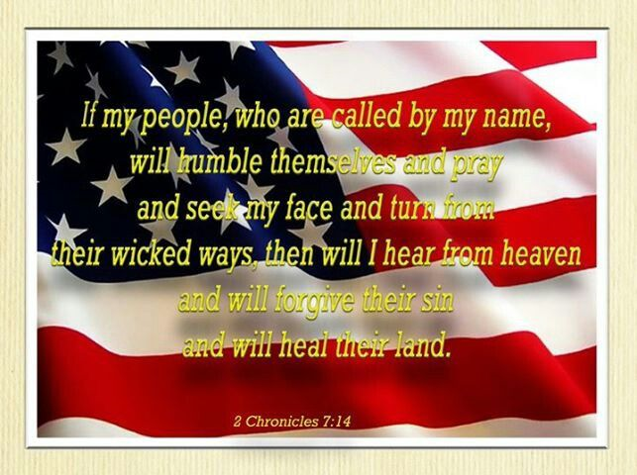

Slide 12
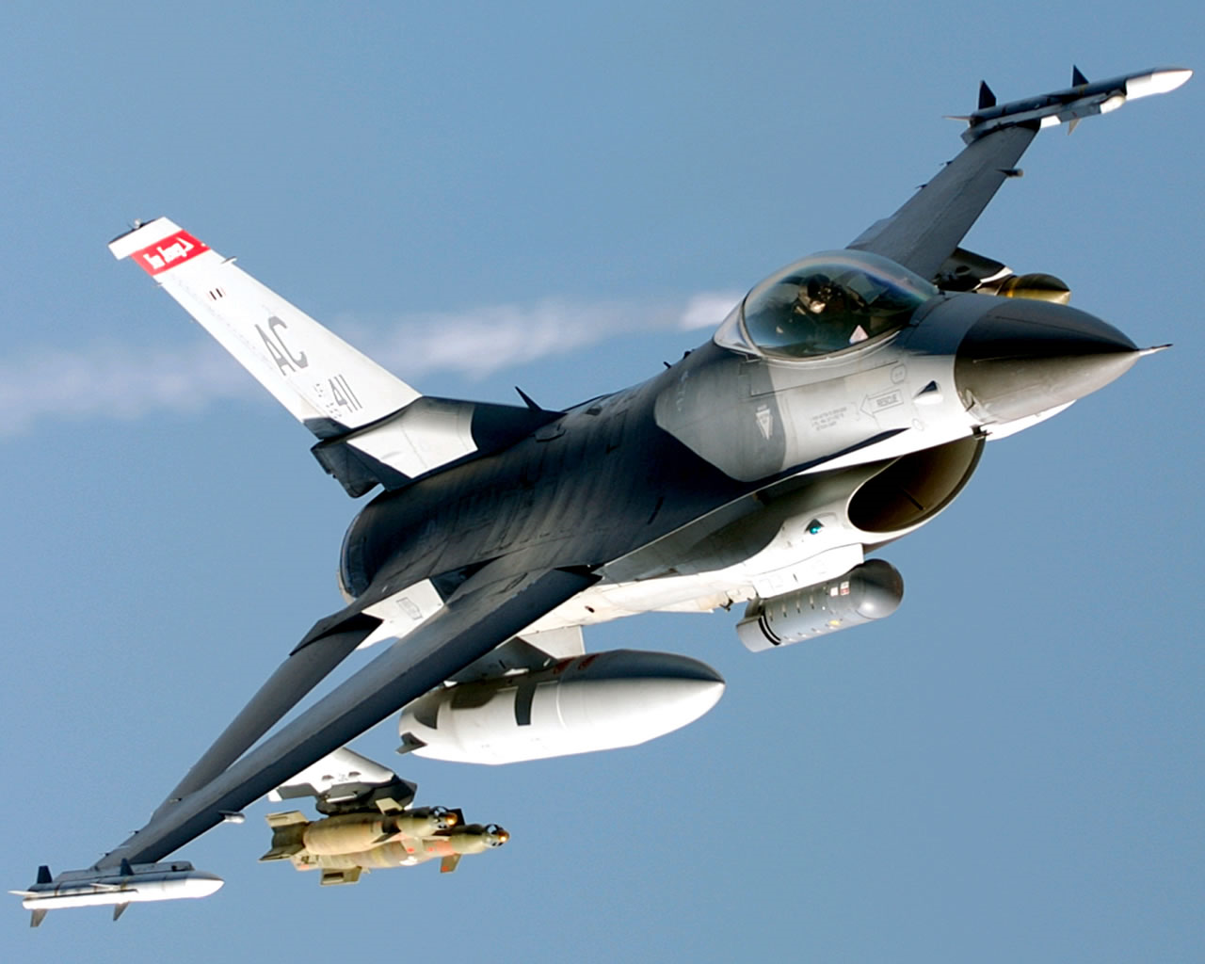

Slide 13
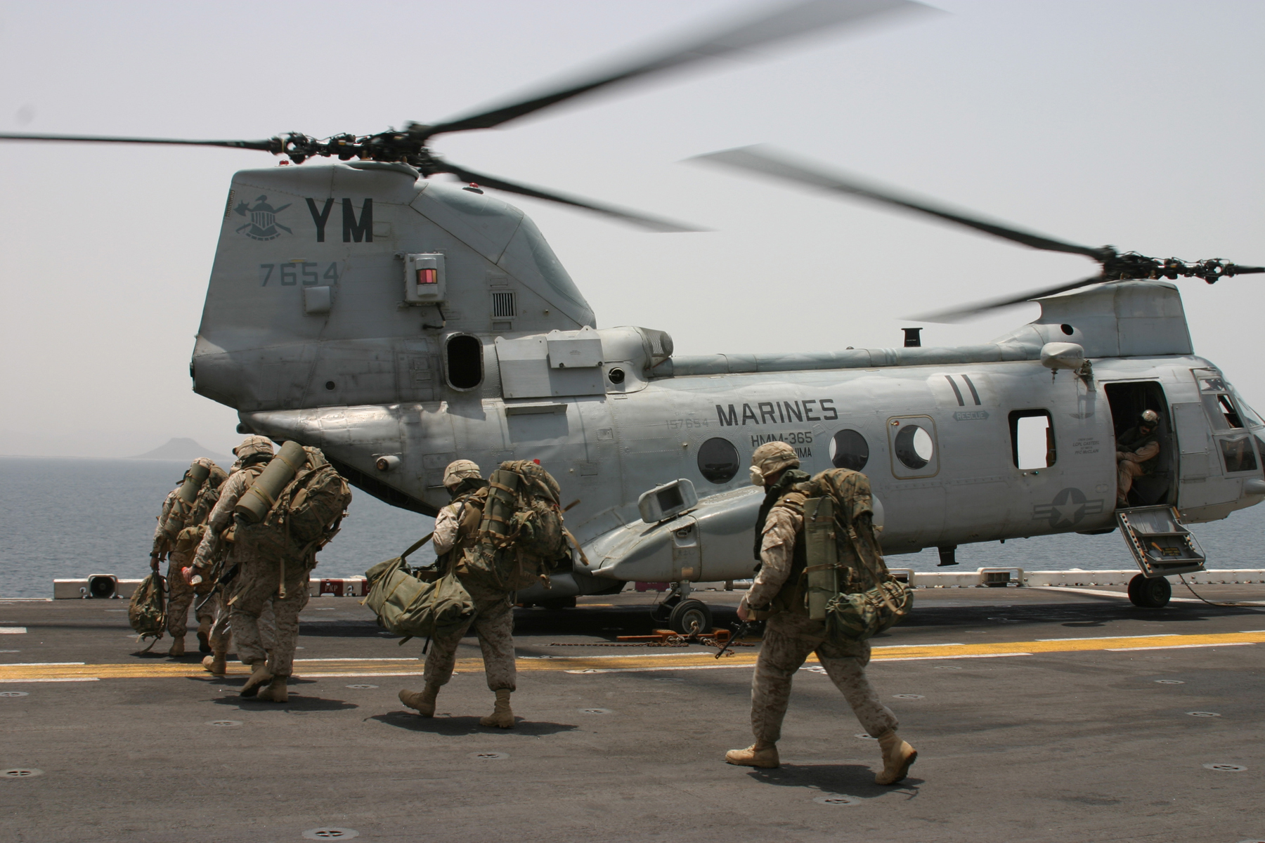

Slide 14
2 Kings 18:1
Now it came to pass in the third year of Hoshea son of Elah king of Israel, that Hezekiah the son of Ahaz king of Judah began to reign.

Slide 15
2 Kings 18:2
Twenty and five years old was he when he began to reign; and he reigned twenty and nine years in Jerusalem. His mother's name also was Abi, the daughter of Zachariah.

Slide 16
2 Kings 18:3
And he did that which was right in the sight of the LORD, according to all that David his father did.

Slide 17
2 Kings 18:4a
He removed the high places, and brake the images, and cut down the groves, and brake in pieces the brasen serpent that Moses had made:

Slide 18
2 Kings 18:4b
for unto those days the children of Israel did burn incense to it: and he called it Nehushtan.

Slide 19
2 Kings 18:5
He trusted in the LORD God of Israel; so that after him was none like him among all the kings of Judah, nor any that were before him.

Slide 20
2 Kings 18:6
For he clave to the LORD, and departed not from following him, but kept his commandments, which the LORD commanded Moses.

Slide 21
Psalm 63:8
My soul followeth hard after thee: thy right hand upholdeth me.

Slide 22
2 Kings 18:7
And the LORD was with him; and he prospered whithersoever he went forth: and he rebelled against the king of Assyria, and served him not.

Slide 23
2 Kings 18:8
He smote the Philistines, even unto Gaza, and the borders thereof, from the tower of the watchmen to the fenced city.

Slide 24
Romans 1:16
For I am not ashamed of the gospel of Christ: for it is the power of God unto salvation to every one that believeth; to the Jew first, and also to the Greek.

Slide 25
Romans 1:17
For therein is the righteousness of God revealed from faith to faith: as it is written, The just shall live by faith.

Slide 26
Colossians 4:2
Continue in prayer, and watch in the same with thanksgiving;

Slide 27
Colossians 4:3
Withal praying also for us, that God would open unto us a door of utterance, to speak the mystery of Christ, for which I am also in bonds:

Slide 28
Colossians 4:4
That I may make it manifest, as I ought to speak.

Slide 29
Ephesians 2:19
Now, therefore, you are no longer strangers and foreigners, but fellow citizens with the saints and members of the household of God,

Slide 30
2 Timothy 4:1
I charge you therefore before God and the Lord Jesus Christ, who will judge the living and the dead at His appearing and His kingdom:

Slide 31
2 Timothy 4:2
Preach the word! Be ready in season and out of season. Convince, rebuke, exhort, with all longsuffering and teaching.

Slide 32
2 Timothy 4:3
For the time will come when they will not endure sound doctrine, but according to their own desires, because they have itching ears, they will heap up for themselves teachers;

Slide 33
2 Timothy 4:4
and they will turn their ears away from the truth, and be turned aside to fables.

Slide 34
2 Timothy 4:5
But you be watchful in all things, endure afflictions, do the work of an evangelist, fulfill your ministry.

Slide 35


