Slide 1
Standing on Solid Ground: The Resurrection of Jesus Christ!
1 Corinthians 15:1-9, 12-17
Resurrection Sunday, 2014

Slide 2
1 Corinthians 15:1
Moreover, brethren, I declare to you the gospel which I preached to you, which also you received and in which you stand,

Slide 3
1 Corinthians 15:2
by which also you are saved, if you hold fast that word which I preached to you—unless you believed in vain.

Slide 4
1 Corinthians 15:3
For I delivered to you first of all that which I also received: that Christ died for our sins according to the Scriptures,

Slide 5
1 Corinthians 15:4
and that He was buried, and that He rose again the third day according to the Scriptures,

Slide 6
1 Corinthians 15:5
and that He was seen by Cephas, then by the twelve.

Slide 7
1 Corinthians 15:6
After that He was seen by over five hundred brethren at once, of whom the greater part remain to the present, but some have fallen asleep.

Slide 8
1 Corinthians 15:7
After that He was seen by James, then by all the apostles.

Slide 9
1 Corinthians 15:8
Then last of all He was seen by me also, as by one born out of due time.

Slide 10
1 Corinthians 15:9
For I am the least of the apostles, who am not worthy to be called an apostle, because I persecuted the church of God.

Slide 11
1 Corinthians 15:12
Now if Christ is preached that He has been raised from the dead, how do some among you say that there is no resurrection of the dead?

Slide 12
1 Corinthians 15:13
But if there is no resurrection of the dead, then Christ is not risen.

Slide 13
1 Corinthians 15:14
And if Christ is not risen, then our preaching is empty and your faith is also empty.

Slide 14
1 Corinthians 15:15
Yes, and we are found false witnesses of God, because we have testified of God that He raised up Christ, whom He did not raise up—if in fact the dead do not rise.

Slide 15
1 Corinthians 15:16
For if the dead do not rise, then Christ is not risen.

Slide 16
1 Corinthians 15:17
And if Christ is not risen, your faith is futile; you are still in your sins!

Slide 18
1 Corinthians 15:17
And if Christ is not risen, your faith is futile (worthless); you are still in your sins!

Slide 19
Acts 1:1
The former account I made, O Theophilus, of all that Jesus began both to do and teach,

Slide 20
Acts 1:2
until the day in which He was taken up, after He through the Holy Spirit had given commandments to the apostles whom He had chosen,

Slide 21
Acts 1:3a
to whom He also presented Himself alive after His suffering by many infallible proofs,

Slide 22
Acts 1:3b
being seen by them during forty days and speaking of the things pertaining to the kingdom of God.

Slide 23
The Empty Tomb

Slide 24
John 19:38a
After this, Joseph of Arimathea, being a disciple of Jesus, but secretly, for fear of the Jews, asked Pilate that he might take away the body of Jesus;

Slide 25
John 19:38b
and Pilate gave him permission. So he came and took the body of Jesus.

Slide 26
John 19:39
And Nicodemus, who at first came to Jesus by night, also came, bringing a mixture of myrrh and aloes, about a hundred pounds.

Slide 27
John 39:40
Then they took the body of Jesus, and bound it in strips of linen with the spices, as the custom of the Jews is to bury.

Slide 28
John 39:41
Now in the place where He was crucified there was a garden, and in the garden a new tomb in which no one had yet been laid.

Slide 29
John 39:42
So there they laid Jesus, because of the Jews' Preparation Day, for the tomb was nearby.

Slide 30
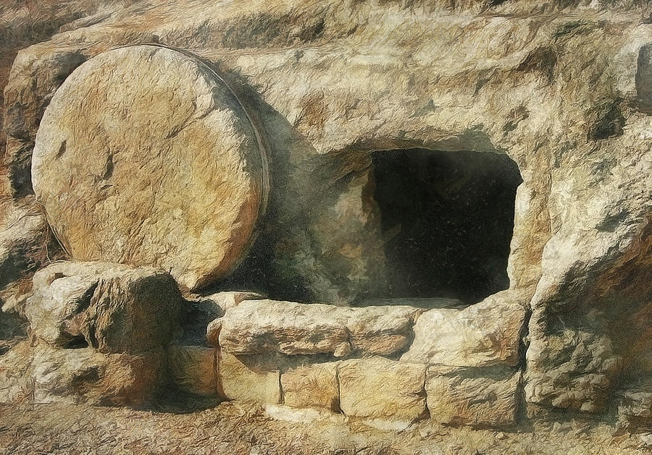

Slide 31
Mark 10:33
Behold, we are going up to Jerusalem, and the Son of Man will be betrayed to the chief priests and to the scribes; and they will condemn Him to death and deliver Him to the Gentiles;

Slide 32
Mark 10:34
and they will mock Him, and scourge Him, and spit on Him, and kill Him. And the third day He will rise again.

Slide 33
Multiple Witnesses

Slide 34
1 Corinthians 15:5
and that He was seen by Cephas, then by the twelve.

Slide 35
1 Corinthians 15:6
After that He was seen by over five hundred brethren at once, of whom the greater part remain to the present, but some have fallen asleep.

Slide 36
1 Corinthians 15:7
After that He was seen by James, then by all the apostles.

Slide 37
1 Corinthians 15:8
Then last of all He was seen by me also, as by one born out of due time.

Slide 38
Acts 1:3a
to whom He also presented Himself alive after His suffering by many infallible proofs,

Slide 39
Acts 1:3b
being seen by them during forty days and speaking of the things pertaining to the kingdom of God.

Slide 40
Acts 2:32
This Jesus God has raised up, of which we are all witnesses.

Slide 41
2 Peter 1:16
For we did not follow cunningly devised fables when we made known to you the power and coming of our Lord Jesus Christ, but were eyewitnesses of His majesty.

Slide 42
Changed Lives!

Slide 43
John 20:19a
Then, the same day at evening, being the first day of the week, when the doors were shut where the disciples were assembled, for fear of the Jews,

Slide 44
John 20:19b
Jesus came and stood in the midst, and said to them, "Peace be with you."

Slide 45
John 20:20
When He had said this, He showed them His hands and His side. Then the disciples were glad when they saw the Lord.

Slide 46
John 14:1
Let not your heart be troubled; you believe in God, believe also in Me.

Slide 47
John 14:2
In My Father's house are many mansions; if it were not so, I would have told you. I go to prepare a place for you.

Slide 48
John 14:3
And if I go and prepare a place for you, I will come again and receive you to Myself; that where I am, there you may be also.

Slide 49
1 Thessalonians 4:16
For the Lord Himself will descend from heaven with a shout, with the voice of an archangel, and with the trumpet of God. And the dead in Christ will rise first.

Slide 50
1 Thessalonians 4:17
Then we who are alive and remain shall be caught up together with them in the clouds to meet the Lord in the air. And thus we shall always be with the Lord.

Slide 51
1 Thessalonians 4:18
Therefore comfort one another with these words.

