Slide 1
Revelation 7:9-17
Wednesday, June 12, 2013
Calvary Chapel of El Paso
Pastor Charlie Flores

Slide 2
Revelation 7:9
After these things I looked, and behold, a great multitude which no one could number, of all nations, tribes, peoples, and tongues, standing before the throne and before the Lamb, clothed with white robes, with palm branches in their hands,

Slide 3
Revelation 7:10
and crying out with a loud voice, saying, "Salvation belongs to our God who sits on the throne, and to the Lamb!"

Slide 4
Revelation 7:11
All the angels stood around the throne and the elders and the four living creatures, and fell on their faces before the throne and worshiped God,

Slide 5
Revelation 7:12
saying: "Amen! Blessing and glory and wisdom, Thanksgiving and honor and power and might, Be to our God forever and ever. Amen."

Slide 6
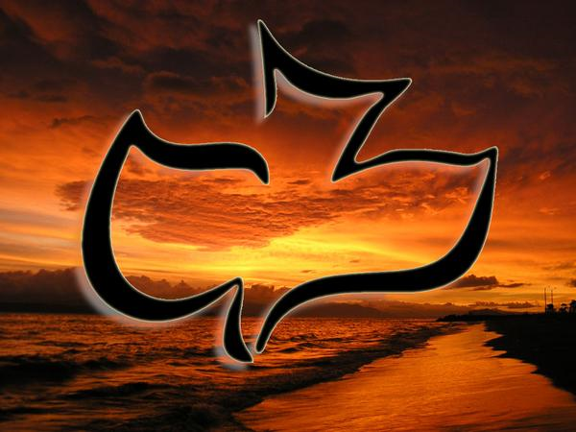

Slide 7
Revelation 7:4
And I heard the number of those who were sealed. One hundred and forty-four thousand of all the tribes of the children of Israel were sealed:

Slide 8
Revelation 7:5
of the tribe of Judah twelve thousand were sealed; of the tribe of Reuben twelve thousand were sealed; of the tribe of Gad twelve thousand were sealed;

Slide 9
Revelation 7:6
of the tribe of Asher twelve thousand were sealed; of the tribe of Naphtali twelve thousand were sealed; of the tribe of Manasseh twelve thousand were sealed;

Slide 10
Revelation 7:7
of the tribe of Simeon twelve thousand were sealed; of the tribe of Levi twelve thousand were sealed; of the tribe of Issachar twelve thousand were sealed;

Slide 11
Revelation 7:8
of the tribe of Zebulun twelve thousand were sealed; of the tribe of Joseph twelve thousand were sealed; of the tribe of Benjamin twelve thousand were sealed.

Slide 12
Judges 18:30
Then the children of Dan set up for themselves the carved image; and Jonathan the son of Gershom, the son of Manasseh, and his sons were priests to the tribe of Dan until the day of the captivity of the land.

Slide 13
Hosea 4:17
Ephraim is joined to idols, Let him alone.

Slide 14
Hosea 4:18
Their drink is rebellion, They commit harlotry continually. Her rulers dearly love dishonor.

Slide 15
Hosea 4:19
The wind has wrapped her up in its wings, And they shall be ashamed because of their sacrifices.

Slide 16
Deuteronomy 29:29
The secret things belong to the LORD our God, but those things which are revealed belong to us and to our children forever, that we may do all the words of this law.

Slide 17
Defying Satan’s Secular Dominion

Slide 18
Revelation 7:9
After these things I looked, and behold, a great multitude which no one could number, of all nations, tribes, peoples, and tongues, standing before the throne and before the Lamb, clothed with white robes, with palm branches in their hands,

Slide 19
Revelation 7:10
and crying out with a loud voice, saying, "Salvation belongs to our God who sits on the throne, and to the Lamb!"

Slide 20
Revelation 7:11
All the angels stood around the throne and the elders and the four living creatures, and fell on their faces before the throne and worshiped God,

Slide 21
Revelation 7:12
saying: "Amen! Blessing and glory and wisdom, Thanksgiving and honor and power and might, Be to our God forever and ever. Amen."

Slide 22
Denying Satan’s Spiritual Dominion

Slide 23
2 Timothy 2:19
Nevertheless the solid foundation of God stands, having this seal: "The Lord knows those who are His," and, "Let everyone who names the name of Christ depart from iniquity."

Slide 24
Isaiah 60:1
Arise, shine; For your light has come! And the glory of the LORD is risen upon you.

Slide 25
Isaiah 60:2
For behold, the darkness shall cover the earth, And deep darkness the people; But the LORD will arise over you, And His glory will be seen upon you.

Slide 26
Isaiah 60:3
The Gentiles shall come to your light, And kings to the brightness of your rising.

Slide 27
Psalm 122:1
I was glad when they said to me, "Let us go into the house of the LORD."

Slide 28
Hebrews 10:24
And let us consider one another in order to stir up love and good works,

Slide 29
Hebrews 10:25
not forsaking the assembling of ourselves together, as is the manner of some, but exhorting one another, and so much the more as you see the Day approaching.

Slide 30
Revelation 7:13
Then one of the elders answered, saying to me, "Who are these arrayed in white robes, and where did they come from?"

Slide 31
Revelation 7:14
And I said to him, "Sir, you know." So he said to me, "These are the ones who come out of the great tribulation, and washed their robes and made them white in the blood of the Lamb.

Slide 32
Revelation 7:15
Therefore they are before the throne of God, and serve Him day and night in His temple. And He who sits on the throne will dwell among them.

Slide 33
Revelation 7:16
They shall neither hunger anymore nor thirst anymore; the sun shall not strike them, nor any heat;

Slide 34
Revelation 7:17
for the Lamb who is in the midst of the throne will shepherd them and lead them to living fountains of waters. And God will wipe away every tear from their eyes."

Slide 35
John 1:14
And the Word became flesh and dwelt among us, and we beheld His glory, the glory as of the only begotten of the Father, full of grace and truth.

Slide 36
2 Chronicles 7:1
When Solomon had finished praying, fire came down from heaven and consumed the burnt offering and the sacrifices; and the glory of the LORD filled the temple.

Slide 37
2 Chronicles 7:2
And the priests could not enter the house of the LORD, because the glory of the LORD had filled the LORD'S house.

Slide 38
2 Chronicles 7:3
When all the children of Israel saw how the fire came down, and the glory of the LORD on the temple, they bowed their faces to the ground on the pavement, and worshiped and praised the LORD, saying: "For He is good, For His mercy endures forever."

Slide 39
Isaiah 25:8
He will swallow up death forever, And the Lord GOD will wipe away tears from all faces; The rebuke of His people He will take away from all the earth; For the LORD has spoken.

Slide 40
Revelation 21:4
And God will wipe away every tear from their eyes; there shall be no more death, nor sorrow, nor crying. There shall be no more pain, for the former things have passed away."

Slide 41
Revelation 6:9
When He opened the fifth seal, I saw under the altar the souls of those who had been slain for the word of God and for the testimony which they held.

Slide 42
Revelation 6:10
And they cried with a loud voice, saying, "How long, O Lord, holy and true, until You judge and avenge our blood on those who dwell on the earth?"

Slide 43
Revelation 6:11
Then a white robe was given to each of them; and it was said to them that they should rest a little while longer, until both the number of their fellow servants and their brethren, who would be killed as they were, was completed.

