Slide 1
Revelation 6:7-8
Wednesday, May 8, 2013
Calvary Chapel of El Paso
Pastor Charlie Flores

Slide 2
Revelation 6:1
Now I saw when the Lamb opened one of the seals; and I heard one of the four living creatures saying with a voice like thunder, "Come and see."

Slide 3
Revelation 6:2
And I looked, and behold, a white horse. He who sat on it had a bow; and a crown was given to him, and he went out conquering and to conquer.

Slide 4
Revelation 6:3
When He opened the second seal, I heard the second living creature saying, "Come and see."

Slide 5
Revelation 6:4
Another horse, fiery red, went out. And it was granted to the one who sat on it to take peace from the earth, and that people should kill one another; and there was given to him a great sword.

Slide 6
Revelation 6:5
When He opened the third seal, I heard the third living creature say, "Come and see." So I looked, and behold, a black horse, and he who sat on it had a pair of scales in his hand.

Slide 7
Revelation 6:6
And I heard a voice in the midst of the four living creatures saying, "A quart of wheat for a denarius, and three quarts of barley for a denarius; and do not harm the oil and the wine."

Slide 8
Revelation 6:7
When He opened the fourth seal, I heard the voice of the fourth living creature saying, "Come and see."

Slide 9
Revelation 6:8
So I looked, and behold, a pale horse. And the name of him who sat on it was Death, and Hades followed with him. And power was given to them over a fourth of the earth, to kill with sword, with hunger, with death, and by the beasts of the earth.

Slide 10
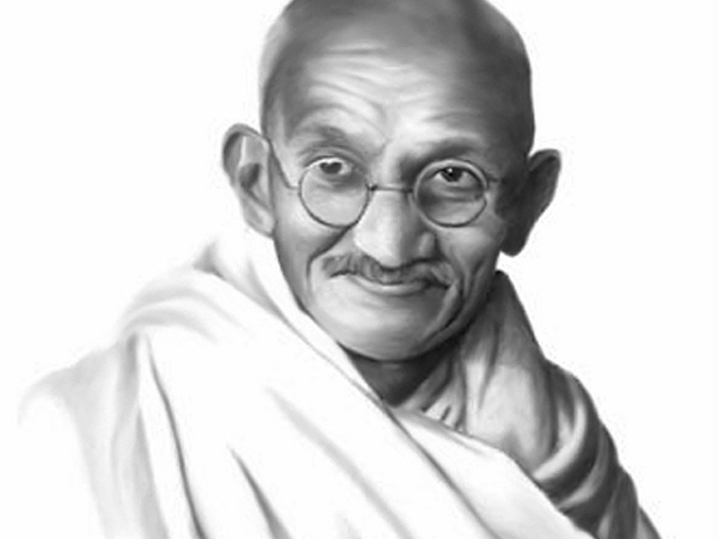

Slide 11
Gandhi, 15 years before death:
I must tell you in all humility that Hinduism, as I know it, entirely satisfies my soul, fills my whole being, and I find solace in the Bhagavad and Upanishads that I miss even in the Sermon on the Mount.”

Slide 12
Gandhi, just before death:
My days are numbered. I am not likely to live very long—perhaps a year or a little more. For the first time in fifty years I find myself in the slough of despond (the hopelessness of depression and dejection). All about me is darkness. I am praying for light.”

Slide 13
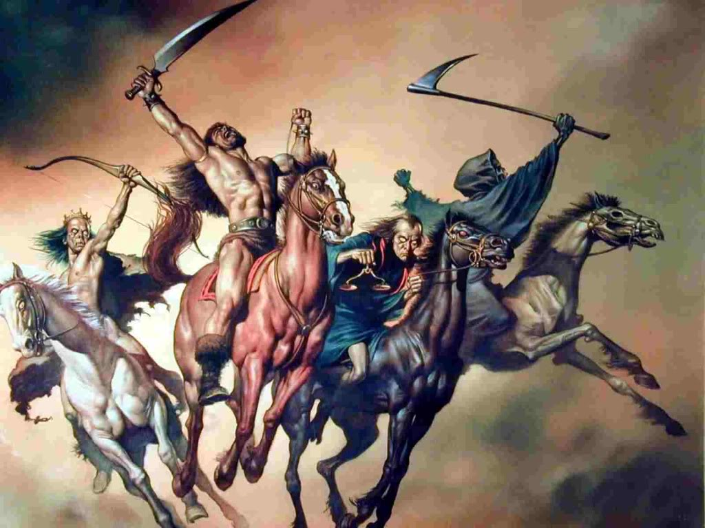

Slide 14
1 Thessalonians 5:3
For when they say, "Peace and safety!" then sudden destruction comes upon them, as labor pains upon a pregnant woman. And they shall not escape.

Slide 16
Revelation 6:7
When He opened the fourth seal, I heard the voice of the fourth living creature saying, "Come and see."

Slide 17
Revelation 6:8
So I looked, and behold, a pale horse. And the name of him who sat on it was Death, and Hades followed with him. And power was given to them over a fourth of the earth, to kill with sword, with hunger, with death, and by the beasts of the earth.

Slide 18
Ezekiel 14:21
For thus says the Lord GOD: "How much more it shall be when I send My four severe judgments on Jerusalem—the sword and famine and wild beasts and pestilence—to cut off man and beast from it?

Slide 19
Weapons of Mass Destruction:
Biological
Chemical
Nuclear
Radiological

Slide 20
Revelation 6:8
So I looked, and behold, a pale horse. And the name of him who sat on it was Death, and Hades followed with him. And power was given to them over a fourth of the earth, to kill with sword, with hunger, with death, and by the beasts of the earth.

Slide 21
Hebrews 2:14
Inasmuch then as the children have partaken of flesh and blood, He Himself likewise shared in the same, that through death He might destroy him who had the power of death, that is, the devil,

Slide 22
Revelation 1:18
I am He who lives, and was dead, and behold, I am alive forevermore. Amen. And I have the keys of Hades and of Death.

Slide 23
Revelation 20:13
The sea gave up the dead who were in it, and Death and Hades delivered up the dead who were in them. And they were judged, each one according to his works.

Slide 24
Revelation 20:14
Then Death and Hades were cast into the lake of fire. This is the second death.

Slide 25
Revelation 20:15
And anyone not found written in the Book of Life was cast into the lake of fire.

Slide 26
John 8:44
You are of your father the devil, and the desires of your father you want to do. He was a murderer from the beginning, and does not stand in the truth, because there is no truth in him. When he speaks a lie, he speaks from his own resources, for he is a liar and the father of it.

Slide 27
Ephesians 6:17
And take the helmet of salvation, and the sword of the Spirit, which is the word of God;

Slide 28
2 Thessalonians 2:9
The coming of the lawless one is according to the working of Satan, with all power, signs, and lying wonders,

Slide 29
2 Thessalonians 2:10
and with all unrighteous deception among those who perish, because they did not receive the love of the truth, that they might be saved.

Slide 30
2 Thessalonians 2:11
And for this reason God will send them strong delusion, that they should believe the lie,

Slide 31
2 Thessalonians 2:12
that they all may be condemned who did not believe the truth but had pleasure in unrighteousness.

Slide 32
Matthew 24:4
And Jesus answered and said to them: "Take heed that no one deceives you.

Slide 33
Matthew 24:5
For many will come in My name, saying, 'I am the Christ,' and will deceive many.

Slide 34
Matthew 24:6
And you will hear of wars and rumors of wars. See that you are not troubled; for all these things must come to pass, but the end is not yet.

Slide 35
Matthew 24:7
For nation will rise against nation, and kingdom against kingdom. And there will be famines, pestilences, and earthquakes in various places.

Slide 36
Matthew 24:8
All these are the beginning of sorrows.

Slide 37
Luke 21:34
"But take heed to yourselves, lest your hearts be weighed down with carousing, drunkenness, and cares of this life, and that Day come on you unexpectedly.

Slide 38
Luke 21:35
For it will come as a snare on all those who dwell on the face of the whole earth.

Slide 39
Luke 21:36
Watch therefore, and pray always that you may be counted worthy to escape all these things that will come to pass, and to stand before the Son of Man."

