Slide 1
Revelation 6:3-4
Wednesday, April 24, 2013
Calvary Chapel of El Paso
Pastor Charlie Flores

Slide 2
Revelation 6:1
Now I saw when the Lamb opened one of the seals; and I heard one of the four living creatures saying with a voice like thunder, "Come and see."

Slide 3
Revelation 6:2
And I looked, and behold, a white horse. He who sat on it had a bow; and a crown was given to him, and he went out conquering and to conquer.

Slide 4
Revelation 6:3
When He opened the second seal, I heard the second living creature saying, "Come and see."

Slide 5
Revelation 6:4
Another horse, fiery red, went out. And it was granted to the one who sat on it to take peace from the earth, and that people should kill one another; and there was given to him a great sword.

Slide 6
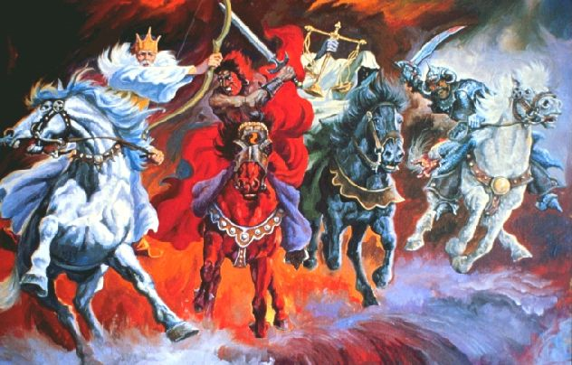

Slide 7
Isaiah 30:18
Therefore the LORD will wait, that He may be gracious to you; And therefore He will be exalted, that He may have mercy on you. For the LORD is a God of justice; Blessed are all those who wait for Him.

Slide 8
Philippians 2:9
Therefore God also has highly exalted Him and given Him the name which is above every name,

Slide 9
Philippians 2:10
that at the name of Jesus every knee should bow, of those in heaven, and of those on earth, and of those under the earth,

Slide 10
Philippians 2:11
and that every tongue should confess that Jesus Christ is Lord, to the glory of God the Father.

Slide 11
Here’s the Reality:
Some People Glorify God by Surrendering to Christ’s Payment for Their Sin. Others will Glorify God by Paying for Their Own Sin!

Slide 12
Peace On Their Own Terms
Salvation On Their Own Terms
Church On Their Own Terms
Christianity On Their Own Terms
Morality On Their Own Terms

Slide 13
Secular Humanism
Evolution: there is no real evidence that God exists

Slide 14
Situation Ethics: man is the final authority; there are no absolute rules

Slide 15
Moral Freedom: everyone, including children, should be exposed to all realistic viewpoints (including the moral and perverse) as acceptable methods of self-expression

Slide 16
Self-sufficiency: man is not accountable to any higher power; responsible only to himself

Slide 17
Sexual Permissiveness: any form acceptable

Slide 18
Anti-religious Bias: religion is harmful, meaningless, irrelevant

Slide 19
Socialism: government ownership or control

Slide 20
One World Government

Slide 21
Death Education: no life beyond the grave; euthanasia acceptable

Slide 22
Human Destiny: man takes charge of his own future and has the power within himself to achieve the world of his dreams

Slide 23
Romans 3:15-18
¹⁵"Their feet are swift to shed blood; ¹⁶Destruction and misery are in their ways; ¹⁷And the way of peace they have not known." ¹⁸"There is no fear of God before their eyes."

Slide 24
1 Thessalonians 5:1
But concerning the times and the seasons, brethren, you have no need that I should write to you.

Slide 25
1 Thessalonians 5:2
For you yourselves know perfectly that the day of the Lord so comes as a thief in the night.

Slide 26
1 Thessalonians 5:3
For when they say, "Peace and safety!" then sudden destruction comes upon them, as labor pains upon a pregnant woman. And they shall not escape.

Slide 27
Revelation 6:3
When He opened the second seal, I heard the second living creature saying, "Come and see."

Slide 28
Revelation 6:4
Another horse, fiery red, went out. And it was granted to the one who sat on it to take peace from the earth, and that people should kill one another; and there was given to him a great sword.

Slide 29
Revelation 12:3
And another sign appeared in heaven: behold, a great, fiery red dragon having seven heads and ten horns, and seven diadems on his heads.

Slide 30
Revelation 12:9
So the great dragon was cast out, that serpent of old, called the Devil and Satan, who deceives the whole world; he was cast to the earth, and his angels were cast out with him.

Slide 31
John 8:44
You are of your father the devil, and the desires of your father you want to do. He was a murderer from the beginning, and does not stand in the truth, because there is no truth in him. When he speaks a lie, he speaks from his own resources, for he is a liar and the father of it.

Slide 32
2 Thessalonians 2:7
For the mystery of lawlessness is already at work; only He who now restrains will do so until He is taken out of the way.

Slide 33
Matthew 24:6
And you will hear of wars and rumors of wars. See that you are not troubled; for all these things must come to pass, but the end is not yet.

Slide 34
Matthew 24:7
For nation will rise against nation, and kingdom against kingdom. And there will be famines, pestilences, and earthquakes in various places.

Slide 35
Ezekiel 38:21
I will call for a sword against Gog throughout all My mountains," says the Lord GOD. "Every man's sword will be against his brother.

Slide 36
Matthew 24:21
For then there will be great tribulation, such as has not been since the beginning of the world until this time, no, nor ever shall be.

Slide 37
Matthew 24:22
And unless those days were shortened, no flesh would be saved; but for the elect's sake those days will be shortened.

Slide 38
Jeremiah 30:7
Alas! For that day is great, So that none is like it; And it is the time of Jacob's trouble, But he shall be saved out of it.

Slide 39
Jeremiah 17:9
"The heart is deceitful above all things, And desperately wicked; Who can know it?

Slide 40
John 16:33
These things I have spoken to you, that in Me you may have peace. In the world you will have tribulation; but be of good cheer, I have overcome the world."

Slide 41
Psalm 61:1
Hear my cry, O God; Attend to my prayer.

Slide 42
Psalm 61:2
From the end of the earth I will cry to You, When my heart is overwhelmed; Lead me to the rock that is higher than I.

Slide 43
Psalm 61:3
For You have been a shelter for me, A strong tower from the enemy.

Slide 44
Psalm 61:4
I will abide in Your tabernacle forever; I will trust in the shelter of Your wings.

