Slide 1
Revelation 6:1-2
Wednesday, April 17, 2013
Calvary Chapel of El Paso
Pastor Charlie Flores

Slide 2
Revelation 6:1
Now I saw when the Lamb opened one of the seals; and I heard one of the four living creatures saying with a voice like thunder, "Come and see."

Slide 3
Revelation 6:2
And I looked, and behold, a white horse. He who sat on it had a bow; and a crown was given to him, and he went out conquering and to conquer.

Slide 4
Revelation 6:3
When He opened the second seal, I heard the second living creature saying, "Come and see."

Slide 5
Revelation 6:4
Another horse, fiery red, went out. And it was granted to the one who sat on it to take peace from the earth, and that people should kill one another; and there was given to him a great sword.

Slide 6
Revelation 6:5
When He opened the third seal, I heard the third living creature say, "Come and see." So I looked, and behold, a black horse, and he who sat on it had a pair of scales in his hand.

Slide 7
Revelation 6:6
And I heard a voice in the midst of the four living creatures saying, "A quart of wheat for a denarius, and three quarts of barley for a denarius; and do not harm the oil and the wine."

Slide 8
Revelation 6:7
When He opened the fourth seal, I heard the voice of the fourth living creature saying, "Come and see."

Slide 9
Revelation 6:8
So I looked, and behold, a pale horse. And the name of him who sat on it was Death, and Hades followed with him. And power was given to them over a fourth of the earth, to kill with sword, with hunger, with death, and by the beasts of the earth.

Slide 10
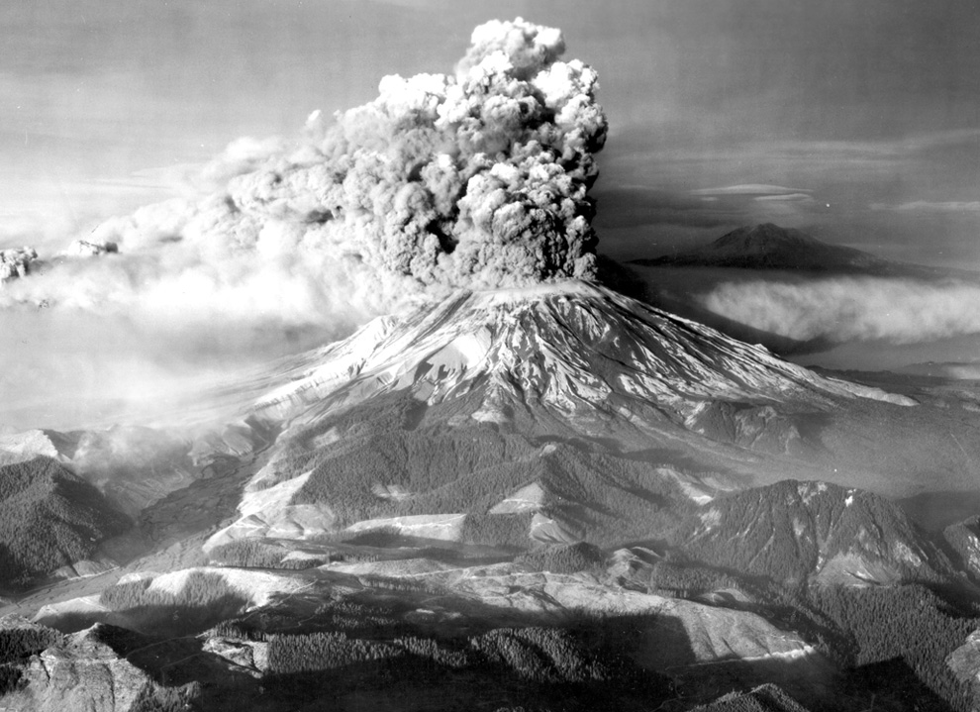

Slide 11
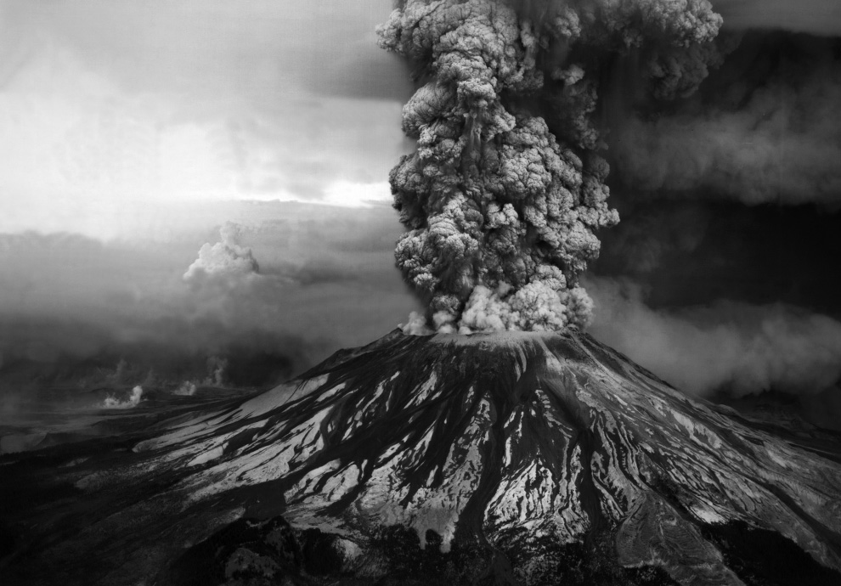

Slide 12
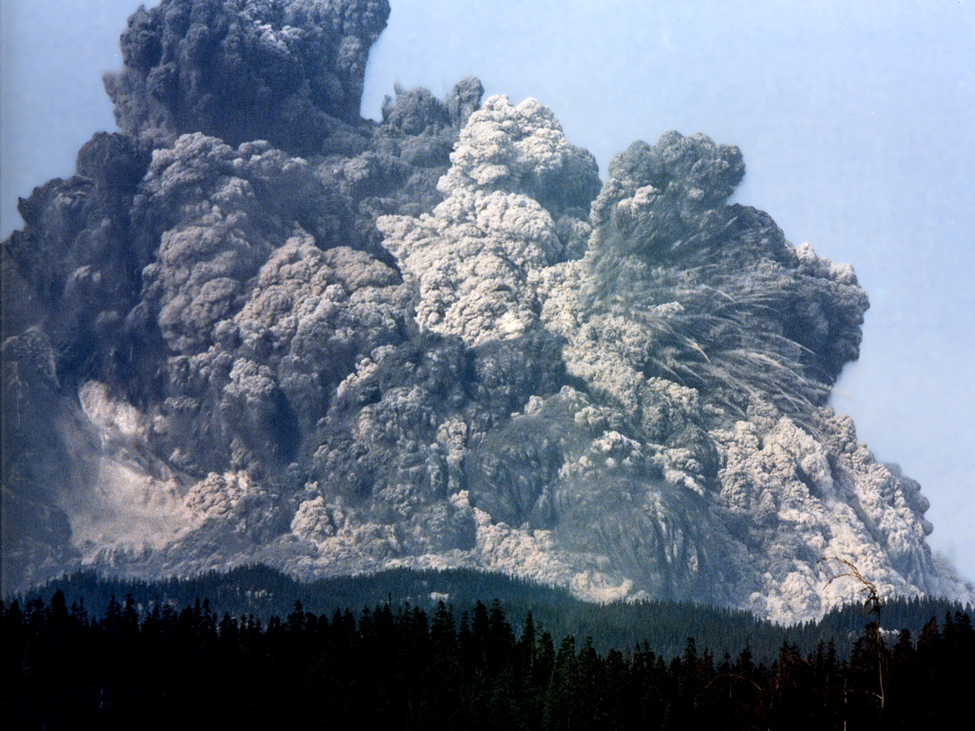

Slide 13
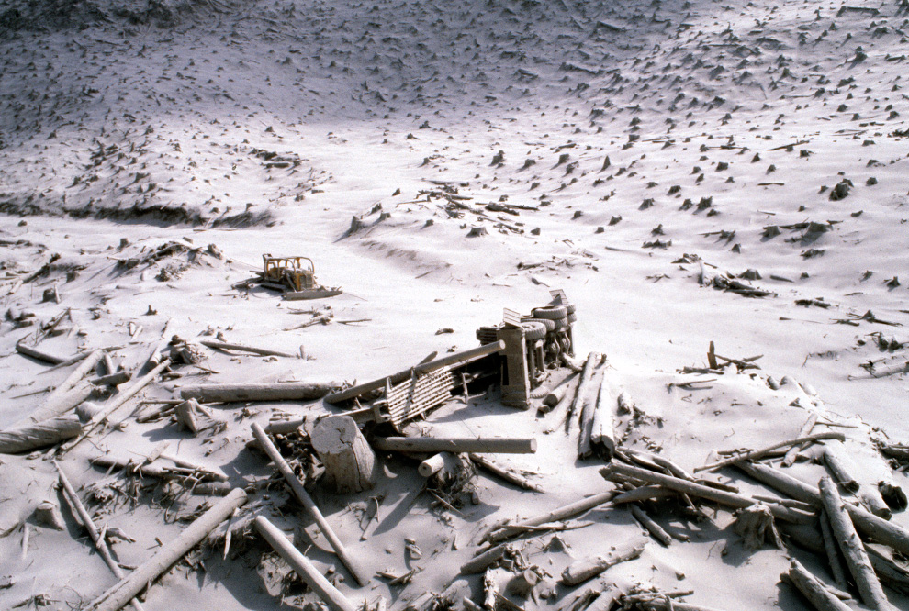

Slide 14
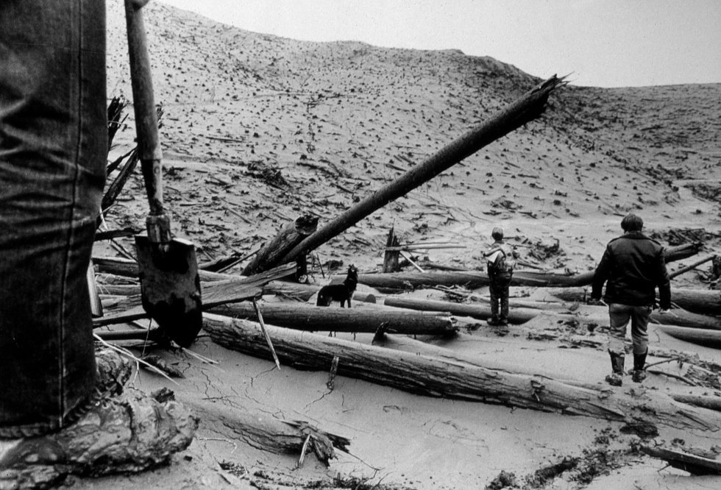

Slide 15
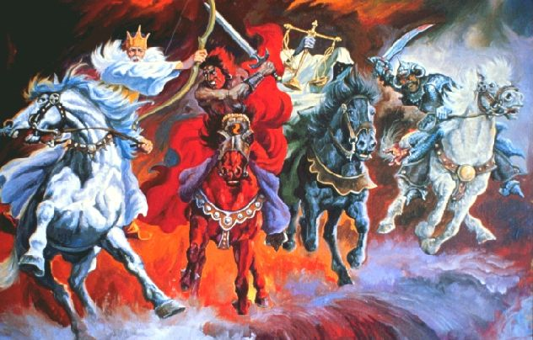

Slide 16
Zephaniah 1:14-18

Slide 17
The Day of the Lord
God’s Wrath Poured Out upon the Inhabitants of the Earth because:
Of Their Sin
Of Their Rejection of Messiah, Jesus

Slide 18
Isaiah 64:6
But we are all like an unclean thing, And all our righteousnesses are like filthy rags; We all fade as a leaf, And our iniquities, like the wind, Have taken us away.

Slide 19
Luke 21:34-36

Slide 20
Luke 21:36
Watch therefore, and pray always that you may be counted worthy to escape all these things that will come to pass, and to stand before the Son of Man."

Slide 21
The First Seal
The White Horse: False Peace

Slide 22
Revelation 6:1
Now I saw when the Lamb opened one of the seals; and I heard one of the four living creatures saying with a voice like thunder, "Come and see."

Slide 23
Revelation 6:2
And I looked, and behold, a white horse. He who sat on it had a bow; and a crown was given to him, and he went out conquering and to conquer.

Slide 24
Three Series of Judgments
Seal Judgments: World Ruined by Man
Trumpet Judgments: World Ruled by Satan
Bowl Judgments: World Rescued by God

Slide 25
Revelation 19:11-13

Slide 26
2 Corinthians 11:13-15

Slide 27
Daniel 9:26-27
²⁶ "And after the sixty-two weeks Messiah shall be cut off, but not for Himself; And the people of the prince who is to come Shall destroy the city and the sanctuary. The end of it shall be with a flood, And till the end of the war desolations are determined. ²⁷ Then he shall confirm a covenant with many for one week; But in the middle of the week He shall bring an end to sacrifice and offering. And on the wing of abominations shall be one who makes desolate, Even until the consummation, which is determined, Is poured out on the desolate."

Slide 28
John 5:43
I have come in My Father's name, and you do not receive Me; if another comes in his own name, him you will receive.

Slide 29
2 Thessalonians 2:3-4
³ Let no one deceive you by any means; for that Day will not come unless the falling away comes first, and the man of sin is revealed, the son of perdition, ⁴ who opposes and exalts himself above all that is called God or that is worshiped, so that he sits as God in the temple of God, showing himself that he is God.

Slide 30
2 Thessalonians 2:9-12

Slide 31
“What we learn from history is that we learn nothing from history!”

Slide 32
1 Thessalonians 5:1-11

Slide 33
John 16:33
These things I have spoken to you, that in Me you may have peace. In the world you will have tribulation; but be of good cheer, I have overcome the world."

