Slide 1
Revelation 5:8-14
Wednesday, April 10, 2013
Calvary Chapel of El Paso

Slide 2
Revelation 5:8
Now when He had taken the scroll, the four living creatures and the twenty-four elders fell down before the Lamb, each having a harp, and golden bowls full of incense, which are the prayers of the saints.

Slide 3
Revelation 5:9
And they sang a new song, saying: "You are worthy to take the scroll, And to open its seals; For You were slain, And have redeemed us to God by Your blood Out of every tribe and tongue and people and nation,

Slide 4
Revelation 5:10
And have made us kings and priests to our God; And we shall reign on the earth."

Slide 5
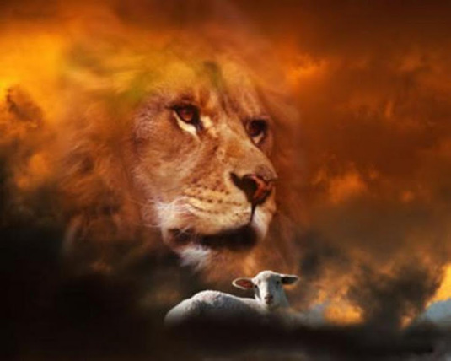

Slide 6
“Who is worthy to open the scroll and loose the seals?”

Slide 7
Revelation 5:6
And I looked, and behold, in the midst of the throne and of the four living creatures, and in the midst of the elders, stood a Lamb as though it had been slain, having seven horns and seven eyes, which are the seven Spirits of God sent out into all the earth.

Slide 8
The Lamb’s Perfection
Perfect Power: Omnipotence
Perfect Wisdom: Omniscience
Perfect Presence: Omnipresence

Slide 9
Revelation 5:8
Now when He had taken the scroll, the four living creatures and the twenty-four elders fell down before the Lamb, each having a harp, and golden bowls full of incense, which are the prayers of the saints.

Slide 10
Daniel 7:13-14
¹³ "I was watching in the night visions, And behold, One like the Son of Man, Coming with the clouds of heaven! He came to the Ancient of Days, And they brought Him near before Him. ¹⁴ Then to Him was given dominion and glory and a kingdom, That all peoples, nations, and languages should serve Him. His dominion is an everlasting dominion, Which shall not pass away, And His kingdom the one Which shall not be destroyed.

Slide 11
Psalm 141:2
Let my prayer be set before You as incense, The lifting up of my hands as the evening sacrifice.

Slide 12
Revelation 5:9
And they sang a new song, saying: "You are worthy to take the scroll, And to open its seals; For You were slain, And have redeemed us to God by Your blood Out of every tribe and tongue and people and nation,

Slide 13
“For You were slain, and have redeemed us to God by Your blood out of every tribe and tongue and people and nation!”

Slide 14
Galatians 2:20
I have been crucified with Christ; it is no longer I who live, but Christ lives in me; and the life which I now live in the flesh I live by faith in the Son of God, who loved me and gave Himself for me.

Slide 15
Exodus 12:3
Speak to all the congregation of Israel, saying: 'On the tenth day of this month every man shall take for himself a lamb, according to the house of his father, a lamb for a household.

Slide 16
Isaiah 53:8
He was taken from prison and from judgment, And who will declare His generation? For He was cut off from the land of the living; For the transgressions of My people He was stricken.

Slide 17
John 1:29
The next day John saw Jesus coming toward him, and said, "Behold! The Lamb of God who takes away the sin of the world!

Slide 18
Revelation 5:10
And have made us kings and priests to our God; And we shall reign on the earth."

Slide 19
Revelation 20:6
Blessed and holy is he who has part in the first resurrection. Over such the second death has no power, but they shall be priests of God and of Christ, and shall reign with Him a thousand years.

Slide 20
Revelation 5:11-14

Slide 21
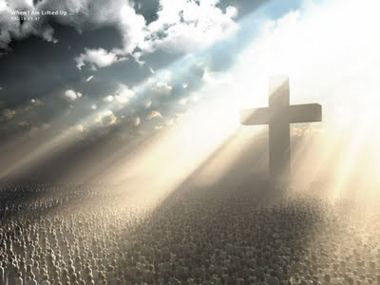

Slide 22
Revelation 5:11-12
¹¹ Then I looked, and I heard the voice of many angels around the throne, the living creatures, and the elders; and the number of them was ten thousand times ten thousand, and thousands of thousands, ¹² saying with a loud voice: "Worthy is the Lamb who was slain To receive power and riches and wisdom, And strength and honor and glory and blessing!"

Slide 23
Power—in heaven all men and angels yield to His authority!

Slide 24
Hebrews 1:3
who being the brightness of His glory and the express image of His person, and upholding all things by the word of His power, when He had by Himself purged our sins, sat down at the right hand of the Majesty on high,

Slide 25
Riches—in heaven all men and angels will lay their resources at His feet!

Slide 26
2 Corinthians 8:9
For you know the grace of our Lord Jesus Christ, that though He was rich, yet for your sakes He became poor, that you through His poverty might become rich.

Slide 27
Wisdom—in heaven all wisdom is attributed to Him!

Slide 28
1 Corinthians 1:30
But of Him you are in Christ Jesus, who became for us wisdom from God—and righteousness and sanctification and redemption—

Slide 29
Strength—in heaven all men and angels acknowledge Him as the source of their strength!

Slide 30
Psalm 24:8
Who is this King of glory? The LORD strong and mighty, The LORD mighty in battle.

Slide 31
Honor—in heaven all men and angels honor Him!

Slide 32
Psalm 104:1
Bless the LORD, O my soul! O LORD my God, You are very great: You are clothed with honor and majesty,

Slide 33
Glory—in heaven all men and angels think more highly of Him than they do of themselves or each other!

Slide 34
John 1:14
And the Word became flesh and dwelt among us, and we beheld His glory, the glory as of the only begotten of the Father, full of grace and truth.

Slide 35
Blessing—in heaven men and angels do this!

Slide 36
Psalm 103:1-2
Bless the LORD, O my soul; And all that is within me, bless His holy name! ² Bless the LORD, O my soul, And forget not all His benefits:

Slide 37
Revelation 5:13-14
¹³ And every creature which is in heaven and on the earth and under the earth and such as are in the sea, and all that are in them, I heard saying: "Blessing and honor and glory and power Be to Him who sits on the throne, And to the Lamb, forever and ever!" ¹⁴ Then the four living creatures said, "Amen!" And the twenty-four elders fell down and worshiped Him who lives forever and ever.

