Slide 1
Revelation 5:1-7
Wednesday, April 3, 2013
Calvary Chapel of El Paso

Slide 2
Revelation 5:1
And I saw in the right hand of Him who sat on the throne a scroll written inside and on the back, sealed with seven seals.

Slide 3
Revelation 5:2
Then I saw a strong angel proclaiming with a loud voice, "Who is worthy to open the scroll and to loose its seals?"

Slide 4
Revelation 5:3
And no one in heaven or on the earth or under the earth was able to open the scroll, or to look at it.

Slide 5
Revelation 5:4
So I wept much, because no one was found worthy to open and read the scroll, or to look at it.

Slide 6
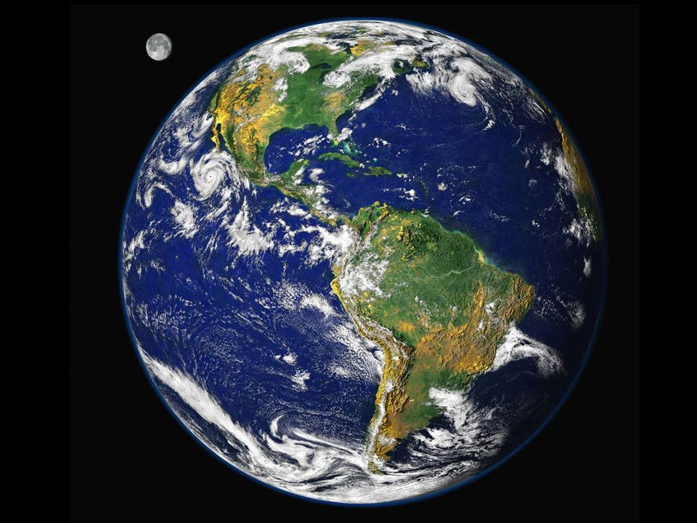

Slide 7
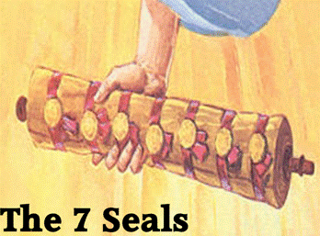

Slide 8
“Redemption Clause”
Leviticus 25:23-46
The Book of Ruth
Jeremiah 32:6-15

Slide 9
Leviticus 25:25
'If one of your brethren becomes poor, and has sold some of his possession, and if his redeeming relative comes to redeem it, then he may redeem what his brother sold.

Slide 10
go’el—
Kinsman/Redeemer

Slide 11
Ruth 4:1
Now Boaz went up to the gate and sat down there; and behold, the close relative of whom Boaz had spoken came by. So Boaz said, "Come aside, friend, sit down here." So he came aside and sat down.

Slide 12
Ruth 4:2
And he took ten men of the elders of the city, and said, "Sit down here." So they sat down.

Slide 13
Ruth 4:3
Then he said to the close relative, "Naomi, who has come back from the country of Moab, sold the piece of land which belonged to our brother Elimelech.

Slide 14
Ruth 4:4
And I thought to inform you, saying, 'Buy it back in the presence of the inhabitants and the elders of my people. If you will redeem it, redeem it; but if you will not redeem it, then tell me, that I may know; for there is no one but you to redeem it, and I am next after you.' "And he said, "I will redeem it."

Slide 15
Jeremiah 32:10-12
¹⁰ And I signed the deed and sealed it, took witnesses, and weighed the money on the scales. ¹¹ So I took the purchase deed, both that which was sealed according to the law and custom, and that which was open; ¹² and I gave the purchase deed to Baruch the son of Neriah, son of Mahseiah, in the presence of Hanamel my uncle's son, and in the presence of the witnesses who signed the purchase deed, before all the Jews who sat in the court of the prison.

Slide 16
Revelation 5:2-4
² Then I saw a strong angel proclaiming with a loud voice, "Who is worthy to open the scroll and to loose its seals?" ³ And no one in heaven or on the earth or under the earth was able to open the scroll, or to look at it. ⁴ So I wept much, because no one was found worthy to open and read the scroll, or to look at it.

Slide 17
God Gave Man the Earth for a Possession
Genesis 1:28 Then God blessed them, and God said to them, "Be fruitful and multiply; fill the earth and subdue it; have dominion over the fish of the sea, over the birds of the air, and over every living thing that moves on the earth."

Slide 18
Man Gave Dominion Over the Earth to Satan
Romans 5:12 Therefore, just as through one man sin entered the world, and death through sin, and thus death spread to all men, because all sinned—

Slide 19
Revelation 5:2
Then I saw a strong angel proclaiming with a loud voice, "Who is worthy to open the scroll and to loose its seals?"

Slide 20
Isaiah 29:11
The whole vision has become to you like the words of a book that is sealed, which men deliver to one who is literate, saying, "Read this, please." And he says, "I cannot, for it is sealed."

Slide 21
Hosea 4:6
My people are destroyed for lack of knowledge. Because you have rejected knowledge, I also will reject you from being priest for Me; Because you have forgotten the law of your God, I also will forget your children.

Slide 22
Revelation 5:5
But one of the elders said to me, "Do not weep. Behold, the Lion of the tribe of Judah, the Root of David, has prevailed to open the scroll and to loose its seven seals."

Slide 23
Revelation 5:6
And I looked, and behold, in the midst of the throne and of the four living creatures, and in the midst of the elders, stood a Lamb as though it had been slain, having seven horns and seven eyes, which are the seven Spirits of God sent out into all the earth.

Slide 24
Revelation 5:7
Then He came and took the scroll out of the right hand of Him who sat on the throne.

Slide 25
Lion of the Tribe of Judah
Genesis 49:9-10 ⁹ Judah is a lion's whelp; From the prey, my son, you have gone up. He bows down, he lies down as a lion; And as a lion, who shall rouse him? ¹⁰ The scepter shall not depart from Judah, Nor a lawgiver from between his feet, Until Shiloh comes; And to Him shall be the obedience of the people.

Slide 26
The Root of David
Matthew 22:42-45 ⁴² saying, "What do you think about the Christ? Whose Son is He?" They said to Him, "The Son of David." ⁴³ He said to them, "How then does David in the Spirit call Him 'Lord,' saying: ⁴⁴ 'The LORD said to my Lord, "Sit at My right hand, Till I make Your enemies Your footstool"'? ⁴⁵ "If David then calls Him 'Lord,' how is He his Son?"

Slide 27
The Wrath of the Lamb
Revelation 6:16 ¹⁶ and said to the mountains and rocks, "Fall on us and hide us from the face of Him who sits on the throne and from the wrath of the Lamb!

Slide 28
The Blood of the Lamb
Revelation 7:14 ¹⁴ And I said to him, "Sir, you know." So he said to me, "These are the ones who come out of the great tribulation, and washed their robes and made them white in the blood of the Lamb.

Slide 29
The Bride of the Lamb
Revelation 19:7 Let us be glad and rejoice and give Him glory, for the marriage of the Lamb has come, and His wife has made herself ready."

Slide 30
The Bride of the Lamb
Revelation 21:9 Then one of the seven angels who had the seven bowls filled with the seven last plagues came to me and talked with me, saying, "Come, I will show you the bride, the Lamb's wife."

Slide 31
Where is the Lamb?
Genesis 22:7 But Isaac spoke to Abraham his father and said, "My father!" And he said, "Here I am, my son." Then he said, "Look, the fire and the wood, but where is the lamb for a burnt offering?"

Slide 32
John 1:29
The next day John saw Jesus coming toward him, and said, "Behold! The Lamb of God who takes away the sin of the world!

Slide 33
Revelation 5:12 saying with a loud voice: "Worthy is the Lamb who was slain To receive power and riches and wisdom, And strength and honor and glory and blessing!"

