Slide 1
Revelation 4:4-11
Wednesday, March 20, 2013
Calvary Chapel of El Paso
Pastor Charlie Flores

Slide 2
Revelation 4:4
Around the throne were twenty-four thrones, and on the thrones I saw twenty-four elders sitting, clothed in white robes; and they had crowns of gold on their heads.

Slide 3
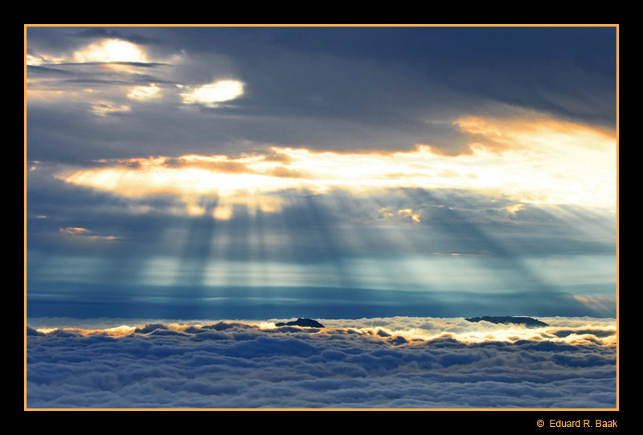

Slide 4
Luke 24:39
Behold My hands and My feet, that it is I Myself. Handle Me and see, for a spirit does not have flesh and bones as you see I have."

Slide 5
There IS a heaven and there is a throne, and John got to see them—
and HIM!

Slide 6
Revelation 5:9
And they sang a new song, saying: "You are worthy to take the scroll, And to open its seals; For You were slain, And have redeemed us to God by Your blood Out of every tribe and tongue and people and nation,

Slide 7
Revelation 21:12-14
¹² Also she had a great and high wall with twelve gates, and twelve angels at the gates, and names written on them, which are the names of the twelve tribes of the children of Israel: ¹³ three gates on the east, three gates on the north, three gates on the south, and three gates on the west. ¹⁴ Now the wall of the city had twelve foundations, and on them were the names of the twelve apostles of the Lamb.

Slide 8
Revelation 19:8
And to her it was granted to be arrayed in fine linen, clean and bright, for the fine linen is the righteous acts of the saints.

Slide 9
1 John 3:2
Beloved, now we are children of God; and it has not yet been revealed what we shall be, but we know that when He is revealed, we shall be like Him, for we shall see Him as He is.

Slide 10
Philippians 3:20-21
²⁰ For our citizenship is in heaven, from which we also eagerly wait for the Savior, the Lord Jesus Christ, ²¹ who will transform our lowly body that it may be conformed to His glorious body, according to the working by which He is able even to subdue all things to Himself.

Slide 11
Revelation 1:5-6
⁵ and from Jesus Christ, the faithful witness, the firstborn from the dead, and the ruler over the kings of the earth. To Him who loved us and washed us from our sins in His own blood, ⁶ and has made us kings and priests to His God and Father, to Him be glory and dominion forever and ever. Amen.

Slide 12
Revelation 4:5
And from the throne proceeded lightnings, thunderings, and voices. Seven lamps of fire were burning before the throne, which are the seven Spirits of God.

Slide 13
Exodus 19:16
Then it came to pass on the third day, in the morning, that there were thunderings and lightnings, and a thick cloud on the mountain; and the sound of the trumpet was very loud, so that all the people who were in the camp trembled.

Slide 14
2 Thessalonians 1:6-8
⁶ since it is a righteous thing with God to repay with tribulation those who trouble you, ⁷ and to give you who are troubled rest with us when the Lord Jesus is revealed from heaven with His mighty angels, ⁸ in flaming fire taking vengeance on those who do not know God, and on those who do not obey the gospel of our Lord Jesus Christ.

Slide 15
Prelude to Judgment

Slide 16
Revelation 4:6
Before the throne there was a sea of glass, like crystal. And in the midst of the throne, and around the throne, were four living creatures full of eyes in front and in back.

Slide 17
Revelation 4:7
The first living creature was like a lion, the second living creature like a calf, the third living creature had a face like a man, and the fourth living creature was like a flying eagle.

Slide 18
Revelation 4:8
The four living creatures, each having six wings, were full of eyes around and within. And they do not rest day or night, saying: "Holy, holy, holy, Lord God Almighty, Who was and is and is to come!"

Slide 19
Revelation 4:9
Whenever the living creatures give glory and honor and thanks to Him who sits on the throne, who lives forever and ever,

Slide 20
Revelation 4:10
the twenty-four elders fall down before Him who sits on the throne and worship Him who lives forever and ever, and cast their crowns before the throne, saying:

Slide 21
Revelation 4:11
"You are worthy, O Lord, To receive glory and honor and power; For You created all things, And by Your will they exist and were created."

Slide 22
Hebrews 9:23
Therefore it was necessary that the copies of the things in the heavens should be purified with these, but the heavenly things themselves with better sacrifices than these.

Slide 23
1 Kings 7:23
And he made the Sea of cast bronze, ten cubits from one brim to the other; it was completely round. Its height was five cubits, and a line of thirty cubits measured its circumference.

Slide 24
1 John 1:9
If we confess our sins, He is faithful and just to forgive us our sins and to cleanse us from all unrighteousness.

Slide 25
2 Corinthians 3:18
But we all, with unveiled face, beholding as in a mirror the glory of the Lord, are being transformed into the same image from glory to glory, just as by the Spirit of the Lord.

Slide 26
Ezekiel 28:14
You were the anointed cherub who covers; I established you; You were on the holy mountain of God; You walked back and forth in the midst of fiery stones.

Slide 27
Romans 12:1
I beseech you therefore, brethren, by the mercies of God, that you present your bodies a living sacrifice, holy, acceptable to God, which is your reasonable (logical, rational) service [of worship].

Slide 28
Matthew: “Lion”—Jesus as the Lion of the Tribe of Judah
Mark: “Ox”—Jesus as a Humble Servant, a Worker
Luke: “Man”—Jesus, the Perfect Man, the Second Adam
John: “Eagle”—Jesus, the Eternal Word of God (soaring above all)

Slide 29
We see Jesus as the KING, who came to SERVE as a MAN, but who is fully GOD!

Slide 30
Exodus 25:22
And there I will meet with you, and I will speak with you from above the mercy seat, from between the two cherubim which are on the ark of the Testimony, about everything which I will give you in commandment to the children of Israel.

Slide 31
Hebrews 4:15-16
¹⁵ For we do not have a High Priest who cannot sympathize with our weaknesses, but was in all points tempted as we are, yet without sin. ¹⁶ Let us therefore come boldly to the throne of grace, that we may obtain mercy and find grace to help in time of need.

