Slide 1
Revelation 4 Part 2
Wednesday, March 6, 2013
Calvary Chapel of El Paso
Pastor Charlie Flores

Slide 2
Revelation 4:1
After these things I looked, and behold, a door standing open in heaven. And the first voice which I heard was like a trumpet speaking with me, saying, "Come up here, and I will show you things which must take place after this."

Slide 3
Revelation 4:2
Immediately I was in the Spirit; and behold, a throne set in heaven, and One sat on the throne.

Slide 4
Revelation 4:3
And He who sat there was like a jasper and a sardius stone in appearance; and there was a rainbow around the throne, in appearance like an emerald.

Slide 5
Revelation 4:4
Around the throne were twenty-four thrones, and on the thrones I saw twenty-four elders sitting, clothed in white robes; and they had crowns of gold on their heads.

Slide 6
Revelation 4:5
And from the throne proceeded lightnings, thunderings, and voices. Seven lamps of fire were burning before the throne, which are the seven Spirits of God.

Slide 7
Revelation 4:6
Before the throne there was a sea of glass, like crystal. And in the midst of the throne, and around the throne, were four living creatures full of eyes in front and in back.

Slide 8
Revelation 4:7
The first living creature was like a lion, the second living creature like a calf, the third living creature had a face like a man, and the fourth living creature was like a flying eagle.

Slide 9
Revelation 4:8
The four living creatures, each having six wings, were full of eyes around and within. And they do not rest day or night, saying: "Holy, holy, holy, Lord God Almighty, Who was and is and is to come!"

Slide 10
Revelation 4:9
Whenever the living creatures give glory and honor and thanks to Him who sits on the throne, who lives forever and ever,

Slide 11
Revelation 4:10
the twenty-four elders fall down before Him who sits on the throne and worship Him who lives forever and ever, and cast their crowns before the throne, saying:

Slide 12
Revelation 4:11
"You are worthy, O Lord, To receive glory and honor and power; For You created all things, And by Your will they exist and were created."

Slide 13
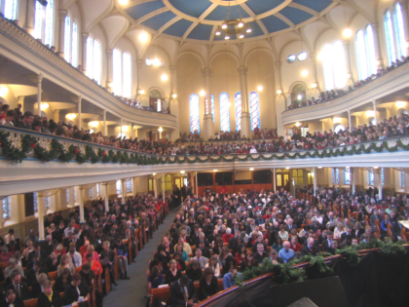

Slide 15
Revelation 4:2-3
² Immediately I was in the Spirit; and behold, a throne set in heaven, and One sat on the throne. ³ And He who sat there was like a jasper and a sardius stone in appearance; and there was a rainbow around the throne, in appearance like an emerald.

Slide 16
Revelation 4:11
"You are worthy, O Lord, To receive glory and honor and power; For You created all things, And by Your will they exist and were created."

Slide 17
Psalm 110:1
The LORD said to my Lord, "Sit at My right hand, Till I make Your enemies Your footstool."

Slide 18
Acts 2:32-33
³² This Jesus God has raised up, of which we are all witnesses. ³³ Therefore being exalted to the right hand of God, and having received from the Father the promise of the Holy Spirit, He poured out this which you now see and hear.

Slide 19
Acts 7:55-56
⁵⁵ But he, being full of the Holy Spirit, gazed into heaven and saw the glory of God, and Jesus standing at the right hand of God, ⁵⁶ and said, "Look! I see the heavens opened and the Son of Man standing at the right hand of God!"

Slide 20
Ephesians 1:19-20
¹⁹ and what is the exceeding greatness of His power toward us who believe, according to the working of His mighty power ²⁰ which He worked in Christ when He raised Him from the dead and seated Him at His right hand in the heavenly places,

Slide 21
Colossians 3:1
¹ If then you were raised with Christ, seek those things which are above, where Christ is, sitting at the right hand of God.

Slide 22
Hebrews 12:2
² looking unto Jesus, the author and finisher of our faith, who for the joy that was set before Him endured the cross, despising the shame, and has sat down at the right hand of the throne of God.

Slide 23
Sit on My right hand “UNTIL”
It is not Jesus taking the throne before the age of Grace
It is Christ RISING from the throne at the end of the age of Grace

Slide 24
Revelation 4:3
And He who sat there was like a jasper and a sardius stone in appearance; and there was a rainbow around the throne, in appearance like an emerald.

Slide 25
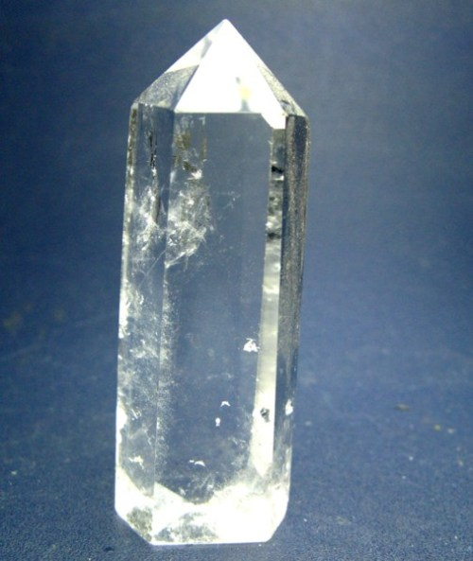

Slide 26
Revelation 21:10-11
¹⁰ And he carried me away in the Spirit to a great and high mountain, and showed me the great city, the holy Jerusalem, descending out of heaven from God, ¹¹ having the glory of God. Her light was like a most precious stone, like a jasper stone, clear as crystal.

Slide 27
Isaiah 6:1
In the year that King Uzziah died, I saw the Lord sitting on a throne, high and lifted up, and the train of His robe filled the temple.

Slide 28
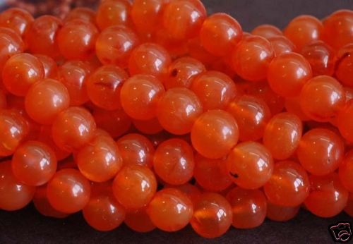

Slide 29
Deuteronomy 4:24
For the LORD your God is a consuming fire, a jealous God.

Slide 30
Hebrews 12:28-29
²⁸ Therefore, since we are receiving a kingdom which cannot be shaken, let us have grace, by which we may serve God acceptably with reverence and godly fear. ²⁹ For our God is a consuming fire.

Slide 31
A Rainbow Around The Throne

Slide 32
Luke 12:31-32
³¹ But seek the kingdom of God, and all these things shall be added to you. ³² Do not fear, little flock, for it is your Father's good pleasure to give you the kingdom.

Slide 33
What John Saw Around The Throne

Slide 34
Revelation 4:4-6
Around the throne were twenty-four thrones, and on the thrones I saw twenty-four elders sitting, clothed in white robes; and they had crowns of gold on their heads.

Slide 35
Revelation 4:4-6
⁵ And from the throne proceeded lightnings, thunderings, and voices. Seven lamps of fire were burning before the throne, which are the seven Spirits of God.

Slide 36
Revelation 4:4-6
⁶ Before the throne there was a sea of glass, like crystal. And in the midst of the throne, and around the throne, were four living creatures full of eyes in front and in back.

Slide 37
Revelation 5:9
⁹ And they sang a new song, saying: "You are worthy to take the scroll, And to open its seals; For You were slain, And have redeemed us to God by Your blood Out of every tribe and tongue and people and nation,

Slide 38
Revelation 21:12-14
¹² Also she had a great and high wall with twelve gates, and twelve angels at the gates, and names written on them, which are the names of the twelve tribes of the children of Israel: ¹³ three gates on the east, three gates on the north, three gates on the south, and three gates on the west. ¹⁴ Now the wall of the city had twelve foundations, and on them were the names of the twelve apostles of the Lamb.

Slide 39
Do we come to church to worship men or to worship the Most High God?

