Slide 1
The Letter to the Church of Philadelphia
Revelation 3:7-13
Wednesday, February 6, 2012
Calvary Chapel of El Paso
Pastor Charlie Flores

Slide 2
Revelation 3:7-13
⁷ And to the angel of the church in Philadelphia write; These things saith he that is holy, he that is true, he that hath the key of David, he that openeth, and no man shutteth; and shutteth, and no man openeth;

Slide 3
Revelation 3:7-13
⁸ I know thy works: behold, I have set before thee an open door, and no man can shut it: for thou hast a little strength, and hast kept my word, and hast not denied my name.

Slide 4
Revelation 3:7-13
⁹ Behold, I will make them of the synagogue of Satan, which say they are Jews, and are not, but do lie; behold, I will make them to come and worship before thy feet, and to know that I have loved thee.

Slide 5
Revelation 3:7-13
¹⁰ Because thou hast kept the word of my patience, I also will keep thee from the hour of temptation, which shall come upon all the world, to try them that dwell upon the earth.

Slide 6
Revelation 3:7-13
¹¹ Behold, I come quickly: hold that fast which thou hast, that no man take thy crown.

Slide 7
Revelation 3:7-13
¹² Him that overcometh will I make a pillar in the temple of my God, and he shall go no more out: and I will write upon him the name of my God, and the name of the city of my God, which is new Jerusalem, which cometh down out of heaven from my God: and I will write upon him my new name.

Slide 8
Revelation 3:7-13
¹³ He that hath an ear, let him hear what the Spirit saith unto the churches.

Slide 9
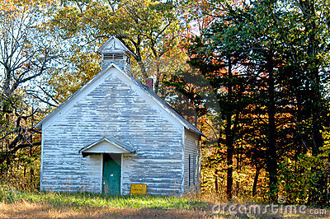

Slide 11
Ephesus—The Loveless Church:
Return to Your First Love
Smyrna—The Persecuted Church:
Don’t Fear Those Who will Try You
Pergamos—The Compromising Church:
Repent and Rely on God’s Truth
Thyatira—The Corrupt Church:
Obey and Be Faithful
Sardis—The Dead Church:
Wake Up and Strengthen What Remains

Slide 12
Destination: Philadelphia
Revelation 3:7 "And to the angel of the church in Philadelphia write, 'These things says He who is holy, He who is true, "He who has the key of David, He who opens and no one shuts, and shuts and no one opens":

Slide 13
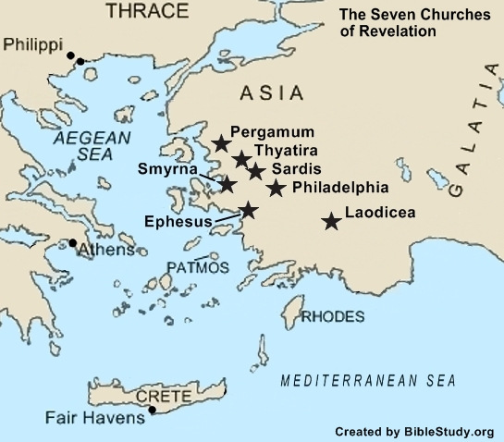

Slide 14
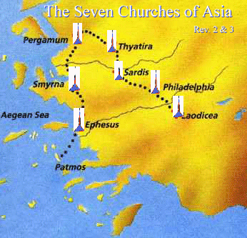

Slide 15
1 John 2:9-11
⁹ He who says he is in the light, and hates his brother, is in darkness until now. ¹⁰ He who loves his brother abides in the light, and there is no cause for stumbling in him. ¹¹ But he who hates his brother is in darkness and walks in darkness, and does not know where he is going, because the darkness has blinded his eyes.

Slide 16
Psalm 133:1
¹ Behold, how good and how pleasant it is For brethren to dwell together in unity!

Slide 17
John 13:34-35
³⁴ A new commandment I give to you, that you love one another; as I have loved you, that you also love one another. ³⁵ By this all will know that you are My disciples, if you have love for one another."

Slide 18
Description: Jesus
Revelation 3:7 "And to the angel of the church in Philadelphia write, 'These things says He who is holy, He who is true, "He who has the key of David, He who opens and no one shuts, and shuts and no one opens":

Slide 19
Romans 8:1
¹ There is therefore now no condemnation to those who are in Christ Jesus, who do not walk according to the flesh, but according to the Spirit.

Slide 20
He Who Is Holy
Set Apart or Separate
Set Apart from Creation
Separate from All Evil

Slide 21
John 1:1-3
¹ In the beginning was the Word, and the Word was with God, and the Word was God. ² He was in the beginning with God. ³ All things were made through Him, and without Him nothing was made that was made.

Slide 22
1 Peter 2:21-22
²¹ For to this you were called, because Christ also suffered for us, leaving us an example, that you should follow His steps: ²² "Who committed no sin, Nor was deceit found in His mouth";

Slide 23
He Who Is True
Genuine and Real
Trustworthy and Reliable

Slide 24
Hebrews 6:17-18
¹⁷ Thus God, determining to show more abundantly to the heirs of promise the immutability of His counsel, confirmed it by an oath, ¹⁸ that by two immutable things, in which it is impossible for God to lie, we might have strong consolation, who have fled for refuge to lay hold of the hope set before us.

Slide 25
WE CAN—
Count On Him
Believe Everything He Says
Trust Every Promise!

Slide 26
Revelation 3:7
⁷ "And to the angel of the church in Philadelphia write, 'These things says He who is holy, He who is true, "He who has the key of David, He who opens and no one shuts, and shuts and no one opens":

Slide 27
He Who Is Sovereign
Jesus Has Control over All Things!
Keys to Death and Hades
Keys to Life and Death
Heaven and Hell

Slide 28
Isaiah 22:22
²² The key of the house of David I will lay on his shoulder; So he shall open, and no one shall shut; And he shall shut, and no one shall open.

Slide 29
John 14:6
⁶ Jesus said to him, "I am the way, the truth, and the life. No one comes to the Father except through Me.

Slide 30
Commendation
Revelation 3:8 I know your works. See, I have set before you an open door, and no one can shut it; for you have a little strength, have kept My word, and have not denied My name.

Slide 31
1 Corinthians 16:9
⁹ For a great and effective door has opened to me, and there are many adversaries.

Slide 32
2 Corinthians 2:12
¹² Furthermore, when I came to Troas to preach Christ's gospel, and a door was opened to me by the Lord,

Slide 33
Colossians 4:3
³ meanwhile praying also for us, that God would open to us a door for the word, to speak the mystery of Christ, for which I am also in chains,

Slide 34
1 Peter 4:10
¹⁰ As each one has received a gift, minister it to one another, as good stewards of the manifold grace of God. ¹¹ If anyone speaks, let him speak as the oracles of God. If anyone ministers, let him do it as with the ability which God supplies, that in all things God may be glorified through Jesus Christ, to whom belong the glory and the dominion forever and ever. Amen.

Slide 35
Exhortation
Revelation 3:9-11 ⁹ Indeed I will make those of the synagogue of Satan, who say they are Jews and are not, but lie—indeed I will make them come and worship before your feet, and to know that I have loved you. ¹⁰ Because you have kept My command to persevere, I also will keep you from the hour of trial which shall come upon the whole world, to test those who dwell on the earth. ¹¹ Behold, I am coming quickly! Hold fast what you have, that no one may take your crown.

Slide 36
1 Thessalonians 1:10
¹⁰ and to wait for His Son from heaven, whom He raised from the dead, even Jesus who delivers us from the wrath to come.

Slide 37
Hold Fast What You Have!

Slide 38
Vance Havner:
“Never forget that the man most likely to steal your crown is yourself. ‘Keep thy heart with all diligence, for out of it are the issues of life’ (Proverbs 4:23). You are in no greater danger from anyone or anything than from yourself.”

Slide 39
Promise
Revelation 3:12 (NKJV) ¹² He who overcomes, I will make him a pillar in the temple of My God, and he shall go out no more. And I will write on him the name of My God and the name of the city of My God, the New Jerusalem, which comes down out of heaven from My God. And I will write on him My new name.

Slide 40
Philippians 2:9-11
⁹ Therefore God also has highly exalted Him and given Him the name which is above every name, ¹⁰ that at the name of Jesus every knee should bow, of those in heaven, and of those on earth, and of those under the earth, ¹¹ and that every tongue should confess that Jesus Christ is Lord, to the glory of God the Father.

Slide 41
Admonition to Heed
Revelation 3:13 He who has an ear, let him hear what the Spirit says to the churches." '

Slide 42
2 Timothy 4:7
⁷ I have fought the good fight, I have finished the race, I have kept the faith.

