Slide 1
The Letter to the Church of Laodicea, Part 2
Revelation 3:14-22
Wednesday, February 20, 2013
Calvary Chapel of El Paso
Pastor Charlie Flores

Slide 2
Revelation 3:14-22
¹⁴ "And to the angel of the church of the Laodiceans write, 'These things says the Amen, the Faithful and True Witness, the Beginning of the creation of God:

Slide 3
Revelation 3:14-22
¹⁵ I know your works, that you are neither cold nor hot. I could wish you were cold or hot.

Slide 4
Revelation 3:14-22
¹⁶ So then, because you are lukewarm, and neither cold nor hot, I will vomit you out of My mouth.

Slide 5
Revelation 3:14-22
¹⁷ Because you say, 'I am rich, have become wealthy, and have need of nothing'—and do not know that you are wretched, miserable, poor, blind, and naked—

Slide 6
Revelation 3:14-22
¹⁸ I counsel you to buy from Me gold refined in the fire, that you may be rich; and white garments, that you may be clothed, that the shame of your nakedness may not be revealed; and anoint your eyes with eye salve, that you may see.

Slide 7
Revelation 3:14-22
¹⁹ As many as I love, I rebuke and chasten. Therefore be zealous and repent.

Slide 8
Revelation 3:14-22
²⁰ Behold, I stand at the door and knock. If anyone hears My voice and opens the door, I will come in to him and dine with him, and he with Me.

Slide 9
Revelation 3:14-22
²¹ To him who overcomes I will grant to sit with Me on My throne, as I also overcame and sat down with My Father on His throne.

Slide 10
Revelation 3:14-22
²² He who has an ear, let him hear what the Spirit says to the churches."'"

Slide 11


Slide 12
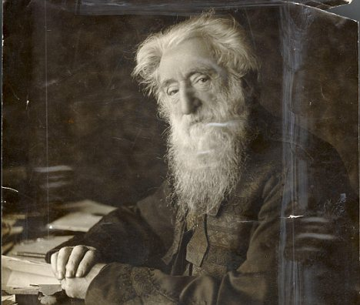

Slide 13
General William Booth:
The chief danger of the 20th Century will be:
  Christianity without Christ
  Religion without the Holy Spirit
  Salvation without Regeneration
  Forgiveness without Repentance
  Heaven without Hell

Slide 14
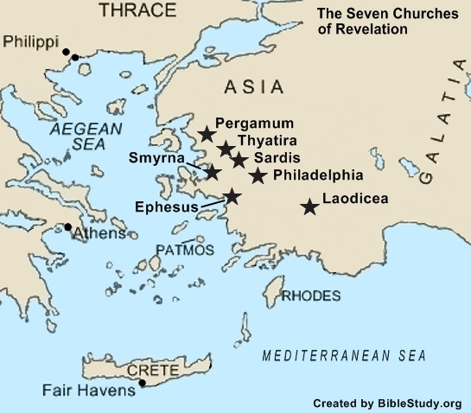

Slide 15
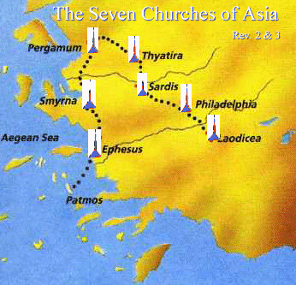

Slide 16
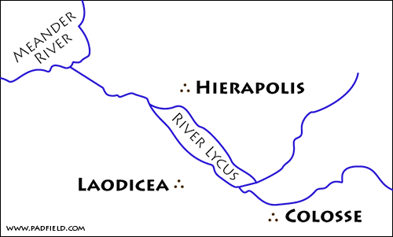

Slide 17
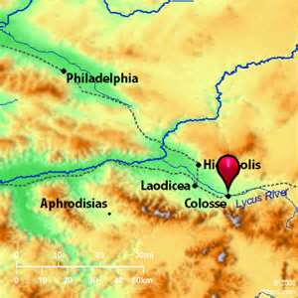

Slide 18
The Christ of authority
Revelation 3:14 "And to the angel of the church of the Laodiceans write, 'These things says the Amen, the Faithful and True Witness, the Beginning of the creation of God:

Slide 19
The Christ of analysis
Revelation 3:15 I know your works, that you are neither cold nor hot. I could wish you were cold or hot.

Slide 20
Ephesians 3:8
⁸ To me, who am less than the least of all the saints, this grace was given, that I should preach among the Gentiles the unsearchable riches of Christ,

Slide 21
1 Corinthians 15:9
⁹ For I am the least of the apostles, who am not worthy to be called an apostle, because I persecuted the church of God.

Slide 22
1 Timothy 1:15
¹⁵ This is a faithful saying and worthy of all acceptance, that Christ Jesus came into the world to save sinners, of whom I am chief.

Slide 23
They said they believed but lived like it was unimportant!

Slide 24
Psalm 139:23-24
²³ Search me, O God, and know my heart; Try me, and know my anxieties; ²⁴ And see if there is any wicked way in me, And lead me in the way everlasting.

Slide 25
The christ of appeal
Revelation 3:18-19 ¹⁸ I counsel you to buy from Me gold refined in the fire, that you may be rich; and white garments, that you may be clothed, that the shame of your nakedness may not be revealed; and anoint your eyes with eye salve, that you may see. ¹⁹ As many as I love, I rebuke and chasten. Therefore be zealous and repent.

Slide 26
Matthew 6:19-21
¹⁹ "Do not lay up for yourselves treasures on earth, where moth and rust destroy and where thieves break in and steal; ²⁰ but lay up for yourselves treasures in heaven, where neither moth nor rust destroys and where thieves do not break in and steal. ²¹ For where your treasure is, there your heart will be also.

Slide 27
1 Peter 1:7
⁷ that the genuineness of your faith, being much more precious than gold that perishes, though it is tested by fire, may be found to praise, honor, and glory at the revelation of Jesus Christ,

Slide 28
God does not accept a person because he or she:
Is religious
Has been baptized
Belongs to the church
Attends worship
Does religious work
Professes Christ
Does good
Gives generously!

Slide 29
2 Corinthians 5:17
¹⁷ Therefore, if anyone is in Christ, he is a new creation; old things have passed away; behold, all things have become new.

Slide 30
2 Corinthians 5:21
²¹ For He made Him who knew no sin to be sin for us, that we might become the righteousness of God in Him.

Slide 31
Ephesians 4:24
²⁴ and that you put on the new man which was created according to God, in true righteousness and holiness.

Slide 32
Colossians 3:10
¹⁰ and have put on the new man who is renewed in knowledge according to the image of Him who created him,

Slide 33
John 1:4
⁴ In Him was life, and the life was the light of men.

Slide 34
John 8:12
¹² Then Jesus spoke to them again, saying, "I am the light of the world. He who follows Me shall not walk in darkness, but have the light of life."

Slide 35
John 12:35
³⁵ Then Jesus said to them, "A little while longer the light is with you. Walk while you have the light, lest darkness overtake you; he who walks in darkness does not know where he is going.

Slide 36
2 Corinthians 4:6
⁶ For it is the God who commanded light to shine out of darkness, who has shone in our hearts to give the light of the knowledge of the glory of God in the face of Jesus Christ.

Slide 37
Exhortation and rebuke
Revelation 3:19 As many as I love, I rebuke and chasten. Therefore be zealous and repent.

Slide 38
He loves them!

Slide 39
Hebrews 12:5-6
⁵ And you have forgotten the exhortation which speaks to you as to sons: "My son, do not despise the chastening of the Lord, Nor be discouraged when you are rebuked by Him; ⁶ For whom the Lord loves He chastens, And scourges every son whom He receives."

Slide 40
promise
Revelation 3:20-21 ²⁰ Behold, I stand at the door and knock. If anyone hears My voice and opens the door, I will come in to him and dine with him, and he with Me. ²¹ To him who overcomes I will grant to sit with Me on My throne, as I also overcame and sat down with My Father on His throne.

Slide 41
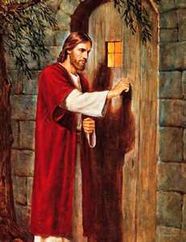

Slide 42
Matthew 25:21
²¹ His lord said to him, 'Well done, good and faithful servant; you were faithful over a few things, I will make you ruler over many things. Enter into the joy of your lord.'

Slide 43
1 John 5:4-5
⁴ For whatever is born of God overcomes the world. And this is the victory that has overcome the world—our faith. ⁵ Who is he who overcomes the world, but he who believes that Jesus is the Son of God?

Slide 44
Revelation 3:22
²² He who has an ear, let him hear what the Spirit says to the churches."'"

