Slide 1
The Letter to the Church of Sardis
Revelation 3:1-6
Wednesday, January 30, 2013
Calvary Chapel of El Paso

Slide 2
Revelation 3:1-6
¹ And unto the angel of the church in Sardis write; These things saith he that hath the seven Spirits of God, and the seven stars; I know thy works, that thou hast a name that thou livest, and art dead.

Slide 3
Revelation 3:1-6
² Be watchful, and strengthen the things which remain, that are ready to die: for I have not found thy works perfect before God.

Slide 4
Revelation 3:1-6
³ Remember therefore how thou hast received and heard, and hold fast, and repent. If therefore thou shalt not watch, I will come on thee as a thief, and thou shalt not know what hour I will come upon thee.

Slide 5
Revelation 3:1-6
⁴ Thou hast a few names even in Sardis which have not defiled their garments; and they shall walk with me in white: for they are worthy.

Slide 6
Revelation 3:1-6
⁵ He that overcometh, the same shall be clothed in white raiment; and I will not blot out his name out of the book of life, but I will confess his name before my Father, and before his angels.

Slide 7
Revelation 3:1-6
⁶ He that hath an ear, let him hear what the Spirit saith unto the churches.

Slide 8
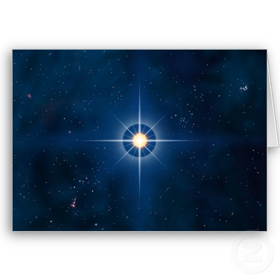

Slide 9
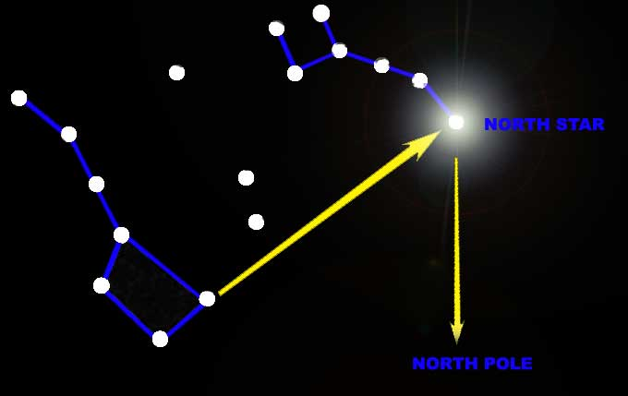

Slide 10
Destination: Sardis
Revelation 3:1 And unto the angel of the church in Sardis write; These things saith he that hath the seven Spirits of God, and the seven stars; I know thy works, that thou hast a name that thou livest, and art dead.

Slide 11
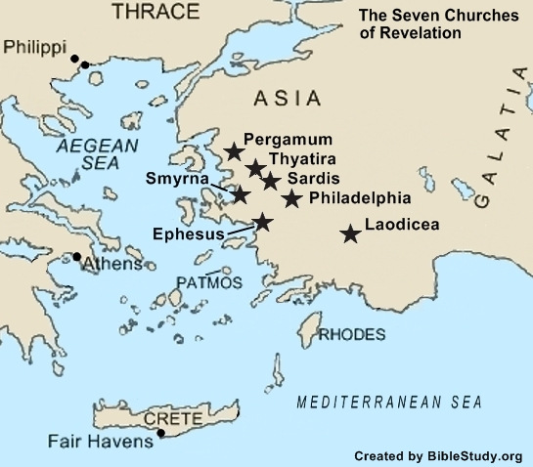

Slide 12
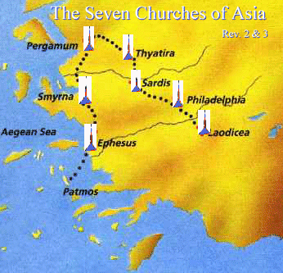

Slide 13
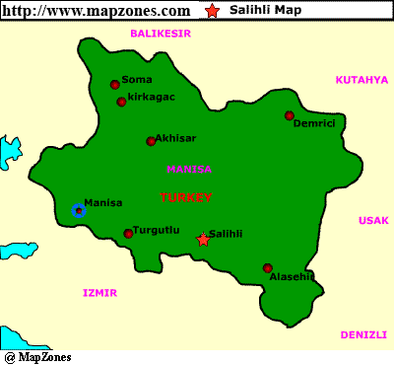

Slide 14
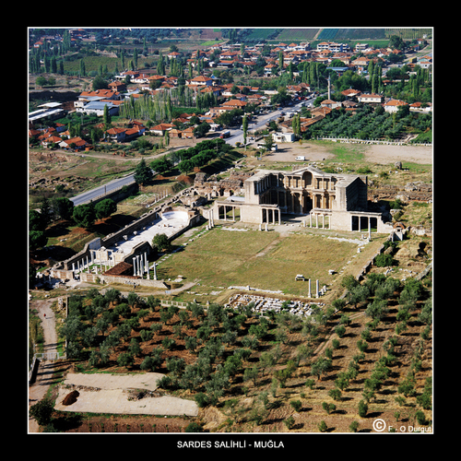

Slide 15
John 14:6
⁶ Jesus saith unto him, I am the way, the truth, and the life: no man cometh unto the Father, but by me.

Slide 16
Acts 4:10-12
¹⁰ Be it known unto you all, and to all the people of Israel, that by the name of Jesus Christ of Nazareth, whom ye crucified, whom God raised from the dead, even by him doth this man stand here before you whole. ¹¹ This is the stone which was set at nought of you builders, which is become the head of the corner. ¹² Neither is there salvation in any other: for there is none other name under heaven given among men, whereby we must be saved.

Slide 17
Description: Jesus
Revelation 3:1 And unto the angel of the church in Sardis write; These things saith he that hath the seven Spirits of God, and the seven stars; I know thy works, that thou hast a name that thou livest, and art dead.

Slide 18
He is the Comforter, the Other Helper
John 14:16 And I will pray the Father, and He will give you another Helper, that He may abide with you forever—

Slide 19
He is the Spirit of Truth
John 14:17 the Spirit of truth, whom the world cannot receive, because it neither sees Him nor knows Him; but you know Him, for He dwells with you and will be in you.

Slide 20
He is the Personal Presence of Christ
John 14:18-20 ¹⁸ I will not leave you orphans; I will come to you. ¹⁹ "A little while longer and the world will see Me no more, but you will see Me. Because I live, you will live also. ²⁰ At that day you will know that I am in My Father, and you in Me, and I in you.

Slide 21
He is the Very Special Manifestation of Christ within the Believer
John 14:21-22 (NKJV) ²¹ He who has My commandments and keeps them, it is he who loves Me. And he who loves Me will be loved by My Father, and I will love him and manifest Myself to him." ²² Judas (not Iscariot) said to Him, "Lord, how is it that You will manifest Yourself to us, and not to the world?"

Slide 22
He is the Abiding Presence of the Trinity
John 14:23-24 (NKJV) ²³ Jesus answered and said to him, "If anyone loves Me, he will keep My word; and My Father will love him, and We will come to him and make Our home with him. ²⁴ He who does not love Me does not keep My words; and the word which you hear is not Mine but the Father's who sent Me.

Slide 23
He is the Teacher
John 14:25-26 (NKJV) ²⁵ "These things I have spoken to you while being present with you. ²⁶ But the Helper, the Holy Spirit, whom the Father will send in My name, He will teach you all things, and bring to your remembrance all things that I said to you.

Slide 24
He is the Peace of Christ
John 14:27 (NKJV) ²⁷ Peace I leave with you, My peace I give to you; not as the world gives do I give to you. Let not your heart be troubled, neither let it be afraid.

Slide 25
Luke 11:13
¹³ If you then, being evil, know how to give good gifts to your children, how much more will your heavenly Father give the Holy Spirit to those who ask Him!"

Slide 26
Romans 8:11
¹¹ But if the Spirit of Him who raised Jesus from the dead dwells in you, He who raised Christ from the dead will also give life to your mortal bodies through His Spirit who dwells in you.

Slide 27
Condemnation / Rebuke
Revelation 3:1 (NKJV) ¹ "And to the angel of the church in Sardis write, 'These things says He who has the seven Spirits of God and the seven stars: "I know your works, that you have a name that you are alive, but you are dead.

Slide 28
G. B . Caird
The Church of Sardis— “…a perfect model of inoffensive Christianity!”

Slide 29
The Church is in Danger when…
It begins to worship its own past
It is more concerned with form instead of faith
It loves systems more than it loves the Savior
It is more concerned with physical substance than with the Person of the Spirit

Slide 30
Matthew 15:8
⁸ 'These people draw near to Me with their mouth, And honor Me with their lips, But their heart is far from Me.

Slide 31
Romans 14:17
¹⁷ for the kingdom of God is not eating and drinking, but righteousness and peace and joy in the Holy Spirit.

Slide 32
Exhortation
Revelation 3:2-3 (NKJV) ² Be watchful, and strengthen the things which remain, that are ready to die, for I have not found your works perfect before God. ³ Remember therefore how you have received and heard; hold fast and repent. Therefore if you will not watch, I will come upon you as a thief, and you will not know what hour I will come upon you.

Slide 33
WAKE UP!
Romans 13:11-12 (NKJV) ¹¹ And do this, knowing the time, that now it is high time to awake out of sleep; for now our salvation is nearer than when we first believed. ¹² The night is far spent, the day is at hand. Therefore let us cast off the works of darkness, and let us put on the armor of light.

Slide 34
STRENGTHEN THE THINGS WHICH REMAIN!
Hebrews 2:1-3 (NKJV) ¹ Therefore we must give the more earnest heed to the things we have heard, lest we drift away. ² For if the word spoken through angels proved steadfast, and every transgression and disobedience received a just reward, ³ how shall we escape if we neglect so great a salvation, which at the first began to be spoken by the Lord, and was confirmed to us by those who heard Him,

Slide 35
REMEMBER FROM WHERE YOU CAME!
2 Timothy 1:5-7 (NKJV) ⁵ when I call to remembrance the genuine faith that is in you, which dwelt first in your grandmother Lois and your mother Eunice, and I am persuaded is in you also. ⁶ Therefore I remind you to stir up the gift of God which is in you through the laying on of my hands. ⁷ For God has not given us a spirit of fear, but of power and of love and of a sound mind.

Slide 36
HOLD FAST!
Philippians 2:14-16 (NKJV) ¹⁴ Do all things without complaining and disputing, ¹⁵ that you may become blameless and harmless, children of God without fault in the midst of a crooked and perverse generation, among whom you shine as lights in the world, ¹⁶ holding fast the word of life, so that I may rejoice in the day of Christ that I have not run in vain or labored in vain.

Slide 37
REPENT!
2 Corinthians 13:5-6 (NKJV) ⁵ Examine yourselves as to whether you are in the faith. Test yourselves. Do you not know yourselves, that Jesus Christ is in you?--unless indeed you are disqualified. ⁶ But I trust that you will know that we are not disqualified.

Slide 38
WARNING
Revelation 3:3 Remember therefore how you have received and heard; hold fast and repent. Therefore if you will not watch, I will come upon you as a thief, and you will not know what hour I will come upon you.

Slide 39
Count the Cost!
1 Corinthians 3:13-15 (NKJV) ¹³ each one's work will become clear; for the Day will declare it, because it will be revealed by fire; and the fire will test each one's work, of what sort it is. ¹⁴ If anyone's work which he has built on it endures, he will receive a reward. ¹⁵ If anyone's work is burned, he will suffer loss; but he himself will be saved, yet so as through fire.

Slide 40
PROMISE
Revelation 3:4-5 (NKJV) ⁴ You have a few names even in Sardis who have not defiled their garments; and they shall walk with Me in white, for they are worthy. ⁵ He who overcomes shall be clothed in white garments, and I will not blot out his name from the Book of Life; but I will confess his name before My Father and before His angels.

Slide 41
Philippians 3:8-9
⁸ Yet indeed I also count all things loss for the excellence of the knowledge of Christ Jesus my Lord, for whom I have suffered the loss of all things, and count them as rubbish, that I may gain Christ ⁹ and be found in Him, not having my own righteousness, which is from the law, but that which is through faith in Christ, the righteousness which is from God by faith;

Slide 42
ADMONITION TO HEED
Revelation 3:6 He who has an ear, let him hear what the Spirit says to the churches." '

Slide 43
General William Booth
The chief danger of the 20th Century will be:
Christianity without Christ
Religion without the Holy Spirit
Salvation without Regeneration
Forgiveness without Repentance
And Heaven without Hell

