Slide 1
Revelation 21:1
September 3, 2014
Calvary Chapel of El Paso

Slide 2
Revelation 21:1
And I saw a new heaven and a new earth: for the first heaven and the first earth were passed away; and there was no more sea.

Slide 3
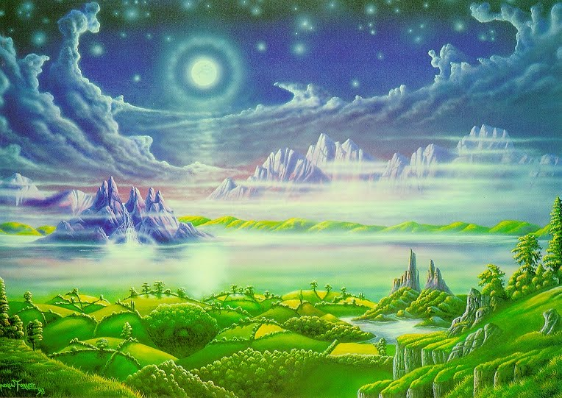

Slide 4
Isaiah 43:18
Remember ye not the former things, neither consider the things of old.

Slide 5
Isaiah 43:19
Behold, I will do a new thing; now it shall spring forth; shall ye not know it? I will even make a way in the wilderness, and rivers in the desert.

Slide 6
Isaiah 65:17
For behold, I create new heavens and a new earth; And the former shall not be remembered or come to mind.

Slide 7
Isaiah 65:18
But be glad and rejoice forever in what I create; For behold, I create Jerusalem as a rejoicing, And her people a joy.

Slide 8
Isaiah 65:19
I will rejoice in Jerusalem, And joy in My people; The voice of weeping shall no longer be heard in her, Nor the voice of crying.

Slide 9
Psalm 102:25
Of old You laid the foundation of the earth, And the heavens are the work of Your hands.

Slide 10
Psalm 102:26
They will perish, but You will endure; Yes, they will all grow old like a garment; Like a cloak You will change them, And they will be changed.

Slide 11
Psalm 102:27
But You are the same, And Your years will have no end.

Slide 12
2 Peter 3:10
But the day of the Lord will come as a thief in the night, in which the heavens will pass away with a great noise, and the elements will melt with fervent heat; both the earth and the works that are in it will be burned up.

Slide 13
2 Peter 3:11
Therefore, since all these things will be dissolved, what manner of persons ought you to be in holy conduct and godliness,

Slide 14
2 Peter 3:12
looking for and hastening the coming of the day of God, because of which the heavens will be dissolved, being on fire, and the elements will melt with fervent heat?

Slide 15
2 Peter 3:13
Nevertheless we, according to His promise, look for new heavens and a new earth in which righteousness dwells.

Slide 16
Jesus, the Lord of the Churches (Rev. 1:1 to 3:22)
Jesus, the Lion over the Nations (Rev. 4:1 to 20:15)
Jesus, the Lamb among Believers (Rev. 21:1 to 22:21)

Slide 17
2 Corinthians 12:2
I know a man in Christ who fourteen years ago—whether in the body I do not know, or whether out of the body I do not know, God knows—such a one was caught up to the third heaven.

Slide 18
Ephesians 2:1
And you He made alive, who were dead in trespasses and sins,

Slide 19
Ephesians 2:2
in which you once walked according to the course of this world, according to the prince of the power of the air, the spirit who now works in the sons of disobedience,

Slide 20
Ephesians 6:12
For we do not wrestle against flesh and blood, but against principalities, against powers, against the rulers of the darkness of this age, against spiritual hosts of wickedness in the heavenly places.

Slide 21
Isaiah 65:17
For behold, I create new heavens and a new earth; And the former shall not be remembered or come to mind.

Slide 22
Psalm 72:8
He shall have dominion also from sea to sea, And from the River to the ends of the earth.

Slide 23
Zechariah 9:10
I will cut off the chariot from Ephraim And the horse from Jerusalem; The battle bow shall be cut off. He shall speak peace to the nations; His dominion shall be 'from sea to sea, And from the River to the ends of the earth.

Slide 24
Zechariah 14:8
And in that day it shall be That living waters shall flow from Jerusalem, Half of them toward the eastern sea And half of them toward the western sea; In both summer and winter it shall occur.

Slide 25
Revelation 13:1
Then I stood on the sand of the sea. And I saw a beast rising up out of the sea, having seven heads and ten horns, and on his horns ten crowns, and on his heads a blasphemous name.

Slide 26
Revelation 20:13
The sea gave up the dead who were in it, and Death and Hades delivered up the dead who were in them. And they were judged, each one according to his works.

Slide 27
Isaiah 57:20
But the wicked are like the troubled sea, When it cannot rest, Whose waters cast up mire and dirt.

Slide 28
Psalm 89:8
O LORD God of hosts, Who is mighty like You, O LORD? Your faithfulness also surrounds You.

Slide 29
Psalm 89:9
You rule the raging of the sea; When its waves rise, You still them.

Slide 30
Romans 5:9
Much more then, having now been justified by His blood, we shall be saved from wrath through Him.

Slide 31
Romans 5:10
For if when we were enemies we were reconciled to God through the death of His Son, much more, having been reconciled, we shall be saved by His life.

Slide 32
Romans 5:15
But the free gift is not like the offense. For if by the one man's offense many died, much more the grace of God and the gift by the grace of the one Man, Jesus Christ, abounded to many.

Slide 33
Romans 5:17
For if by the one man's offense death reigned through the one, much more those who receive abundance of grace and of the gift of righteousness will reign in life through the One, Jesus Christ.

Slide 34
Romans 5:20
Moreover the law entered that the offense might abound. But where sin abounded, grace abounded much more,

Slide 35
Revelation 21:4
And God will wipe away every tear from their eyes; there shall be no more death, nor sorrow, nor crying. There shall be no more pain, for the former things have passed away.

