Slide 1
Revelation 20:7-10
Wednesday, August 20, 2014
Calvary Chapel of El Paso

Slide 2
Revelation 20:7
Now when the thousand years have expired, Satan will be released from his prison

Slide 3
Revelation 20:8
and will go out to deceive the nations which are in the four corners of the earth, Gog and Magog, to gather them together to battle, whose number is as the sand of the sea.

Slide 4
Revelation 20:9
They went up on the breadth of the earth and surrounded the camp of the saints and the beloved city. And fire came down from God out of heaven and devoured them.

Slide 5
Revelation 20:10
The devil, who deceived them, was cast into the lake of fire and brimstone where the beast and the false prophet are. And they will be tormented day and night forever and ever.

Slide 6
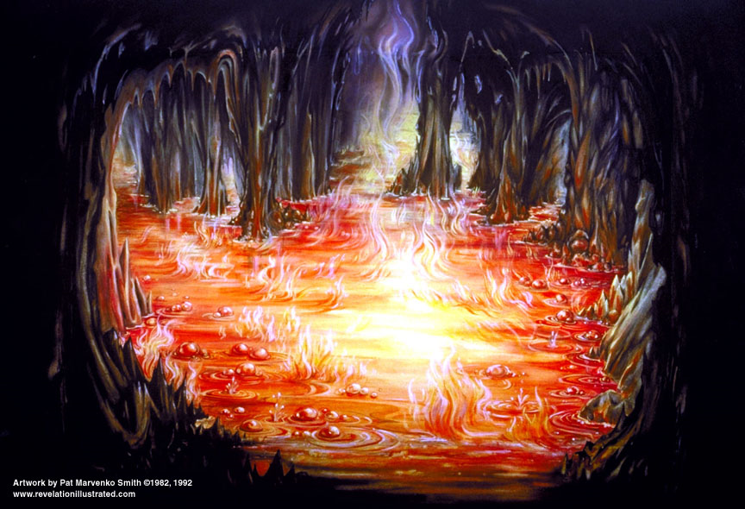

Slide 7
Luke 11:2
And he said unto them, When ye pray, say, Our Father which art in heaven, Hallowed be thy name. Thy kingdom come. Thy will be done, as in heaven, so in earth.

Slide 8
Revelation 11:15
And the seventh angel sounded; and there were great voices in heaven, saying, The kingdoms of this world are become the kingdoms of our Lord, and of his Christ; and he shall reign for ever and ever.

Slide 9
Isaiah 65:19
I will rejoice in Jerusalem, And joy in My people; The voice of weeping shall no longer be heard in her, Nor the voice of crying.

Slide 10
Isaiah 65:20
No more shall an infant from there live but a few days, Nor an old man who has not fulfilled his days; For the child shall die one hundred years old, But the sinner being one hundred years old shall be accursed.

Slide 11
Isaiah 65:25
The wolf and the lamb shall feed together, The lion shall eat straw like the ox, And dust shall be the serpent's food. They shall not hurt nor destroy in all My holy mountain," Says the LORD.

Slide 12
Isaiah 11:7
The cow and the bear shall graze; Their young ones shall lie down together; And the lion shall eat straw like the ox.

Slide 13
Isaiah 11:8
The nursing child shall play by the cobra's hole, And the weaned child shall put his hand in the viper's den.

Slide 14
Isaiah 11:9
They shall not hurt nor destroy in all My holy mountain, For the earth shall be full of the knowledge of the LORD As the waters cover the sea.

Slide 15
Isaiah 11:10
"And in that day there shall be a Root of Jesse, Who shall stand as a banner to the people; For the Gentiles shall seek Him, And His resting place shall be glorious."

Slide 16
Isaiah 2:4a
He shall judge between the nations, And rebuke many people; They shall beat their swords into plowshares, And their spears into pruning hooks;

Slide 17
Isaiah 2:4b
Nation shall not lift up sword against nation, Neither shall they learn war anymore.

Slide 18
Revelation 20:3a
and he cast him into the bottomless pit, and shut him up, and set a seal on him, so that he should deceive the nations no more till the thousand years were finished…

Slide 19
Revelation 20:3b
…But after these things he must be released for a little while.

Slide 20
Genesis 6:5
Then the LORD saw that the wickedness of man was great in the earth, and that every intent of the thoughts of his heart was only evil continually.

Slide 21
Jeremiah 17:9
The heart is deceitful above all things, And desperately wicked; Who can know it?

Slide 22
Satan—Temptation
Choice—Theirs!

Slide 23
Tested in the Garden of delight, man broke through the only prohibition laid upon him

Slide 24
Tested under conscience, corruption and violence filled the earth, and the world had to be cleared by the flood

Slide 25
Tested under the restraining influence of divinely appointed government, man fell into idolatry and turned away from his creator (Judges)

Slide 26
Tested under law, man cast off restraint and crucified the Lord of Glory

Slide 27
Tested under grace, man has shown himself utterly unable to appreciate such mercy, and has rejected the only means of being saved

Slide 28
When tested under the personal reign of the Lord Jesus Christ, after one thousand years of unparalleled righteousness and peace, man will be ready to listen once again to the voice of the devil

Slide 29
Romans 7:21
I find then a law, that evil is present with me, the one who wills to do good.

Slide 30
Romans 7:22
For I delight in the law of God according to the inward man.

Slide 31
Romans 7:23
But I see another law in my members, warring against the law of my mind, and bringing me into captivity to the law of sin which is in my members.

Slide 32
Romans 7:24
O wretched man that I am! Who will deliver me from this body of death?

Slide 33
Romans 7:25
I thank God—through Jesus Christ our Lord! So then, with the mind I myself serve the law of God, but with the flesh the law of sin.

Slide 34
Revelation 20:7
Now when the thousand years have expired, Satan will be released from his prison

Slide 35
Revelation 20:8
and will go out to deceive the nations which are in the four corners of the earth, Gog and Magog, to gather them together to battle, whose number is as the sand of the sea.

Slide 36
Revelation 20:9
They went up on the breadth of the earth and surrounded the camp of the saints and the beloved city. And fire came down from God out of heaven and devoured them.

Slide 37
Revelation 20:10
The devil, who deceived them, was cast into the lake of fire and brimstone where the beast and the false prophet are. And they will be tormented day and night forever and ever.

Slide 38
Isaiah 60:21
Also your people shall all be righteous; They shall inherit the land forever, The branch of My planting, The work of My hands, That I may be glorified.

Slide 39
Hebrews 12:28
Therefore, since we are receiving a kingdom which cannot be shaken, let us have grace, by which we may serve God acceptably with reverence and godly fear.

Slide 40
Hebrews 12:29
For our God is a consuming fire.

Slide 41
Ezekiel 38:22
And I will bring him to judgment with pestilence and bloodshed; I will rain down on him, on his troops, and on the many peoples who are with him, flooding rain, great hailstones, fire, and brimstone.

Slide 42
Revelation 20:10
The devil, who deceived them, was cast into the lake of fire and brimstone where the beast and the false prophet are. And they will be tormented day and night forever and ever.

Slide 43
John 12:31
Now is the judgment of this world; now the ruler of this world will be cast out.

Slide 44
John 12:32
And I, if I am lifted up from the earth, will draw all peoples to Myself.

Slide 45
John 12:33
This He said, signifying by what death He would die.

Slide 46
Matthew 25:41
Then He will also say to those on the left hand, 'Depart from Me, you cursed, into the everlasting fire prepared for the devil and his angels:

Slide 47
2 Peter 2:4
For if God did not spare the angels who sinned, but cast them down to hell and delivered them into chains of darkness, to be reserved for judgment;

Slide 48
God Cares for You!

Slide 49
Hebrews 4:14
Seeing then that we have a great High Priest who has passed through the heavens, Jesus the Son of God, let us hold fast our confession.

Slide 50
Hebrews 4:15
For we do not have a High Priest who cannot sympathize with our weaknesses, but was in all points tempted as we are, yet without sin.

Slide 51
Hebrews 4:16
Let us therefore come boldly to the throne of grace, that we may obtain mercy and find grace to help in time of need.

Slide 52
God Controls All Things!

Slide 53
Daniel 4:35
All the inhabitants of the earth are reputed as nothing; He does according to His will in the army of heaven And among the inhabitants of the earth. No one can restrain His hand Or say to Him, "What have You done?"

Slide 54
God Communicates His Way with Us!

Slide 55
Deuteronomy 29:29
The secret things belong to the LORD our God, but those things which are revealed belong to us and to our children forever, that we may do all the words of this law.

Slide 56
