Slide 1
The Letter to the Church of Thyatira
Revelation 2:18-29
Wednesday, January 23, 2013
Calvary Chapel of El Paso
Pastor Charlie Flores

Slide 2
Revelation 2:18-29
¹⁸ And unto the angel of the church in Thyatira write; These things saith the Son of God, who hath his eyes like unto a flame of fire, and his feet are like fine brass;

Slide 3
Revelation 2:18-29
¹⁹ I know thy works, and charity, and service, and faith, and thy patience, and thy works; and the last to be more than the first.

Slide 4
Revelation 2:18-29
²⁰ Notwithstanding I have a few things against thee, because thou sufferest that woman Jezebel, which calleth herself a prophetess, to teach and to seduce my servants to commit fornication, and to eat things sacrificed unto idols.

Slide 5
Revelation 2:18-29
²¹ And I gave her space to repent of her fornication; and she repented not.

Slide 6
Revelation 2:18-29
²² Behold, I will cast her into a bed, and them that commit adultery with her into great tribulation, except they repent of their deeds.

Slide 7
Revelation 2:18-29
²³ And I will kill her children with death; and all the churches shall know that I am he which searcheth the reins and hearts: and I will give unto every one of you according to your works.

Slide 8
Revelation 2:18-29
²⁴ But unto you I say, and unto the rest in Thyatira, as many as have not this doctrine, and which have not known the depths of Satan, as they speak; I will put upon you none other burden.

Slide 9
Revelation 2:18-23
²⁵ But that which ye have already hold fast till I come.

Slide 10
Revelation 2:18-29
²⁶ And he that overcometh, and keepeth my works unto the end, to him will I give power over the nations:

Slide 11
Revelation 2:18-29
²⁷ And he shall rule them with a rod of iron; as the vessels of a potter shall they be broken to shivers: even as I received of my Father.

Slide 12
Revelation 2:18-29
²⁸ And I will give him the morning star.

Slide 13
Revelation 2:18-29
²⁹ He that hath an ear, let him hear what the Spirit saith unto the churches.

Slide 14
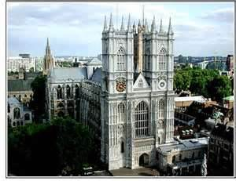

Slide 15
The Seven Key Elements in the Letters
Destination—Salutation
Title and Description—Christ’s Identification
Commendation—Condition of the Church
Rebuke—Condemnation
Exhortation—Promised or Threatened Coming
Warning—An Admonition to Heed
A Promised Blessing

Slide 16
Destination / Salutation
Revelation 2:18 And unto the angel of the church in Thyatira write; These things saith the Son of God, who hath his eyes like unto a flame of fire, and his feet are like fine brass;

Slide 17
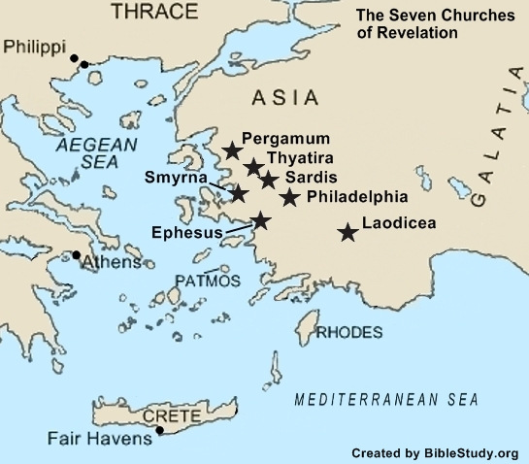

Slide 18
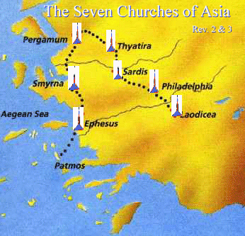

Slide 19
Acts 16:14
¹⁴ And a certain woman named Lydia, a seller of purple, of the city of Thyatira, which worshipped God, heard us: whose heart the Lord opened, that she attended unto the things which were spoken of Paul.

Slide 20
Title and Description of Jesus
Revelation 2:18 And unto the angel of the church in Thyatira write; These things saith the Son of God, who hath his eyes like unto a flame of fire, and his feet are like fine brass;

Slide 21
Revelation 1:15
¹⁵ And his feet like unto fine brass, as if they burned in a furnace; and his voice as the sound of many waters.

Slide 22
Commendation
Revelation 2:19 I know thy works, and charity, and service, and faith, and thy patience, and thy works; and the last to be more than the first.

Slide 23
Philippians 1:9-11
⁹ And this I pray, that your love may abound yet more and more in knowledge and in all judgment; ¹⁰ That ye may approve things that are excellent; that ye may be sincere and without offence till the day of Christ; ¹¹ Being filled with the fruits of righteousness, which are by Jesus Christ, unto the glory and praise of God.

Slide 24
Condemnation and Rebuke
Revelation 2:20-21 ²⁰ Notwithstanding I have a few things against thee, because thou sufferest (tolerate) that woman Jezebel, which calleth herself a prophetess, to teach and to seduce my servants to commit fornication, and to eat things sacrificed unto idols. ²¹ And I gave her space to repent of her fornication; and she repented not.

Slide 25
For Further Reading on Jezebel
1 Kings 16-21
2 Kings 9:30-37

Slide 26
Matthew 24:11
¹¹ And many false prophets shall rise, and shall deceive many.

Slide 27
The sin of the people was listening to Jezebel!

Slide 28
Hosea 5:4
⁴ "They do not direct their deeds Toward turning to their God, For the spirit of harlotry is in their midst, And they do not know the Lord.

Slide 29
James 4:4
⁴ Adulterers and adulteresses! Do you not know that friendship with the world is enmity with God? Whoever therefore wants to be a friend of the world makes himself an enemy of God.

Slide 30
Exhortation
Revelation 2:21 And I gave her space to repent of her fornication; and she repented not.

Slide 31
1 Corinthians 10:12
¹² Therefore let him who thinks he stands take heed lest he fall.

Slide 32
1 John 1:9
⁹ If we confess our sins, He is faithful and just to forgive us our sins and to cleanse us from all unrighteousness.

Slide 33
Warning
Revelation 2:22-23 (KJV) ²² Behold, I will cast her into a bed, and them that commit adultery with her into great tribulation, except they repent of their deeds. ²³ And I will kill her children with death; and all the churches shall know that I am he which searcheth the reins and hearts: and I will give unto every one of you according to your works.

Slide 34
Galatians 6:7-8
⁷ Be not deceived; God is not mocked: for whatsoever a man soweth, that shall he also reap. ⁸ For he that soweth to his flesh shall of the flesh reap corruption; but he that soweth to the Spirit shall of the Spirit reap life everlasting.

Slide 35
Promise
Revelation 2:24-25 ²⁴ But unto you I say, and unto the rest in Thyatira, as many as have not this doctrine, and which have not known the depths of Satan, as they speak; I will put upon you none other burden. ²⁵ But that which ye have already hold fast till I come I give power over.

Slide 36
Promise
Revelation 2:26-27 ²⁶ And he that overcometh, and keepeth my works unto the end, to him will I give power over the nations: ²⁷ And he shall rule them with a rod of iron; as the vessels of a potter shall they be broken to shivers: even as I received of my Father.

Slide 37
Promise
Revelation 2:28-29 ²⁸ And I will give him the morning star. ²⁹ He that hath an ear, let him hear what the Spirit saith unto the churches.

Slide 38
1 Thessalonians 5:9
⁹ For God did not appoint us to wrath, but to obtain salvation through our Lord Jesus Christ,

Slide 39
Ephesians 5:6-8
⁶ Let no one deceive you with empty words, for because of these things the wrath of God comes upon the sons of disobedience. ⁷ Therefore do not be partakers with them. ⁸ For you were once darkness, but now you are light in the Lord. Walk as children of light.

Slide 40
Do you have an ear? What is the Spirit saying to the churches?
Ephesus: Get back to your first love
Smyrna: He sees your trouble
Pergamos: Don’t compromise
Thyatira: Repent and keep doing good

