Slide 1
The letter to the church of pergamos
Revelation 2:12-17
Wednesday, January 16, 2013
Calvary Chapel of El Paso
Pastor Charlie Flores

Slide 2
Revelation 2:12-17
¹² And to the angel of the church in Pergamos write; These things saith he which hath the sharp sword with two edges;

Slide 3
Revelation 2:12-17
¹³ I know thy works, and where thou dwellest, even where Satan's seat is: and thou holdest fast my name, and hast not denied my faith, even in those days wherein Antipas was my faithful martyr, who was slain among you, where Satan dwelleth.

Slide 4
Revelation 2:12-17
¹⁴ But I have a few things against thee, because thou hast there them that hold the doctrine of Balaam, who taught Balac to cast a stumblingblock before the children of Israel, to eat things sacrificed unto idols, and to commit fornication.

Slide 5
Revelation 2:12-17
¹⁵ So hast thou also them that hold the doctrine of the Nicolaitans, which thing I hate.

Slide 6
Revelation 2:12-17
¹⁶ Repent; or else I will come unto thee quickly, and will fight against them with the sword of my mouth.

Slide 7
Revelation 2:12-17
¹⁷ He that hath an ear, let him hear what the Spirit saith unto the churches; To him that overcometh will I give to eat of the hidden manna, and will give him a white stone, and in the stone a new name written, which no man knoweth saving he that receiveth it.

Slide 9
Acts 20:29-30
²⁹ For I know this, that after my departing shall grievous wolves enter in among you, not sparing the flock. ³⁰ Also of your own selves shall men arise, speaking perverse things, to draw away disciples after them.

Slide 10
DESTINATION: PERGAMOS
Revelation 2:12 (KJV) ¹² And to the angel of the church in Pergamos write; These things saith he which hath the sharp sword with two edges;

Slide 11
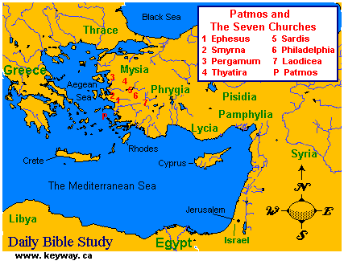

Slide 12
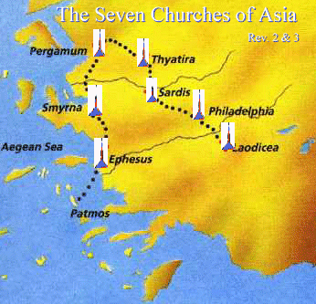

Slide 14
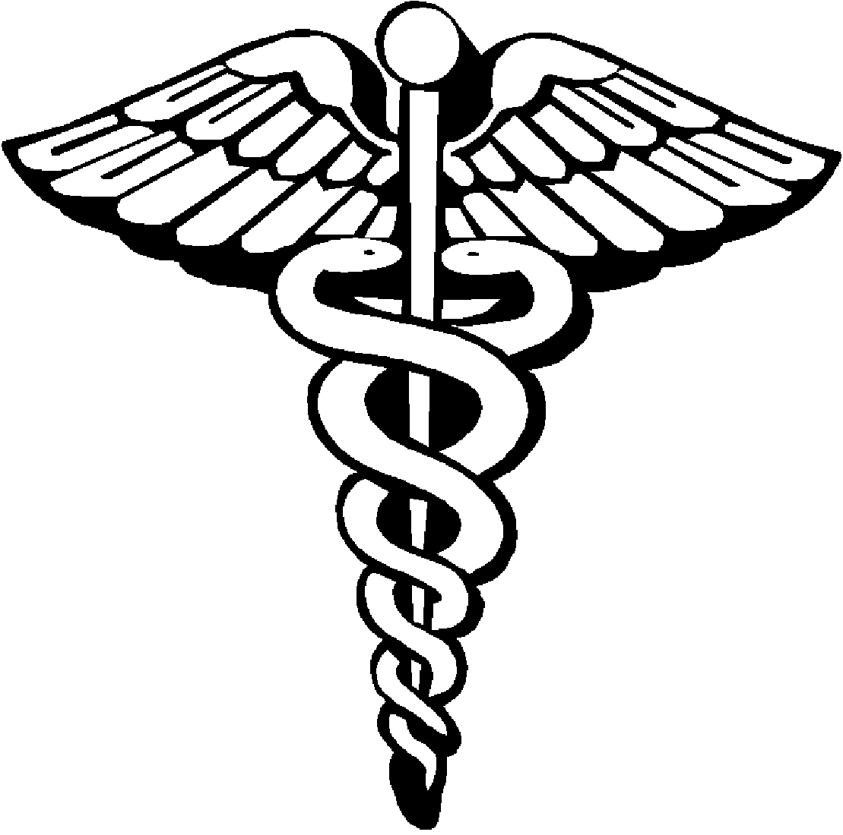

Slide 15
DESCRIPTION: JESUS CHRIST
Revelation 2:12 (KJV) ¹² And to the angel of the church in Pergamos write; These things saith he which hath the sharp sword with two edges;

Slide 16
Revelation 1:16
¹⁶ And he had in his right hand seven stars: and out of his mouth went a sharp twoedged sword: and his countenance was as the sun shineth in his strength.

Slide 17
Ephesians 6:17
¹⁷ And take the helmet of salvation, and the sword of the Spirit, which is the word of God:

Slide 18
Hebrews 4:12
¹² For the word of God is quick, and powerful, and sharper than any twoedged sword, piercing even to the dividing asunder of soul and spirit, and of the joints and marrow, and is a discerner of the thoughts and intents of the heart.

Slide 19
COMMENDATION: WHAT JESUS KNOWS
Revelation 2:13 (KJV) ¹³ I know thy works, and where thou dwellest, even where Satan's seat is: and thou holdest fast my name, and hast not denied my faith, even in those days wherein Antipas was my faithful martyr, who was slain among you, where Satan dwelleth.

Slide 20
Matthew 4:2-4
² And when he had fasted forty days and forty nights, he was afterward an hungred. ³ And when the tempter came to him, he said, If thou be the Son of God, command that these stones be made bread. ⁴ But he answered and said, It is written, Man shall not live by bread alone, but by every word that proceedeth out of the mouth of God.

Slide 21
Hebrews 11:38
³⁸ (Of whom the world was not worthy:) they wandered in deserts, and in mountains, and in dens and caves of the earth.

Slide 22
CONDEMNATION: REBUKE
Revelation 2:14-15 (KJV) ¹⁴ But I have a few things against thee, because thou hast there them that hold the doctrine of Balaam, who taught Balac to cast a stumblingblock before the children of Israel, to eat things sacrificed unto idols, and to commit fornication. ¹⁵ So hast thou also them that hold the doctrine of the Nicolaitans, which thing I hate.

Slide 23
Numbers 25:1-3
¹ And Israel abode in Shittim, and the people began to commit whoredom with the daughters of Moab. ² And they called the people unto the sacrifices of their gods: and the people did eat, and bowed down to their gods. ³ And Israel joined himself unto Baalpeor: and the anger of the LORD was kindled against Israel.

Slide 24
2 Corinthians 6:14-18
¹⁴ Be ye not unequally yoked together with unbelievers: for what fellowship hath righteousness with unrighteousness? and what communion hath light with darkness? ¹⁵ And what concord hath Christ with Belial? or what part hath he that believeth with an infidel?

Slide 25
2 Corinthians 6:14-18
¹⁶ And what agreement hath the temple of God with idols? for ye are the temple of the living God; as God hath said, I will dwell in them, and walk in them; and I will be their God, and they shall be my people.

Slide 26
2 Corinthians 6:14-18
¹⁷ Wherefore come out from among them, and be ye separate, saith the Lord, and touch not the unclean thing; and I will receive you, ¹⁸ And will be a Father unto you, and ye shall be my sons and daughters, saith the Lord Almighty.

Slide 27
1 Timothy 2:5-6
⁵ For there is one God, and one mediator between God and men, the man Christ Jesus; ⁶ Who gave himself a ransom for all, to be testified in due time.

Slide 28
EXHORTATION: THE PROMISED OR THREATENED COMING
Revelation 2:16 (KJV) ¹⁶ Repent; or else I will come unto thee quickly, and will fight against them with the sword of my mouth.

Slide 29
John 12:47-48
⁴⁷ And if any man hear my words, and believe not, I judge him not: for I came not to judge the world, but to save the world. ⁴⁸ He that rejecteth me, and receiveth not my words, hath one that judgeth him: the word that I have spoken, the same shall judge him in the last day.

Slide 30
ADMONITION: LISTEN!
Revelation 2:17 (KJV) ¹⁷ He that hath an ear, let him hear what the Spirit saith unto the churches; To him that overcometh will I give to eat of the hidden manna, and will give him a white stone, and in the stone a new name written, which no man knoweth saving he that receiveth it.

Slide 31
John 6:32-33
³² Then Jesus said unto them, Verily, verily, I say unto you, Moses gave you not that bread from heaven; but my Father giveth you the true bread from heaven. ³³ For the bread of God is he which cometh down from heaven, and giveth life unto the world.

Slide 32
The hidden manna takes care of us today; the white stone is our promise for the future!

