Slide 1
Letters to the Seven Churches The Church of Ephesus
Revelation 2:1-7
Wednesday, December 26, 2012
Calvary Chapel of El Paso
Pastor Charlie flores

Slide 2
Revelation 2:1-7
¹ Unto the angel of the church of Ephesus write; These things saith he that holdeth the seven stars in his right hand, who walketh in the midst of the seven golden candlesticks;

Slide 3
Revelation 2:1-7
² I know thy works, and thy labour, and thy patience, and how thou canst not bear them which are evil: and thou hast tried them which say they are apostles, and are not, and hast found them liars:

Slide 4
Revelation 2:1-7
³ And hast borne, and hast patience, and for my name's sake hast laboured, and hast not fainted.

Slide 5
Revelation 2:1-7
⁴ Nevertheless I have somewhat against thee, because thou hast left thy first love.

Slide 6
Revelation 2:1-7
⁵ Remember therefore from whence thou art fallen, and repent, and do the first works; or else I will come unto thee quickly, and will remove thy candlestick out of his place, except thou repent.

Slide 7
Revelation 2:1-7
⁶ But this thou hast, that thou hatest the deeds of the Nicolaitans, which I also hate.

Slide 8
Revelation 2:1-7
⁷ He that hath an ear, let him hear what the Spirit saith unto the churches; To him that overcometh will I give to eat of the tree of life, which is in the midst of the paradise of God.

Slide 10
Seven Key Elements in the 7 Letters
Salutation
Christ’s Identification as Sender
A Statement Regarding the Condition of the Church
Comment and Exhortation

Slide 11
Seven Key Elements in the 7 Letters
A Promised or Threatened Coming
An Admonition to Heed
A Promised Blessing

Slide 12
Salutation (to Recipients)
¹ Unto the angel of the church of Ephesus write; These things saith he that holdeth the seven stars in his right hand, who walketh in the midst of the seven golden candlesticks;

Slide 13
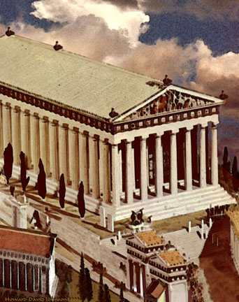

Slide 14
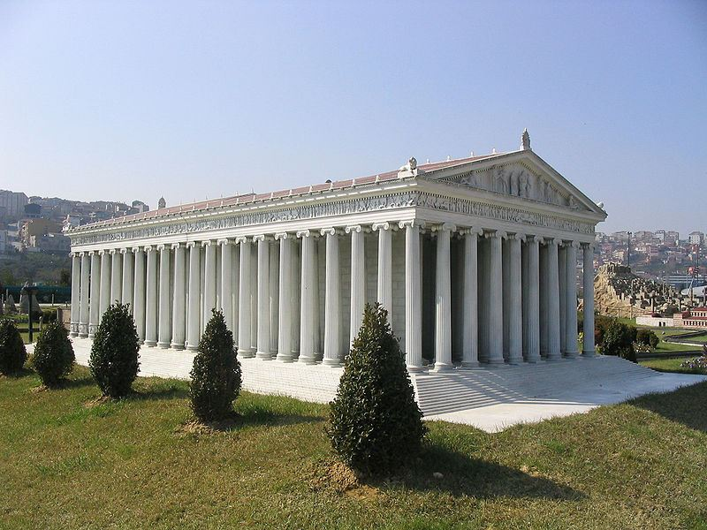

Slide 15
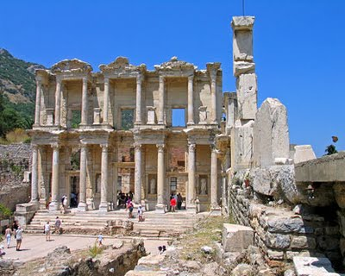

Slide 16
Acts 19:8-10
Acts 19:8-10 (KJV) ⁸ And he went into the synagogue, and spake boldly for the space of three months, disputing and persuading the things concerning the kingdom of God. ⁹ But when divers were hardened, and believed not, but spake evil of that way before the multitude, he departed from them, and separated the disciples, disputing daily in the school of one Tyrannus. ¹⁰ And this continued by the space of two years; so that all they which dwelt in Asia heard the word of the Lord Jesus, both Jews and Greeks.

Slide 17
Christ’s Identification as Sender
Revelation 2:1 (KJV) ¹ Unto the angel of the church of Ephesus write; These things saith he that holdeth the seven stars in his right hand, who walketh in the midst of the seven golden candlesticks;

Slide 18
Christ: Central to the Church
Ephesians 1:19-23 (KJV) ¹⁹ And what is the exceeding greatness of his power to us-ward who believe, according to the working of his mighty power, ²⁰ Which he wrought in Christ, when he raised him from the dead, and set him at his own right hand in the heavenly places, ²¹ Far above all principality, and power, and might, and dominion, and every name that is named, not only in this world, but also in that which is to come: ²² And hath put all things under his feet, and gave him to be the head over all things to the church, ²³ Which is his body, the fulness of him that filleth all in all.

Slide 19
Christ: Central to the Church
Colossians 1:18 (KJV) ¹⁸ And he is the head of the body, the church: who is the beginning, the firstborn from the dead; that in all things he might have the preeminence.

Slide 20
Commendation
Revelation 2:2-3 (KJV)
² I know thy works, and thy labour, and thy patience, and how thou canst not bear them which are evil: and thou hast tried them which say they are apostles, and are not, and hast found them liars: ³ And hast borne, and hast patience, and for my name's sake hast laboured, and hast not fainted.

Slide 21
Acts 20:29-31
Acts 20:29-31 (KJV) ²⁹ For I know this, that after my departing shall grievous wolves enter in among you, not sparing the flock. ³⁰ Also of your own selves shall men arise, speaking perverse things, to draw away disciples after them. ³¹ Therefore watch, and remember, that by the space of three years I ceased not to warn every one night and day with tears.

Slide 22
1 Peter 1:13-16
1 Peter 1:13-16 (KJV) ¹³ Wherefore gird up the loins of your mind, be sober, and hope to the end for the grace that is to be brought unto you at the revelation of Jesus Christ; ¹⁴ As obedient children, not fashioning yourselves according to the former lusts in your ignorance: ¹⁵ But as he which hath called you is holy, so be ye holy in all manner of conversation; ¹⁶ Because it is written, Be ye holy; for I am holy.

Slide 23
Condemnation
Revelation 2:4 (KJV)
⁴ Nevertheless I have somewhat against thee, because thou hast left thy first love.

Slide 24
Ephesians 3:16-19
Ephesians 3:16-19 (KJV) ¹⁶ That he would grant you, according to the riches of his glory, to be strengthened with might by his Spirit in the inner man; ¹⁷ That Christ may dwell in your hearts by faith; that ye, being rooted and grounded in love, ¹⁸ May be able to comprehend with all saints what is the breadth, and length, and depth, and height; ¹⁹ And to know the love of Christ, which passeth knowledge, that ye might be filled with all the fulness of God.

Slide 25
Jeremiah 2:1-2
Jeremiah 2:1-2 (KJV) ¹ Moreover the word of the LORD came to me, saying, ² Go and cry in the ears of Jerusalem, saying, Thus saith the LORD; I remember thee, the kindness of thy youth, the love of thine espousals, when thou wentest after me in the wilderness, in a land that was not sown.

Slide 26
Let’s not become rich in works and poor in love!

Slide 27
2 Corinthians 5:14-15
2 Corinthians 5:14-15 (KJV) ¹⁴ For the love of Christ constraineth (compels) us; because we thus judge, that if one died for all, then were all dead: ¹⁵ And that he died for all, that they which live should not henceforth live unto themselves, but unto him which died for them, and rose again.

Slide 28
A Promised or Threatened Coming
Revelation 2:5 (KJV)
⁵ Remember therefore from whence thou art fallen, and repent, and do the first works; or else I will come unto thee quickly, and will remove thy candlestick out of his place, except thou repent.

Slide 29
Three Things to Note:
REMEMBER: how things used to be!
REPENT: turn back to God!
REPEAT: your first works!

Slide 30
Remember, Repent, and Repeat:
OR
REMOVAL of light will take place!

Slide 31
Matthew 5:13-16
Matthew 5:13-16 (KJV) ¹³ Ye are the salt of the earth: but if the salt have lost his savour, wherewith shall it be salted? it is thenceforth good for nothing, but to be cast out, and to be trodden under foot of men. ¹⁴ Ye are the light of the world. A city that is set on an hill cannot be hid. ¹⁵ Neither do men light a candle, and put it under a bushel, but on a candlestick; and it giveth light unto all that are in the house. ¹⁶ Let your light so shine before men, that they may see your good works, and glorify your Father which is in heaven.

Slide 32
An Admonition to Heed
Revelation 2:6-7 (KJV)
⁶ But this thou hast, that thou hatest the deeds of the Nicolaitans, which I also hate. ⁷ He that hath an ear, let him hear what the Spirit saith unto the churches; To him that overcometh will I give to eat of the tree of life, which is in the midst of the paradise of God.

Slide 33
A Promised Blessing
Revelation 2:7 (KJV)
⁷ He that hath an ear, let him hear what the Spirit saith unto the churches; To him that overcometh will I give to eat of the tree of life, which is in the midst of the paradise of God.

Slide 34
Who is He that Overcomes?
1 John 5:3-5 (KJV) ³ For this is the love of God, that we keep his commandments: and his commandments are not grievous. ⁴ For whatsoever is born of God overcometh the world: and this is the victory that overcometh the world, even our faith. ⁵ Who is he that overcometh the world, but he that believeth that Jesus is the Son of God?

Slide 35
Eternal Life!
1 John 2:25 (KJV) ²⁵ And this is the promise that he hath promised us, even eternal life.

