Slide 2
Revelation 2-3
Jesus’ Letters to the Churches of Asia Minor
Wednesday Evening, December 12, 2012
Calvary Chapel of El Paso
Pastor Charlie Flores

Slide 3
Revelation 1:16-20
16 And he had in his right hand seven stars: and out of his mouth went a sharp twoedged sword: and his countenance was as the sun shineth in his strength.

Slide 4
Revelation 1:16-20
17 And when I saw him, I fell at his feet as dead. And he laid his right hand upon me, saying unto me, Fear not; I am the first and the last:

Slide 5
Revelation 1:16-20
18 I am he that liveth, and was dead; and, behold, I am alive for evermore, Amen; and have the keys of hell and of death.

Slide 6
Revelation 1:16-20
19 Write the things which thou hast seen, and the things which are, and the things which shall be hereafter;

Slide 7
Revelation 1:16-20
20 The mystery of the seven stars which thou sawest in my right hand, and the seven golden candlesticks. The seven stars are the angels of the seven churches: and the seven candlesticks which thou sawest are the seven churches.

Slide 9
Matthew 16:15-18 (KJV)
15 He saith unto them, But whom say ye that I am? 16 And Simon Peter answered and said, Thou art the Christ, the Son of the living God.

Slide 10
Matthew 16:15-18 (KJV)
17 And Jesus answered and said unto him, Blessed art thou, Simon Barjona: for flesh and blood hath not revealed it unto thee, but my Father which is in heaven. 18 And I say also unto thee, That thou art Peter, and upon this rock I will build my church; and the gates of hell shall not prevail against it.

Slide 11
2 Corinthians 5:8
8 We are confident, I say, and willing rather to be absent from the body, and to be present with the Lord.

Slide 12
1 Corinthians 12:13
13 For by one Spirit are we all baptized into one body, whether we be Jews or Gentiles, whether we be bond or free; and have been all made to drink into one Spirit.

Slide 13
Ephesians 5:23
23 For the husband is the head of the wife, even as Christ is the head of the church: and he is the saviour of the body.

Slide 14
Ephesians 5:25-27
25 Husbands, love your wives, even as Christ also loved the church, and gave himself for it; 26 That he might sanctify and cleanse it with the washing of water by the word,

Slide 15
Ephesians 5:25-27
27 That he might present it to himself a glorious church, not having spot, or wrinkle, or any such thing; but that it should be holy and without blemish.

Slide 16
Hebrews 12:23
23 To the general assembly and church of the firstborn, which are written in heaven, and to God the Judge of all, and to the spirits of just men made perfect,

Slide 17
Revelation 1:19
19 Write the things which thou hast seen, and the things which are, and the things which shall be hereafter;

Slide 18
The Seven Churches
The seven churches are representing all churches!

Slide 19
The seven churches
The characteristics of the churches clearly show that the churches are representative of all other churches.

Slide 20
The messages to the seven churches
Personal Application
Prophetic Perspective

Slide 21
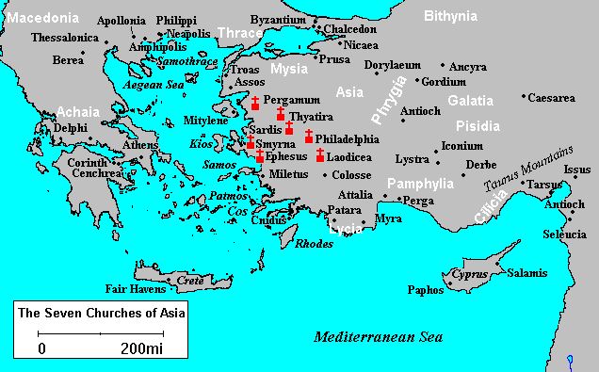

Slide 22
Five Reasons for persecution
They had a zeal for winning people to Christ!
They claimed obedience the King of kings and Lord of lords!
They refused to bow to pagan idols!

Slide 23
Five Reasons for persecution
They were rumored to be cannibals for “eating the body and blood of Jesus” at communion!
Simply, they were looked down upon as the trash of the earth!

Slide 24
Matthew 10:22
22 And ye shall be hated of all men for my name's sake: but he that endureth to the end shall be saved.

Slide 25
Matthew 24:9
9 Then shall they deliver you up to be afflicted, and shall kill you: and ye shall be hated of all nations for my name's sake.

Slide 26
John 15:18-21
18 If the world hate you, ye know that it hated me before it hated you. 19 If ye were of the world, the world would love his own: but because ye are not of the world, but I have chosen you out of the world, therefore the world hateth you.

Slide 27
John 15:18-21
20 Remember the word that I said unto you, The servant is not greater than his lord. If they have persecuted me, they will also persecute you; if they have kept my saying, they will keep yours also. 21 But all these things will they do unto you for my name's sake, because they know not him that sent me.

Slide 28
Acts 14:22
22 Confirming the souls of the disciples, and exhorting them to continue in the faith, and that we must through much tribulation enter into the kingdom of God.

Slide 29
1 Peter 2:18-21
18 Servants, be subject to your masters with all fear; not only to the good and gentle, but also to the froward. 19 For this is thankworthy, if a man for conscience toward God endure grief, suffering wrongfully.

Slide 30
1 Peter 2:18-21
20 For what glory is it, if, when ye be buffeted for your faults, ye shall take it patiently? but if, when ye do well, and suffer for it, ye take it patiently, this is acceptable with God.

Slide 31
1 Peter 2:18-21
21 For even hereunto were ye called: because Christ also suffered for us, leaving us an example, that ye should follow his steps:

Slide 32
The prophetic perspective

Slide 33
The prophetic perspective
The Seven Churches Represent ALL Churches
The Seven Churches Represent DIFFERENT Churches
The Seven Churches Represent Different CHURCH MEMBERS

Slide 34
Prophetic implications
Revelation 2:25 (KJV) ²⁵ But that which ye have already hold fast till I come.

Slide 35
Prophetic implications
Revelation 3:3 (KJV) ³ Remember therefore how thou hast received and heard, and hold fast, and repent. If therefore thou shalt not watch, I will come on thee as a thief, and thou shalt not know what hour I will come upon thee.

Slide 36
Prophetic implications
Revelation 3:11 (KJV) ¹¹ Behold, I come quickly: hold that fast which thou hast, that no man take thy crown.

Slide 37
Prophetic implications
Revelation 3:20 (KJV) ²⁰ Behold, I stand at the door, and knock: if any man hear my voice, and open the door, I will come in to him, and will sup with him, and he with me.

Slide 38
Format of the seven messages
SALUTATION
CHRIST’S IDENTIFICATION AS SENDER
A STATEMENT REGARDING THE CONDITION OF THE CHURCH
COMMENT AND EXHORTATION

Slide 39
FORMAT OF THE SEVEN MESSAGES
A PROMISED OR THREATENED COMING
AN ADMONITION TO HEED
A PROMISED BLESSING

Slide 40
Has the church failed?

Slide 41
John 6:37-40
37 All that the Father giveth me shall come to me; and him that cometh to me I will in no wise cast out. 38 For I came down from heaven, not to do mine own will, but the will of him that sent me.

Slide 42
John 6:37-40
39 And this is the Father's will which hath sent me, that of all which he hath given me I should lose nothing, but should raise it up again at the last day. 40 And this is the will of him that sent me, that every one which seeth the Son, and believeth on him, may have everlasting life: and I will raise him up at the last day.

Slide 43
1 Corinthians 9:22
²² To the weak became I as weak, that I might gain the weak: I am made all things to all men, that I might by all means save some.

Slide 44
Romans 8:30
Romans 8:30 (KJV) ³⁰ Moreover whom HE did predestinate, them HE also called: and whom HE called, them HE also justified: and whom HE justified, them HE also glorified.

