Slide 1
Revelation 19:7-10
Wednesday, June 25, 2014
Calvary Chapel of El Paso

Slide 2
Revelation 19:1
After these things I heard a loud voice of a great multitude in heaven, saying, "Alleluia! Salvation and glory and honor and power belong to the Lord our God!

Slide 3
Revelation 19:2
For true and righteous are His judgments, because He has judged the great harlot who corrupted the earth with her fornication; and He has avenged on her the blood of His servants shed by her."

Slide 4
Revelation 19:3
Again they said, "Alleluia! Her smoke rises up forever and ever!"

Slide 5
Revelation 19:4
And the twenty-four elders and the four living creatures fell down and worshiped God who sat on the throne, saying, "Amen! Alleluia!"

Slide 6
Revelation 19:5
Then a voice came from the throne, saying, "Praise our God, all you His servants and those who fear Him, both small and great!"

Slide 7
Revelation 19:6
And I heard, as it were, the voice of a great multitude, as the sound of many waters and as the sound of mighty thunderings, saying, "Alleluia! For the Lord God Omnipotent reigns!

Slide 8
Revelation 19:7
Let us be glad and rejoice and give Him glory, for the marriage of the Lamb has come, and His wife has made herself ready."

Slide 9
Revelation 19:8
And to her it was granted to be arrayed in fine linen, clean and bright, for the fine linen is the righteous acts of the saints.

Slide 10
Revelation 19:9
Then he said to me, "Write: 'Blessed are those who are called to the marriage supper of the Lamb!'" And he said to me, "These are the true sayings of God."

Slide 11
Revelation 19:10a
And I fell at his feet to worship him. But he said to me, "See that you do not do that! I am your fellow servant, and of your brethren who have the testimony of Jesus.

Slide 12
Revelation 19:10b
Worship God! For the testimony of Jesus is the spirit of prophecy."

Slide 14
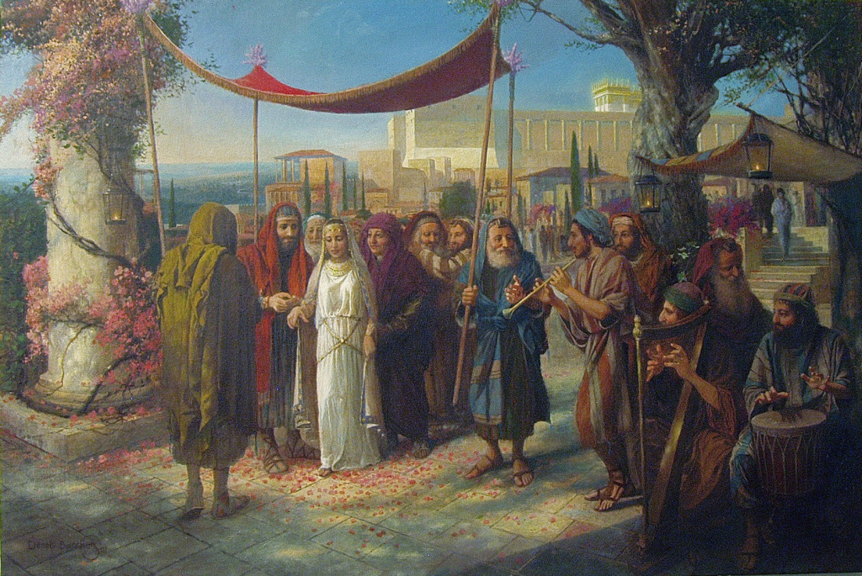

Slide 15
John 14:1
Let not your heart be troubled; you believe in God, believe also in Me.

Slide 16
John 14:2
In My Father's house are many mansions; if it were not so, I would have told you. I go to prepare a place for you.

Slide 17
John 14:3
And if I go and prepare a place for you, I will come again and receive you to Myself; that where I am, there you may be also.

Slide 18
Ephesians 5:25
Husbands, love your wives, just as Christ also loved the church and gave Himself for her,

Slide 19
John 3:16
For God so loved the world that He gave His only begotten Son, that whoever believes in Him should not perish but have everlasting life.

Slide 20
2 Corinthians 11:2
For I am jealous for you with godly jealousy. For I have betrothed you to one husband, that I may present you as a chaste virgin to Christ.

Slide 21
1 Thessalonians 4:16
For the Lord Himself will descend from heaven with a shout, with the voice of an archangel, and with the trumpet of God. And the dead in Christ will rise first.

Slide 22
1 Thessalonians 4:17
Then we who are alive and remain shall be caught up together with them in the clouds to meet the Lord in the air. And thus we shall always be with the Lord.

Slide 23
Revelation 19:7
Let us be glad and rejoice and give Him glory, for the marriage of the Lamb has come, and His wife has made herself ready."

Slide 24
Revelation 19:8
And to her it was granted to be arrayed in fine linen, clean and bright, for the fine linen is the righteous acts of the saints.

Slide 25
Zechariah 3:1
Then he showed me Joshua the high priest standing before the Angel of the LORD, and Satan standing at his right hand to oppose him.

Slide 26
Zechariah 3:2
And the LORD said to Satan, "The LORD rebuke you, Satan! The LORD who has chosen Jerusalem rebuke you! Is this not a brand plucked from the fire?"

Slide 27
Zechariah 3:3
Now Joshua was clothed with filthy garments, and was standing before the Angel.

Slide 28
Zechariah 3:4a
Then He answered and spoke to those who stood before Him, saying, "Take away the filthy garments from him."

Slide 29
Zechariah 3:4b
And to him He said, "See, I have removed your iniquity from you, and I will clothe you with rich robes."

Slide 30
Zechariah 3:5
And I said, "Let them put a clean turban on his head." So they put a clean turban on his head, and they put the clothes on him. And the Angel of the LORD stood by.

Slide 31
Isaiah 64:6
But we are all like an unclean thing, And all our righteousnesses are like filthy rags; We all fade as a leaf, And our iniquities, like the wind, Have taken us away.

Slide 32
Isaiah 61:10a
I will greatly rejoice in the LORD, My soul shall be joyful in my God; For He has clothed me with the garments of salvation,

Slide 33
Isaiah 61:10b
He has covered me with the robe of righteousness, As a bridegroom decks himself with ornaments, And as a bride adorns herself with her jewels.

Slide 34
Revelation 19:8
And to her it was granted to be arrayed in fine linen, clean and bright, for the fine linen is the righteous acts of the saints.

Slide 35
2 Corinthians 5:9
Therefore we make it our aim, whether present or absent, to be well pleasing to Him.

Slide 36
2 Corinthians 5:10
For we must all appear before the judgment seat of Christ, that each one may receive the things done in the body, according to what he has done, whether good or bad.

Slide 37
Revelation 19:9
Then he said to me, "Write: 'Blessed are those who are called to the marriage supper of the Lamb!'" And he said to me, "These are the true sayings of God."

Slide 38
Revelation 19:10a
And I fell at his feet to worship him. But he said to me, "See that you do not do that! I am your fellow servant, and of your brethren who have the testimony of Jesus.

Slide 39
Revelation 19:10b
Worship God! For the testimony of Jesus is the spirit of prophecy."

