Slide 1
Revelation 18:9-24
Wednesday, May 28, 2014
Calvary Chapel of El Paso

Slide 2
Revelation 18:9
"The kings of the earth who committed fornication and lived luxuriously with her will weep and lament for her, when they see the smoke of her burning,

Slide 3
Revelation 18:10
standing at a distance for fear of her torment, saying, 'Alas, alas, that great city Babylon, that mighty city! For in one hour your judgment has come.'

Slide 4
Fact One:
Israel is the key to understanding all of Bible Prophecy

Slide 5
Fact Two:
Some students of Bible Prophecy have over-emphasized the active involvement of Western countries, i.e. Europe…

Slide 6
Fact Three:
Notwithstanding, the Eastern countries (Turkey, Asia Minor, Middle East) have been under-emphasized as to their importance until recently

Slide 7
Fact Four:
Nonetheless, there is still plenty of evidence, biblically, historically, and currently, to know that there will be a global move toward One World Government…

Slide 8
Fact Four:
One World Religious cooperation, focused on a global rejection of the One true God and of salvation through His only begotten Son, Jesus the Messiah

Slide 9
Fact Five:
Antichrist is not only to be recognized as a person but must also be considered a system of animosity and aggression toward the Biblical, Judeo-Christian faith, and a representation of Satan’s goals and desires ultimately

Slide 10
Fact Six:
Not all nations shall be destroyed

Slide 11
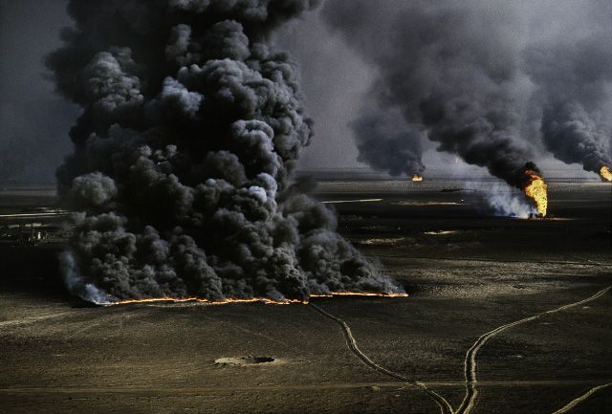

Slide 12
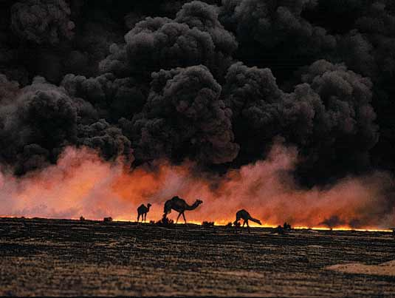

Slide 13
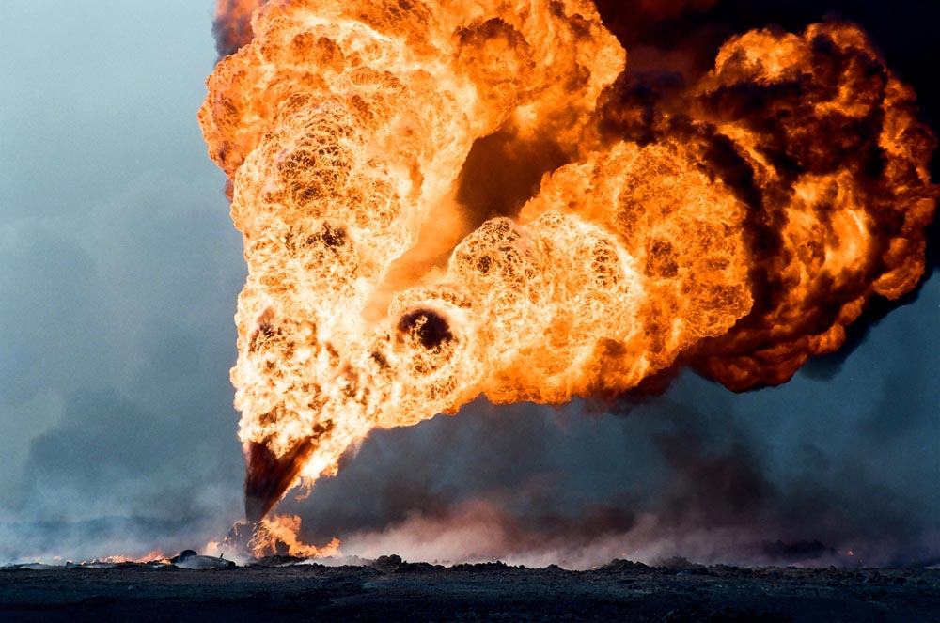

Slide 14
Revelation 18:8
Therefore her plagues will come in one day—death and mourning and famine. And she will be utterly burned with fire, for strong is the Lord God who judges her.

Slide 15
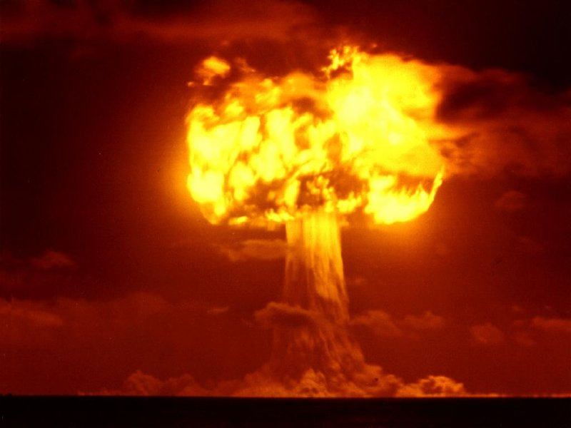

Slide 16
Revelation 18:11
And the merchants of the earth will weep and mourn over her, for no one buys their merchandise anymore:

Slide 17
Revelation 18:12
merchandise of gold and silver, precious stones and pearls, fine linen and purple, silk and scarlet, every kind of citron wood, every kind of object of ivory, every kind of object of most precious wood, bronze, iron, and marble;

Slide 18
Revelation 18:13
and cinnamon and incense, fragrant oil and frankincense, wine and oil, fine flour and wheat, cattle and sheep, horses and chariots, and bodies and souls of men.

Slide 19
Revelation 18:14
The fruit that your soul longed for has gone from you, and all the things which are rich and splendid have gone from you, and you shall find them no more at all.

Slide 20
Revelation 18:15
The merchants of these things, who became rich by her, will stand at a distance for fear of her torment, weeping and wailing,

Slide 21
Revelation 18:16
and saying, 'Alas, alas, that great city that was clothed in fine linen, purple, and scarlet, and adorned with gold and precious stones and pearls!

Slide 22
Revelation 18:17
For in one hour such great riches came to nothing.' Every shipmaster, all who travel by ship, sailors, and as many as trade on the sea, stood at a distance

Slide 23
Revelation 18:18
and cried out when they saw the smoke of her burning, saying, 'What is like this great city?'

Slide 24
Revelation 18:19
They threw dust on their heads and cried out, weeping and wailing, and saying, 'Alas, alas, that great city, in which all who had ships on the sea became rich by her wealth! For in one hour she is made desolate.'

Slide 25
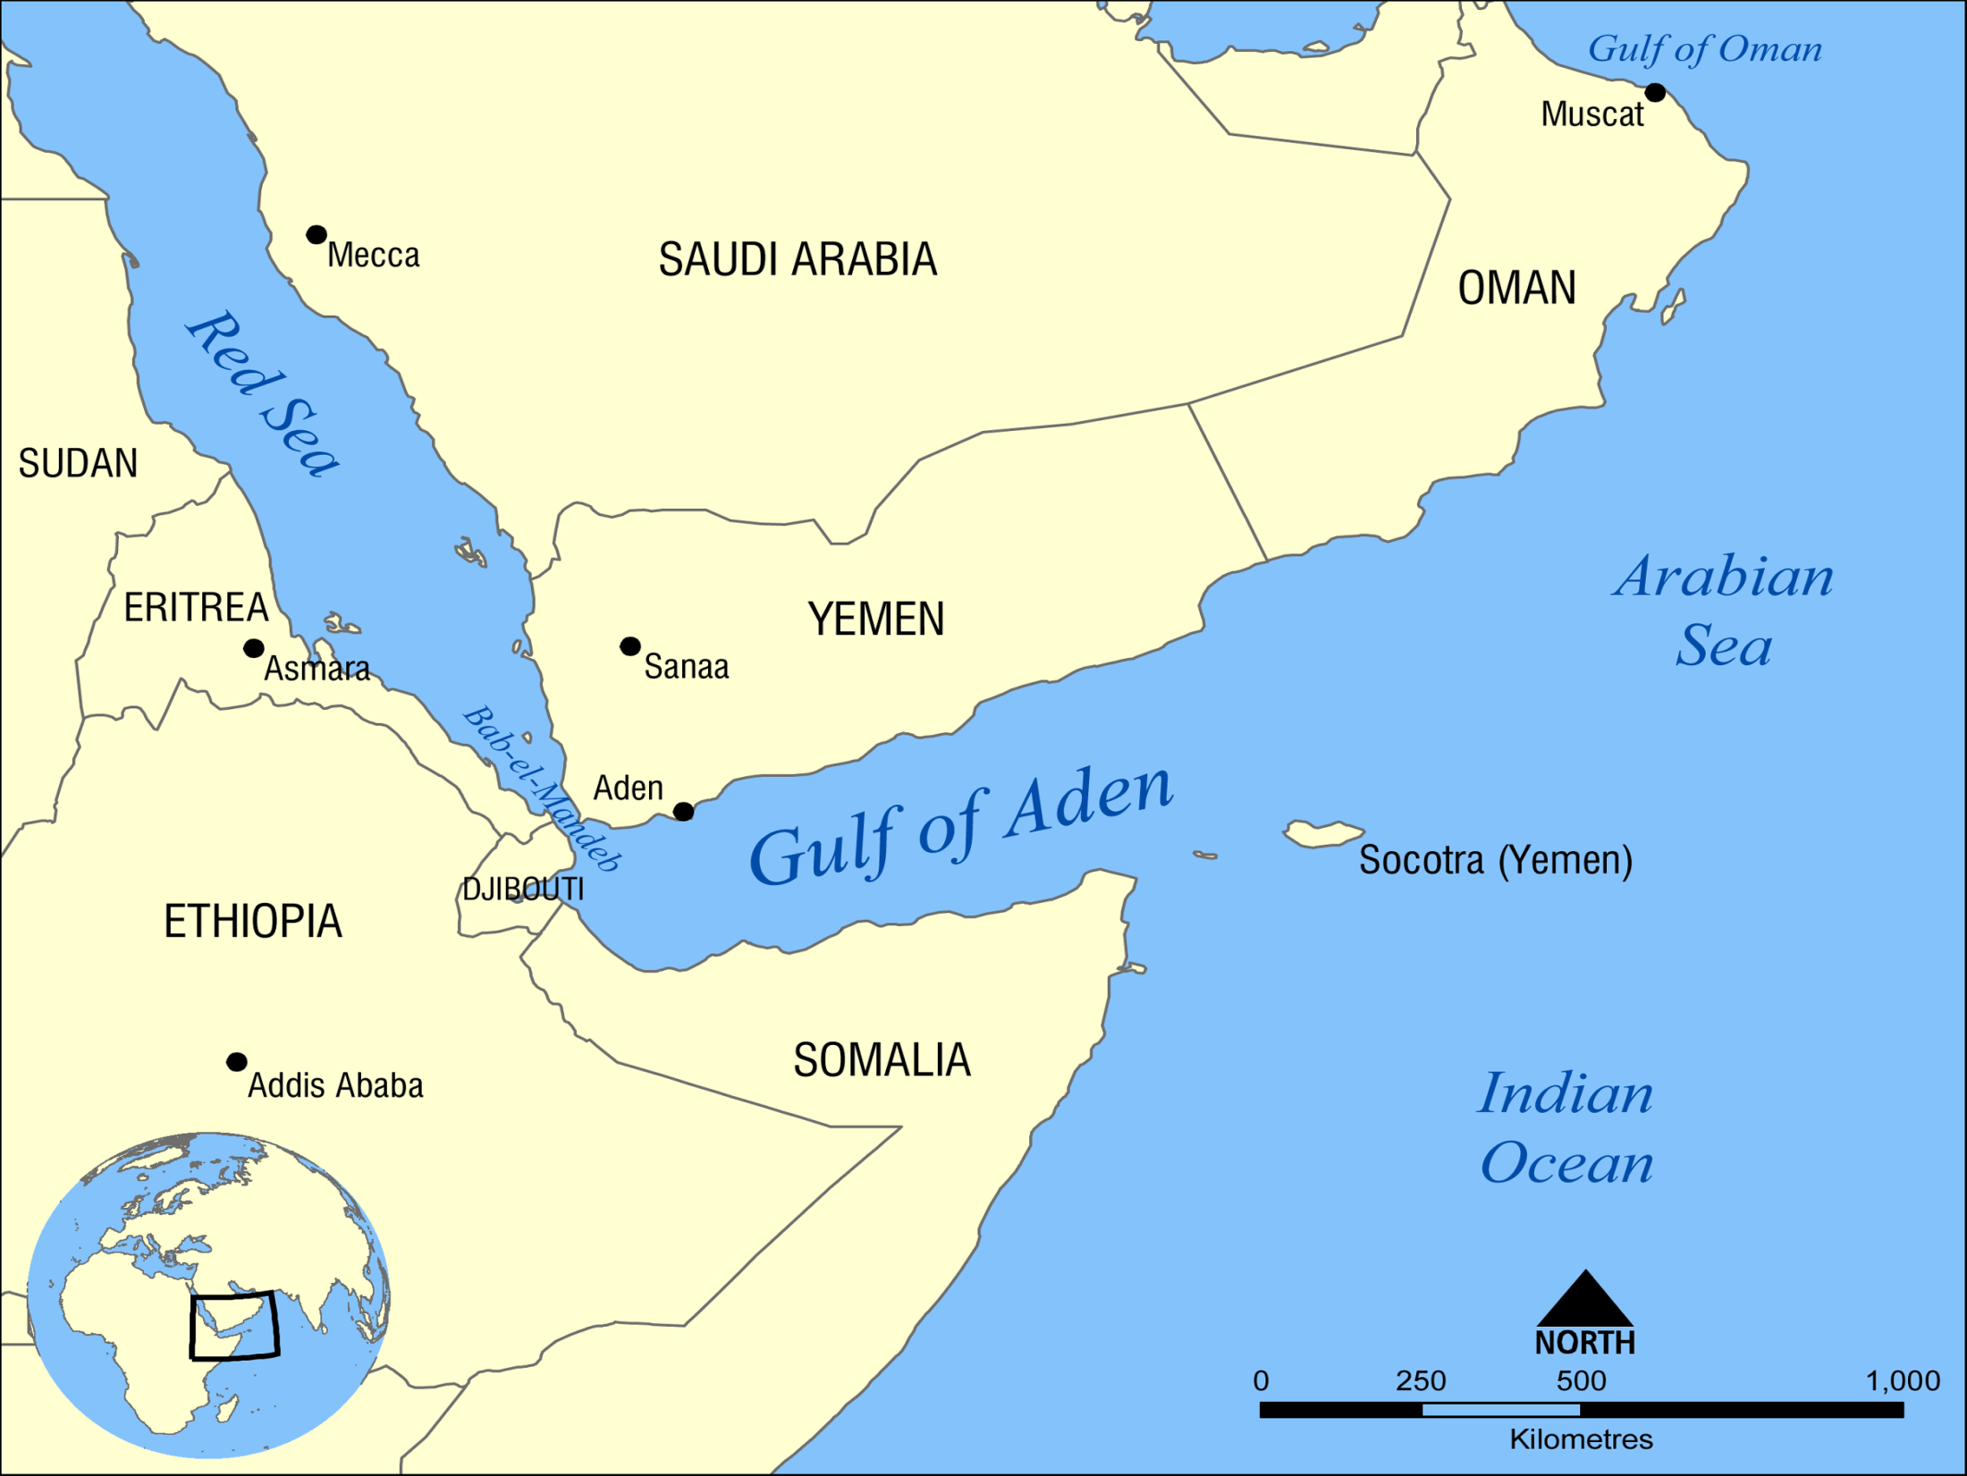

Slide 26
Ezekiel 27:12
Tarshish was your merchant because of your many luxury goods. They gave you silver, iron, tin, and lead for your goods.

Slide 27
Ezekiel 27:13
Javan, Tubal, and Meshech were your traders. They bartered human lives and vessels of bronze for your merchandise.

Slide 28
Ezekiel 27:27a
Your riches, wares, and merchandise, Your mariners and pilots, Your caulkers and merchandisers,

Slide 29
Ezekiel 27:27b
All your men of war who are in you, And the entire company which is in your midst, Will fall into the midst of the seas on the day of your ruin.

Slide 30
Romans 12:1
I beseech you therefore, brethren, by the mercies of God, that you present your bodies a living sacrifice, holy, acceptable to God, which is your reasonable service.

Slide 31
Romans 12:2
And do not be conformed to this world, but be transformed by the renewing of your mind, that you may prove what is that good and acceptable and perfect will of God.

Slide 32
Hebrews 11:10
for he waited for the city which has foundations, whose builder and maker is God.

Slide 33
Matthew 5:6
Blessed are those who hunger and thirst for righteousness, For they shall be filled.

Slide 34
Matthew 13:49
So it will be at the end of the age. The angels will come forth, separate the wicked from among the just,

Slide 35
Matthew 13:50
and cast them into the furnace of fire. There will be wailing and gnashing of teeth.

Slide 36
Mark 8:36
For what will it profit a man if he gains the whole world, and loses his own soul?

Slide 37
Revelation 18:20
Rejoice over her, O heaven, and you holy apostles and prophets, for God has avenged you on her!"

Slide 38
Revelation 18:21
Then a mighty angel took up a stone like a great millstone and threw it into the sea, saying, "Thus with violence the great city Babylon shall be thrown down, and shall not be found anymore.

Slide 39
Revelation 18:22a
The sound of harpists, musicians, flutists, and trumpeters shall not be heard in you anymore…

Slide 40
Revelation 18:22b
No craftsman of any craft shall be found in you anymore, and the sound of a millstone shall not be heard in you anymore.

Slide 41
Revelation 18:23a
The light of a lamp shall not shine in you anymore, and the voice of bridegroom and bride shall not be heard in you anymore.

Slide 42
Revelation 18:23b
For your merchants were the great men of the earth, for by your sorcery all the nations were deceived.

Slide 43
Revelation 18:24
And in her was found the blood of prophets and saints, and of all who were slain on the earth."

Slide 44
Jeremiah 51:63
Now it shall be, when you have finished reading this book, that you shall tie a stone to it and throw it out into the Euphrates.

Slide 45
Jeremiah 51:64
Then you shall say, 'Thus Babylon shall sink and not rise from the catastrophe that I will bring upon her. And they shall be weary.'" Thus far are the words of Jeremiah.

Slide 46
Matthew 18:6
But whoever causes one of these little ones who believe in Me to sin, it would be better for him if a millstone were hung around his neck, and he were drowned in the depth of the sea.

Slide 47
John 15:18
If the world hates you, you know that it hated Me before it hated you.

Slide 48
John 15:19
If you were of the world, the world would love its own. Yet because you are not of the world, but I chose you out of the world, therefore the world hates you.

Slide 49
John 15:20
Remember the word that I said to you, 'A servant is not greater than his master.' If they persecuted Me, they will also persecute you. If they kept My word, they will keep yours also.

Slide 50
