Slide 1
Revelation 18:3-8
Wednesday, May 21, 2014
Calvary Chapel of El Paso

Slide 2
Revelation 18:1
After these things I saw another angel coming down from heaven, having great authority, and the earth was illuminated with his glory.

Slide 3
Revelation 18:2
And he cried mightily with a loud voice, saying, "Babylon the great is fallen, is fallen, and has become a dwelling place of demons, a prison for every foul spirit, and a cage for every unclean and hated bird!

Slide 4
Revelation 18:3a
For all the nations have drunk of the wine of the wrath of her fornication, the kings of the earth have committed fornication with her,

Slide 5
Revelation 18:3b
and the merchants of the earth have become rich through the abundance of her luxury."

Slide 6
Revelation 18:4
And I heard another voice from heaven saying, "Come out of her, my people, lest you share in her sins, and lest you receive of her plagues.

Slide 7
Revelation 18:5
For her sins have reached to heaven, and God has remembered her iniquities.

Slide 8
Revelation 18:6
Render to her just as she rendered to you, and repay her double according to her works; in the cup which she has mixed, mix double for her.

Slide 9
Revelation 18:7
In the measure that she glorified herself and lived luxuriously, in the same measure give her torment and sorrow; for she says in her heart, 'I sit as queen, and am no widow, and will not see sorrow.'

Slide 10
Revelation 18:8
Therefore her plagues will come in one day—death and mourning and famine. And she will be utterly burned with fire, for strong is the Lord God who judges her.

Slide 11
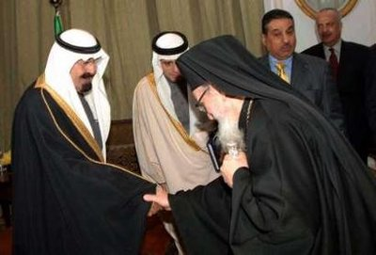

Slide 12
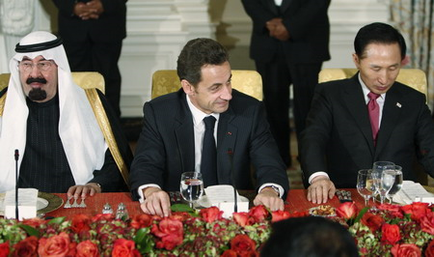

Slide 13
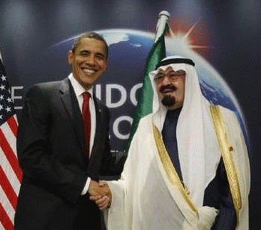

Slide 14
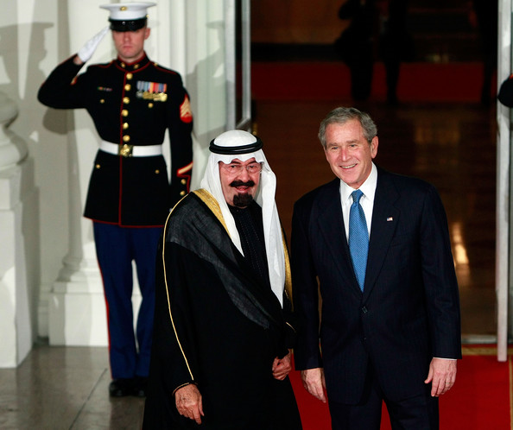

Slide 15
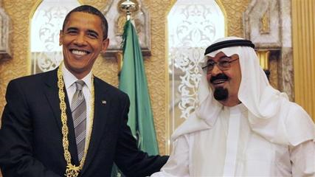

Slide 16
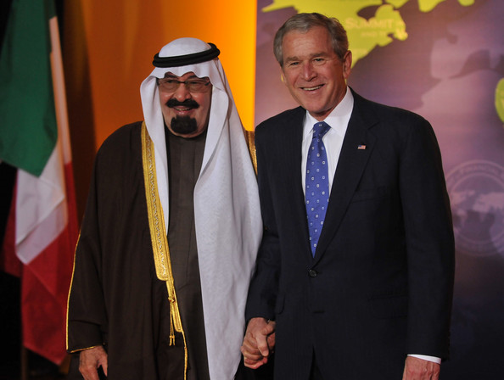

Slide 17
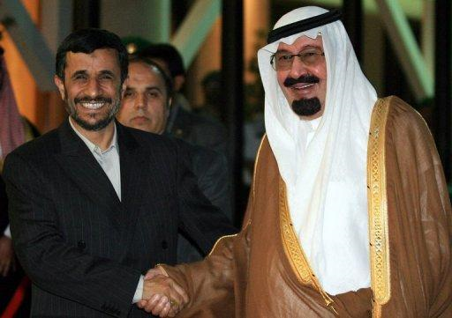

Slide 18
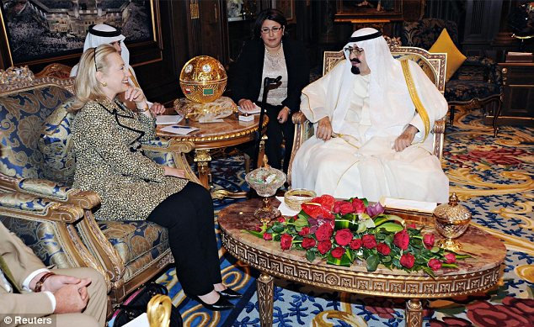

Slide 20
Galatians 4:22
For it is written that Abraham had two sons: the one by a bondwoman, the other by a freewoman.

Slide 21
Galatians 4:23
But he who was of the bondwoman was born according to the flesh, and he of the freewoman through promise,

Slide 22
Galatians 4:24
which things are symbolic. For these are the two covenants: the one from Mount Sinai which gives birth to bondage, which is Hagar—

Slide 23
Galatians 4:25
for this Hagar is Mount Sinai in Arabia, and corresponds to Jerusalem which now is, and is in bondage with her children—

Slide 24
Galatians 4:26
but the Jerusalem above is free, which is the mother of us all.

Slide 25
Exodus 16:1a
And they journeyed from Elim, and all the congregation of the children of Israel came to the Wilderness of Sin,

Slide 26
Exodus 16:1b
which is between Elim and Sinai, on the fifteenth day of the second month after they departed from the land of Egypt.

Slide 27
Judges 8:21a
So Zebah and Zalmunna said, "Rise yourself, and kill us; for as a man is, so is his strength."

Slide 28
Judges 8:21b
So Gideon arose and killed Zebah and Zalmunna, and took the crescent ornaments that were on their camels' necks.

Slide 29
Isaiah 14:12
How you are fallen from heaven, O Lucifer, son of the morning! How you are cut down to the ground, You who weakened the nations!

Slide 30
Revelation 18:4
And I heard another voice from heaven saying, "Come out of her, my people, lest you share in her sins, and lest you receive of her plagues.

Slide 31
Revelation 18:5
For her sins have reached to heaven, and God has remembered her iniquities.

Slide 32
Isaiah 48:20
Go forth from Babylon! Flee from the Chaldeans! With a voice of singing, Declare, proclaim this, Utter it to the end of the earth; Say, "The LORD has redeemed His servant Jacob!"

Slide 33
Isaiah 52:11
Depart! Depart! Go out from there, Touch no unclean thing; Go out from the midst of her, Be clean, You who bear the vessels of the LORD.

Slide 34
Jeremiah 50:8
Move from the midst of Babylon, Go out of the land of the Chaldeans; And be like the rams before the flocks.

Slide 35
Jeremiah 51:6
Flee from the midst of Babylon, And every one save his life! Do not be cut off in her iniquity, For this is the time of the LORD'S vengeance; He shall recompense her.

Slide 36
Jeremiah 51:45
My people, go out of the midst of her! And let everyone deliver himself from the fierce anger of the LORD.

Slide 37
2 Corinthians 6:14
Do not be unequally yoked together with unbelievers. For what fellowship has righteousness with lawlessness? And what communion has light with darkness?

Slide 38
2 Corinthians 6:17
Therefore "Come out from among them And be separate, says the Lord. Do not touch what is unclean, And I will receive you."

Slide 39
John 17:14
I have given them Your word; and the world has hated them because they are not of the world, just as I am not of the world.

Slide 40
John 17:15
I do not pray that You should take them out of the world, but that You should keep them from the evil one.

Slide 41
John 17:16
They are not of the world, just as I am not of the world.

Slide 42
Jeremiah 51:9
We would have healed Babylon, But she is not healed. Forsake her, and let us go everyone to his own country; For her judgment reaches to heaven and is lifted up to the skies.

Slide 43
Revelation 18:5
For her sins have reached to heaven, and God has remembered her iniquities.

Slide 44
Revelation 18:6
Render to her just as she rendered to you, and repay her double according to her works; in the cup which she has mixed, mix double for her.

Slide 45
Revelation 18:7
In the measure that she glorified herself and lived luxuriously, in the same measure give her torment and sorrow; for she says in her heart, 'I sit as queen, and am no widow, and will not see sorrow.'

Slide 46
Revelation 18:8
Therefore her plagues will come in one day—death and mourning and famine. And she will be utterly burned with fire, for strong is the Lord God who judges her.

Slide 47
Isaiah 47:7
And you said, 'I shall be a lady forever,' So that you did not take these things to heart, Nor remember the latter end of them.

Slide 48
Isaiah 47:8a
"Therefore hear this now, you who are given to pleasures, Who dwell securely, Who say in your heart, 'I am, and there is no one else besides me;

Slide 49
Isaiah 47:8b
I shall not sit as a widow, Nor shall I know the loss of children'

Slide 50
Isaiah 47:9a
But these two things shall come to you In a moment, in one day: The loss of children, and widowhood.

Slide 51
Isaiah 47:9b
They shall come upon you in their fullness Because of the multitude of your sorceries, For the great abundance of your enchantments.

Slide 52
Isaiah 47:10
"For you have trusted in your wickedness; You have said, 'No one sees me'; Your wisdom and your knowledge have warped you; And you have said in your heart, 'I am, and there is no one else besides me.'

Slide 53
Isaiah 47:11a
Therefore evil shall come upon you; You shall not know from where it arises. And trouble shall fall upon you; You will not be able to put it off.

Slide 54
Isaiah 47:11b
And desolation shall come upon you suddenly, Which you shall not know.

Slide 55
Isaiah 47:15
Thus shall they be to you With whom you have labored, Your merchants from your youth; They shall wander each one to his quarter. No one shall save you.

Slide 56
Luke 14:11
For whoever exalts himself will be humbled, and he who humbles himself will be exalted.

Slide 57
