Slide 1
Revelation 18:1-3
Wednesday, May 14, 2014
Calvary Chapel of El Paso

Slide 2
Revelation 18:1
After these things I saw another angel coming down from heaven, having great authority, and the earth was illuminated with his glory.

Slide 3
Revelation 18:2
And he cried mightily with a loud voice, saying, "Babylon the great is fallen, is fallen, and has become a dwelling place of demons, a prison for every foul spirit, and a cage for every unclean and hated bird!

Slide 4
Revelation 18:3a
For all the nations have drunk of the wine of the wrath of her fornication, the kings of the earth have committed fornication with her,

Slide 5
Revelation 18:3b
and the merchants of the earth have become rich through the abundance of her luxury."

Slide 6
Revelation 18:4
And I heard another voice from heaven saying, "Come out of her, my people, lest you share in her sins, and lest you receive of her plagues.

Slide 7
Revelation 18:5
For her sins have reached to heaven, and God has remembered her iniquities.

Slide 8
Revelation 18:6
Render to her just as she rendered to you, and repay her double according to her works; in the cup which she has mixed, mix double for her.

Slide 9
Revelation 18:7
In the measure that she glorified herself and lived luxuriously, in the same measure give her torment and sorrow; for she says in her heart, 'I sit as queen, and am no widow, and will not see sorrow.'

Slide 10
Revelation 18:8
Therefore her plagues will come in one day—death and mourning and famine. And she will be utterly burned with fire, for strong is the Lord God who judges her.

Slide 12
Isaiah 21:9
And look, here comes a chariot of men with a pair of horsemen!" Then he answered and said, "Babylon is fallen, is fallen! And all the carved images of her gods He has broken to the ground."

Slide 13
Revelation 14:8
And another angel followed, saying, "Babylon is fallen, is fallen, that great city, because she has made all nations drink of the wine of the wrath of her fornication."

Slide 14
Jeremiah 51:7
Babylon was a golden cup in the LORD'S hand, That made all the earth drunk. The nations drank her wine; Therefore the nations are deranged.

Slide 15
Jeremiah 51:8
Babylon has suddenly fallen and been destroyed. Wail for her! Take balm for her pain; Perhaps she may be healed.

Slide 16
Revelation 18:1
After these things I saw another angel coming down from heaven, having great authority, and the earth was illuminated with his glory.

Slide 17
Revelation 18:2
And he cried mightily with a loud voice, saying, "Babylon the great is fallen, is fallen, and has become a dwelling place of demons, a prison for every foul spirit, and a cage for every unclean and hated bird!

Slide 18
Revelation 18:3a
For all the nations have drunk of the wine of the wrath of her fornication, the kings of the earth have committed fornication with her,

Slide 19
Revelation 18:3b
and the merchants of the earth have become rich through the abundance of her luxury."

Slide 20
Ephesians 2:19
Now, therefore, you are no longer strangers and foreigners, but fellow citizens with the saints and members of the household of God,

Slide 21
Ephesians 2:20
having been built on the foundation of the apostles and prophets, Jesus Christ Himself being the chief corner stone,

Slide 22
Ephesians 2:21
in whom the whole building, being joined together, grows into a holy temple in the Lord,

Slide 23
Ephesians 2:22
in whom you also are being built together for a dwelling place of God in the Spirit.

Slide 24
1 Corinthians 2:11
For what man knows the things of a man except the spirit of the man which is in him? Even so no one knows the things of God except the Spirit of God.

Slide 25
1 Corinthians 2:12
Now we have received, not the spirit of the world, but the Spirit who is from God, that we might know the things that have been freely given to us by God.

Slide 26
Ephesians 2:2
in which you once walked according to the course of this world, according to the prince of the power of the air, the spirit who now works in the sons of disobedience,

Slide 27
1 John 4:6
We are of God. He who knows God hears us; he who is not of God does not hear us. By this we know the spirit of truth and the spirit of error.

Slide 28
Romans 8:15
For you did not receive the spirit of bondage again to fear, but you received the Spirit of adoption by whom we cry out, "Abba, Father."

Slide 29
1 John 4:1
Beloved, do not believe every spirit, but test the spirits, whether they are of God; because many false prophets have gone out into the world.

Slide 30
1 John 4:2
By this you know the Spirit of God: Every spirit that confesses that Jesus Christ has come in the flesh is of God,

Slide 31
1 John 4:3
and every spirit that does not confess that Jesus Christ has come in the flesh is not of God. And this is the spirit of the Antichrist, which you have heard was coming, and is now already in the world.

Slide 32
1 John 2:21
I have not written to you because you do not know the truth, but because you know it, and that no lie is of the truth.

Slide 33
1 John 2:22
Who is a liar but he who denies that Jesus is the Christ? He is antichrist who denies the Father and the Son.

Slide 34
1 John 2:23
Whoever denies the Son does not have the Father either; he who acknowledges the Son has the Father also.

Slide 35
Mark 4:14
The sower sows the word.

Slide 36
Mark 4:15
And these are the ones by the wayside where the word is sown. When they hear, Satan comes immediately and takes away the word that was sown in their hearts.

Slide 37
Revelation 18:3a
For all the nations have drunk of the wine of the wrath of her fornication, the kings of the earth have committed fornication with her,

Slide 38
Revelation 18:3b
and the merchants of the earth have become rich through the abundance of her luxury."

Slide 39
Isaiah 21:1
The burden of the desert of the sea. As whirlwinds in the south pass through; so it cometh from the desert, from a terrible land.

Slide 40
Isaiah 21:1
The burden against the Wilderness of the Sea. As whirlwinds in the South pass through, So it comes from the desert, from a terrible land.

Slide 41
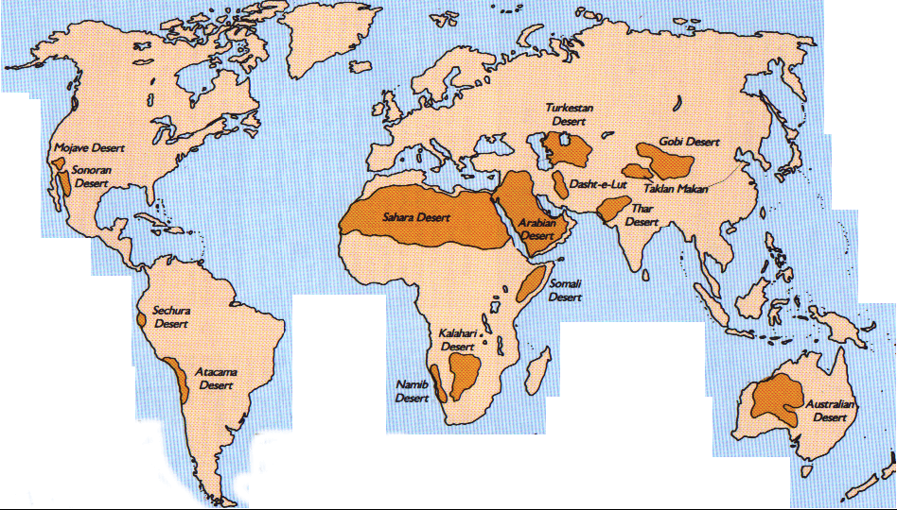

Slide 42
Galatians 4:22
For it is written that Abraham had two sons: the one by a bondwoman, the other by a freewoman.

Slide 43
Galatians 4:23
But he who was of the bondwoman was born according to the flesh, and he of the freewoman through promise,

Slide 44
Galatians 4:24
which things are symbolic. For these are the two covenants: the one from Mount Sinai which gives birth to bondage, which is Hagar—

Slide 45
Galatians 4:25
for this Hagar is Mount Sinai in Arabia, and corresponds to Jerusalem which now is, and is in bondage with her children—

Slide 46
Galatians 4:26
but the Jerusalem above is free, which is the mother of us all.

Slide 47
Revelation 21:1
Now I saw a new heaven and a new earth, for the first heaven and the first earth had passed away. Also there was no more sea.

Slide 48
Revelation 21:2
Then I, John, saw the holy city, New Jerusalem, coming down out of heaven from God, prepared as a bride adorned for her husband.

Slide 49
Revelation 21:3
And I heard a loud voice from heaven saying, "Behold, the tabernacle of God is with men, and He will dwell with them, and they shall be His people. God Himself will be with them and be their God.

Slide 50
Revelation 21:4
And God will wipe away every tear from their eyes; there shall be no more death, nor sorrow, nor crying. There shall be no more pain, for the former things have passed away."

Slide 51
