Slide 1
Revelation 17:12-18
Wednesday, April 23, 2014
Calvary Chapel of El Paso

Slide 2
Revelation 17:12
The ten horns which you saw are ten kings who have received no kingdom as yet, but they receive authority for one hour as kings with the beast.

Slide 3
Revelation 17:13
These are of one mind, and they will give their power and authority to the beast.

Slide 4
Revelation 17:14
These will make war with the Lamb, and the Lamb will overcome them, for He is Lord of lords and King of kings; and those who are with Him are called, chosen, and faithful."

Slide 5
Revelation 17:15
Then he said to me, "The waters which you saw, where the harlot sits, are peoples, multitudes, nations, and tongues.

Slide 6
Revelation 17:16
And the ten horns which you saw on the beast, these will hate the harlot, make her desolate and naked, eat her flesh and burn her with fire.

Slide 7
Revelation 17:17
For God has put it into their hearts to fulfill His purpose, to be of one mind, and to give their kingdom to the beast, until the words of God are fulfilled.

Slide 8
Revelation 17:18
And the woman whom you saw is that great city which reigns over the kings of the earth."

Slide 9
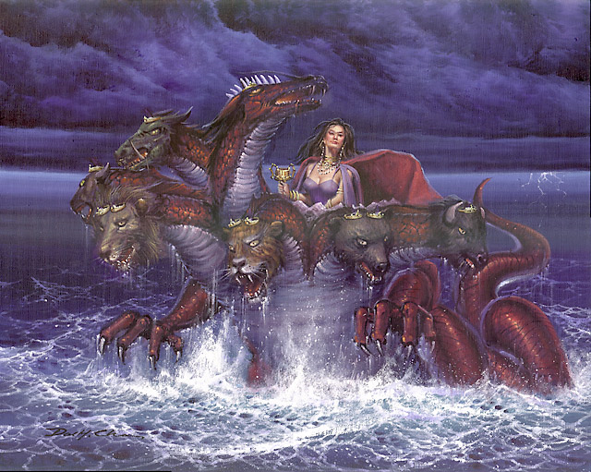

Slide 10
Daniel 12:4
"But you, Daniel, shut up the words, and seal the book until the time of the end; many shall run to and fro, and knowledge shall increase."

Slide 11
May 14, 1948
Establishment of the State of Israel

Slide 12
May 15, 1948
Israel Invaded by Five Arab States

Slide 13
1948-1949
Israel’s War of Independence

Slide 14
1956
The Sinai Campaign:
Israel fought to put an end to the terrorist incursions into Israel and to remove the Egyptian blockade of Eilat

Slide 15
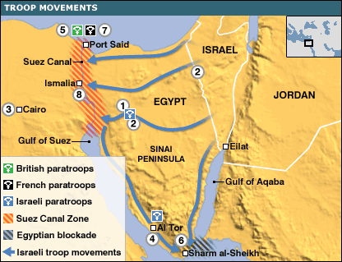

Slide 16
1967
Egyptian President Gamal Abdel Nasser closes straits of Tiran to Israeli shipping

Slide 17
June 5-10, 1967
Six Day War leads to reunification of Jerusalem under Israeli rule

Slide 18
1973
Yom Kippur War: surprise attack on Israel by Egypt and Syria

Slide 19
Genesis 3:9
Then the LORD God called to Adam and said to him, "Where are you?"

Slide 20
Genesis 3:10
So he said, "I heard Your voice in the garden, and I was afraid because I was naked; and I hid myself."

Slide 21
Genesis 3:11
And He said, "Who told you that you were naked? Have you eaten from the tree of which I commanded you that you should not eat?"

Slide 22
Genesis 3:12
Then the man said, "The woman whom You gave to be with me, she gave me of the tree, and I ate."

Slide 23
Genesis 3:13
And the LORD God said to the woman, "What is this you have done?" The woman said, "The serpent deceived me, and I ate."

Slide 24
Genesis 3:14
So the LORD God said to the serpent: "Because you have done this, You are cursed more than all cattle, And more than every beast of the field; On your belly you shall go, And you shall eat dust All the days of your life.

Slide 25
Genesis 3:15
And I will put enmity Between you and the woman, And between your seed and her Seed; He shall bruise your head, And you shall bruise His heel."

Slide 26
Genesis 3:1
Now the serpent was more cunning than any beast of the field which the LORD God had made. And he said to the woman, "Has God indeed said, 'You shall not eat of every tree of the garden'?"

Slide 27
Genesis 3:2
And the woman said to the serpent, "We may eat the fruit of the trees of the garden;

Slide 28
Genesis 3:3
but of the fruit of the tree which is in the midst of the garden, God has said, 'You shall not eat it, nor shall you touch it, lest you die.'"

Slide 29
Genesis 3:4
Then the serpent said to the woman, "You will not surely die.

Slide 30
Genesis 3:5
For God knows that in the day you eat of it your eyes will be opened, and you will be like God, knowing good and evil."

Slide 31
John 8:44a
You are of your father the devil, and the desires of your father you want to do. He was a murderer from the beginning, and does not stand in the truth,

Slide 32
John 8:44b
because there is no truth in him. When he speaks a lie, he speaks from his own resources, for he is a liar and the father of it.

Slide 33
2 Thessalonians 2:9
The coming of the lawless one is according to the working of Satan, with all power, signs, and lying wonders,

Slide 34
2 Thessalonians 2:10
and with all unrighteous deception among those who perish, because they did not receive the love of the truth, that they might be saved.

Slide 35
2 Thessalonians 2:11
And for this reason God will send them strong delusion, that they should believe the lie,

Slide 36
2 Thessalonians 2:12
that they all may be condemned who did not believe the truth but had pleasure in unrighteousness.

Slide 37
Daniel 11:36a
Then the king shall do according to his own will: he shall exalt and magnify himself above every god, shall speak blasphemies against the God of gods,

Slide 38
Daniel 11:36b
and shall prosper till the wrath has been accomplished; for what has been determined shall be done.

Slide 39
Daniel 11:37
He shall regard neither the God (gods) of his fathers nor the desire of women, nor regard any god; for he shall exalt himself above them all.

Slide 40
Daniel 11:38
But in their place he shall honor a god of fortresses; and a god which his fathers did not know he shall honor with gold and silver, with precious stones and pleasant things.

Slide 41
Daniel 11:39
Thus he shall act against the strongest fortresses with a foreign god, which he shall acknowledge, and advance its glory; and he shall cause them to rule over many, and divide the land for gain.

Slide 42
Revelation 12:1
Now a great sign appeared in heaven: a woman clothed with the sun, with the moon under her feet, and on her head a garland of twelve stars.

Slide 43
Revelation 12:2
Then being with child, she cried out in labor and in pain to give birth.

Slide 44
Revelation 12:3
And another sign appeared in heaven: behold, a great, fiery red dragon having seven heads and ten horns, and seven diadems on his heads.

Slide 45
Revelation 12:4
His tail drew a third of the stars of heaven and threw them to the earth. And the dragon stood before the woman who was ready to give birth, to devour her Child as soon as it was born.

Slide 46
Revelation 12:5
She bore a male Child who was to rule all nations with a rod of iron. And her Child was caught up to God and His throne.

Slide 47
Revelation 12:6
Then the woman fled into the wilderness, where she has a place prepared by God, that they should feed her there one thousand two hundred and sixty days.

Slide 48
Mother and Child Worship
Isis and Osiris in Egypt
Fortuna and Jupiter in Rome
Aphrodite and Eros in Greece
Venus and Cupid (also in Rome)
Mary and the baby Jesus

Slide 49
Luke 1:46
And Mary said: "My soul magnifies the Lord,

Slide 50
Luke 1:47
And my spirit has rejoiced in God my Savior.

Slide 51
Luke 1:48
For He has regarded the lowly state of His maidservant; For behold, henceforth all generations will call me blessed.

Slide 52
Luke 1:49
For He who is mighty has done great things for me, And holy is His name.

Slide 53
Luke 1:50
And His mercy is on those who fear Him From generation to generation.

Slide 54
Luke 1:51
He has shown strength with His arm; He has scattered the proud in the imagination of their hearts.

Slide 55
Luke 1:52
He has put down the mighty from their thrones, And exalted the lowly.

Slide 56
Luke 1:53
He has filled the hungry with good things, And the rich He has sent away empty.

Slide 57
Luke 1:54
He has helped His servant Israel, In remembrance of His mercy,

Slide 58
Luke 1:55
As He spoke to our fathers, To Abraham and to his seed forever."

