Slide 1
Revelation 17:7-11
Wednesday, April 16, 2014
Calvary Chapel of El Paso

Slide 2
Revelation 17:7
But the angel said to me, "Why did you marvel? I will tell you the mystery of the woman and of the beast that carries her, which has the seven heads and the ten horns.

Slide 3
Revelation 17:8a
The beast that you saw was, and is not, and will ascend out of the bottomless pit and go to perdition. And those who dwell on the earth will marvel,

Slide 4
Revelation 17:8b
whose names are not written in the Book of Life from the foundation of the world, when they see the beast that was, and is not, and yet is.

Slide 5
Revelation 17:9
Here is the mind which has wisdom: The seven heads are seven mountains on which the woman sits.

Slide 6
Revelation 17:10
There are also seven kings. Five have fallen, one is, and the other has not yet come. And when he comes, he must continue a short time.

Slide 7
Revelation 17:11
And the beast that was, and is not, is himself also the eighth, and is of the seven, and is going to perdition.

Slide 8
Revelation 17:12
The ten horns which you saw are ten kings who have received no kingdom as yet, but they receive authority for one hour as kings with the beast.

Slide 9
Revelation 17:13
These are of one mind, and they will give their power and authority to the beast.

Slide 10
Revelation 17:14
These will make war with the Lamb, and the Lamb will overcome them, for He is Lord of lords and King of kings; and those who are with Him are called, chosen, and faithful."

Slide 13
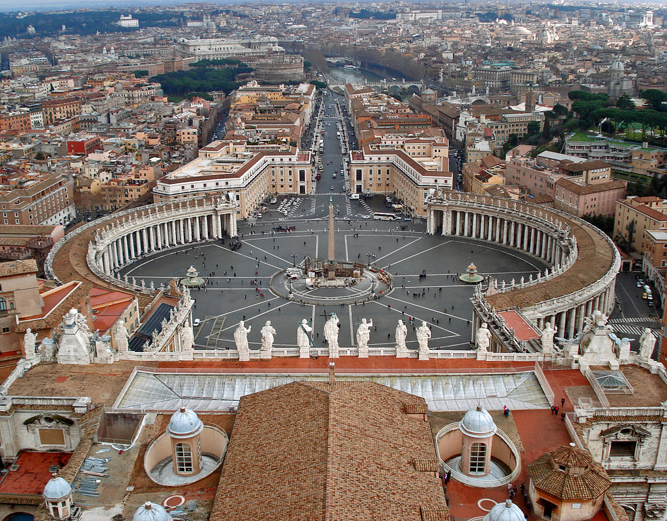

Slide 14
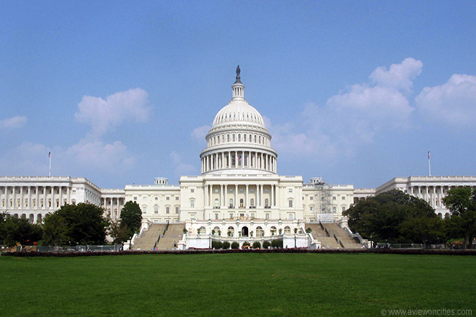

Slide 16
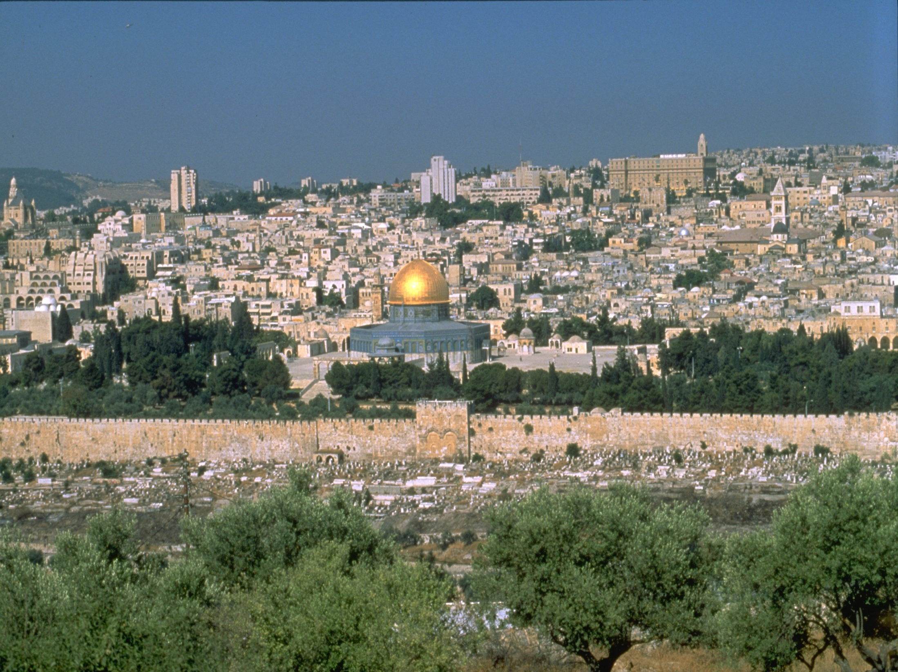

Slide 17
2 Corinthians 11:2
For I am jealous for you with godly jealousy. For I have betrothed you to one husband, that I may present you as a chaste virgin to Christ.

Slide 18
2 Corinthians 11:3
But I fear, lest somehow, as the serpent deceived Eve by his craftiness, so your minds may be corrupted from the simplicity that is in Christ.

Slide 19
2 Corinthians 11:4a
For if he who comes preaches another Jesus whom we have not preached, or if you receive a different spirit which you have not received,

Slide 20
2 Corinthians 11:4b
or a different gospel which you have not accepted—you may well put up with it!

Slide 21
United Religions Initiative?

Slide 22
1 Thessalonians 5:1
But concerning the times and the seasons, brethren, you have no need that I should write to you.

Slide 23
1 Thessalonians 5:2
For you yourselves know perfectly that the day of the Lord so comes as a thief in the night.

Slide 24
1 Thessalonians 5:3
For when they say, "Peace and safety!" then sudden destruction comes upon them, as labor pains upon a pregnant woman. And they shall not escape.

Slide 25
Revelation 17:7
But the angel said to me, "Why did you marvel? I will tell you the mystery of the woman and of the beast that carries her, which has the seven heads and the ten horns.

Slide 26
Revelation 17:8a
The beast that you saw was, and is not, and will ascend out of the bottomless pit and go to perdition. And those who dwell on the earth will marvel,

Slide 27
Revelation 17:8b
whose names are not written in the Book of Life from the foundation of the world, when they see the beast that was, and is not, and yet is.

Slide 28
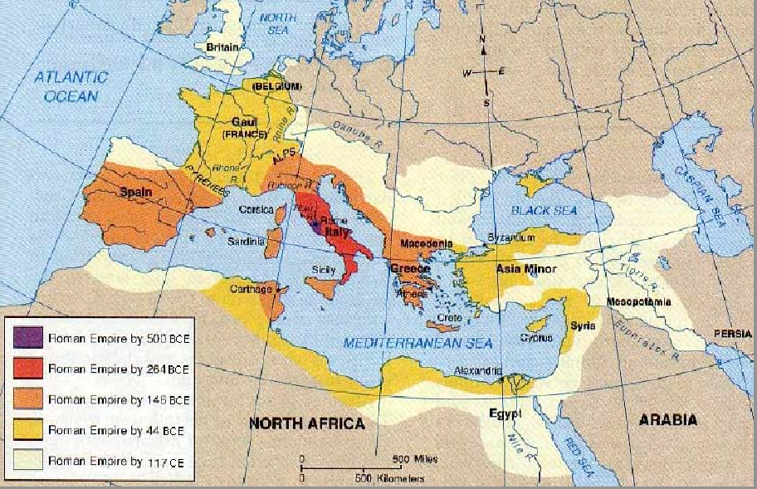

Slide 29
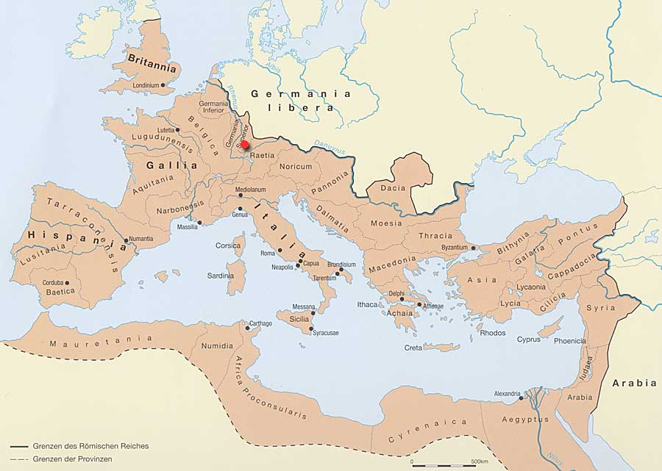

Slide 30
Revelation 17:9
Here is the mind which has wisdom: The seven heads are seven mountains on which the woman sits.

Slide 31
Revelation 17:10
There are also seven kings. Five have fallen, one is, and the other has not yet come. And when he comes, he must continue a short time.

Slide 32
Five have Fallen:
Egyptian
Assyrian
Babylonian
Medo-Persian
Greek

Slide 33
Revelation 17:11
And the beast that was, and is not, is himself also the eighth, and is of the seven, and is going to perdition.

Slide 34
Revelation 13:3
And I saw one of his heads as if it had been mortally wounded, and his deadly wound was healed. And all the world marveled and followed the beast.

Slide 35
Revelation 13:4
So they worshiped the dragon who gave authority to the beast; and they worshiped the beast, saying, "Who is like the beast? Who is able to make war with him?"

Slide 36
Revelation 13:5
And he was given a mouth speaking great things and blasphemies, and he was given authority to continue for forty-two months.

Slide 37
Titus 2:11
For the grace of God that brings salvation has appeared to all men,

Slide 38
Titus 2:12
teaching us that, denying ungodliness and worldly lusts, we should live soberly, righteously, and godly in the present age,

Slide 39
Titus 2:13
looking for the blessed hope and glorious appearing of our great God and Savior Jesus Christ,

Slide 40
Titus 2:14
who gave Himself for us, that He might redeem us from every lawless deed and purify for Himself His own special people, zealous for good works.

Slide 41
Titus 2:15
Speak these things, exhort, and rebuke with all authority. Let no one despise you.

Slide 42
1 Thessalonians 5:7
For those who sleep, sleep at night, and those who get drunk are drunk at night.

Slide 43
1 Thessalonians 5:8
But let us who are of the day be sober, putting on the breastplate of faith and love, and as a helmet the hope of salvation.

Slide 44
1 Thessalonians 5:9
For God did not appoint us to wrath, but to obtain salvation through our Lord Jesus Christ,

Slide 45
1 Thessalonians 5:10
who died for us, that whether we wake or sleep, we should live together with Him.

Slide 46
1 Thessalonians 5:11
Therefore comfort each other and edify one another, just as you also are doing.

