Slide 1
Revelation 17:1-3, Part 2
Wednesday, April 9, 2014
Calvary Chapel of El Paso

Slide 2
Revelation 17:1
Then one of the seven angels who had the seven bowls came and talked with me, saying to me, "Come, I will show you the judgment of the great harlot who sits on many waters,

Slide 3
Revelation 17:2
with whom the kings of the earth committed fornication, and the inhabitants of the earth were made drunk with the wine of her fornication."

Slide 4
Revelation 17:3
So he carried me away in the Spirit into the wilderness. And I saw a woman sitting on a scarlet beast which was full of names of blasphemy, having seven heads and ten horns.

Slide 5
Revelation 17:4
The woman was arrayed in purple and scarlet, and adorned with gold and precious stones and pearls, having in her hand a golden cup full of abominations and the filthiness of her fornication.

Slide 6
Revelation 17:5
And on her forehead a name was written: MYSTERY, BABYLON THE GREAT, THE MOTHER OF HARLOTS AND OF THE ABOMINATIONS OF THE EARTH.

Slide 7
Revelation 17:6
I saw the woman, drunk with the blood of the saints and with the blood of the martyrs of Jesus. And when I saw her, I marveled with great amazement.

Slide 8
Revelation 17:7
But the angel said to me, "Why did you marvel? I will tell you the mystery of the woman and of the beast that carries her, which has the seven heads and the ten horns.

Slide 9
Revelation 17:8a
The beast that you saw was, and is not, and will ascend out of the bottomless pit and go to perdition. And those who dwell on the earth will marvel,

Slide 10
Revelation 17:8b
whose names are not written in the Book of Life from the foundation of the world, when they see the beast that was, and is not, and yet is.

Slide 11
Revelation 17:9
Here is the mind which has wisdom: The seven heads are seven mountains on which the woman sits.

Slide 12
Revelation 17:10
There are also seven kings. Five have fallen, one is, and the other has not yet come. And when he comes, he must continue a short time.

Slide 13
Revelation 17:11
And the beast that was, and is not, is himself also the eighth, and is of the seven, and is going to perdition.

Slide 14
Revelation 17:12
The ten horns which you saw are ten kings who have received no kingdom as yet, but they receive authority for one hour as kings with the beast.

Slide 15
Revelation 17:13
These are of one mind, and they will give their power and authority to the beast.

Slide 16
Revelation 17:14
These will make war with the Lamb, and the Lamb will overcome them, for He is Lord of lords and King of kings; and those who are with Him are called, chosen, and faithful."

Slide 17
Revelation 17:15
Then he said to me, "The waters which you saw, where the harlot sits, are peoples, multitudes, nations, and tongues.

Slide 18
Revelation 17:16
And the ten horns which you saw on the beast, these will hate the harlot, make her desolate and naked, eat her flesh and burn her with fire.

Slide 19
Revelation 17:17
For God has put it into their hearts to fulfill His purpose, to be of one mind, and to give their kingdom to the beast, until the words of God are fulfilled.

Slide 20
Revelation 17:18
And the woman whom you saw is that great city which reigns over the kings of the earth."

Slide 21
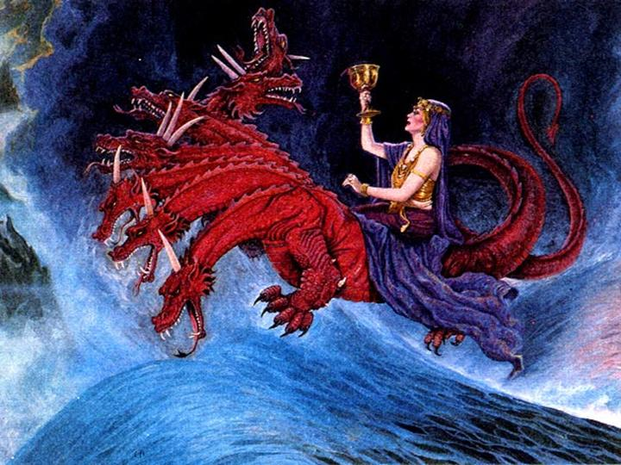

Slide 22
History: His Story!

Slide 23
The Traditions of Men or the Word of God?

Slide 24
Matthew 15:1
Then the scribes and Pharisees who were from Jerusalem came to Jesus, saying,

Slide 25
Matthew 15:2
"Why do Your disciples transgress the tradition of the elders? For they do not wash their hands when they eat bread."

Slide 26
Matthew 15:3
He answered and said to them, "Why do you also transgress the commandment of God because of your tradition?

Slide 27
Matthew 15:4
For God commanded, saying, 'Honor your father and your mother'; and, 'He who curses father or mother, let him be put to death.'

Slide 28
Matthew 15:5
But you say, 'Whoever says to his father or mother, "Whatever profit you might have received from me is a gift to God"—

Slide 29
Matthew 15:6
then he need not honor his father or mother.' Thus you have made the commandment of God of no effect by your tradition.

Slide 30
Mark 7:6
He answered and said to them, "Well did Isaiah prophesy of you hypocrites, as it is written: 'This people honors Me with their lips, But their heart is far from Me.

Slide 31
Mark 7:7
And in vain they worship Me, Teaching as doctrines the commandments of men.'

Slide 32
Mark 7:8
"For laying aside the commandment of God, you hold the tradition of men—the washing of pitchers and cups, and many other such things you do."

Slide 33
Mark 7:13
making the word of God of no effect through your tradition which you have handed down. And many such things you do."

Slide 34
Revelation 17:6
I saw the woman, drunk with the blood of the saints and with the blood of the martyrs of Jesus. And when I saw her, I marveled with great amazement.

Slide 35
Revelation 17:7
But the angel said to me, "Why did you marvel? I will tell you the mystery of the woman and of the beast that carries her, which has the seven heads and the ten horns.

Slide 36
2 Corinthians 11:24
From the Jews five times I received forty stripes minus one.

Slide 37
2 Corinthians 11:25
Three times I was beaten with rods; once I was stoned; three times I was shipwrecked; a night and a day I have been in the deep;

Slide 38
2 Corinthians 11:26a
in journeys often, in perils of waters, in perils of robbers, in perils of my own countrymen,

Slide 39
2 Corinthians 11:26b
in perils of the Gentiles, in perils in the city, in perils in the wilderness, in perils in the sea, in perils among false brethren;

Slide 40
2 John 4
I rejoiced greatly that I have found some of your children walking in truth, as we received commandment from the Father.

Slide 41
2 John 5
And now I plead with you, lady, not as though I wrote a new commandment to you, but that which we have had from the beginning: that we love one another.

Slide 42
2 John 6
This is love, that we walk according to His commandments. This is the commandment, that as you have heard from the beginning, you should walk in it.

Slide 43
2 John 7
For many deceivers have gone out into the world who do not confess Jesus Christ as coming in the flesh. This is a deceiver and an antichrist.

Slide 44
2 Peter 2:1a
But there were also false prophets among the people, even as there will be false teachers among you,

Slide 45
2 Peter 2:1b
who will secretly bring in destructive heresies, even denying the Lord who bought them, and bring on themselves swift destruction.

Slide 46
2 Peter 2:2
And many will follow their destructive ways, because of whom the way of truth will be blasphemed.

Slide 47
2 Peter 2:3
By covetousness they will exploit you with deceptive words; for a long time their judgment has not been idle, and their destruction does not slumber.

Slide 48
1 John 4:1
Beloved, do not believe every spirit, but test the spirits, whether they are of God; because many false prophets have gone out into the world.

Slide 49
1 John 4:2
By this you know the Spirit of God: Every spirit that confesses that Jesus Christ has come in the flesh is of God,

Slide 50
1 John 4:3
and every spirit that does not confess that Jesus Christ has come in the flesh is not of God. And this is the spirit of the Antichrist, which you have heard was coming, and is now already in the world.

Slide 51
Matthew 24:10
And then many will be offended, will betray one another, and will hate one another.

Slide 52
Matthew 24:11
Then many false prophets will rise up and deceive many.

Slide 53
Matthew 24:12
And because lawlessness will abound, the love of many will grow cold.

Slide 54
Matthew 24:24
For false christs and false prophets will rise and show great signs and wonders to deceive, if possible, even the elect.

Slide 55
Matthew 24:25
See, I have told you beforehand.

Slide 56
Acts 20:27
For I have not shunned to declare to you the whole counsel of God.

Slide 57
Acts 20:28
Therefore take heed to yourselves and to all the flock, among which the Holy Spirit has made you overseers, to shepherd the church of God which He purchased with His own blood.

Slide 58
Acts 20:29
For I know this, that after my departure savage wolves will come in among you, not sparing the flock.

Slide 59
Acts 20:30
Also from among yourselves men will rise up, speaking perverse things, to draw away the disciples after themselves.

Slide 60
Acts 20:31
Therefore watch, and remember that for three years I did not cease to warn everyone night and day with tears.

Slide 61
Acts 20:32
So now, brethren, I commend you to God and to the word of His grace, which is able to build you up and give you an inheritance among all those who are sanctified.

Slide 62
Revelation 1:3
Blessed is he who reads and those who hear the words of this prophecy, and keep those things which are written in it; for the time is near.

Slide 63
Revelation 22:7
"Behold, I am coming quickly! Blessed is he who keeps the words of the prophecy of this book."

Slide 64
Revelation 12:1
Now a great sign appeared in heaven: a woman clothed with the sun, with the moon under her feet, and on her head a garland of twelve stars.

Slide 65
Revelation 17:3
So he carried me away in the Spirit into the wilderness. And I saw a woman sitting on a scarlet beast which was full of names of blasphemy, having seven heads and ten horns.

Slide 66
Revelation 12:5
She bore a male Child who was to rule all nations with a rod of iron. And her Child was caught up to God and His throne.

Slide 67
Revelation 12:6
Then the woman fled into the wilderness, where she has a place prepared by God, that they should feed her there one thousand two hundred and sixty days.

