Slide 1
Revelation 16:1-7
Wednesday, February 26, 2014
Calvary Chapel of El Paso

Slide 2
Revelation 16:1
Then I heard a loud voice from the temple saying to the seven angels, "Go and pour out the bowls of the wrath of God on the earth."

Slide 3
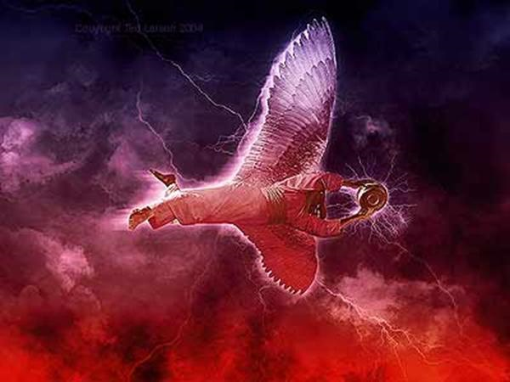

Slide 4
Exodus 20:3
Thou shalt have no other gods before me.

Slide 5
Exodus 20:4
Thou shalt not make unto thee any graven image, or any likeness of any thing that is in heaven above, or that is in the earth beneath, or that is in the water under the earth:

Slide 6
Exodus 20:5
Thou shalt not bow down thyself to them, nor serve them: for I the LORD thy God am a jealous God, visiting the iniquity of the fathers upon the children unto the third and fourth generation of them that hate me;

Slide 7
Exodus 20:6
And shewing mercy unto thousands of them that love me, and keep my commandments.

Slide 8
Isaiah 14:12
How you are fallen from heaven, O Lucifer, son of the morning! How you are cut down to the ground, You who weakened the nations!

Slide 9
Isaiah 14:13
For you have said in your heart: 'I will ascend into heaven, I will exalt my throne above the stars of God; I will also sit on the mount of the congregation On the farthest sides of the north;

Slide 10
Isaiah 14:14
I will ascend above the heights of the clouds, I will be like the Most High.

Slide 11
Matthew 4:8
Again, the devil took Him up on an exceedingly high mountain, and showed Him all the kingdoms of the world and their glory.

Slide 12
Matthew 4:9
And he said to Him, "All these things I will give You if You will fall down and worship me."

Slide 13
Matthew 4:10
Then Jesus said to him, "Away with you, Satan! For it is written, 'You shall worship the LORD your God, and Him only you shall serve.'"

Slide 14
Revelation 16:1
Then I heard a loud voice from the temple saying to the seven angels, "Go and pour out the bowls of the wrath of God on the earth."

Slide 15
Revelation 16:2
So the first went and poured out his bowl upon the earth, and a foul and loathsome sore came upon the men who had the mark of the beast and those who worshiped his image.

Slide 16
1 Peter 4:7
But the end of all things is at hand; therefore be serious and watchful in your prayers.

Slide 17
Romans 13:11
And do this, knowing the time, that now it is high time to awake out of sleep; for now our salvation is nearer than when we first believed.

Slide 18
Romans 13:12
The night is far spent, the day is at hand. Therefore let us cast off the works of darkness, and let us put on the armor of light.

Slide 19
Romans 13:13
Let us walk properly, as in the day, not in revelry and drunkenness, not in lewdness and lust, not in strife and envy.

Slide 20
Romans 13:14
But put on the Lord Jesus Christ, and make no provision for the flesh, to fulfill its lusts.

Slide 21
James 5:8
You also be patient. Establish your hearts, for the coming of the Lord is at hand.

Slide 22
James 5:9
Do not grumble against one another, brethren, lest you be condemned. Behold, the Judge is standing at the door!

Slide 23
Hebrews 10:30
For we know Him who said, "Vengeance is Mine, I will repay," says the Lord. And again, "The LORD will judge His people."

Slide 24
Hebrews 10:31
It is a fearful thing to fall into the hands of the living God.

Slide 25
Deuteronomy 28:27
The LORD will strike you with the boils of Egypt, with tumors, with the scab, and with the itch, from which you cannot be healed.

Slide 26
Deuteronomy 28:35
The LORD will strike you in the knees and on the legs with severe boils which cannot be healed, and from the sole of your foot to the top of your head.

Slide 27
Exodus 32:35
So the LORD plagued the people because of what they did with the calf which Aaron made.

Slide 28
Job 2:7
So Satan went out from the presence of the LORD, and struck Job with painful boils from the sole of his foot to the crown of his head.

Slide 29
Job 2:8
And he took for himself a potsherd with which to scrape himself while he sat in the midst of the ashes.

Slide 30
Revelation 16:3
Then the second angel poured out his bowl on the sea, and it became blood as of a dead man; and every living creature in the sea died.

Slide 31
Revelation 6:3
When He opened the second seal, I heard the second living creature saying, "Come and see."

Slide 32
Revelation 6:4
Another horse, fiery red, went out. And it was granted to the one who sat on it to take peace from the earth, and that people should kill one another; and there was given to him a great sword.

Slide 33
Revelation 8:8
Then the second angel sounded: And something like a great mountain burning with fire was thrown into the sea, and a third of the sea became blood.

Slide 34
Exodus 7:18
And the fish that are in the river shall die, the river shall stink, and the Egyptians will loathe to drink the water of the river.

Slide 35
Psalm 105:29
He turned their waters into blood, And killed their fish.

Slide 36
Revelation 16:4
Then the third angel poured out his bowl on the rivers and springs of water, and they became blood.

Slide 37
Revelation 16:5
And I heard the angel of the waters saying: "You are righteous, O Lord, The One who is and who was and who is to be, Because You have judged these things.

Slide 38
Revelation 16:6
For they have shed the blood of saints and prophets, And You have given them blood to drink. For it is their just due."

Slide 39
Revelation 16:7
And I heard another from the altar saying, "Even so, Lord God Almighty, true and righteous are Your judgments."

Slide 40
Deuteronomy 19:15
One witness shall not rise against a man concerning any iniquity or any sin that he commits; by the mouth of two or three witnesses the matter shall be established.

Slide 41
Genesis 18:25
Far be it from You to do such a thing as this, to slay the righteous with the wicked, so that the righteous should be as the wicked; far be it from You! Shall not the Judge of all the earth do right?

Slide 42
Deuteronomy 32:40
For I raise My hand to heaven, And say, "As I live forever,

Slide 43
Deuteronomy 32:41
If I whet My glittering sword, And My hand takes hold on judgment, I will render vengeance to My enemies, And repay those who hate Me.

Slide 44
Deuteronomy 32:42
I will make My arrows drunk with blood, And My sword shall devour flesh, With the blood of the slain and the captives, From the heads of the leaders of the enemy."'

Slide 45
Deuteronomy 32:43
"Rejoice, O Gentiles, with His people; For He will avenge the blood of His servants, And render vengeance to His adversaries; He will provide atonement for His land and His people."

