Slide 1
Revelation 15:5-8
Wednesday, February 19, 2014
Calvary Chapel of El Paso

Slide 2
Revelation 15:5
After these things I looked, and behold, the temple of the tabernacle of the testimony in heaven was opened.

Slide 3
Revelation 15:6
And out of the temple came the seven angels having the seven plagues, clothed in pure bright linen, and having their chests girded with golden bands.

Slide 4
Revelation 15:7
Then one of the four living creatures gave to the seven angels seven golden bowls full of the wrath of God who lives forever and ever.

Slide 5
Revelation 15:8
The temple was filled with smoke from the glory of God and from His power, and no one was able to enter the temple till the seven plagues of the seven angels were completed.

Slide 6
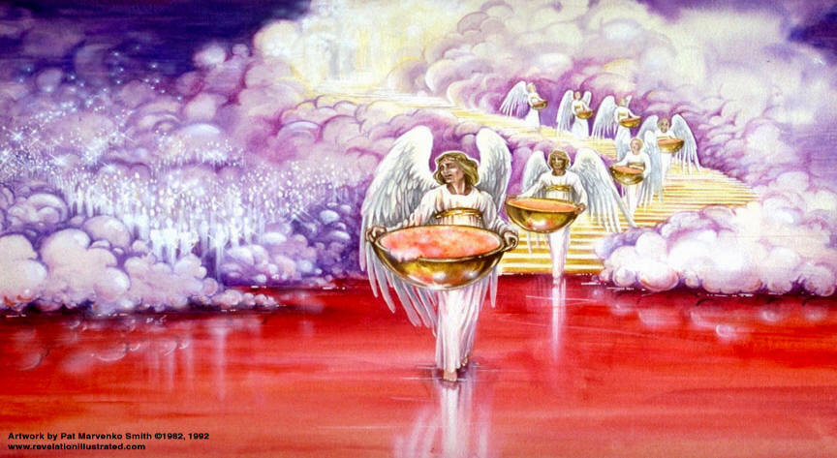

Slide 7
2 Peter 3:9
The Lord is not slack concerning His promise, as some count slackness, but is longsuffering toward us, not willing that any should perish but that all should come to repentance.

Slide 8
Isaiah 46:9
Remember the former things of old, For I am God, and there is no other; I am God, and there is none like Me,

Slide 9
Isaiah 46:10
Declaring the end from the beginning, And from ancient times things that are not yet done, Saying, 'My counsel shall stand, And I will do all My pleasure,'

Slide 10
Preparing the Bowl Judgments

Slide 11
Revelation 15:5
After these things I looked, and behold, the temple of the tabernacle of the testimony in heaven was opened.

Slide 12
Revelation 15:6
And out of the temple came the seven angels having the seven plagues, clothed in pure bright linen, and having their chests girded with golden bands.

Slide 13
Exodus 25:8
And let them make Me a sanctuary, that I may dwell among them.

Slide 14
Exodus 25:9
According to all that I show you, that is, the pattern of the tabernacle and the pattern of all its furnishings, just so you shall make it.

Slide 15
Hebrews 9:11
But Christ came as High Priest of the good things to come, with the greater and more perfect tabernacle not made with hands, that is, not of this creation.

Slide 16
Hebrews 9:12
Not with the blood of goats and calves, but with His own blood He entered the Most Holy Place once for all, having obtained eternal redemption.

Slide 17
Hebrews 9:13
For if the blood of bulls and goats and the ashes of a heifer, sprinkling the unclean, sanctifies for the purifying of the flesh,

Slide 18
Hebrews 9:14
how much more shall the blood of Christ, who through the eternal Spirit offered Himself without spot to God, cleanse your conscience from dead works to serve the living God?

Slide 19
John 14:6
Jesus said to him, "I am the way, the truth, and the life. No one comes to the Father except through Me.

Slide 20
Hebrews 9:23
Therefore it was necessary that the copies of the things in the heavens should be purified with these, but the heavenly things themselves with better sacrifices than these.

Slide 21
Hebrews 9:24
For Christ has not entered the holy places made with hands, which are copies of the true, but into heaven itself, now to appear in the presence of God for us;

Slide 22
John 4:23
But the hour is coming, and now is, when the true worshipers will worship the Father in spirit and truth; for the Father is seeking such to worship Him.

Slide 23
John 4:24
God is Spirit, and those who worship Him must worship in spirit and truth."

Slide 24
Revelation 15:6
And out of the temple came the seven angels having the seven plagues, clothed in pure bright linen, and having their chests girded with golden bands.

Slide 25
Romans 13:11
And do this, knowing the time, that now it is high time to awake out of sleep; for now our salvation is nearer than when we first believed.

Slide 26
Romans 13:12
The night is far spent, the day is at hand. Therefore let us cast off the works of darkness, and let us put on the armor of light.

Slide 27
Romans 13:13
Let us walk properly, as in the day, not in revelry and drunkenness, not in lewdness and lust, not in strife and envy.

Slide 28
Romans 13:14
But put on the Lord Jesus Christ, and make no provision for the flesh, to fulfill its lusts.

Slide 29
Revelation 15:7
Then one of the four living creatures gave to the seven angels seven golden bowls full of the wrath of God who lives forever and ever.

Slide 30
Revelation 15:8
The temple was filled with smoke from the glory of God and from His power, and no one was able to enter the temple till the seven plagues of the seven angels were completed.

Slide 31
Revelation 6:1
Now I saw when the Lamb opened one of the seals; and I heard one of the four living creatures saying with a voice like thunder, "Come and see."

Slide 32
Revelation 6:3
When He opened the second seal, I heard the second living creature saying, "Come and see."

Slide 33
Revelation 6:5
When He opened the third seal, I heard the third living creature say, "Come and see." So I looked, and behold, a black horse, and he who sat on it had a pair of scales in his hand.

Slide 34
Revelation 6:7
When He opened the fourth seal, I heard the voice of the fourth living creature saying, "Come and see."

Slide 35
1 Kings 8:10
And it came to pass, when the priests came out of the holy place, that the cloud filled the house of the LORD,

Slide 36
1 Kings 8:11
so that the priests could not continue ministering because of the cloud; for the glory of the LORD filled the house of the LORD.

Slide 37
Isaiah 6:1
In the year that King Uzziah died, I saw the Lord sitting on a throne, high and lifted up, and the train of His robe filled the temple.

Slide 38
Isaiah 6:2
Above it stood seraphim; each one had six wings: with two he covered his face, with two he covered his feet, and with two he flew.

Slide 39
Isaiah 6:3
And one cried to another and said: "Holy, holy, holy is the LORD of hosts; The whole earth is full of His glory!"

Slide 40
Isaiah 6:4
And the posts of the door were shaken by the voice of him who cried out, and the house was filled with smoke.

Slide 41
Isaiah 6:5
So I said: "Woe is me, for I am undone! Because I am a man of unclean lips, And I dwell in the midst of a people of unclean lips; For my eyes have seen the King, The LORD of hosts."

Slide 42
Genesis 6:3
And the LORD said, "My Spirit shall not strive with man forever, for he is indeed flesh; yet his days shall be one hundred and twenty years."

Slide 43
Matthew 11:28
Come to Me, all you who labor and are heavy laden, and I will give you rest.

Slide 44
Matthew 11:29
Take My yoke upon you and learn from Me, for I am gentle and lowly in heart, and you will find rest for your souls.

Slide 45
Matthew 11:30
For My yoke is easy and My burden is light."

Slide 46
John 6:44
No one can come to Me unless the Father who sent Me draws him; and I will raise him up at the last day.

Slide 47
Psalm 18:3
I will call upon the LORD, who is worthy to be praised; So shall I be saved from my enemies.

Slide 48
Psalm 145:18
The LORD is near to all who call upon Him, To all who call upon Him in truth.

Slide 49
Isaiah 55:6
Seek the LORD while He may be found, Call upon Him while He is near.

Slide 50
Isaiah 55:7
Let the wicked forsake his way, And the unrighteous man his thoughts; Let him return to the LORD, And He will have mercy on him; And to our God, For He will abundantly pardon.

