Slide 1
Revelation 15:1
Wednesday, February 5, 2014
Calvary Chapel of El Paso

Slide 2
Revelation 15:1
Then I saw another sign in heaven, great and marvelous: seven angels having the seven last plagues, for in them the wrath of God is complete.

Slide 3
Revelation 15:2a
And I saw something like a sea of glass mingled with fire, and those who have the victory over the beast,

Slide 4
Revelation 15:2b
over his image and over his mark and over the number of his name, standing on the sea of glass, having harps of God.

Slide 5
Revelation 15:3
They sing the song of Moses, the servant of God, and the song of the Lamb, saying: "Great and marvelous are Your works, Lord God Almighty! Just and true are Your ways, O King of the saints!

Slide 6
Revelation 15:4
Who shall not fear You, O Lord, and glorify Your name? For You alone are holy. For all nations shall come and worship before You, For Your judgments have been manifested."

Slide 7
Revelation 15:5
After these things I looked, and behold, the temple of the tabernacle of the testimony in heaven was opened.

Slide 8
Revelation 15:6
And out of the temple came the seven angels having the seven plagues, clothed in pure bright linen, and having their chests girded with golden bands.

Slide 9
Revelation 15:7
Then one of the four living creatures gave to the seven angels seven golden bowls full of the wrath of God who lives forever and ever.

Slide 10
Revelation 15:8
The temple was filled with smoke from the glory of God and from His power, and no one was able to enter the temple till the seven plagues of the seven angels were completed.

Slide 11
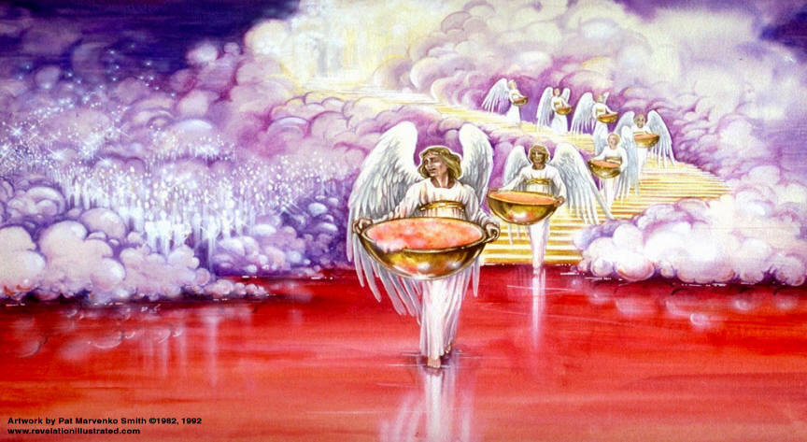

Slide 12
Revelation 6:12
I looked when He opened the sixth seal, and behold, there was a great earthquake; and the sun became black as sackcloth of hair, and the moon became like blood.

Slide 13
Revelation 6:13
And the stars of heaven fell to the earth, as a fig tree drops its late figs when it is shaken by a mighty wind.

Slide 14
Revelation 6:14
Then the sky receded as a scroll when it is rolled up, and every mountain and island was moved out of its place.

Slide 15
Revelation 6:15
And the kings of the earth, the great men, the rich men, the commanders, the mighty men, every slave and every free man, hid themselves in the caves and in the rocks of the mountains,

Slide 16
Revelation 6:16
and said to the mountains and rocks, "Fall on us and hide us from the face of Him who sits on the throne and from the wrath of the Lamb!

Slide 17
Revelation 6:17
For the great day of His wrath has come, and who is able to stand?"

Slide 18
Revelation 6:10
And they cried with a loud voice, saying, "How long, O Lord, holy and true, until You judge and avenge our blood on those who dwell on the earth?"

Slide 19
Revelation 6:11a
Then a white robe was given to each of them; and it was said to them that they should rest a little while longer,

Slide 20
Revelation 6:11b
until both the number of their fellow servants and their brethren, who would be killed as they were, was completed.

Slide 21
The Prelude to the Bowl Judgments

Slide 22
Revelation 15:1
Then I saw another sign in heaven, great and marvelous: seven angels having the seven last plagues, for in them the wrath of God is complete.

Slide 23
Revelation 15:2a
And I saw something like a sea of glass mingled with fire, and those who have the victory over the beast,

Slide 24
Revelation 15:2b
over his image and over his mark and over the number of his name, standing on the sea of glass, having harps of God.

Slide 25
Revelation 15:3
They sing the song of Moses, the servant of God, and the song of the Lamb, saying: "Great and marvelous are Your works, Lord God Almighty! Just and true are Your ways, O King of the saints!

Slide 26
Revelation 15:4
Who shall not fear You, O Lord, and glorify Your name? For You alone are holy. For all nations shall come and worship before You, For Your judgments have been manifested."

Slide 27
John 19:30
So when Jesus had received the sour wine, He said, "It is finished!" And bowing His head, He gave up His spirit.

Slide 28
2 Corinthians 5:21
For He made Him who knew no sin to be sin for us, that we might become the righteousness of God in Him.

Slide 29
Colossians 2:13
And you, being dead in your trespasses and the uncircumcision of your flesh, He has made alive together with Him, having forgiven you all trespasses,

Slide 30
Colossians 2:14
having wiped out the handwriting of requirements that was against us, which was contrary to us. And He has taken it out of the way, having nailed it to the cross.

Slide 31
Revelation 16:17
Then the seventh angel poured out his bowl into the air, and a loud voice came out of the temple of heaven, from the throne, saying, "It is done!"

Slide 32
Leviticus 26:21
Then, if you walk contrary to Me, and are not willing to obey Me, I will bring on you seven times more plagues, according to your sins.

Slide 33
Leviticus 26:22
I will also send wild beasts among you, which shall rob you of your children, destroy your livestock, and make you few in number; and your highways shall be desolate.

Slide 34
Leviticus 26:23
And if by these things you are not reformed by Me, but walk contrary to Me,

Slide 35
Leviticus 26:24
then I also will walk contrary to you, and I will punish you yet seven times for your sins.

Slide 36
Revelation 14:10
he himself shall also drink of the wine of the wrath (thymos) of God, which is poured out full strength into the cup of His indignation (orge)…

Slide 37
Psalm 103:8
The LORD is merciful and gracious, Slow to anger, and abounding in mercy.

Slide 38
Psalm 103:9
He will not always strive with us, Nor will He keep His anger forever.

Slide 39
Psalm 103:10
He has not dealt with us according to our sins, Nor punished us according to our iniquities.

Slide 40
Psalm 103:11
For as the heavens are high above the earth, So great is His mercy toward those who fear Him;

Slide 41
Psalm 103:12
As far as the east is from the west, So far has He removed our transgressions from us.

Slide 42
Zephaniah 3:8a
"Therefore wait for Me," says the LORD, "Until the day I rise up for plunder; My determination is to gather the nations To My assembly of kingdoms,

Slide 43
Zephaniah 3:8b
To pour on them My indignation, All my fierce anger; All the earth shall be devoured With the fire of My jealousy.

Slide 44
Zephaniah 3:9
“For then I will restore to the peoples a pure language, That they all may call on the name of the LORD, To serve Him with one accord.”

