Slide 1
Revelation 14:4-7
Wednsday, December 18, 2013
Calvary Chapel of El Paso

Slide 2
Revelation 14:1
Then I looked, and behold, a Lamb standing on Mount Zion, and with Him one hundred and forty-four thousand, having His Father's name written on their foreheads.

Slide 3
Revelation 14:2
And I heard a voice from heaven, like the voice of many waters, and like the voice of loud thunder. And I heard the sound of harpists playing their harps.

Slide 4
Revelation 14:3
They sang as it were a new song before the throne, before the four living creatures, and the elders; and no one could learn that song except the hundred and forty-four thousand who were redeemed from the earth.

Slide 5
Revelation 14:4a
These are the ones who were not defiled with women, for they are virgins. These are the ones who follow the Lamb wherever He goes…

Slide 6
Revelation 14:4b
…These were redeemed from among men, being firstfruits to God and to the Lamb.

Slide 7
Revelation 14:5
And in their mouth was found no deceit, for they are without fault before the throne of God.

Slide 8
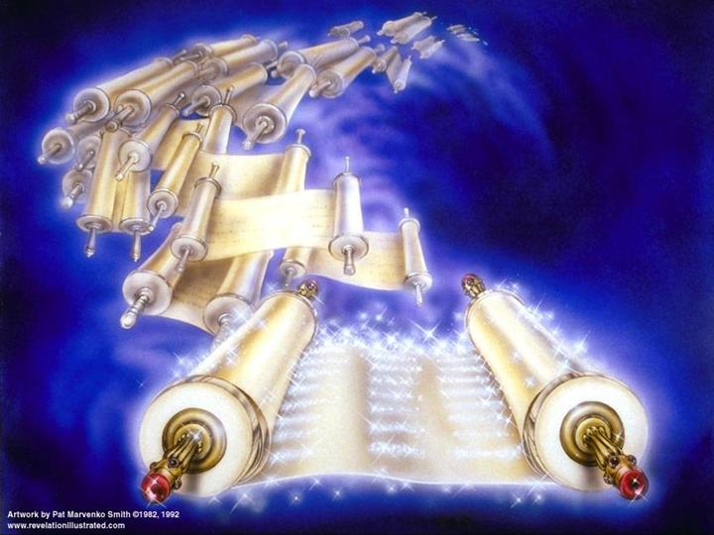

Slide 9
Revelation 14:4a
These are the ones who were not defiled with women, for they are virgins. These are the ones who follow the Lamb wherever He goes…

Slide 10
2 Corinthians 11:2
For I am jealous for you with godly jealousy. For I have betrothed you to one husband, that I may present you as a chaste virgin to Christ.

Slide 11
Matthew 24:19
But woe to those who are pregnant and to those who are nursing babies in those days!

Slide 12
Matthew 24:20
And pray that your flight may not be in winter or on the Sabbath.

Slide 13
Matthew 24:21
For then there will be great tribulation, such as has not been since the beginning of the world until this time, no, nor ever shall be.

Slide 14
1 Corinthians 7:25
Now concerning virgins: I have no commandment from the Lord; yet I give judgment as one whom the Lord in His mercy has made trustworthy.

Slide 15
1 Corinthians 7:26
I suppose therefore that this is good because of the present distress—that it is good for a man to remain as he is:

Slide 16
Revelation 14:4a
These are the ones who were not defiled with women, for they are virgins. These are the ones who follow the Lamb wherever He goes…

Slide 17
Revelation 14:4b
…These were redeemed from among men, being firstfruits to God and to the Lamb.

Slide 18
Revelation 7:9
After these things I looked, and behold, a great multitude which no one could number, of all nations, tribes, peoples, and tongues, standing before the throne and before the Lamb, clothed with white robes, with palm branches in their hands,

Slide 19
Revelation 7:14
And I said to him, "Sir, you know." So he said to me, "These are the ones who come out of the great tribulation, and washed their robes and made them white in the blood of the Lamb.

Slide 20
Revelation 14:5
And in their mouth was found no deceit, for they are without fault before the throne of God.

Slide 21
John 8:44a
You are of your father the devil, and the desires of your father you want to do. He was a murderer from the beginning, and does not stand in the truth, because there is no truth in him…

Slide 22
John 8:44b
When he speaks a lie, he speaks from his own resources, for he is a liar and the father of it.

Slide 23
Revelation 14:5
And in their mouth was found no deceit, for they are without fault before the throne of God.

Slide 24
Zephaniah 3:13
The remnant of Israel shall do no unrighteousness And speak no lies, Nor shall a deceitful tongue be found in their mouth; For they shall feed their flocks and lie down, And no one shall make them afraid.

Slide 25
Jude 24
Now to Him who is able to keep you from stumbling, And to present you faultless Before the presence of His glory with exceeding joy,

Slide 26
Jude 25
To God our Savior, Who alone is wise, Be glory and majesty, Dominion and power, Both now and forever. Amen.

Slide 27
Revelation 14:6
Then I saw another angel flying in the midst of heaven, having the everlasting gospel to preach to those who dwell on the earth—to every nation, tribe, tongue, and people—

Slide 28
Revelation 14:7
saying with a loud voice, "Fear God and give glory to Him, for the hour of His judgment has come; and worship Him who made heaven and earth, the sea and springs of water."

Slide 29
Matthew 24:14
And this gospel of the kingdom will be preached in all the world as a witness to all the nations, and then the end will come.

Slide 30
2 Peter 3:9
The Lord is not slack concerning His promise, as some count slackness, but is longsuffering toward us, not willing that any should perish but that all should come to repentance.

Slide 31
Philippians 2:9
Therefore God also has highly exalted Him and given Him the name which is above every name,

Slide 32
Philippians 2:10
that at the name of Jesus every knee should bow, of those in heaven, and of those on earth, and of those under the earth,

Slide 33
Philippians 2:11
and that every tongue should confess that Jesus Christ is Lord, to the glory of God the Father.

Slide 34
Romans 1:18
For the wrath of God is revealed from heaven against all ungodliness and unrighteousness of men, who suppress the truth in unrighteousness,

Slide 35
Romans 1:19
because what may be known of God is manifest in them, for God has shown it to them.

Slide 36
Romans 1:20
For since the creation of the world His invisible attributes are clearly seen, being understood by the things that are made, even His eternal power and Godhead, so that they are without excuse,

Slide 37
Romans 1:21
because, although they knew God, they did not glorify Him as God, nor were thankful, but became futile in their thoughts, and their foolish hearts were darkened.

Slide 38
Romans 1:22
Professing to be wise, they became fools,

Slide 39
Romans 1:23
and changed the glory of the incorruptible God into an image made like corruptible man—and birds and four-footed animals and creeping things.

