Slide 1
Revelation 14:1-3
Wednesday, December 11, 2013
Calvary Chapel of El Paso

Slide 2
Revelation 14:1
Then I looked, and behold, a Lamb standing on Mount Zion, and with Him one hundred and forty-four thousand, having His Father's name written on their foreheads.

Slide 3
Revelation 14:2
And I heard a voice from heaven, like the voice of many waters, and like the voice of loud thunder. And I heard the sound of harpists playing their harps.

Slide 4
Revelation 14:3
They sang as it were a new song before the throne, before the four living creatures, and the elders; and no one could learn that song except the hundred and forty-four thousand who were redeemed from the earth.

Slide 5
Revelation 14:4a
These are the ones who were not defiled with women, for they are virgins. These are the ones who follow the Lamb wherever He goes…

Slide 6
Revelation 14:4b
…These were redeemed from among men, being firstfruits to God and to the Lamb.

Slide 7
Revelation 14:5
And in their mouth was found no deceit, for they are without fault before the throne of God.

Slide 8
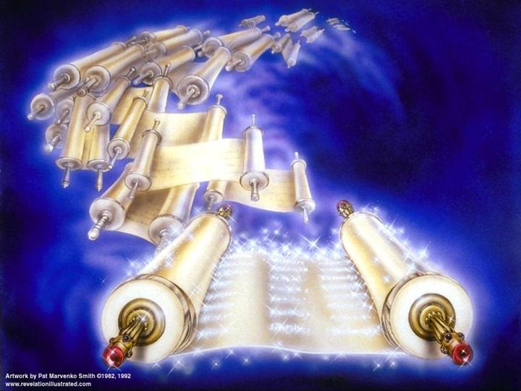

Slide 9
Revelation 14:1
Then I looked, and behold, a Lamb standing on Mount Zion, and with Him one hundred and forty-four thousand, having His Father's name written on their foreheads.

Slide 10
Exodus 12:5
Your lamb shall be without blemish, a male of the first year. You may take it from the sheep or from the goats.

Slide 11
Exodus 12:6
Now you shall keep it until the fourteenth day of the same month. Then the whole assembly of the congregation of Israel shall kill it at twilight.

Slide 12
Exodus 12:7
And they shall take some of the blood and put it on the two doorposts and on the lintel of the houses where they eat it.

Slide 13
Revelation 9:4
They were commanded not to harm the grass of the earth, or any green thing, or any tree, but only those men who do not have the seal of God on their foreheads.

Slide 14
Hebrews 12:22
But you have come to Mount Zion and to the city of the living God, the heavenly Jerusalem, to an innumerable company of angels,

Slide 15
Hebrews 12:23
to the general assembly and church of the firstborn who are registered in heaven, to God the Judge of all, to the spirits of just men made perfect,

Slide 16
Hebrews 12:24
to Jesus the Mediator of the new covenant, and to the blood of sprinkling that speaks better things than that of Abel.

Slide 17
Psalm 48:1
Great is the LORD, and greatly to be praised In the city of our God, In His holy mountain.

Slide 18
Psalm 48:2
Beautiful in elevation, The joy of the whole earth, Is Mount Zion on the sides of the north, The city of the great King.

Slide 19
Isaiah 24:21
It shall come to pass in that day That the LORD will punish on high the host of exalted ones, And on the earth the kings of the earth.

Slide 20
Isaiah 24:22
They will be gathered together, As prisoners are gathered in the pit, And will be shut up in the prison; After many days they will be punished.

Slide 21
Isaiah 24:23
Then the moon will be disgraced And the sun ashamed; For the LORD of hosts will reign On Mount Zion and in Jerusalem And before His elders, gloriously.

Slide 22
Joel 2:32
And it shall come to pass That whoever calls on the name of the LORD Shall be saved. For in Mount Zion and in Jerusalem there shall be deliverance, As the LORD has said, Among the remnant whom the LORD calls.

Slide 23
Exodus 3:13
And Moses said unto God, Behold, when I come unto the children of Israel, and shall say unto them, The God of your fathers hath sent me unto you; and they shall say to me, What is his name? what shall I say unto them?

Slide 24
Exodus 3:14
And God said unto Moses, I AM THAT I AM: and he said, Thus shalt thou say unto the children of Israel, I AM hath sent me unto you.

Slide 25
John 8:58
Jesus said to them, "Most assuredly, I say to you, before Abraham was, I AM."

Slide 26
Revelation 14:2
And I heard a voice from heaven, like the voice of many waters, and like the voice of loud thunder. And I heard the sound of harpists playing their harps.

Slide 27
Revelation 14:3
They sang as it were a new song before the throne, before the four living creatures, and the elders; and no one could learn that song except the hundred and forty-four thousand who were redeemed from the earth.

Slide 28
Revelation 5:8
Now when He had taken the scroll, the four living creatures and the twenty-four elders fell down before the Lamb, each having a harp, and golden bowls full of incense, which are the prayers of the saints.

Slide 29
Revelation 5:9
And they sang a new song, saying: "You are worthy to take the scroll, And to open its seals; For You were slain, And have redeemed us to God by Your blood Out of every tribe and tongue and people and nation,

Slide 30
Revelation 5:10
And have made us kings and priests to our God; And we shall reign on the earth."

Slide 31
Psalm 150:6
Let everything that has breath praise the LORD. Praise the LORD!

Slide 32
Acts 16:25
But at midnight Paul and Silas were praying and singing hymns to God, and the prisoners were listening to them.

Slide 33
