Slide 1
Revelation 13:16-18
Wednesday, December 4, 2013
Calvary Chapel of El Paso

Slide 2
Revelation 13:11
And I beheld another beast coming up out of the earth; and he had two horns like a lamb, and he spake as a dragon.

Slide 3
Revelation 13:12
And he exerciseth all the power of the first beast before him, and causeth the earth and them which dwell therein to worship the first beast, whose deadly wound was healed.

Slide 4
Revelation 13:13
And he doeth great wonders, so that he maketh fire come down from heaven on the earth in the sight of men,

Slide 5
Revelation 13:14a
And deceiveth them that dwell on the earth by the means of those miracles which he had power to do in the sight of the beast;

Slide 6
Revelation 13:14b
saying to them that dwell on the earth, that they should make an image to the beast, which had the wound by a sword, and did live.

Slide 7
Revelation 13:15
And he had power to give life unto the image of the beast, that the image of the beast should both speak, and cause that as many as would not worship the image of the beast should be killed.

Slide 8
Revelation 13:16
And he causeth all, both small and great, rich and poor, free and bond, to receive a mark in their right hand, or in their foreheads:

Slide 9
Revelation 13:17
And that no man might buy or sell, save he that had the mark, or the name of the beast, or the number of his name.

Slide 10
Revelation 13:18
Here is wisdom. Let him that hath understanding count the number of the beast: for it is the number of a man; and his number is Six hundred threescore and six.

Slide 11
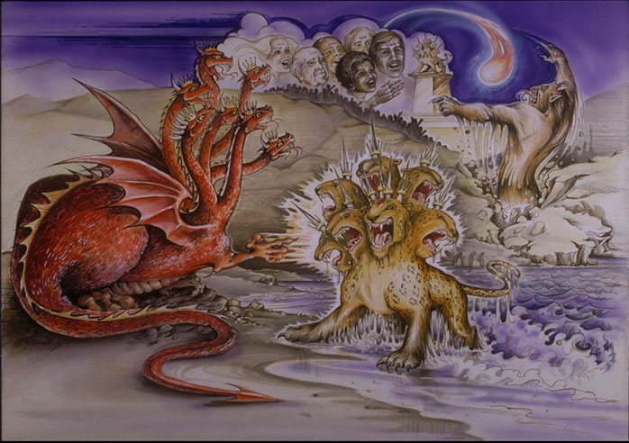

Slide 12
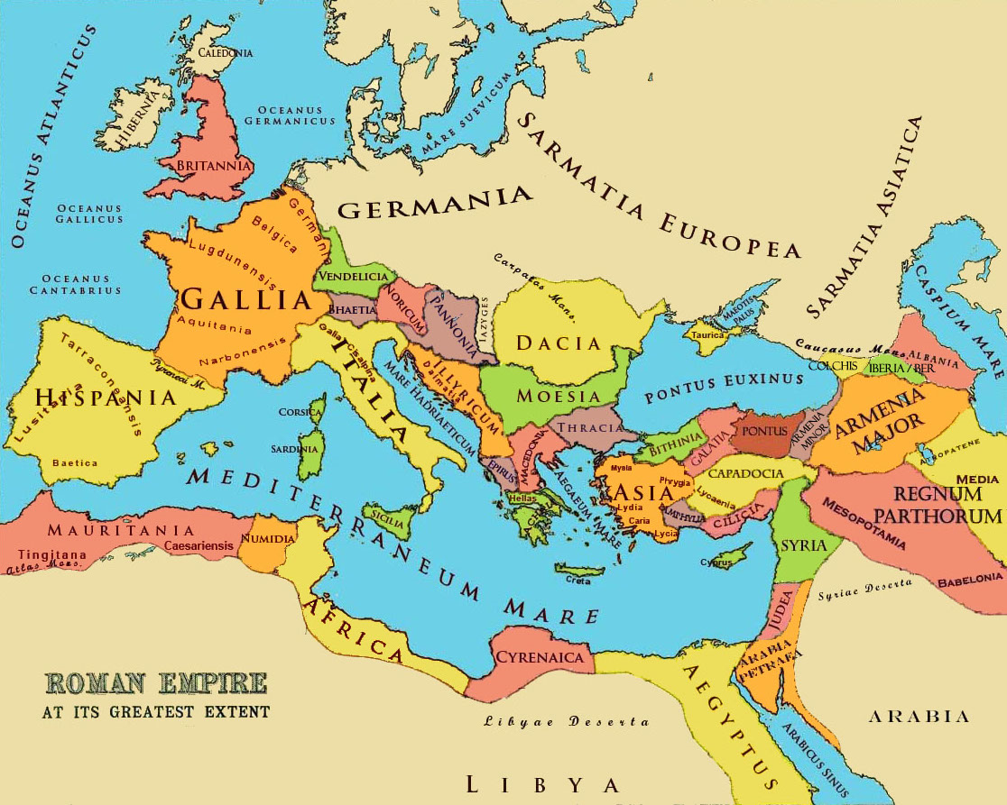

Slide 13
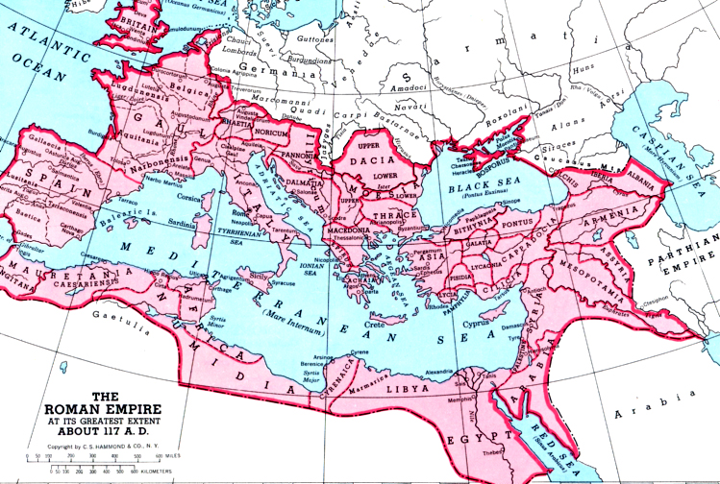

Slide 14
Ecclesiastes 1:9
That which has been is what will be, That which is done is what will be done, And there is nothing new under the sun.

Slide 15
Revelation 13:16
And he causeth all, both small and great, rich and poor, free and bond, to receive a mark in their right hand, or in their foreheads:

Slide 16
Deuteronomy 6:4
Hear, O Israel: The LORD our God is one LORD:

Slide 17
Deuteronomy 6:5
And thou shalt love the LORD thy God with all thine heart, and with all thy soul, and with all thy might.

Slide 18
Deuteronomy 6:6
And these words, which I command thee this day, shall be in thine heart:

Slide 19
Deuteronomy 6:7
And thou shalt teach them diligently unto thy children, and shalt talk of them when thou sittest in thine house, and when thou walkest by the way, and when thou liest down, and when thou risest up.

Slide 20
Deuteronomy 6:8
And thou shalt bind them for a sign upon thine hand, and they shall be as frontlets between thine eyes.

Slide 21
Deuteronomy 6:9
And thou shalt write them upon the posts of thy house, and on thy gates.

Slide 22
Revelation 7:3
saying, "Do not harm the earth, the sea, or the trees till we have sealed the servants of our God on their foreheads."

Slide 23
Revelation 7:4
And I heard the number of those who were sealed. One hundred and forty-four thousand of all the tribes of the children of Israel were sealed:

Slide 24
Revelation 14:9
Then a third angel followed them, saying with a loud voice, "If anyone worships the beast and his image, and receives his mark on his forehead or on his hand,

Slide 25
Revelation 14:10a
he himself shall also drink of the wine of the wrath of God, which is poured out full strength into the cup of His indignation.

Slide 26
Revelation 14:10b
He shall be tormented with fire and brimstone in the presence of the holy angels and in the presence of the Lamb.

Slide 27
Revelation 14:11
And the smoke of their torment ascends forever and ever; and they have no rest day or night, who worship the beast and his image, and whoever receives the mark of his name."

Slide 28
Revelation 13:17
And that no man might buy or sell, save he that had the mark, or the name of the beast, or the number of his name.

Slide 29
Isaiah 7:14
Therefore the Lord Himself will give you a sign: Behold, the virgin shall conceive and bear a Son, and shall call His name Immanuel.

Slide 30
Revelation 13:18
Here is wisdom. Let him that hath understanding count the number of the beast: for it is the number of a man; and his number is Six hundred threescore and six.

Slide 31
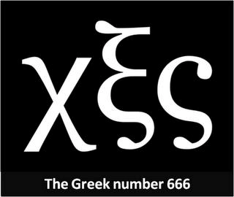

Slide 32
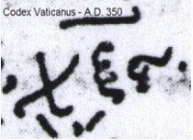

Slide 33
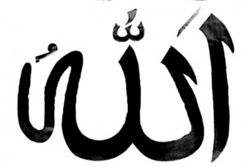

Slide 34
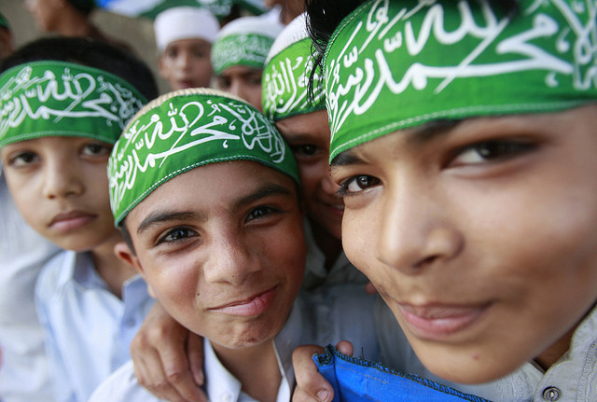

Slide 35
Galatians 6:14
But God forbid that I should boast except in the cross of our Lord Jesus Christ, by whom the world has been crucified to me, and I to the world.

Slide 36
Galatians 6:15
For in Christ Jesus neither circumcision nor uncircumcision avails anything, but a new creation.

Slide 37
Galatians 6:16
And as many as walk according to this rule, peace and mercy be upon them, and upon the Israel of God.

Slide 38
Galatians 6:17
From now on let no one trouble me, for I bear in my body the marks of the Lord Jesus.

Slide 39
Galatians 6:18
Brethren, the grace of our Lord Jesus Christ be with your spirit. Amen.

