Slide 1
Revelation 13:11-15
Wednesday,
November 20, 2013
Calvary Chapel of El Paso

Slide 2
Revelation 13:11
And I beheld another beast coming up out of the earth; and he had two horns like a lamb, and he spake as a dragon.

Slide 3
Revelation 13:12
And he exerciseth all the power of the first beast before him, and causeth the earth and them which dwell therein to worship the first beast, whose deadly wound was healed.

Slide 4
Revelation 13:13
And he doeth great wonders, so that he maketh fire come down from heaven on the earth in the sight of men,

Slide 5
Revelation 13:14a
And deceiveth them that dwell on the earth by the means of those miracles which he had power to do in the sight of the beast;

Slide 6
Revelation 13:14b
saying to them that dwell on the earth, that they should make an image to the beast, which had the wound by a sword, and did live.

Slide 7
Revelation 13:15
And he had power to give life unto the image of the beast, that the image of the beast should both speak, and cause that as many as would not worship the image of the beast should be killed.

Slide 8
Revelation 13:16
And he causeth all, both small and great, rich and poor, free and bond, to receive a mark in their right hand, or in their foreheads:

Slide 9
Revelation 13:17
And that no man might buy or sell, save he that had the mark, or the name of the beast, or the number of his name.

Slide 10
Revelation 13:18
Here is wisdom. Let him that hath understanding count the number of the beast: for it is the number of a man; and his number is Six hundred threescore and six.

Slide 11
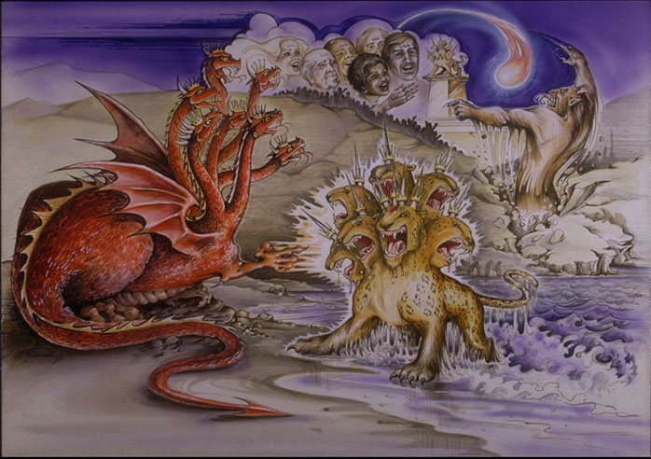

Slide 12
2 Thessalonians 2:9
The coming of the lawless one is according to the working of Satan, with all power, signs, and lying wonders,

Slide 13
2 Thessalonians 2:10
and with all unrighteous deception among those who perish, because they did not receive the love of the truth, that they might be saved.

Slide 14
2 Thessalonians 1:11
And for this reason God will send them strong delusion, that they should believe the lie,

Slide 15
2 Thessalonians 2:12
that they all may be condemned who did not believe the truth but had pleasure in unrighteousness.

Slide 16
Matthew 12:39
But He answered and said to them, "An evil and adulterous generation seeks after a sign, and no sign will be given to it except the sign of the prophet Jonah.

Slide 18
1 John 4:1
Beloved, do not believe every spirit, but test the spirits, whether they are of God; because many false prophets have gone out into the world.

Slide 19
1 Timothy 4:1
Now the Spirit expressly says that in latter times some will depart from the faith, giving heed to deceiving spirits and doctrines of demons,

Slide 20
1 Timothy 4:2
speaking lies in hypocrisy, having their own conscience seared with a hot iron,

Slide 22
Revelation 13:11
And I beheld another beast coming up out of the earth; and he had two horns like a lamb, and he spake as a dragon.

Slide 23
John 14:16
And I will pray the Father, and He will give you another Helper, that He may abide with you forever—

Slide 24
John 14:17
the Spirit of truth, whom the world cannot receive, because it neither sees Him nor knows Him; but you know Him, for He dwells with you and will be in you.

Slide 25
Revelation 19:20
Then the beast was captured, and with him the false prophet who worked signs in his presence, by which he deceived those who received the mark of the beast and those who worshiped his image…

Slide 26
Matthew 7:15
Beware of false prophets, who come to you in sheep's clothing, but inwardly they are ravenous wolves.

Slide 27
Matthew 24:24-25
For false christs and false prophets will rise and show great signs and wonders to deceive, if possible, even the elect. ²⁵ See, I have told you beforehand.

Slide 28
Revelation 13:12
And he exerciseth all the power of the first beast before him, and causeth the earth and them which dwell therein to worship the first beast, whose deadly wound was healed.

Slide 29
Deuteronomy 13:1
If there arises among you a prophet or a dreamer of dreams, and he gives you a sign or a wonder,

Slide 30
Deuteronomy 13:2
and the sign or the wonder comes to pass, of which he spoke to you, saying, 'Let us go after other gods'—which you have not known—'and let us serve them,'

Slide 31
Deuteronomy 13:3
you shall not listen to the words of that prophet or that dreamer of dreams, for the LORD your God is testing you to know whether you love the LORD your God with all your heart and with all your soul.

Slide 32
Deuteronomy 13:4
You shall walk after the LORD your God and fear Him, and keep His commandments and obey His voice, and you shall serve Him and hold fast to Him.

Slide 33
Isaiah 42:8
I am the LORD, that is My name; And My glory I will not give to another, Nor My praise to carved images.

Slide 34
Revelation 13:13
And he doeth great wonders, so that he maketh fire come down from heaven on the earth in the sight of men,

Slide 35
Revelation 13:14a
And deceiveth them that dwell on the earth by the means of those miracles which he had power to do in the sight of the beast;

Slide 36
Revelation 13:14b
saying to them that dwell on the earth, that they should make an image to the beast, which had the wound by a sword, and did live.

Slide 37
Revelation 13:15
And he had power to give life unto the image of the beast, that the image of the beast should both speak, and cause that as many as would not worship the image of the beast should be killed.

Slide 38
Daniel 9:27
Then he shall confirm a covenant with many for one week; But in the middle of the week He shall bring an end to sacrifice and offering. And on the wing of abominations shall be one who makes desolate, Even until the consummation, which is determined, Is poured out on the desolate.

Slide 39
Matthew 24:15
Therefore when you see the 'abomination of desolation,' spoken of by Daniel the prophet, standing in the holy place" (whoever reads, let him understand),

Slide 40
2 Thessalonians 2:3
Let no one deceive you by any means; for that Day will not come unless the falling away comes first, and the man of sin is revealed, the son of perdition,

Slide 41
2 Thessalonians 2:4
who opposes and exalts himself above all that is called God or that is worshiped, so that he sits as God in the temple of God, showing himself that he is God.

Slide 42
John 14:6
Jesus said to him, “I am the way, the truth, and the life. No one comes to the Father except through Me.”

Slide 43
Matthew 7:13
Enter by the narrow gate; for wide is the gate and broad is the way that leads to destruction, and there are many who go in by it.

Slide 44
Matthew 7:14
Because narrow is the gate and difficult is the way which leads to life, and there are few who find it.

