Slide 1
Revelation 13:3-5
Wednesday, November 6, 2013
Calvary Chapel of El Paso

Slide 2
Revelation 13:1
Then I stood on the sand of the sea. And I saw a beast rising up out of the sea, having seven heads and ten horns, and on his horns ten crowns, and on his heads a blasphemous name.

Slide 3
Revelation 13:2
Now the beast which I saw was like a leopard, his feet were like the feet of a bear, and his mouth like the mouth of a lion. The dragon gave him his power, his throne, and great authority.

Slide 4
Revelation 13:3
And I saw one of his heads as if it had been mortally wounded, and his deadly wound was healed. And all the world marveled and followed the beast.

Slide 5
Revelation 13:4
So they worshiped the dragon who gave authority to the beast; and they worshiped the beast, saying, "Who is like the beast? Who is able to make war with him?"

Slide 6
Revelation 13:5
And he was given a mouth speaking great things and blasphemies, and he was given authority to continue for forty-two months.

Slide 7
Revelation 13:6
Then he opened his mouth in blasphemy against God, to blaspheme His name, His tabernacle, and those who dwell in heaven.

Slide 8
Revelation 13:7
It was granted to him to make war with the saints and to overcome them. And authority was given him over every tribe, tongue, and nation.

Slide 9
Revelation 13:8
All who dwell on the earth will worship him, whose names have not been written in the Book of Life of the Lamb slain from the foundation of the world.

Slide 10
Revelation 13:9
If anyone has an ear, let him hear.

Slide 11
Revelation 13:10
He who leads into captivity shall go into captivity; he who kills with the sword must be killed with the sword. Here is the patience and the faith of the saints.

Slide 12
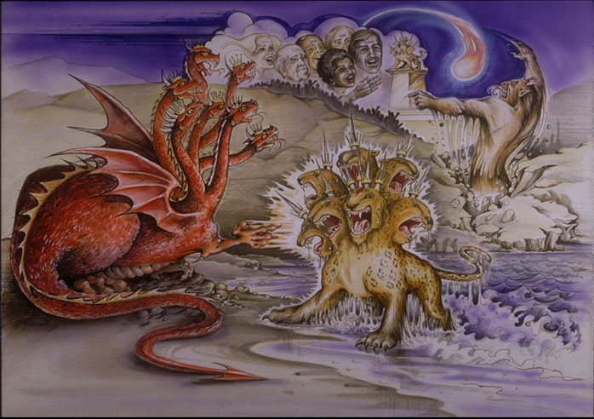

Slide 13
2 Corinthians 11:13
For such are false apostles, deceitful workers, transforming themselves into apostles of Christ.

Slide 14
2 Corinthians 11:14
And no wonder! For Satan himself transforms himself into an angel of light.

Slide 15
2 Corinthians 11:15
Therefore it is no great thing if his ministers also transform themselves into ministers of righteousness, whose end will be according to their works.

Slide 16
2 Thessalonians 2:9
The coming of the lawless one is according to the working of Satan, with all power, signs, and lying wonders,

Slide 17
2 Thessalonians 2:10
and with all unrighteous deception among those who perish, because they did not receive the love of the truth, that they might be saved.

Slide 18
Revelation 12:3
And another sign appeared in heaven: behold, a great, fiery red dragon having seven heads and ten horns, and seven diadems on his heads.

Slide 19
Daniel 7:8a
I was considering the horns, and there was another horn, a little one, coming up among them, before whom three of the first horns were plucked out by the roots.

Slide 20
Daniel 7:8b
And there, in this horn, were eyes like the eyes of a man, and a mouth speaking pompous words.

Slide 21
Revelation 13:2
Now the beast which I saw was like a leopard, his feet were like the feet of a bear, and his mouth like the mouth of a lion. The dragon gave him his power, his throne, and great authority.

Slide 22
Luke 4:5
Then the devil, taking Him up on a high mountain, showed Him all the kingdoms of the world in a moment of time.

Slide 23
Luke 4:6
And the devil said to Him, "All this authority I will give You, and their glory; for this has been delivered to me, and I give it to whomever I wish.

Slide 24
Luke 4:7
Therefore, if You will worship before me, all will be Yours."

Slide 25
Luke 4:8
And Jesus answered and said to him, "Get behind Me, Satan! For it is written, 'You shall worship the LORD your God, and Him only you shall serve.'"

Slide 26
Ephesians 2:1
And you He made alive, who were dead in trespasses and sins,

Slide 27
Ephesians 2:2
in which you once walked according to the course of this world, according to the prince of the power of the air, the spirit who now works in the sons of disobedience,

Slide 28
1 John 5:19
We know that we are of God, and the whole world lies under the sway of the wicked one.

Slide 29
2 Corinthians 4:3
But even if our gospel is veiled, it is veiled to those who are perishing,

Slide 30
2 Corinthians 4:4
whose minds the god of this age has blinded, who do not believe, lest the light of the gospel of the glory of Christ, who is the image of God, should shine on them.

Slide 31
Revelation 13:3
And I saw one of his heads as if it had been mortally wounded, and his deadly wound was healed. And all the world marveled and followed the beast.

Slide 32
Revelation 5:6a
And I looked, and behold, in the midst of the throne and of the four living creatures, and in the midst of the elders, stood a Lamb as though it had been slain,

Slide 33
Revelation 5:6b
having seven horns and seven eyes, which are the seven Spirits of God sent out into all the earth.

Slide 34
Zechariah 11:15
And the LORD said to me, "Next, take for yourself the implements of a foolish shepherd.

Slide 35
Zechariah 11:16
"For indeed I will raise up a shepherd in the land who will not care for those who are cut off, nor seek the young, nor heal those that are broken, nor feed those that still stand. But he will eat the flesh of the fat and tear their hooves in pieces.

Slide 36
Zechariah 11:17
"Woe to the worthless shepherd, Who leaves the flock! A sword shall be against his arm And against his right eye; His arm shall completely wither, And his right eye shall be totally blinded."

Slide 37
Revelation 13:14
And he deceives those who dwell on the earth by those signs which he was granted to do in the sight of the beast, telling those who dwell on the earth to make an image to the beast who was wounded by the sword and lived.

Slide 38
The Beast Comes to Deify Satan

Slide 39
Revelation 13:4
So they worshiped the dragon who gave authority to the beast; and they worshiped the beast, saying, "Who is like the beast? Who is able to make war with him?"

Slide 40
Exodus 15:11
Who is like You, O LORD, among the gods? Who is like You, glorious in holiness, Fearful in praises, doing wonders?

Slide 41
Revelation 19:20a
Then the beast was captured, and with him the false prophet who worked signs in his presence, by which he deceived those who received the mark of the beast and those who worshiped his image.

Slide 42
Revelation 19:20b
These two were cast alive into the lake of fire burning with brimstone.

Slide 43
Revelation 20:10
The devil, who deceived them, was cast into the lake of fire and brimstone where the beast and the false prophet are. And they will be tormented day and night forever and ever.

Slide 44
The Beast Comes to Defy and Take the Place of Christ

Slide 45
Revelation 13:5
And he was given a mouth speaking great things and blasphemies, and he was given authority to continue for forty-two months.

Slide 46
Daniel 11:36a
Then the king shall do according to his own will: he shall exalt and magnify himself above every god, shall speak blasphemies against the God of gods,

Slide 47
Daniel 11:36b
and shall prosper till the wrath has been accomplished; for what has been determined shall be done.

Slide 48
2 Thessalonians 2:8
And then the lawless one will be revealed, whom the Lord will consume with the breath of His mouth and destroy with the brightness of His coming.

Slide 49
Psalm 27:4
One thing I have desired of the LORD, That will I seek: That I may dwell in the house of the LORD All the days of my life, To behold the beauty of the LORD, And to inquire in His temple.

Slide 50
Psalm 27:5
For in the time of trouble He shall hide me in His pavilion; In the secret place of His tabernacle He shall hide me; He shall set me high upon a rock.

Slide 51
Psalm 27:6
And now my head shall be lifted up above my enemies all around me; Therefore I will offer sacrifices of joy in His tabernacle; I will sing, yes, I will sing praises to the LORD.

