Slide 1
Revelation 13:1-2
Wednesday, October 30, 2013
Calvary Chapel of El Paso

Slide 2
Revelation 13:1
Then I stood on the sand of the sea. And I saw a beast rising up out of the sea, having seven heads and ten horns, and on his horns ten crowns, and on his heads a blasphemous name.

Slide 3
Revelation 13:2
Now the beast which I saw was like a leopard, his feet were like the feet of a bear, and his mouth like the mouth of a lion. The dragon gave him his power, his throne, and great authority.

Slide 4
Revelation 13:3
And I saw one of his heads as if it had been mortally wounded, and his deadly wound was healed. And all the world marveled and followed the beast.

Slide 5
Revelation 13:4
So they worshiped the dragon who gave authority to the beast; and they worshiped the beast, saying, "Who is like the beast? Who is able to make war with him?"

Slide 6
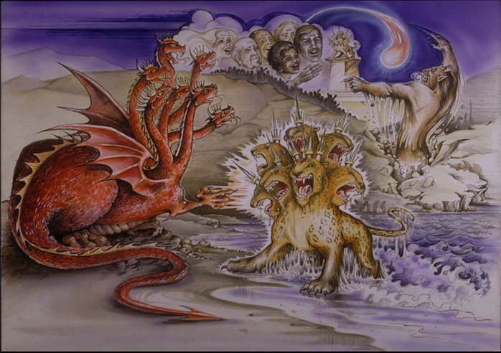

Slide 7
Names of False Christ:
Man of Sin
Son of Perdition
The Beast
The Antichrist

Slide 8
Daniel 3:4
Then a herald cried aloud: "To you it is commanded, O peoples, nations, and languages,

Slide 9
Daniel 3:5
that at the time you hear the sound of the horn, flute, harp, lyre, and psaltery, in symphony with all kinds of music, you shall fall down and worship the gold image that King Nebuchadnezzar has set up;

Slide 10
Daniel 3:6
and whoever does not fall down and worship shall be cast immediately into the midst of a burning fiery furnace."

Slide 11
Revelation 13:1
Then I stood on the sand of the sea. And I saw a beast rising up out of the sea, having seven heads and ten horns, and on his horns ten crowns, and on his heads a blasphemous name.

Slide 12
Psalm 89:8
O LORD God of hosts, Who is mighty like You, O LORD? Your faithfulness also surrounds You.

Slide 13
Psalm 89:9
You rule the raging of the sea; When its waves rise, You still them.

Slide 14
Revelation 13:18
Here is wisdom. Let him who has understanding calculate the number of the beast, for it is the number of a man: His number is 666.

Slide 15
Revelation 11:7
When they finish their testimony, the beast that ascends out of the bottomless pit will make war against them, overcome them, and kill them.

Slide 16
Revelation 17:8a
The beast that you saw was, and is not, and will ascend out of the bottomless pit and go to perdition. And those who dwell on the earth will marvel,

Slide 17
Revelation 17:8b
whose names are not written in the Book of Life from the foundation of the world, when they see the beast that was, and is not, and yet is.

Slide 18
John 13:2
And supper being ended, the devil having already put it into the heart of Judas Iscariot, Simon's son, to betray Him,

Slide 19
John 13:27
Now after the piece of bread, Satan entered him. Then Jesus said to him, "What you do, do quickly."

Slide 20
Revelation 17:9
Here is the mind which has wisdom: The seven heads are seven mountains on which the woman sits.

Slide 21
Revelation 17:10
There are also seven kings. Five have fallen, one is, and the other has not yet come. And when he comes, he must continue a short time.

Slide 22
Daniel 2:31
You, O king, were watching; and behold, a great image! This great image, whose splendor was excellent, stood before you; and its form was awesome.

Slide 23
Daniel 2:32
This image's head was of fine gold, its chest and arms of silver, its belly and thighs of bronze,

Slide 24
Daniel 2:33
its legs of iron, its feet partly of iron and partly of clay.

Slide 25
Daniel 2:34
You watched while a stone was cut out without hands, which struck the image on its feet of iron and clay, and broke them in pieces.

Slide 26
Daniel 2:35a
Then the iron, the clay, the bronze, the silver, and the gold were crushed together, and became like chaff from the summer threshing floors;

Slide 27
Daniel 2:35b
the wind carried them away so that no trace of them was found. And the stone that struck the image became a great mountain and filled the whole earth.

Slide 28
Revelation 13:2
Now the beast which I saw was like a leopard, his feet were like the feet of a bear, and his mouth like the mouth of a lion. The dragon gave him his power, his throne, and great authority.

Slide 29
Daniel 7:7a
After this I saw in the night visions, and behold, a fourth beast, dreadful and terrible, exceedingly strong. It had huge iron teeth;

Slide 30
Daniel 7:7b
it was devouring, breaking in pieces, and trampling the residue with its feet. It was different from all the beasts that were before it, and it had ten horns.

Slide 31
Daniel 7:8a
I was considering the horns, and there was another horn, a little one, coming up among them, before whom three of the first horns were plucked out by the roots.

Slide 32
Daniel 7:8b
And there, in this horn, were eyes like the eyes of a man, and a mouth speaking pompous words.

Slide 33
Isaiah 14:25
That I will break the Assyrian in my land, and upon my mountains tread him under foot: then shall his yoke depart from off them, and his burden depart from off their shoulders.

Slide 34
Jeremiah 23:5
"Behold, the days are coming," says the LORD, "That I will raise to David a Branch of righteousness; A King shall reign and prosper, And execute judgment and righteousness in the earth.

Slide 35
Jeremiah 23:6
In His days Judah will be saved, And Israel will dwell safely; Now this is His name by which He will be called: THE LORD OUR RIGHTEOUSNESS.

