Slide 1
The Book of Revelation
Revelation 1:9-20
Wednesday, November 14, 2012
Calvary Chapel of El Paso
Pastor Charlie Flores

Slide 2
Revelation 1:9
Revelation 1:9 (KJV) ⁹ I John, who also am your brother, and companion in tribulation, and in the kingdom and patience of Jesus Christ, was in the isle that is called Patmos, for the word of God, and for the testimony of Jesus Christ.

Slide 3
1 John 1:1-3
¹ That which was from the beginning, which we have heard, which we have seen with our eyes, which we have looked upon, and our hands have handled, of the Word of life; ² (For the life was manifested, and we have seen it, and bear witness, and shew unto you that eternal life, which was with the Father, and was manifested unto us;) ³ That which we have seen and heard declare we unto you, that ye also may have fellowship with us: and truly our fellowship is with the Father, and with his Son Jesus Christ.

Slide 5
Matthew 24:9-13
⁹ Then shall they deliver you up to be afflicted, and shall kill you: and ye shall be hated of all nations for my name's sake. ¹⁰ And then shall many be offended, and shall betray one another, and shall hate one another.

Slide 6
Matthew 24:9-13
¹¹ And many false prophets shall rise, and shall deceive many. ¹² And because iniquity shall abound, the love of many shall wax cold. ¹³ But he that shall endure unto the end, the same shall be saved.

Slide 8
Daniel 9:2
² In the first year of his reign I Daniel understood by books the number of the years, whereof the word of the LORD came to Jeremiah the prophet, that he would accomplish seventy years in the desolations of Jerusalem.

Slide 9
Daniel 10:1-2
¹ In the third year of Cyrus king of Persia a thing was revealed unto Daniel, whose name was called Belteshazzar; and the thing was true, but the time appointed was long: and he understood the thing, and had understanding of the vision. ² In those days I Daniel was mourning three full weeks.

Slide 10
Revelation 1:10-11
¹⁰ I was in the Spirit on the Lord's day, and heard behind me a great voice, as of a trumpet,

Slide 11
Revelation 1:10-11
¹¹ Saying, I am Alpha and Omega, the first and the last: and, What thou seest, write in a book, and send it unto the seven churches which are in Asia; unto Ephesus, and unto Smyrna, and unto Pergamos, and unto Thyatira, and unto Sardis, and unto Philadelphia, and unto Laodicea.

Slide 13
Isaiah 41:4
⁴ Who hath wrought and done it, calling the generations from the beginning? I the LORD, the first, and with the last; I am he.

Slide 14
Isaiah 44:6
⁶ Thus saith the LORD the King of Israel, and his redeemer the LORD of hosts; I am the first, and I am the last; and beside me there is no God.

Slide 15
Isaiah 48:12
¹² Hearken unto me, O Jacob and Israel, my called; I am he; I am the first, I also am the last.

Slide 16
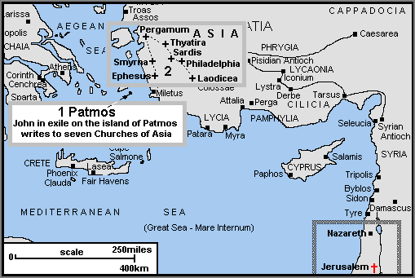

Slide 17
Revelation 1:12-16
¹² And I turned to see the voice that spake with me. And being turned, I saw seven golden candlesticks; ¹³ And in the midst of the seven candlesticks one like unto the Son of man, clothed with a garment down to the foot, and girt about the paps with a golden girdle.

Slide 18
Revelation 1:12-16
¹⁴ His head and his hairs were white like wool, as white as snow; and his eyes were as a flame of fire; ¹⁵ And his feet like unto fine brass, as if they burned in a furnace; and his voice as the sound of many waters.

Slide 19
Revelation 1:12-16
¹⁶ And he had in his right hand seven stars: and out of his mouth went a sharp twoedged sword: and his countenance was as the sun shineth in his strength.

Slide 20
Revelation 1:20
²⁰ The mystery of the seven stars which thou sawest in my right hand, and the seven golden candlesticks. The seven stars are the angels of the seven churches: and the seven candlesticks which thou sawest are the seven churches.

Slide 21
Matthew 5:14-16
¹⁴ Ye are the light of the world. A city that is set on an hill cannot be hid. ¹⁵ Neither do men light a candle, and put it under a bushel, but on a candlestick; and it giveth light unto all that are in the house. ¹⁶ Let your light so shine before men, that they may see your good works, and glorify your Father which is in heaven.

Slide 22
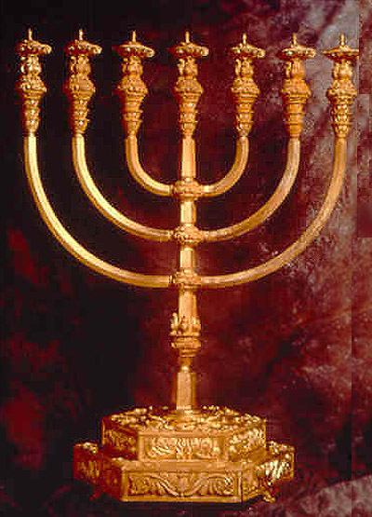

Slide 23
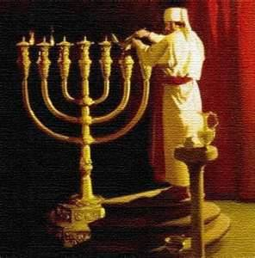

Slide 24
Leviticus 24:1-4
¹ And the LORD spake unto Moses, saying, ² Command the children of Israel, that they bring unto thee pure oil olive beaten for the light, to cause the lamps to burn continually.

Slide 25
Leviticus 24:1-4
³ Without the vail of the testimony, in the tabernacle of the congregation, shall Aaron order it from the evening unto the morning before the LORD continually: it shall be a statute for ever in your generations. ⁴ He shall order the lamps upon the pure candlestick before the LORD continually.

Slide 26
Revelation 1:13-16
¹³ And in the midst of the seven candlesticks one like unto the Son of man, clothed with a garment down to the foot, and girt about the paps with a golden girdle. ¹⁴ His head and his hairs were white like wool, as white as snow; and his eyes were as a flame of fire;

Slide 27
Revelation 1:13-16
¹⁵ And his feet like unto fine brass, as if they burned in a furnace; and his voice as the sound of many waters. ¹⁶ And he had in his right hand seven stars: and out of his mouth went a sharp twoedged sword: and his countenance was as the sun shineth in his strength.

Slide 28
What vision of Christ do we bring into this place when we gather to worship Him?

Slide 29
Jesus: Our Great High Priest
Daniel 7:13 (KJV) ¹³ I saw in the night visions, and, behold, one like the Son of man came with the clouds of heaven, and came to the Ancient of days, and they brought him near before him.

Slide 30
Jesus: Our Great High Priest
Daniel 7:14 (KJV) ¹⁴ And there was given him dominion, and glory, and a kingdom, that all people, nations, and languages, should serve him: his dominion is an everlasting dominion, which shall not pass away, and his kingdom that which shall not be destroyed.

Slide 31
Jesus: Our Great High Priest
Hebrews 2:17-18 (KJV) ¹⁷ Wherefore in all things it behoved him to be made like unto his brethren, that he might be a merciful and faithful high priest in things pertaining to God, to make reconciliation for the sins of the people. ¹⁸ For in that he himself hath suffered being tempted, he is able to succour them that are tempted.

Slide 32
Jesus: Our Great High Priest
Hebrews 4:14-15 (KJV) ¹⁴ Seeing then that we have a great high priest, that is passed into the heavens, Jesus the Son of God, let us hold fast our profession. ¹⁵ For we have not an high priest which cannot be touched with the feeling of our infirmities; but was in all points tempted like as we are, yet without sin.

Slide 33
Jesus: Arrayed in Holiness and Purity!
Isaiah 1:18 (KJV) ¹⁸ Come now, and let us reason together, saith the LORD: though your sins be as scarlet, they shall be as white as snow; though they be red like crimson, they shall be as wool.

Slide 34
Jesus: Arrayed in Holiness and Purity!
1 Peter 1:18-19 (KJV) ¹⁸ Forasmuch as ye know that ye were not redeemed with corruptible things, as silver and gold, from your vain conversation received by tradition from your fathers; ¹⁹ But with the precious blood of Christ, as of a lamb without blemish and without spot:

Slide 35
Jesus: The Righteous Judge!
Hebrews 4:13 (KJV) ¹³ Neither is there any creature that is not manifest in his sight: but all things are naked and opened unto the eyes of him with whom we have to do.

Slide 36
Jesus: The Refiner’s Fire!
Exodus 38:3 (KJV) ³ And he made all the vessels of the altar, the pots, and the shovels, and the basons, and the fleshhooks, and the firepans: all the vessels thereof made he of brass.

Slide 37
Jesus: The Voice of Power and Authority!
Psalms 29:3-4 (KJV) ³ The voice of the LORD is upon the waters: the God of glory thundereth: the LORD is upon many waters. ⁴ The voice of the LORD is powerful; the voice of the LORD is full of majesty.

Slide 38
Jesus: The Head of the Church
Colossians 1:18 (KJV) ¹⁸ And he is the head of the body, the church: who is the beginning, the firstborn from the dead; that in all things he might have the preeminence.

Slide 39
Jesus: The Two-Edged Sword!
Revelation 19:15 (KJV) ¹⁵ And out of his mouth goeth a sharp sword (‘rhomphaia’), that with it he should smite the nations: and he shall rule them with a rod of iron: and he treadeth the winepress of the fierceness and wrath of Almighty God.

Slide 40
Jesus: The Two-Edged Sword!
John 12:47-48 (KJV) ⁴⁷ And if any man hear my words, and believe not, I judge him not: for I came not to judge the world, but to save the world. ⁴⁸ He that rejecteth me, and receiveth not my words, hath one that judgeth him: the word that I have spoken, the same shall judge him in the last day.

Slide 41
Jesus: The Glory of God!
Matthew 17:2 (KJV) ² And was transfigured before them: and his face did shine as the sun, and his raiment was white as the light.

