Slide 1
Revelation 1:1-8
Wednesday, October 31, 2012
Calvary Chapel of El Paso

Slide 2
Revelation 1:1-8
Revelation 1:1 (KJV) ¹ The Revelation of Jesus Christ, which God gave unto him, to shew unto his servants things which must shortly come to pass; and he sent and signified it by his angel unto his servant John:

Slide 3
Revelation 1:1-8
Revelation 1:2 (KJV)
2 Who bare record of the word of God, and of the testimony of Jesus Christ, and of all things that he saw.

Slide 4
Revelation 1:1-8
Revelation 1:3 (KJV) ³ Blessed is he that readeth, and they that hear the words of this prophecy, and keep those things which are written therein: for the time is at hand.

Slide 5
Revelation 1:1-8
Revelation 1:4 (KJV) ⁴ John to the seven churches which are in Asia: Grace be unto you, and peace, from him which is, and which was, and which is to come; and from the seven Spirits which are before his throne;

Slide 6
Revelation 1:1-8
Revelation 1:5 (KJV) ⁵ And from Jesus Christ, who is the faithful witness, and the first begotten of the dead, and the prince of the kings of the earth. Unto him that loved us, and washed us from our sins in his own blood,

Slide 7
Revelation 1:1-8
Revelation 1:6 (KJV) ⁶ And hath made us kings and priests unto God and his Father; to him be glory and dominion for ever and ever. Amen.

Slide 8
Revelation 1:1-8
Revelation 1:7 (KJV) ⁷ Behold, he cometh with clouds; and every eye shall see him, and they also which pierced him: and all kindreds of the earth shall wail because of him. Even so, Amen.

Slide 9
Revelation 1:1-8
Revelation 1:8 (KJV) ⁸ I am Alpha and Omega, the beginning and the ending, saith the Lord, which is, and which was, and which is to come, the Almighty.

Slide 11
Isaiah 8:19-20
19 And when they shall say unto you, Seek unto them that have familiar spirits (mediums), and unto wizards that peep, and that mutter (spiritualists and necromancers): should not a people seek unto their God? for the living to the dead?

Slide 12
Isaiah 8:19-20
20 To the law and to the testimony: if they speak not according to this word, it is because there is no light in them.

Slide 13
Isaiah 44:6-8
6 Thus saith the LORD the King of Israel, and his redeemer the LORD of hosts; I am the first, and I am the last; and beside me there is no God.

Slide 14
Isaiah 44:6-8
7 And who, as I, shall call, and shall declare it, and set it in order for me, since I appointed the ancient people? and the things that are coming, and shall come, let them shew unto them.

Slide 15
Isaiah 44:6-8
8 Fear ye not, neither be afraid: have not I told thee from that time, and have declared it? ye are even my witnesses. Is there a God beside me? yea, there is no God; I know not any.

Slide 16
Isaiah 45:20-21
20 Assemble yourselves and come; draw near together, ye that are escaped of the nations: they have no knowledge that set up the wood of their graven image, and pray unto a god that cannot save.

Slide 17
Isaiah 45:20-21
21 Tell ye, and bring them near; yea, let them take counsel together: who hath declared this from ancient time? who hath told it from that time? have not I the LORD? and there is no God else beside me; a just God and a Saviour; there is none beside me.

Slide 18
Isaiah 46:9-10
9 Remember the former things of old: for I am God, and there is none else; I am God, and there is none like me,

Slide 19
Isaiah 46:9-10
10 Declaring the end from the beginning, and from ancient times the things that are not yet done, saying, My counsel shall stand, and I will do all my pleasure:

Slide 21
Revelation 1:1
1 The Revelation of Jesus Christ, which God gave unto him, to shew unto his servants things which must shortly come to pass; and he sent and signified it by his angel unto his servant John:

Slide 22
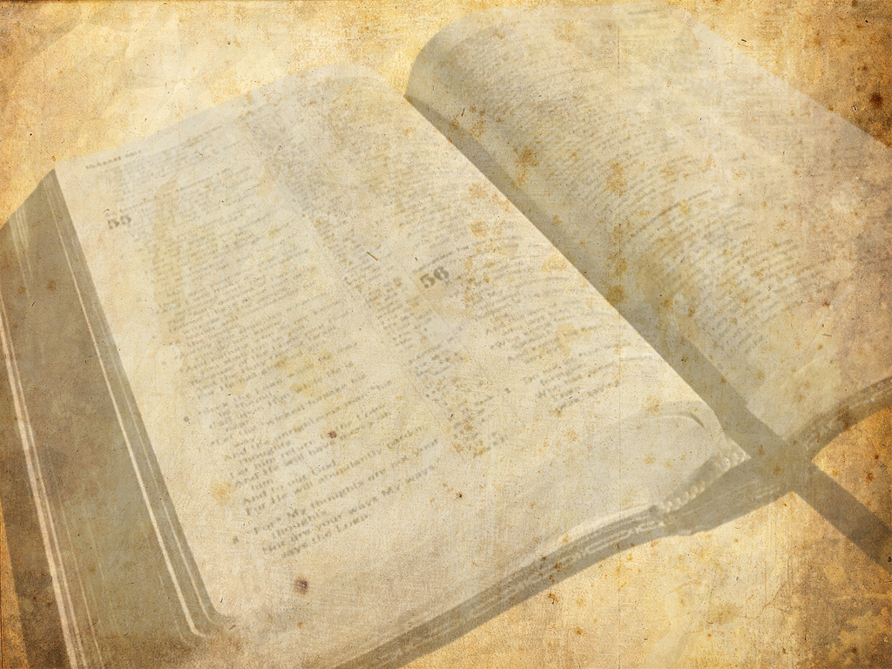
‘apokalupsis’, which means ‘a revealing, a disclosing, or an unveiling.’ It is an unveiling of truth about and concerning Jesus Christ Himself; it is a disclosing of future events, specifically the Second Coming of Christ; and it is a revealing that comes from God Himself, given to His Son, to be presented to all His church through the Apostle John!

Slide 23
Daniel 2:28-29
28 But there is a God in heaven that revealeth secrets, and maketh known to the king Nebuchadnezzar what shall be in the latter days. Thy dream, and the visions of thy head upon thy bed, are these;

Slide 24
Daniel 2:28-29
29 As for thee, O king, thy thoughts came into thy mind upon thy bed, what should come to pass hereafter: and he that revealeth secrets maketh known to thee what shall come to pass.

Slide 25
Joel 2:28
28 And it shall come to pass afterward, that I will pour out my spirit upon all flesh; and your sons and your daughters shall prophesy, your old men shall dream dreams, your young men shall see visions:

Slide 26
Joel 2:32
32 And it shall come to pass, that whosoever shall call on the name of the LORD shall be delivered: for in mount Zion and in Jerusalem shall be deliverance, as the LORD hath said, and in the remnant whom the LORD shall call.

Slide 27
Matthew 24:6-8
6 And ye shall hear of wars and rumours of wars: see that ye be not troubled: for all these things must come to pass, but the end is not yet.

Slide 28
Matthew 24:6-8
7 For nation shall rise against nation, and kingdom against kingdom: and there shall be famines, and pestilences, and earthquakes, in divers places.

Slide 29
Matthew 24:6-8
8 All these are the beginning of sorrows.

Slide 30
Revelation 1:1
1 The Revelation of Jesus Christ, which God gave unto him, to shew unto his servants things which must shortly come to pass; and he sent and signified it by his angel unto his servant John:

Slide 31
Revelation 12:1
1 And there appeared a great wonder (sign: semeion) in heaven; a woman clothed with the sun, and the moon under her feet, and upon her head a crown of twelve stars:

Slide 33
Revelation 1:2
2 Who bare record of the word of God, and of the testimony of Jesus Christ, and of all things that he saw.

Slide 34
Revelation 1:3
3 Blessed is he that readeth, and they that hear the words of this prophecy, and keep those things which are written therein: for the time is at hand.

Slide 36
Titus 2:11-14
11 For the grace of God that bringeth salvation hath appeared to all men,

Slide 37
Titus 2:11-14
12 Teaching us that, denying ungodliness and worldly lusts, we should live soberly, righteously, and godly, in this present world;

Slide 38
Titus 2:11-14
13 Looking for that blessed hope, and the glorious appearing of the great God and our Saviour Jesus Christ;

Slide 39
Titus 2:11-14
14 Who gave himself for us, that he might redeem us from all iniquity, and purify unto himself a peculiar people, zealous of good works.

Slide 40
The Recipients of the Prophecy

Slide 41
Revelation 1:4
4 John to the seven churches which are in Asia: Grace be unto you, and peace, from him which is, and which was, and which is to come; and from the seven Spirits which are before his throne;

Slide 42
Revelation 1:11
11 Saying, I am Alpha and Omega, the first and the last: and, What thou seest, write in a book, and send it unto the seven churches which are in Asia; unto Ephesus, and unto Smyrna, and unto Pergamos, and unto Thyatira, and unto Sardis, and unto Philadelphia, and unto Laodicea.

Slide 43
Revelation 1:4-5
4 John to the seven churches which are in Asia: Grace be unto you, and peace, from him which is, and which was, and which is to come; and from the seven Spirits which are before his throne;

Slide 44
Revelation 1:4-5
5 And from Jesus Christ, who is the faithful witness, and the first begotten of the dead, and the prince of the kings of the earth. Unto him that loved us, and washed us from our sins in his own blood,

Slide 45
Isaiah 11:2
2 And the spirit of the LORD shall rest upon him, the spirit of wisdom and understanding, the spirit of counsel and might, the spirit of knowledge and of the fear of the LORD;

Slide 46
John 14:6
6 Jesus saith unto him, I am the way, the truth, and the life: no man cometh unto the Father, but by me.

Slide 47
John 18:37
37 Pilate therefore said unto him, Art thou a king then? Jesus answered, Thou sayest that I am a king. To this end was I born, and for this cause came I into the world, that I should bear witness unto the truth. Every one that is of the truth heareth my voice.

Slide 48
Psalm 89:27
27 Also I will make him my firstborn, higher than the kings of the earth.

Slide 49
Jeremiah 23:5-6
5 Behold, the days come, saith the LORD, that I will raise unto David a righteous Branch, and a King shall reign and prosper, and shall execute judgment and justice in the earth.

Slide 50
Jeremiah 23:5-6
6 In his days Judah shall be saved, and Israel shall dwell safely: and this is his name whereby he shall be called, THE LORD OUR RIGHTEOUSNESS.

Slide 51
Revelation 1:5-6
5 And from Jesus Christ, who is the faithful witness, and the first begotten of the dead, and the prince of the kings of the earth. Unto him that loved us, and washed us from our sins in his own blood,

Slide 52
Revelation 1:5-6
6 And hath made us kings and priests unto God and his Father; to him be glory and dominion for ever and ever. Amen.

