Slide 1
Replacement Theology:
The Arab Christian Revisionist Narrative
Three key issues:
1. Are the Jews still the covenantal promise holders of God's plan?
Romans 11:1-2
“Did God reject his people? Heaven forbid! I myself am a son of Israel, from the seed of Avraham, of the tribe of Binyamin[Benjamin]. God has not rejected his people, whom he chose in advance."
2. Does the covenant God has made with Israel and the Jews include the land?
Genesis 15:18
On that day Adonai made a covenant with Avram saying “I have given this land to your descendants- from the vadi of Egypt to the great river Euphrates.”
Genesis 17:8
“I will give to you and your descendants all the land of Canaan, for an everlasting possession; and I will be their God.”

Slide 2
Replacement Theology:
The Arab Christian Revisionist Narrative
3. Christians have been grafted into Israel, not the other way around
Romans 11:16-18
“If the root is holy, so are the branches. But if some of the branches were broken off, and you – a wild olive – were grafted in among them and have become equal sharers in the rich root of the olive tree, then don’t boast as if you were better than the branches! However, if you do boast, remember that you are not supporting the root, the root is supporting you.

Slide 3
Replacement Theology:
The Arab Christian Revisionist Narrative cont.
Four Distinct Revisionist Scenarios
Scenario #1:
Some Arab and non-Arab believers are promoting “peace, justice and reconciliation” between Arabs and Jews. On the surface this sounds nice. However, promoting such 'noble' goals is rooted in human reward [such as the oft promoted "two-state solution"] which means dividing up God's land.
Joel 3:2 says "I will enter into judgment there for my people, my heritage Israel, whom they scattered among the nations; then they divided my land." Here God tells us three things-
1. He affirms the Jewish people and the land of Israel are "my people" and "my heritage.
2. It is on their behalf He will hold the nations accountable.
3. They [the nations] will be accountable for "dividing my land.”
James 4:4 says “Whoever chooses to be the world’s friend makes himself God’s enemy.”

Slide 4



Palestinian’s Want Israel Replaced

Slide 5
Replacement Theology:
The Arab Christian Revisionist Narrative cont.
Scenario #2:
Jesus compels them to forgive their enemy.
Scenario #3:
“We are all children of Abraham."
Genesis 17:20- 21 says "But as for Yishma'el [Ishmael], ….I have blessed him. I will make him fruitful and give him many descendants….and I will make him a great nation. But I will establish my covenant with Yitz'chak [Isaac]." Thus the true seed of Avraham is through Yitz'chak. This is confirmed in Romans 9:7- "What is to be called your 'seed' will be in Yitz'chak"

Slide 6
Replacement Theology:
The Arab Christian Revisionist Narrative cont.
Scenario #4:
Jesus is a Palestinian.
This suggests at least two things- [1]He is not a Jew, [2]He is an Arab. Both statements are false.
He is from the Tribe of Judah and from the seed of David: [Isaiah 9:6-7, Jeremiah 23:5-6, Matthew 21:9, Revelation 22:16].
His name is Yeshua ben Yosef [Yeshua, son of Joseph].
He was born "King of the Jews," [Matthew 2:2].
His ministry was to His own people- the Jews.
All His disciples were Jews.
When crucified the sign above Him said "This is Yeshua, King of the Jews." [Matthew 27:37]. Scripture tells us Messiah is the same yesterday, today and forever,[Hebrews 13:8].
Rome changed the name Judea to “Philistia” or “Palestine” in 135 AD

Slide 7
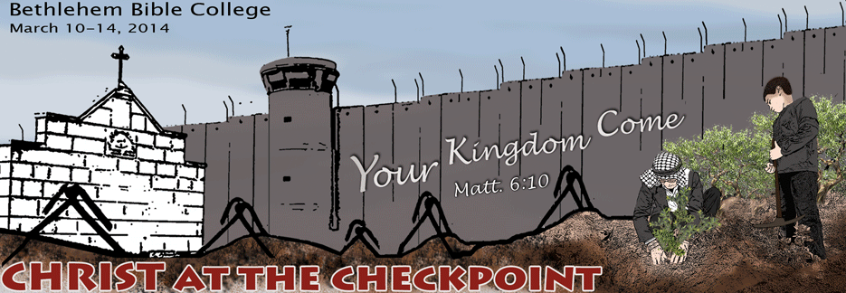
Replacement Theology:
The Arab Christian Revisionist Narrative
A Conference of ‘Christians’ Attacking Christian Zionism

Slide 8
‘Christian’ Conference Manifesto
Conference promoters said it was balanced
There were 34 speakers
Of those, 32 were pro-Palestinian

Slide 9
The Dry Bones Prophesy
Ezekiel 37 prophesy:
The hand of the Lord was on me, and he brought me out by the Spirit of the Lord and set me in the middle of a valley; it was full of bones. He asked me, “Son of man, can these bones live?”
⁴ Then he said to me, “Prophesy to these bones and say to them, ‘Dry bones, hear the word of the Lord! “

Slide 10
Replacement Theology:
The Arab Christian Revisionist Narrative cont.
Examples of Revisionism
Ezekiel 37 [Palestinianized Version:
“The hand of the Lord was on me and He brought me out by the Spirit of the Lord and set me in the middle of the West Bank – Bethlehem, Jenin and Salvit and Nablus and Ramallah. It was full of bones ... He asked me, ‘Son of Man, can these bones live? Can the Palestinian people live?’
Then He said to me, ‘Prophesy to these bones, and say to them, “Dry bones, hear the word of the Lord”’ …
“You see, the Palestinian people were, and a lot are still like this valley of dry bones that is in need of the Church to come and prophesy life on them.”
Jack Sara, President- Bethlehem Bible College
Speaking at Christ at the Checkpoint Conference, March 9, 2012

Slide 11
Evangelical Participants of C.A.T.C. Conference
Standing Against Christian Zionism:
Lynne Hybals: Wife of Pastor Bill Hybals, Willowcreek Church
William Wilson: President of Oral Roberts University
Gary Burge: New Testament Prof. Wheaton College
Stephen Sizer: Vicar, Christ Church, Surrey, England
Pastor Bob Roberts: Northwood Church, Keller, TX
Ruth Padilla DeBorst: Director, World Vision
Colin Chapman: Author, Lecturer

Slide 12

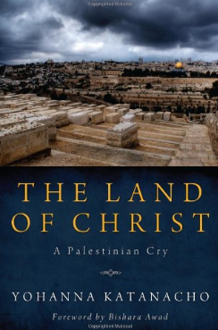
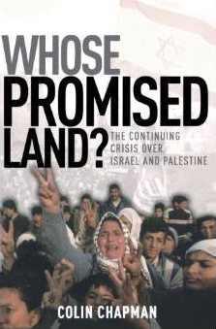
Evangelical Books Attacking God’s Promises to the Jewish People

Slide 13
Quotes from who?
Palestinian Authority, Hamas, Fatah?
The separation wall erected on Palestinian territory, a large part of which has been confiscated for this purpose, has turned our towns and villages into prisons. Gaza, especially after the cruel war Israel launched against it during December 2008 and January 2009, continues to live in inhuman conditions….
Israeli settlements ravage our land in the name of God and in the name of force, controlling our natural resources, including water and agricultural land, thus depriving hundreds of thousands of Palestinians, and constituting an obstacle to any political solution.
Refugees are also part of our reality. Most of them are still living in camps under difficult circumstances. They have been waiting for their right of return, generation after generation. What will be their fate?
In the face of this reality, Israel justifies its actions as self-defence, including occupation, collective punishment and all other forms of reprisals against the Palestinians. In our opinion, this vision is a reversal of reality. Yes, there is Palestinian resistance to the occupation. However, if there were no occupation, there would be no resistance, no fear and no insecurity.
We know that certain theologians in the West try to attach a biblical and theological legitimacy to the infringement of our rights. Thus, the promises, according to their interpretation, have become a menace to our very existence.
*All quotations are from The Kairos Palestine Document, published by The World Council of Churches

Slide 14
Arab’s Rewrite History
The Jews murdered Jesus, the first Palestinian
Source: Al-Hayat Al-Jadida, Jan. 24, 2000
Jesus was first Palestinian Shahid (died for Allah)
Source: Al-Hayat Al- Jadida, Jan. 17, 2005
Jesus was a tortured Palestinian
Source: Palestinian TV (Fatah), Dec. 24, 2009 Mustafa Barghouti
Fatah proud of "Palestinian" Virgin Mary
Source: Fatah website, Mar. 8, 2010
Jesus was the first Palestinian Martyr
Source: Palestinian TV (Fatah), Dec. 3, 2010

Slide 15
Replacement Theology:
The Arab Christian Revisionist Narrative cont.
Examples of Revisionism in Arab Media:
Official PA TV broadcast a speech by District Governor of Ramallah and El-Bireh Laila Ghannam:
"We are standing here, Muslims and Christians, in Yasser Arafat Square, [named after] the symbol of our cause, to celebrate Christmas. So too we will stand united to celebrate victory, far off as it may be. Merry Christmas, let's celebrate and be merry; Jesus the Messiah is Palestinian, and we are Palestinians and will continue to hold our heads high."
[Official PA TV, Dec. 7, 2014]
Christmas is also a Palestinian holiday, because Jesus, peace be upon him, was Palestinian. He was born in Palestine; lived and was sent [as prophet] to Palestine. Therefore, Christmas has a special Palestinian flavor.'"
[Al-Hayat Al-Jadida, Dec. 22, 2014 and Ma'an, Dec. 21, 2014]

Slide 16
Jesus a Palestinian?
"We wish our united Palestinian people a new Christmas that will herald liberty, as did Jesus, the first Palestinian, peace be upon him."
[Facebook page of Fatah Central Committee member,
Tawfiq Tirawi, Dec. 24, 2014]
My lord has created a resistance-fighting man out of clay stones!
My lord blew a soul into Jesus the Palestinian!
My lord bestowed upon Jerusalem [Islam's Prophet Muhammad's] Night Journey and Ascent to Heaven..."
[Al-Hayat Al-Jadida, Dec. 24, 2014]
"We celebrate the birth of Jesus, a Palestinian messenger of love, justice and peace." Mahmoud Abbas [WAFA, Dec. 22, 2014]

Slide 17

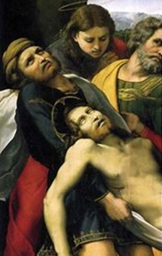
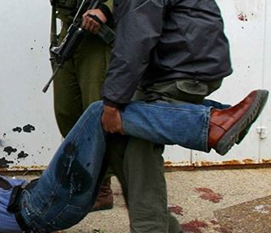
Jesus a Palestinian?

Slide 18
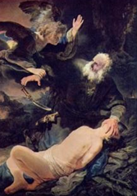
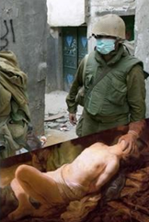
Who Sacrificed Isaac?

Slide 19

A true Christian
Should not be anti-Semitic
Should not blame Jews for Jesus/Yeshua’s death
Should not support a two-state solution
Should not side with Israel’s enemies
Is part of Israel

