Slide 1
Rejoicing in Resurrection Hope
1 Peter 1:3-9
March 30-31, 2013
Calvary Chapel of El Paso

Slide 2
1 Peter 1:3
Blessed be the God and Father of our Lord Jesus Christ, who according to His abundant mercy has begotten us again to a living hope through the resurrection of Jesus Christ from the dead,

Slide 3
1 Peter 1:4
to an inheritance incorruptible and undefiled and that does not fade away, reserved in heaven for you,

Slide 4
1 Peter 1:5
who are kept by the power of God through faith for salvation ready to be revealed in the last time.

Slide 5
1 Peter 1:6
In this you greatly rejoice, though now for a little while, if need be, you have been grieved by various trials,

Slide 6
1 Peter 1:7
that the genuineness of your faith, being much more precious than gold that perishes, though it is tested by fire, may be found to praise, honor, and glory at the revelation of Jesus Christ,

Slide 7
1 Peter 1:8
whom having not seen you love. Though now you do not see Him, yet believing, you rejoice with joy inexpressible and full of glory,

Slide 8
1 Peter 1:9
receiving the end of your faith—the salvation of your souls.

Slide 10
Mark 16:1-8

Slide 11
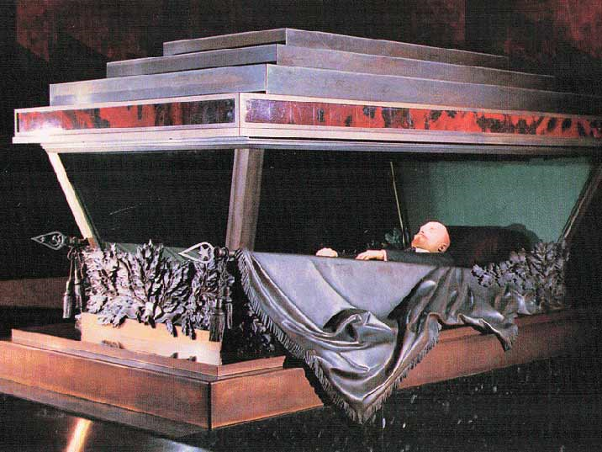

Slide 12
Romans 10:9-11
⁹ that if you confess with your mouth the Lord Jesus and believe in your heart that God has raised Him from the dead, you will be saved. ¹⁰ For with the heart one believes unto righteousness, and with the mouth confession is made unto salvation. ¹¹ For the Scripture says, "Whoever believes on Him will not be put to shame."

Slide 13
1 Corinthians 15:16-20
¹⁶ For if the dead do not rise, then Christ is not risen. ¹⁷ And if Christ is not risen, your faith is futile; you are still in your sins! ¹⁸ Then also those who have fallen asleep in Christ have perished. ¹⁹ If in this life only we have hope in Christ, we are of all men the most pitiable. ²⁰ But now Christ is risen from the dead, and has become the firstfruits of those who have fallen asleep.

Slide 14
Because of the resurrection of Jesus Christ we have been given a Living Hope!

Slide 15
1 Peter 1:3
Blessed be the God and Father of our Lord Jesus Christ, who according to His abundant mercy has begotten us again to a living hope through the resurrection of Jesus Christ from the dead,

Slide 16
We now have a hope and the knowledge that death is not the end!

Slide 17
Colossians 1:18
And He is the head of the body, the church, who is the beginning, the firstborn from the dead, that in all things He may have the preeminence.

Slide 18
Revelation 1:5
and from Jesus Christ, the faithful witness, the firstborn from the dead, and the ruler over the kings of the earth. To Him who loved us and washed us from our sins in His own blood,

Slide 19
Hebrews 7:16
who has come, not according to the law of a fleshly commandment, but according to the power of an endless life.

Slide 20
Our hope includes the knowledge that evil does not win!

Slide 21
Hebrews 2:14-15
¹⁴ Inasmuch then as the children have partaken of flesh and blood, He Himself likewise shared in the same, that through death He might destroy him who had the power of death, that is, the devil, ¹⁵ and release those who through fear of death were all their lifetime subject to bondage.

Slide 22
1 John 3:8
He who sins is of the devil, for the devil has sinned from the beginning. For this purpose the Son of God was manifested, that He might destroy the works of the devil.

Slide 23
“Christ Arose!”
Up from the grave He arose
With a mighty triumph o’er His foes.
He arose the Victor
From the dark domain
And He lives forever
On His throne to reign
He arose, He arose,
Hallelujah Christ Arose!

Slide 24
Our hope also includes the knowledge that God forgives!

Slide 25
Mark 16:7
But go, tell His disciples—and Peter—that He is going before you into Galilee; there you will see Him, as He said to you.

Slide 26
Matthew 26:33-35
³³ Peter answered and said to Him, "Even if all are made to stumble because of You, I will never be made to stumble." ³⁴ Jesus said to him, "Assuredly, I say to you that this night, before the rooster crows, you will deny Me three times." ³⁵ Peter said to Him, "Even if I have to die with You, I will not deny You!" And so said all the disciples.

Slide 27
1 John 1:9
If we confess our sins, He is faithful and just to forgive us our sins and to cleanse us from all unrighteousness.

Slide 28
“If we confess our sins, He will forgive the sins we confess and moreover will even cleanse us from all unrighteousness!”

Slide 29
Our hope in the resurrection includes the knowledge that new life is an option we can receive assuredly!

Slide 30
Romans 6:4
Therefore we were buried with Him through baptism into death, that just as Christ was raised from the dead by the glory of the Father, even so we also should walk in newness of life.

Slide 31
2 Corinthians 5:17
Therefore, if anyone is in Christ, he is a new creation; old things have passed away; behold, all things have become new.

Slide 32
Lastly, our hope includes the promise of a better tomorrow!

Slide 33
1 Peter 1:3-4
³ Blessed be the God and Father of our Lord Jesus Christ, who according to His abundant mercy has begotten us again to a living hope through the resurrection of Jesus Christ from the dead, ⁴ to an inheritance incorruptible and undefiled and that does not fade away, reserved in heaven for you,

Slide 34
John 14:1-6

Slide 35
Jesus Christ is Alive! He is Risen!

