Slide 1
Rebuilding Trust in a Climate of Fear
Genesis 43:15-34
June 28-29, 2014
Calvary Chapel of El Paso

Slide 2
Genesis 43:15
So the men took that present and Benjamin, and they took double money in their hand, and arose and went down to Egypt; and they stood before Joseph.

Slide 3
Genesis 43:16
When Joseph saw Benjamin with them, he said to the steward of his house, "Take these men to my home, and slaughter an animal and make ready; for these men will dine with me at noon."

Slide 4
Genesis 43:17
Then the man did as Joseph ordered, and the man brought the men into Joseph's house.

Slide 5
Genesis 43:18a
Now the men were afraid because they were brought into Joseph's house; and they said,

Slide 6
Genesis 43:18b
"It is because of the money, which was returned in our sacks the first time, that we are brought in, so that he may make a case against us and fall upon us, to take us as slaves with our donkeys."

Slide 7
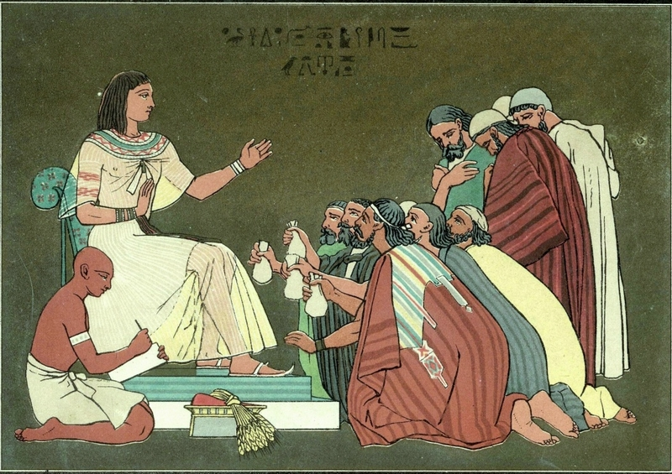

Slide 8
The Invitation to Fear

Slide 9
Proverbs 28:1
The wicked flee when no one pursues, But the righteous are bold as a lion.

Slide 10
Proverbs 24:10
If you faint in the day of adversity, Your strength is small.

Slide 11
Interceding in the Fear

Slide 12
Genesis 43:19
When they drew near to the steward of Joseph's house, they talked with him at the door of the house,

Slide 13
Genesis 43:20
and said, "O sir, we indeed came down the first time to buy food;

Slide 14
Genesis 43:21a
but it happened, when we came to the encampment, that we opened our sacks, and there,

Slide 15
Genesis 43:21b
each man's money was in the mouth of his sack, our money in full weight; so we have brought it back in our hand.

Slide 16
Genesis 43:22
And we have brought down other money in our hands to buy food. We do not know who put our money in our sacks."

Slide 17
Genesis 43:23
But he said, "Peace be with you, do not be afraid. Your God and the God of your father has given you treasure in your sacks; I had your money." Then he brought Simeon out to them.

Slide 18
John 14:27
Peace I leave with you, My peace I give to you; not as the world gives do I give to you. Let not your heart be troubled, neither let it be afraid.

Slide 19
1 John 4:17
Herein is our love made perfect, that we may have boldness in the day of judgment: because as he is, so are we in this world.

Slide 20
1 John 4:18
There is no fear in love; but perfect love casteth out fear: because fear hath torment. He that feareth is not made perfect in love.

Slide 21
1 John 4:19
We love him, because he first loved us.

Slide 22
1 John 4:20
If a man say, I love God, and hateth his brother, he is a liar: for he that loveth not his brother whom he hath seen, how can he love God whom he hath not seen?

Slide 23
1 John 4:21
And this commandment have we from him, That he who loveth God love his brother also.

Slide 24
From Fear to Feast

Slide 25
Genesis 43:24
So the man brought the men into Joseph's house and gave them water, and they washed their feet; and he gave their donkeys feed.

Slide 26
Genesis 43:25
Then they made the present ready for Joseph's coming at noon, for they heard that they would eat bread there.

Slide 27
Genesis 43:26
And when Joseph came home, they brought him the present which was in their hand into the house, and bowed down before him to the earth.

Slide 28
Genesis 43:27
Then he asked them about their well-being, and said, "Is your father well, the old man of whom you spoke? Is he still alive?"

Slide 29
Genesis 43:28
And they answered, "Your servant our father is in good health; he is still alive." And they bowed their heads down and prostrated themselves.

Slide 30
Numbers 23:19
God is not a man, that He should lie, Nor a son of man, that He should repent. Has He said, and will He not do? Or has He spoken, and will He not make it good?

Slide 31
Genesis 43:29
Then he lifted his eyes and saw his brother Benjamin, his mother's son, and said, "Is this your younger brother of whom you spoke to me?" And he said, "God be gracious to you, my son."

Slide 32
Genesis 43:30
Now his heart yearned for his brother; so Joseph made haste and sought somewhere to weep. And he went into his chamber and wept there.

Slide 33
Proverbs 16:32
He who is slow to anger is better than the mighty, And he who rules his spirit than he who takes a city.

Slide 34
Genesis 43:31
Then he washed his face and came out; and he restrained himself, and said, "Serve the bread."

Slide 35
Genesis 43:32a
So they set him a place by himself, and them by themselves, and the Egyptians who ate with him by themselves;

Slide 36
Genesis 43:32b
because the Egyptians could not eat food with the Hebrews, for that is an abomination to the Egyptians.

Slide 37
Romans 11:33
Oh, the depth of the riches both of the wisdom and knowledge of God! How unsearchable are His judgments and His ways past finding out!

Slide 38
Genesis 43:33
And they sat before him, the firstborn according to his birthright and the youngest according to his youth; and the men looked in astonishment at one another.

Slide 39
Genesis 43:34
Then he took servings to them from before him, but Benjamin's serving was five times as much as any of theirs. So they drank and were merry with him.

Slide 40
Philippians 1:6
being confident of this very thing, that He who has begun a good work in you will complete it until the day of Jesus Christ;

