Slide 1
“Rebuilding Trust”
Studies in the Life of Joseph
Genesis 43:1-14
May 31-June 1, 2014

Slide 2
Genesis 43:1
Now the famine was severe in the land.

Slide 3
Genesis 43:2
And it came to pass, when they had eaten up the grain which they had brought from Egypt, that their father said to them, "Go back, buy us a little food."

Slide 4
Genesis 43:3
But Judah spoke to him, saying, "The man solemnly warned us, saying, 'You shall not see my face unless your brother is with you.'"

Slide 5
Genesis 43:4
"If you send our brother with us, we will go down and buy you food.

Slide 6
Genesis 43:5
But if you will not send him, we will not go down; for the man said to us, 'You shall not see my face unless your brother is with you.'"

Slide 7
Genesis 43:6
And Israel said, "Why did you deal so wrongfully with me as to tell the man whether you had still another brother?"

Slide 8
Genesis 43:7a
But they said, "The man asked us pointedly about ourselves and our family, saying, 'Is your father still alive? Have you another brother?'

Slide 9
Genesis 43:7b
And we told him according to these words. Could we possibly have known that he would say, 'Bring your brother down'?"

Slide 10
Genesis 43:8
Then Judah said to Israel his father, "Send the lad with me, and we will arise and go, that we may live and not die, both we and you and also our little ones.

Slide 11
Genesis 43:9
I myself will be surety for him; from my hand you shall require him. If I do not bring him back to you and set him before you, then let me bear the blame forever.

Slide 12
Genesis 43:10
For if we had not lingered, surely by now we would have returned this second time."

Slide 13
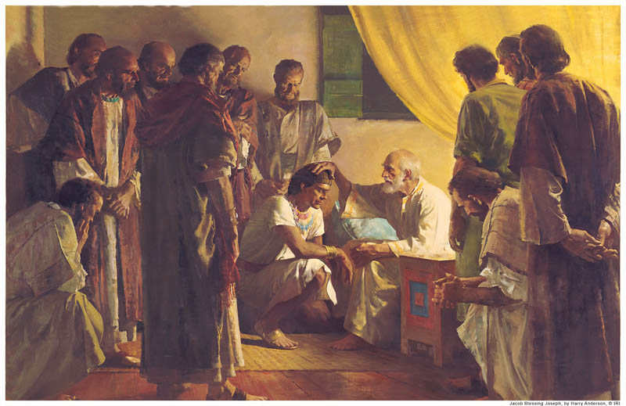

Slide 14
1 John 4:20
If someone says, "I love God," and hates his brother, he is a liar; for he who does not love his brother whom he has seen, how can he love God whom he has not seen?

Slide 15
1 John 4:21
And this commandment we have from Him: that he who loves God must love his brother also.

Slide 16
Consider:
Our experiences on earth are a proving ground for rebuilding trust and expressing God’s Love through our own Love for one another!

Slide 17
The Terms of Our Love

Slide 18
The “One Anothers”:
Be Members of
Prefer
Admonish
Greet
Serve
Bear With
Forgive
Submit to

Slide 19
The “One Anothers”:
Edify
Exhort
Confess to
Consider
Have Compassion for
Show Hospitality

Slide 20
Romans 12:9
Let love be without hypocrisy. Abhor what is evil. Cling to what is good.

Slide 21
Romans 12:10
Be kindly affectionate to one another with brotherly love, in honor giving preference to one another;

Slide 22
Romans 12:11
not lagging in diligence, fervent in spirit, serving the Lord;

Slide 23
Romans 12:12
rejoicing in hope, patient in tribulation, continuing steadfastly in prayer;

Slide 24
Romans 12:13
distributing to the needs of the saints, given to hospitality.

Slide 25
Genesis 43:11a
And their father Israel said to them, "If it must be so, then do this: Take some of the best fruits of the land in your vessels and carry down a present for the man—

Slide 26
Genesis 43:11b
a little balm and a little honey, spices and myrrh, pistachio nuts and almonds.

Slide 27
Genesis 43:12
Take double money in your hand, and take back in your hand the money that was returned in the mouth of your sacks; perhaps it was an oversight.

Slide 28
Genesis 43:13
Take your brother also, and arise, go back to the man.

Slide 29
Genesis 43:14
And may God Almighty give you mercy before the man, that he may release your other brother and Benjamin. If I am bereaved, I am bereaved!"

Slide 30
Ephesians 4:1
I, therefore, the prisoner of the Lord, beseech you to walk worthy of the calling with which you were called,

Slide 31
Ephesians 4:2
with all lowliness and gentleness, with longsuffering, bearing with one another in love,

Slide 32
Ephesians 4:3
endeavoring to keep the unity of the Spirit in the bond of peace.

Slide 33
Ephesians 4:4
There is one body and one Spirit, just as you were called in one hope of your calling;

Slide 34
Ephesians 4:5
one Lord, one faith, one baptism;

Slide 35
Ephesians 4:6
one God and Father of all, who is above all, and through all, and in you all.

Slide 36
Mark 10:45
For even the Son of Man did not come to be served, but to serve, and to give His life a ransom for many.

Slide 37
John 13:14
If I then, your Lord and Teacher, have washed your feet, you also ought to wash one another's feet.

Slide 38
John 13:15
For I have given you an example, that you should do as I have done to you.

Slide 39
Philippians 2:1
Therefore if there is any consolation in Christ, if any comfort of love, if any fellowship of the Spirit, if any affection and mercy,

Slide 40
Philippians 2:2
fulfill my joy by being like-minded, having the same love, being of one accord, of one mind.

Slide 41
Philippians 2:3
Let nothing be done through selfish ambition or conceit, but in lowliness of mind let each esteem others better than himself.

Slide 42
Philippians 2:4
Let each of you look out not only for his own interests, but also for the interests of others.

