Slide 1
Mom’s School of Biblical Ministry
2 Timothy 1:1-7
Mother’s Day, 2015
Calvary Chapel of El Paso

Slide 2
2 Timothy 1:1
Paul, an apostle of Jesus Christ by the will of God, according to the promise of life which is in Christ Jesus,

Slide 3
2 Timothy 1:2
To Timothy, my dearly beloved son: Grace, mercy, and peace, from God the Father and Christ Jesus our Lord.

Slide 4
2 Timothy 1:3
I thank God, whom I serve from my forefathers with pure conscience, that without ceasing I have remembrance of thee in my prayers night and day;

Slide 5
2 Timothy 1:4
Greatly desiring to see thee, being mindful of thy tears, that I may be filled with joy;

Slide 6
2 Timothy 1:5
When I call to remembrance the unfeigned faith that is in thee, which dwelt first in thy grandmother Lois, and thy mother Eunice; and I am persuaded that in thee also.

Slide 7
2 Timothy 1:6
Wherefore I put thee in remembrance that thou stir up the gift of God, which is in thee by the putting on of my hands.

Slide 8
2 Timothy 1:7
For God hath not given us the spirit of fear; but of power, and of love, and of a sound mind.

Slide 9


Slide 10
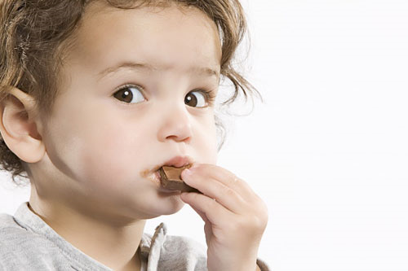

Slide 11
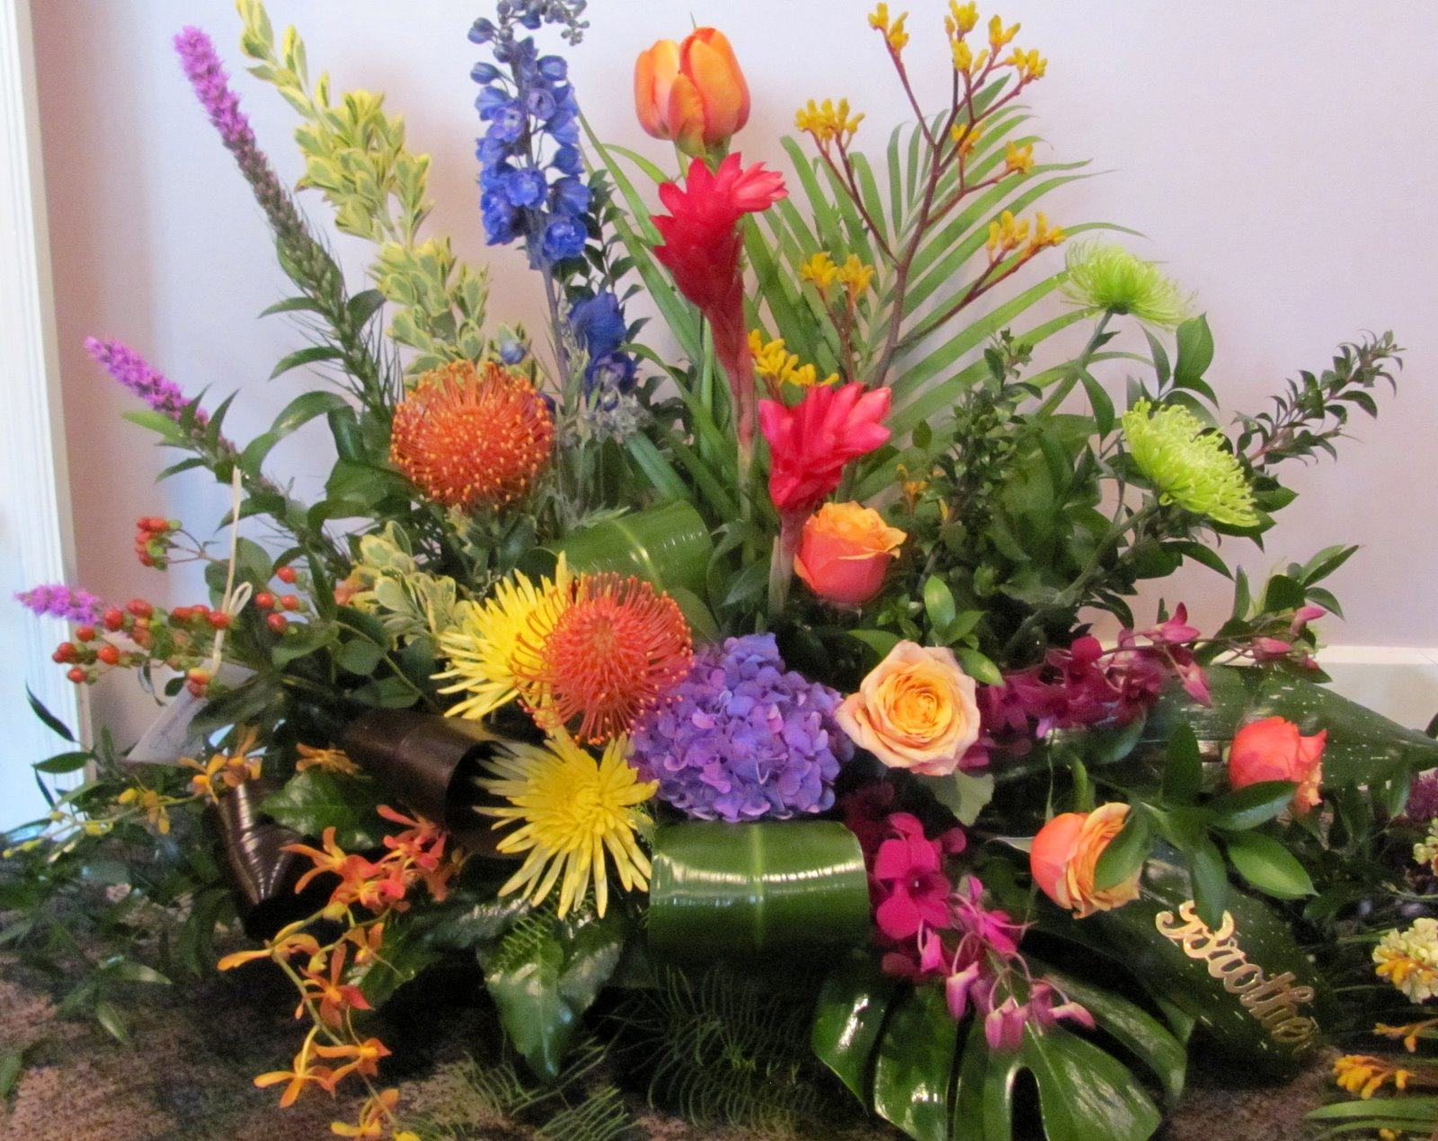

Slide 12
Acts 16:1
Then came he to Derbe and Lystra: and, behold, a certain disciple was there, named Timotheus, the son of a certain woman, which was a Jewess, and believed; but his father was a Greek:

Slide 13
2 Timothy 1:3
I thank God, whom I serve from my forefathers with pure conscience, that without ceasing I have remembrance of thee in my prayers night and day;

Slide 14
2 Timothy 1:4
Greatly desiring to see thee, being mindful of thy tears, that I may be filled with joy;

Slide 15
2 Timothy 1:5
When I call to remembrance the unfeigned faith that is in thee, which dwelt first in thy grandmother Lois, and thy mother Eunice; and I am persuaded that in thee also.

Slide 16
1 Timothy 4:10
For therefore we both labour and suffer reproach, because we trust in the living God, who is the Saviour of all men, specially of those that believe.

Slide 17
1 Timothy 4:11
These things command and teach.

Slide 18
1 Timothy 4:12
Let no man despise thy youth; but be thou an example of the believers, in word, in conversation, in charity, in spirit, in faith, in purity.

Slide 19
1 Timothy 4:13
Till I come, give attendance to reading, to exhortation, to doctrine.

Slide 20
1 Timothy 4:14
Neglect not the gift that is in thee, which was given thee by prophecy, with the laying on of the hands of the presbytery.

Slide 21
1 Timothy 4:15
Meditate upon these things; give thyself wholly to them; that thy profiting may appear to all.

Slide 22
1 Timothy 4:16
Take heed unto thyself, and unto the doctrine; continue in them: for in doing this thou shalt both save thyself, and them that hear thee.

Slide 23
Philippians 2:19
But I trust in the Lord Jesus to send Timotheus shortly unto you, that I also may be of good comfort, when I know your state.

Slide 24
Philippians 2:20
For I have no man likeminded, who will naturally care for your state.

Slide 25
They Not Only Communicated The Truth, They Demonstrated It!

Slide 26
2 Timothy 1:5
When I call to remembrance the unfeigned faith that is in thee, which dwelt first in thy grandmother Lois, and thy mother Eunice; and I am persuaded that in thee also.

Slide 27
John 15:4
Abide in me, and I in you. As the branch cannot bear fruit of itself, except it abide in the vine; no more can ye, except ye abide in me.

Slide 28
John 15:5
I am the vine, ye are the branches: He that abideth in me, and I in him, the same bringeth forth much fruit: for without me ye can do nothing.

Slide 29
Colossians 3:15
And let the peace of God rule in your hearts, to the which also ye are called in one body; and be ye thankful.

Slide 30
Colossians 3:16
Let the word of Christ dwell in you richly in all wisdom; teaching and admonishing one another in psalms and hymns and spiritual songs, singing with grace in your hearts to the Lord.

Slide 31
Colossians 3:17
And whatsoever ye do in word or deed, do all in the name of the Lord Jesus, giving thanks to God and the Father by him.

Slide 32
They Passed On a Sincere Faith

Slide 33
2 Timothy 1:5
When I call to remembrance the unfeigned faith that is in thee, which dwelt first in thy grandmother Lois, and thy mother Eunice; and I am persuaded that in thee also.

Slide 34
1 Timothy 1:5
Now the end of the commandment is charity out of a pure heart, and of a good conscience, and of faith unfeigned:

Slide 35
They Taught Timothy to Respect the Word of God

Slide 36
2 Timothy 3:14
But continue thou in the things which thou hast learned and hast been assured of, knowing of whom thou hast learned them;

Slide 37
2 Timothy 3:15
And that from a child thou hast known the holy scriptures, which are able to make thee wise unto salvation through faith which is in Christ Jesus.

Slide 38
2 Timothy 3:16
All scripture is given by inspiration of God, and is profitable for doctrine, for reproof, for correction, for instruction in righteousness:

Slide 39
2 Timothy 3:17
That the man of God may be perfect, thoroughly furnished unto all good works.

Slide 40
2 Timothy 2:1
Thou therefore, my son, be strong in the grace that is in Christ Jesus.

Slide 41
2 Timothy 2:2
And the things that thou hast heard of me among many witnesses, the same commit thou to faithful men, who shall be able to teach others also.

Slide 42
2 Timothy 2:3
Thou therefore endure hardness, as a good soldier of Jesus Christ.

Slide 43
2 Timothy 2:4
No man that warreth entangleth himself with the affairs of this life; that he may please him who hath chosen him to be a soldier.

Slide 44
2 Timothy 2:5
And if a man also strive for masteries, yet is he not crowned, except he strive lawfully.

Slide 45
2 Timothy 2:6
The husbandman that laboureth must be first partaker of the fruits.

Slide 46
2 Timothy 2:7
Consider what I say; and the Lord give thee understanding in all things.

Slide 47
2 Timothy 4:1
I charge thee therefore before God, and the Lord Jesus Christ, who shall judge the quick and the dead at his appearing and his kingdom;

Slide 48
2 Timothy 4:2
Preach the word; be instant in season, out of season; reprove, rebuke, exhort with all longsuffering and doctrine.

Slide 49
2 Timothy 4:3
For the time will come when they will not endure sound doctrine; but after their own lusts shall they heap to themselves teachers, having itching ears;

Slide 50
2 Timothy 4:4
And they shall turn away their ears from the truth, and shall be turned unto fables.

Slide 51
2 Timothy 4:5
But watch thou in all things, endure afflictions, do the work of an evangelist, make full proof of thy ministry.

Slide 52
2 Timothy 4:6
For I am now ready to be offered, and the time of my departure is at hand.

Slide 53
2 Timothy 4:7
I have fought a good fight, I have finished my course, I have kept the faith:

Slide 54
2 Timothy 4:8
Henceforth there is laid up for me a crown of righteousness, which the Lord, the righteous judge, shall give me at that day: and not to me only, but unto all them also that love his appearing.

Slide 55
…Oh, and by the way, your mother and grandmother sure did make my work with you SO MUCH EASIER!

